Slide 1
    Bosons & Fermions
    LASERs
    Bose-Einstein Condensation
ATOMS
Condensed Matter

Slide 2
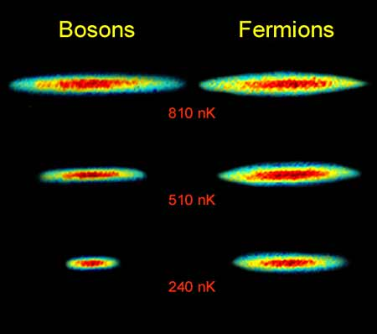
BOSONS & FERMIONS
All particles in nature are
either
Bosons (e.g. photons)
can have same position,
momentum, energy, etc.
Boson Boson
+1 wavefunction
or
Fermions (e.g. electrons)
cannot share same position, momentum, energy, etc.
Fermion
Fermion
-1 wavefunction

Slide 3

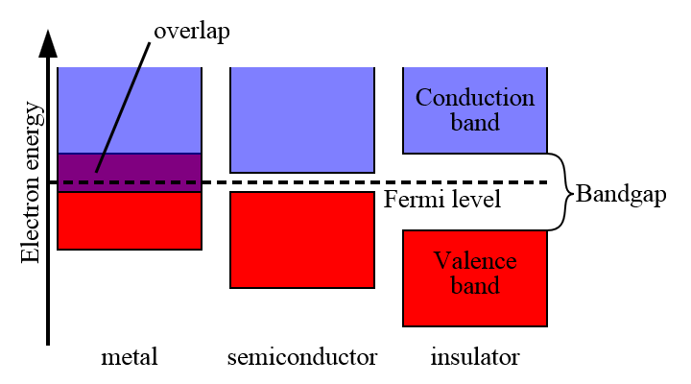
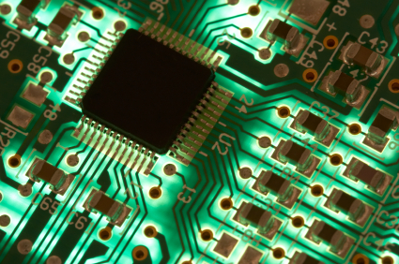
FERMIONS
Pauli Exclusion Principle: No two electrons can occupy the
same state (in an atom)
→ diversity of elements
e.g. electrical
conductors
insulators
semi-conductors

Slide 4
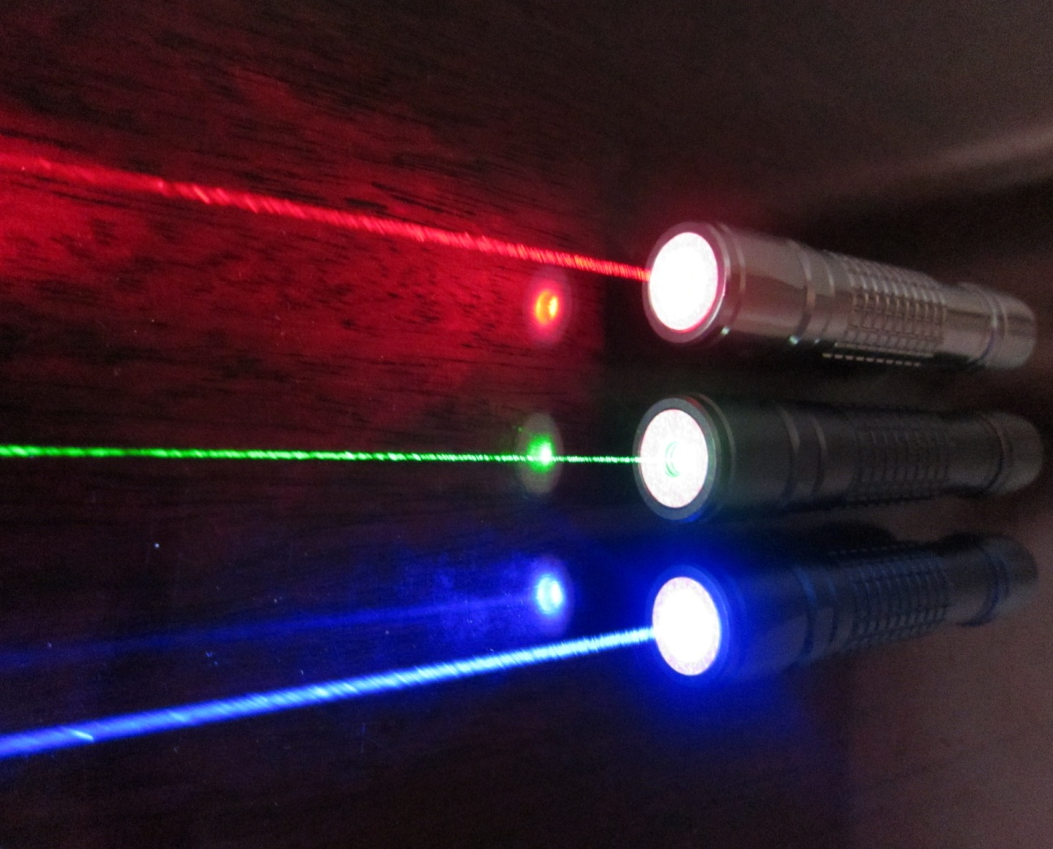
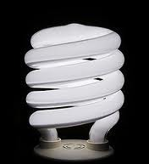
BOSONS
L
A
S
E
R
Iight
mplification
timulated
mission
adiation
Same
Wavelength
Same
Direction
In phase
(intense)
Many
Photons
Normal
light source -> different wavelengths, directions, phases

Slide 5

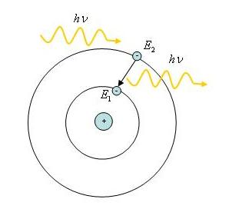
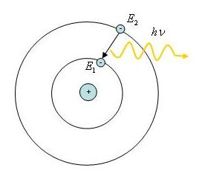
How to make a LASER?
Stimulated Emission (Einstein)
Incoming photon stimulates
electron to jump down
2nd photon emitted,
identical to incoming
Spontaneous Emission
Electron spontaneously
jumps down, emits one photon
hf
hf
hf

Slide 6
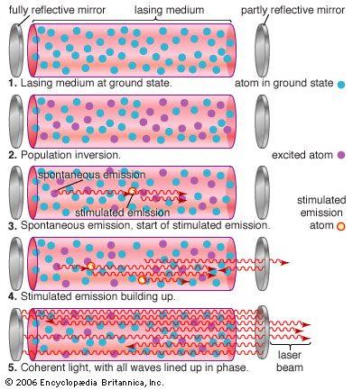
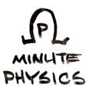
1 photon -> 2 photons -> 4 -> 8 -> 16 -> 32 –> 64 -> …
Chain reaction…all photons of same wavelength, direction

Slide 7
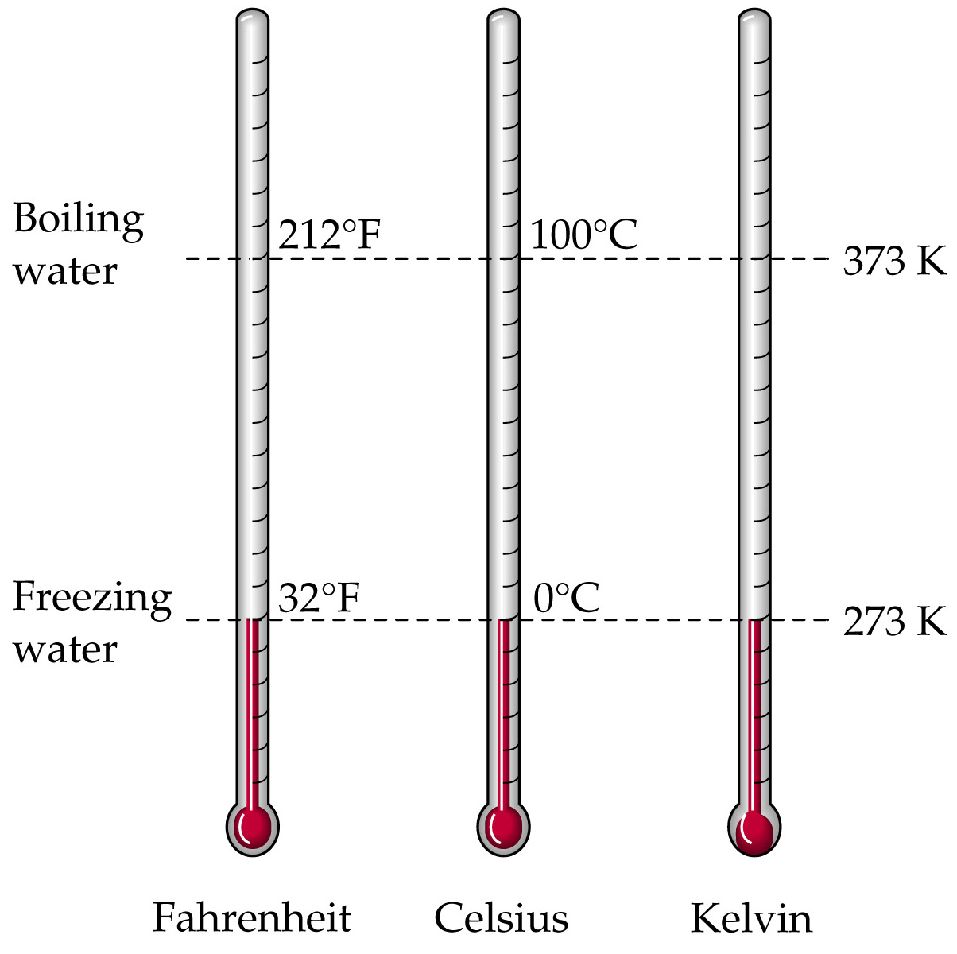
Temperature Scales
Everyday Use
Lab Use
Lowest temp possible
0 K = - 459 ⁰F
= ABSOLUTE ZERO
All atoms stop moving*
*Uncertainty Principle prevents attainment ,
zero-point motion persists

Slide 8

Bosons → Bose-Einstein condensation
At very low temp, many particles enter zero-point motion
E.g. Liquid Helium Atoms @ 2 K
Liquid Helium below 2 K is uperfluid
→ flows without viscosity

Slide 9
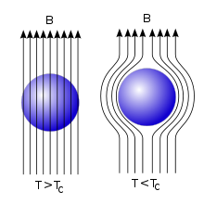
uperconductivity = electrical (electron) flow without resistance
BUT…Electrons are fermions
→ cannot Bose-Einstein condense ??
2 x Electron = Boson (-1 x -1 = +1)
Cooper Pairs → formed in some metals, ceramics at low temp
e.g. Meissner magnetic effect

