Slide 1
SYNTHESIS
Space-Time Revisited
    Antimatter
    Feynman Diagrams
    Quantum Electrodynamics

Slide 2
Relativity
          Deterministic
          E = mc²
          Space-Time/Gravity
Quantum Mechanics
              Probabilistic
              Schrodinger Equation
              Atoms/Nuclei
(Special) Relativity + Quantum = ?

Slide 3
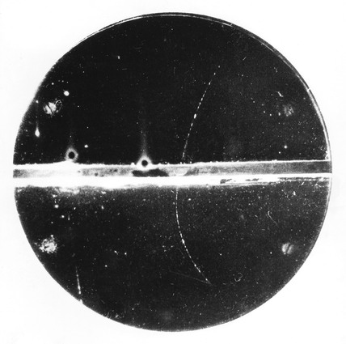
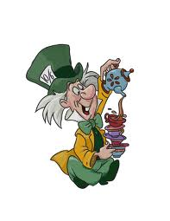
Consistency requires: (Dirac)
Positive and Negative Energy, E = ± mc²
Particle creation and destruction
Negative Energy = Nonsense
(empty space unstable)
time
Positive energy
particle going
forwards in time
space

Slide 4

time
Feynman
Negative energy
particle going
backwards in time
Back wards in time
= Nonsense
But..
nonsense & nonsense
= sense
space
Negative & Backwards = Positive & Forwards
Energy in time Energy in time
Anti-matter
-1 x -1 = +1 x +1

Slide 5
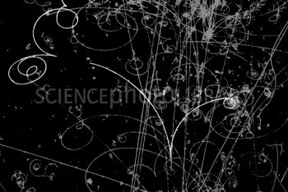

Anti-particles
Every particle type has a corresponding anti-particle
e.g. particle = electron Anti-particle = positron
Notes:
Anti-particles have appearance of positive energy and appear to go forwards in time
Same mass (rest energy) as particle
Some things are opposite e.g. electric charge
Some particles are same as anti-particles e.g. photons
Particles & anti-particles annihilate one another
-> Medical application PET scans

Slide 6
Feynman Diagrams
Quantum mechanics
meets space-time
PARTICLE PHYSICS
Feynman rules assign a
probability phase to each
possible (unobserved)
world-line between two
observed events
Total probability for events
to happen is sum over all world-lines phases between them

Slide 7
2. Feynman rules imply
particle creation and annihilation
Examples:
Electron absorbs a photon
Electron emits a photon (color of atoms)
Photon splits into electron & positron
Electron and positron combine to a photon
Q uantum
E lectro
D ynamics

