Slide 1
SYNTHESIS
Particles & Force-Fields
    What is force?
    Detecting particles
    “Empty” space

Slide 2
Force
Force transmitted by exchange of (unobserved) particles
e.g. Electromagnetic force
Two electrons exchange short-lived “virtual” photons

Slide 3
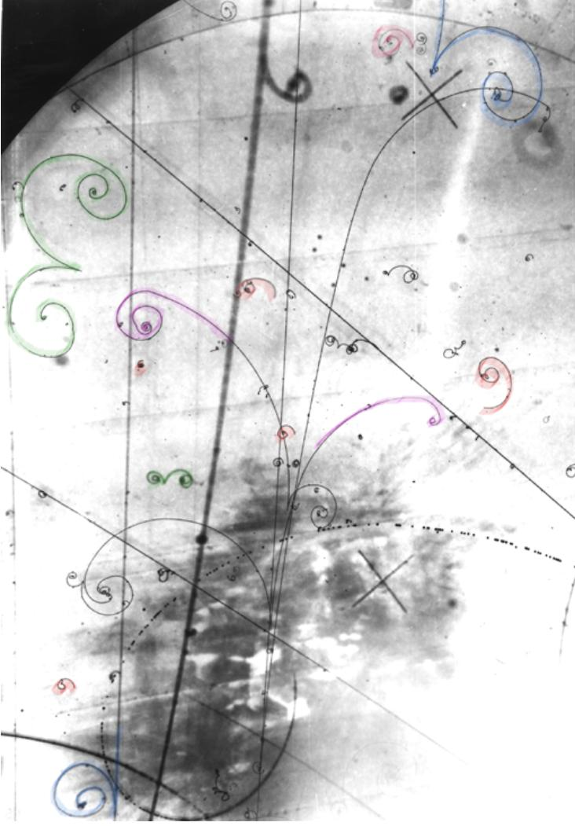
Compton “scattering” of
a photon & electron
….. via virtual electron
Bubble chamber photo
of electron tracks (photons
do not show)
Green = electron/positron
pair creation
Red = Compton scattering

Slide 4
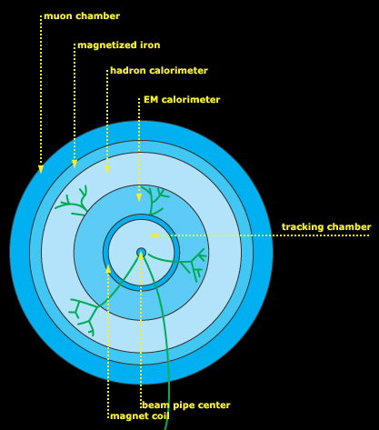
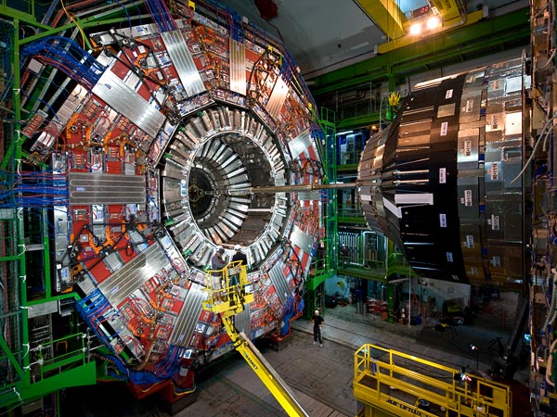
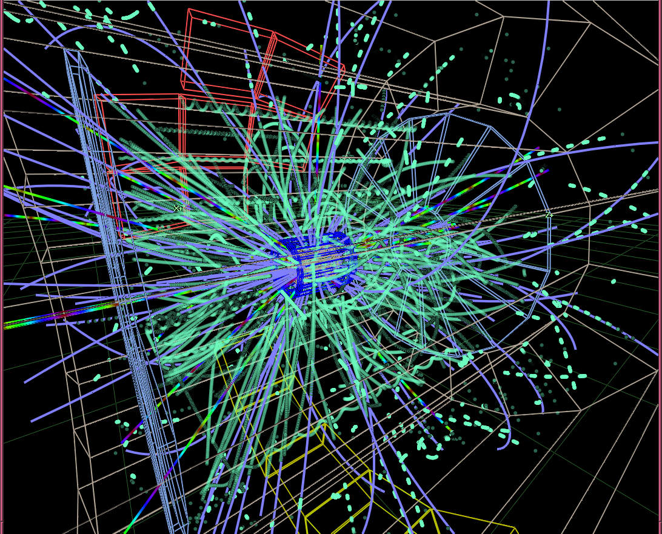
Modern particle detectors

Slide 5
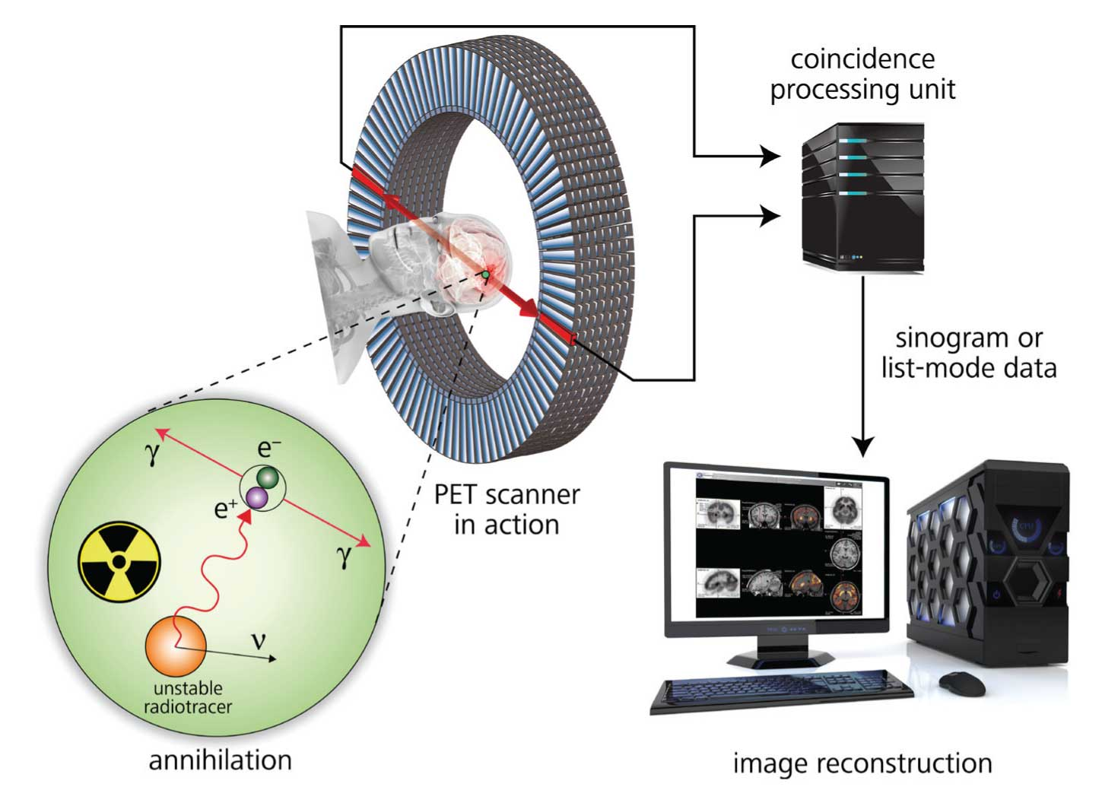
Positron Emission Tomography (PET scan)
blood volume, oxygen usage and glucose metabolism

Slide 6
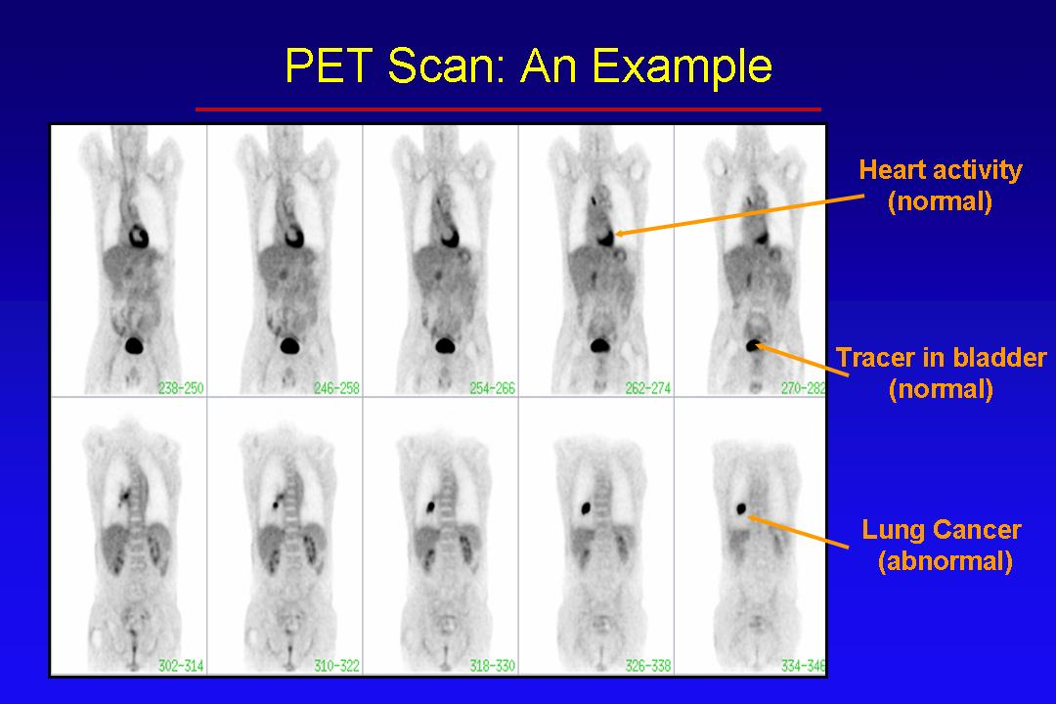

Slide 7
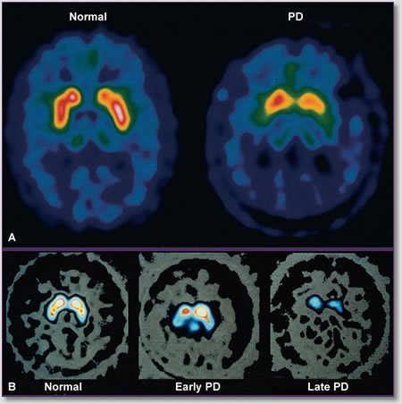
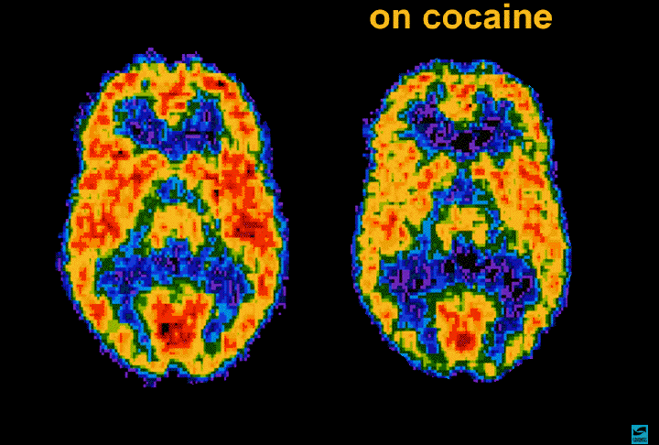

Slide 8
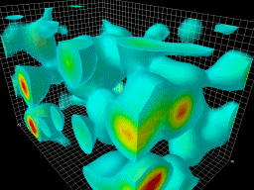
Vacuum Fluctuations

