Slide 1
SYNTHESIS
The Standard Model
    Elementary particles
    Strong nuclear force
    Weak nuclear force
    The Standard Model

Slide 2
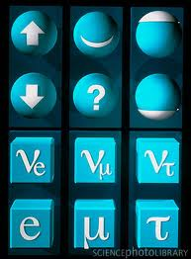
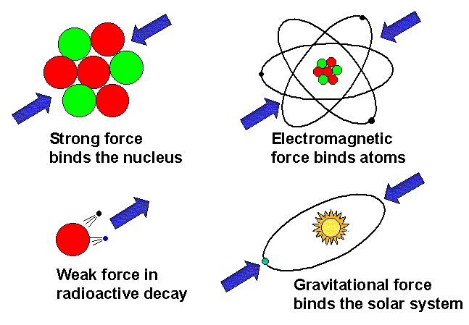
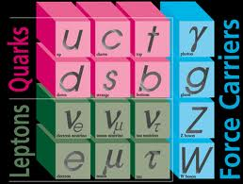
Known Elementary Particles of Matter
Quarks: Up (u), Down (d), Strange (s),
Charm (c), Bottom (b), Top (t)
Leptons: Electron (e), Muon (μ), Tau (τ),
Neutrino (ν) [3 types]
Known Forces of Nature
Force Carrier Particles:
QED -> Photon (γ)
Weak -> W, Z
Strong -> Gluon (g)
Standard Model

Slide 3
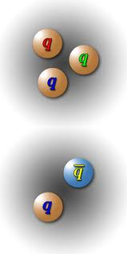
Strong Nuclear Force
Q uantum
C hromo
D ynamics
Binds protons and neutrons
inside atomic nucleus
Quarks always occur either in groups of
THREE (Baryon)
e.g. uud = proton, udd = neutron
or
quark &
anti-quark (Meson)
Baryons & Mesons
are HADRONS:
Feel the strong force

Slide 4

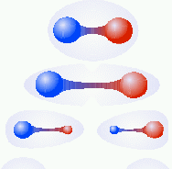
Quarks are permanently confined
inside Hadrons – they have never
been isolated.
Because QCD force between quarks
does not reduce with separation
(unlike electric & gravity forces)
One meson
More and more energy is
needed to separate quarks
This added energy converts to
mass (via E=mc² ) of new quarks
Two mesons

Slide 5




Why does QCD confine quarks?
Extra vertices allow force particle (gluon) itself to feel force
GLUON
CONDENSATE
GLUON
CONDENSATE

Slide 6
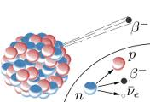
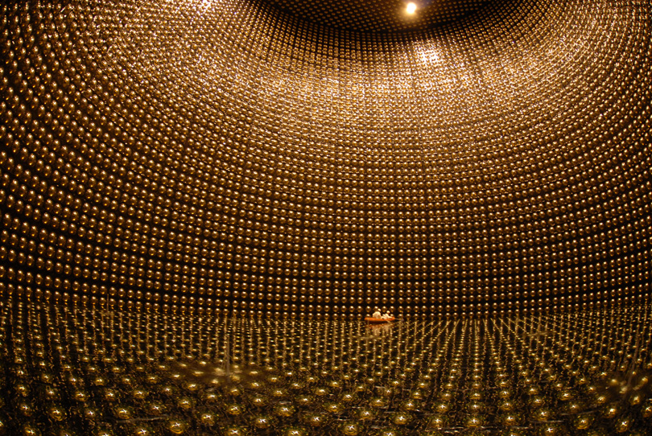
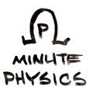
Weak Nuclear Force
Cause of β radioactivity
Carried by very massive
W or Z particles (highly
improbable)
Electron
Neutrino
NEUTRINOs
Almost massless
Very weak interactions

Slide 7
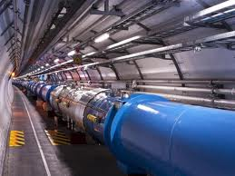
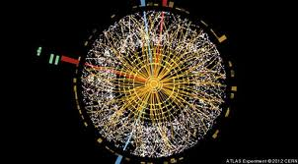
Origin of Mass
Higgs Condensate
All particles really massless!
Slowed down from c by interacting with Higgs
Only appear to have mass.
Higgs particles
directly created
in 2012

Slide 8
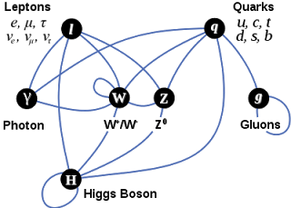
STANDARD MODEL of particle physics
Describes all matter and forces (except gravity)

