Slide 1
SYNTHESIS
Unsolved Mysteries
    Elementary particles patterns?
    Where is all the anti-matter?
    Dark Matter?
    Dark Energy?

Slide 2

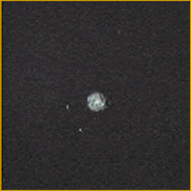
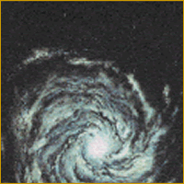
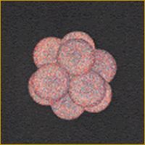
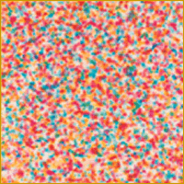
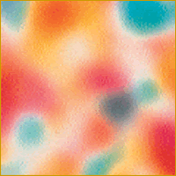
Unsolved Mysteries
....

Slide 3
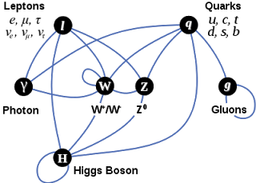
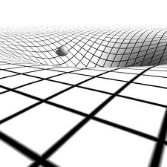
STANDARD MODEL of particle physics
?
Quantum Mechanics & Special Relativity
?
?
?
?
?
?
?
GENERAL RELATIVITY
?
Gravity

Slide 4
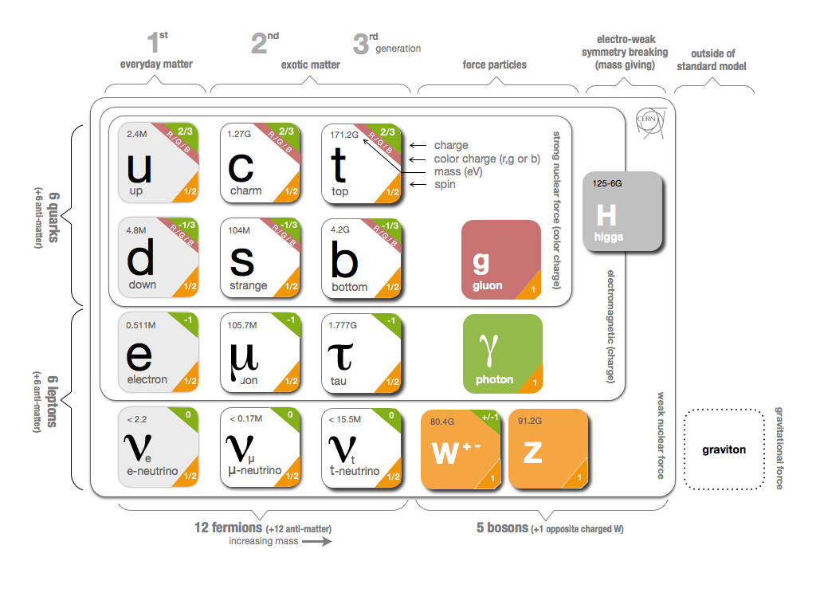

Slide 5
Where’s all the Anti-Matter?
Matter and antimatter
created in equal amounts at
the big bang
Should have annihilated each
other, leaving just light
Maybe it’s in parts of the universe we haven’t seen yet….
Maybe there’s another force causing an asymmetry….

Slide 6

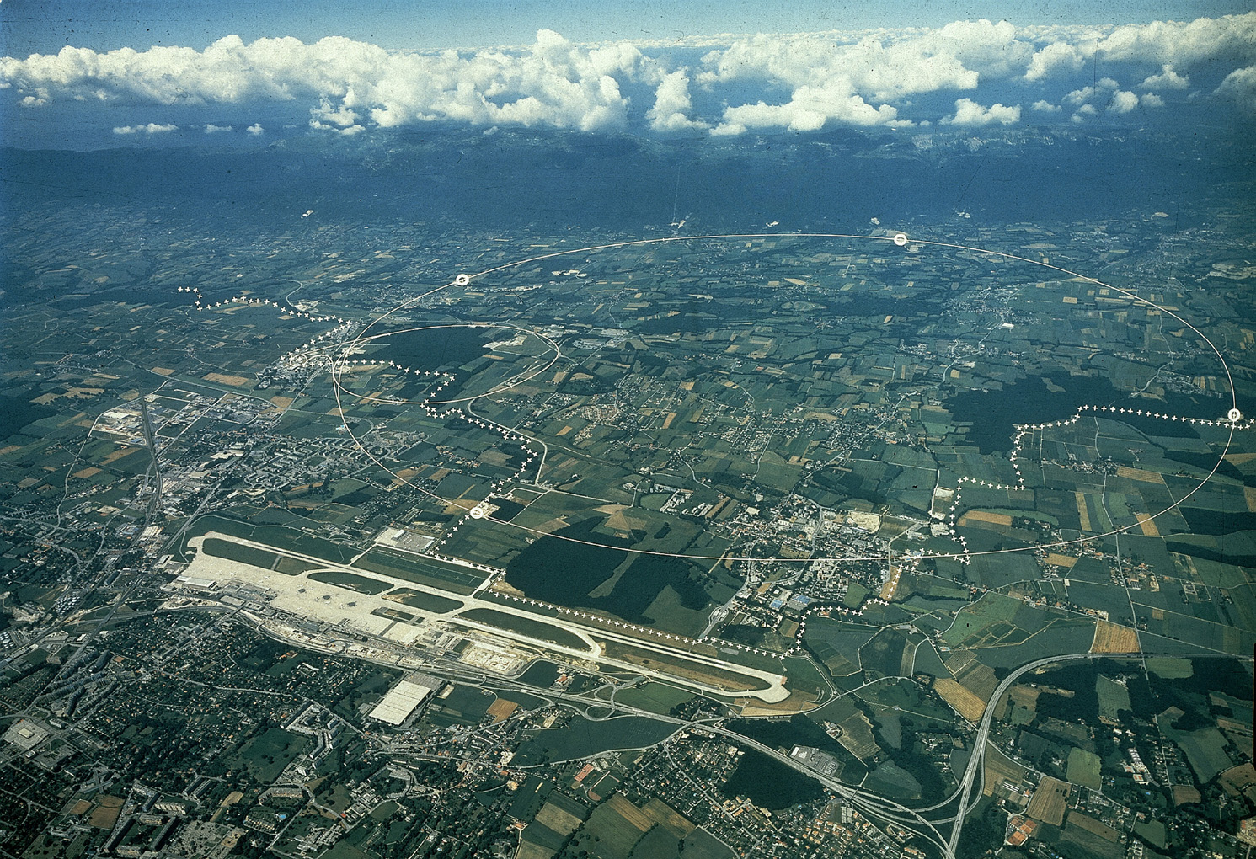
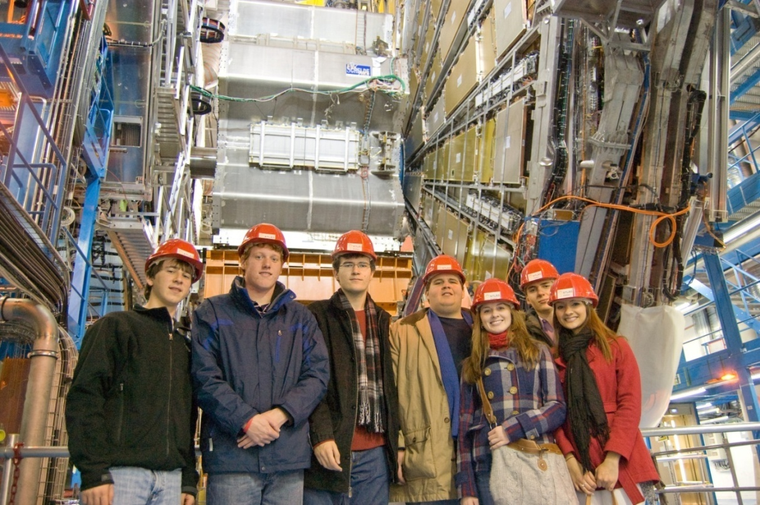
TOOLS
Large Hadron Collider (LHC)

Slide 7
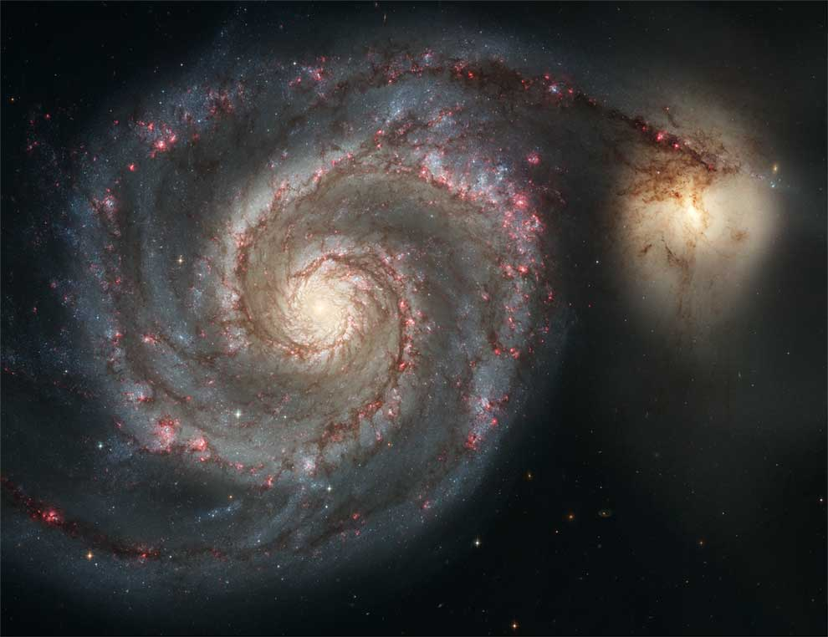
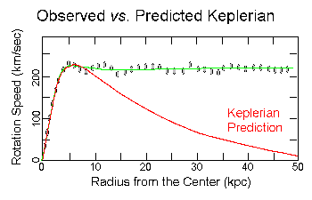
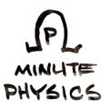
What is the universe made of ?
Galaxy rotation
Is theory of
Gravity wrong?
Or is there
`Dark Matter’ ?

Slide 8
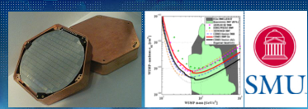
Dark Matter Detectors from SMU

Slide 9
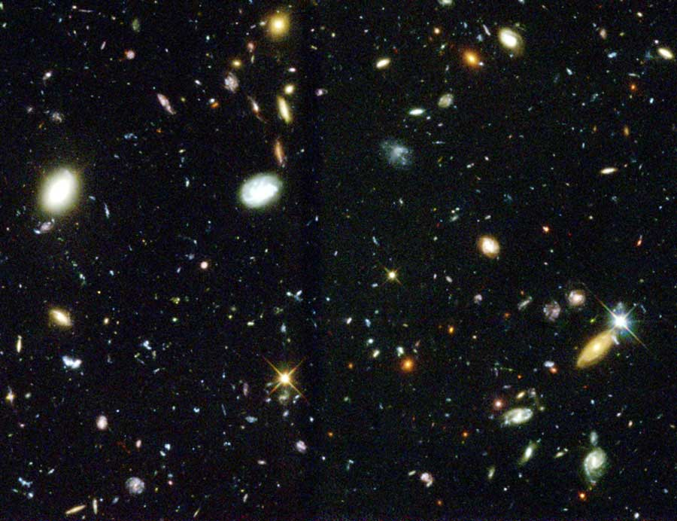
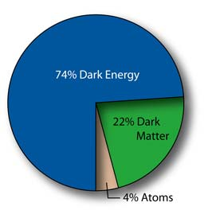
Expansion of the universe
The expansion of the universe is accelerating
Dark Energy?
Energy of the vacuum
But…Standard Model vacuum condensates are 10¹²º too energetic to explain it!

Slide 10
Extra Credit
Explain the pattern of elementary particles observed in the universe.
Discover what Dark Matter in the universe consists of.
Discover the nature of Dark Energy.
Make a unified model of gravity and other forces
^{Deadline: None.}

