Slide 1
Merging Innovative Particle Physics Activities with Project Based Learning
Evelyn Restivo, PTRA, QuarkNet,
Waxahachie Global STEM ECHS
U Texas Tyler and Navarro College

Slide 2
Introduction to Relative Size
Students often seem to have difficulty with the esoteric term’s size, space, and time. To help cope with this problem, I use a series of objects of varying sizes to demonstrate how size is perceived. First, I ask the question, “What do you picture in your mind when you think of a cup of coffee?” Second, I show them cups of different sizes starting with a miniature cup, then a doll cup, a demitasse cup, a type of regular coffee cup, a one-cup measuring cup, a mug, a large mug, and a giant cup. I ask the questions, “Which one is a coffee cup?” “Are they all types of cups?” We discuss the perception of what is a cup and what we think of when we think of a cup, but that all of these are types of cups. I repeat this sequence using bowls and spoons, rearranging the sizes of bowls with spoons until we can agree on which bowl is a cereal bowl and which size spoon is appropriate for the bowl. I use pencils and paper, wrenches, gavels and
mallets in a variety of sizes to continue to view the differences in the sizes available versus the size we think of and the size that is right for the task. The students are impressed by the very tiny, miniature items and the extra large ones such as a battering
mallet and a pencil made from a five-foot mailing tube. The students begin to see that when the frame of reference changes the perception also changes, so what is considered normal size in one space is abnormal in another. This variation allows reproducibility in
time and space. Using the activity as an introduction can help students identify large and small objects and put them in perspective to matching size and shape with task. As the topic advances students begin to see the symmetry of space and the dimensions using
internal coordinates to explore patterns of orientation for appropriate size in space, time, and frames of reference. The concept of time can be addressed using a calendar where each block provides a message starting with time comes in little boxes called units, each
unit is called a day, each day contains activities and divides time into smaller units. The sequence ends with everyone has the same amount of time until they have no more time (What if your next box is empty?), but time continues. An overview of time frames and
perception of amounts of time can create a junction from which a more detailed account of time in space, moving mass in space and relativity can be discussed.

Slide 3
EXPANDING UNIVERSE MODEL
INTRODUCTION: Astronomers have determined that many billions of years ago all the matter in the Universe was concentrated into a very small space. The event that started the expansion is known as the “The Big Bang.” At some point the Universe will collapse again if there is enough matter for gravity to overcome the momentum of expansion. The point is sometimes referred to as “The Big Bounce” and the collapse process is called “The Big Crunch.”
PURPOSE: To model the expansion and contraction of the Universe using the expansion and contraction of a balloon.
PROCEDURE:
Draw several large dots and spiral swirls on both sides of a new balloon using different dark colored markers.
Number or letter each dot on the balloon. The dots and spiral swirls will represent galaxies.
Make a data chart on unlined paper to list and record observations. List the number or letter along with the color of the dot on the data chart.
Draw a line with the marker to measure the distance between two or three of the dots on each side of the balloon. Measure this distance in centimeters and record it on the data chart. A small light may be placed at the opening of the balloon to see the events clearly.
Slowly inflate the balloon to just less than the maximum amount of air it will hold and observe the dots and measure the distances.
List any changes noticed about the dots and distances on the data chart.
Slowly deflate the balloon and observe and record changes on the data chart.
Repeat the entire procedure inflating the balloon to approximately half of the capacity and record all of the data on the data chart.
Tape the deflated balloon over this procedure here on your lab sheet.
QUESTIONS:
What happened to the size of the dots as you inflated the balloon?
What happened to the size of the dots as you deflated the balloon?
What happened to the distance between the dots as you inflated the balloon?
What happened to the distance between the dots as you deflated the balloon?
What instruments and equipment would Astronomers use to develop a more complete understanding of the Universe?
CONCLUSION:
Write a comparison of how the inflation of the balloon seems to mirror the expansion of the Universe and how the deflation of the balloon mirrors the collapse of the Universe. What information can be used to compare The Big Bang Theory using red shift?

Slide 4
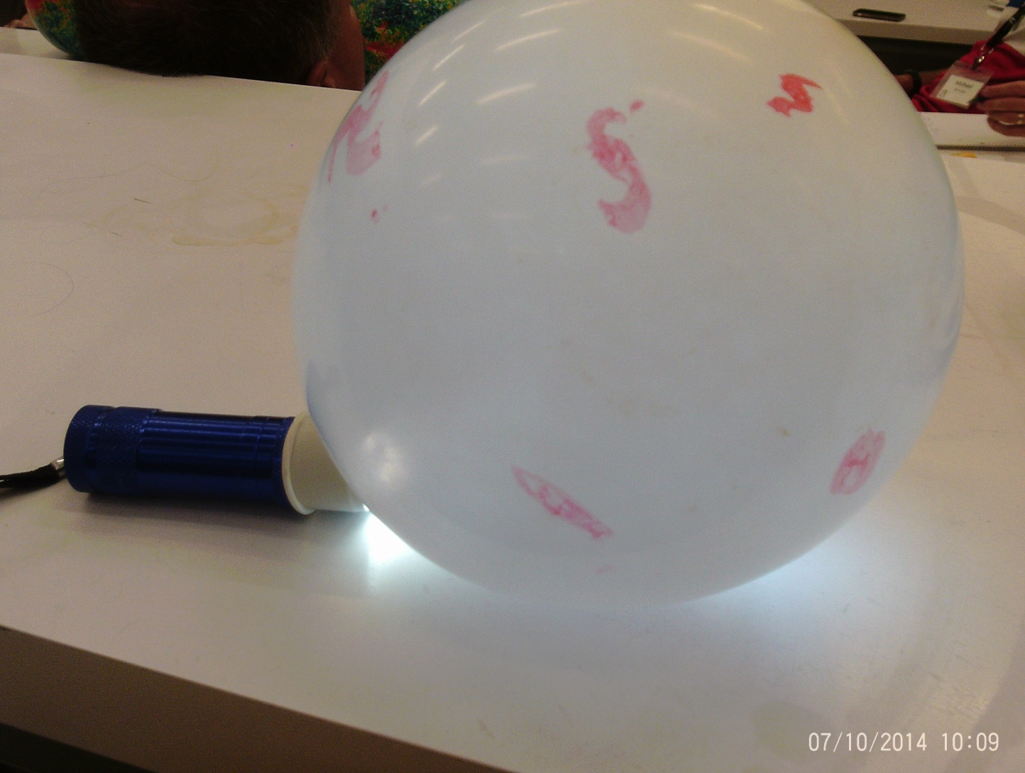
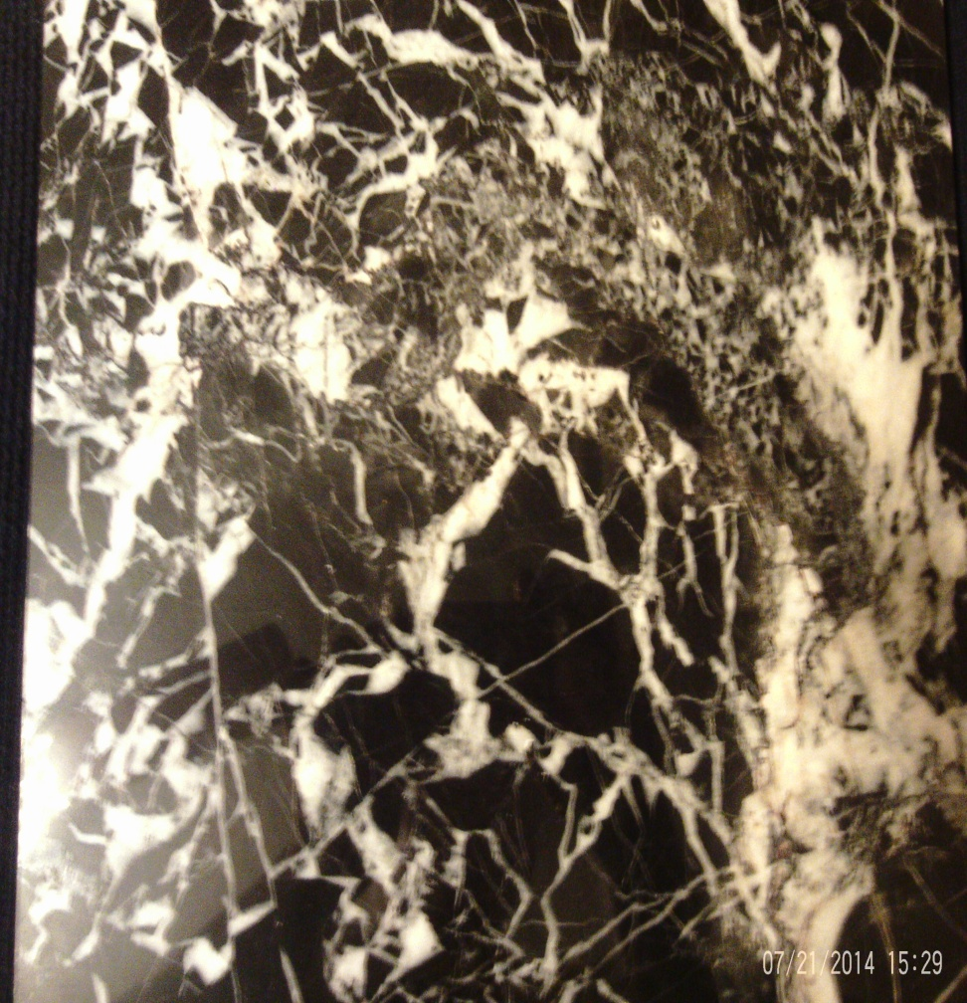
EXPANDING UNIVERSE MODEL

Slide 5
COLLISION SIMULATION
ROUND ABOUT ROLLERS:
Using at least five or all of the spherical objects listed produce one and two-dimensional collisions using two of the objects and then a three-way collision using all three of the same size objects
Copper shot; Steel ball bearing; Small glass marble; Large glass marble; Small super ball; Medium super ball; Large super ball; Cedar wood ball; Deodorant ball; Octagonal ball; Ping Pong ball; Tennis ball; Beach ball; Bocce ball; Bowling ball
Select a collision impact distance of greater than one half meter for each object but less than three meters to use for all of the collisions so that the distance remains constant. Applied force will be a push appropriate to move the object to the impact point or greater push to increase speed. Your data should be shown in the form of labeled vector diagrams drawn to include impact points for each collision and the motion of each object after impact.
In your conclusion discuss the differences in impact points, collisions, and deflections based on speed, size, shape and material from which object was made. Include all probable sources of error that might have a bearing on your results.
Extension:
Repeat the experiment a couple of times to determine what happens if three different sized balls are used? Explain what might be the result if the data from this lab was collected inside a container that you could not see into when you rolled the balls toward impact? Consider how this information compares to collisions in an Accelerator

Slide 6
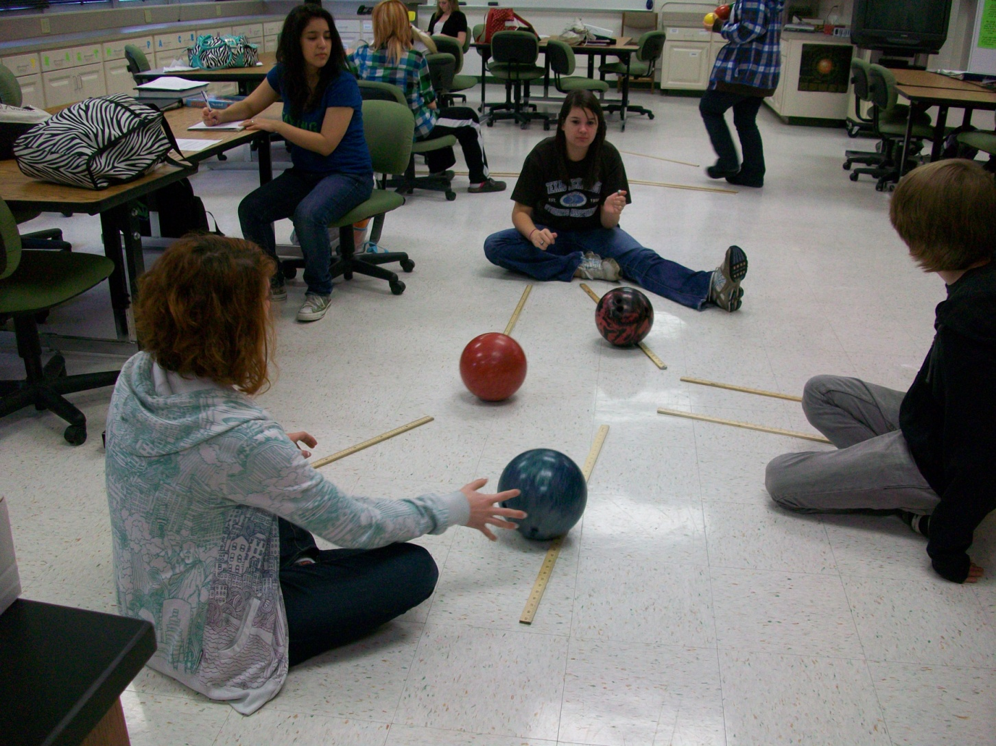
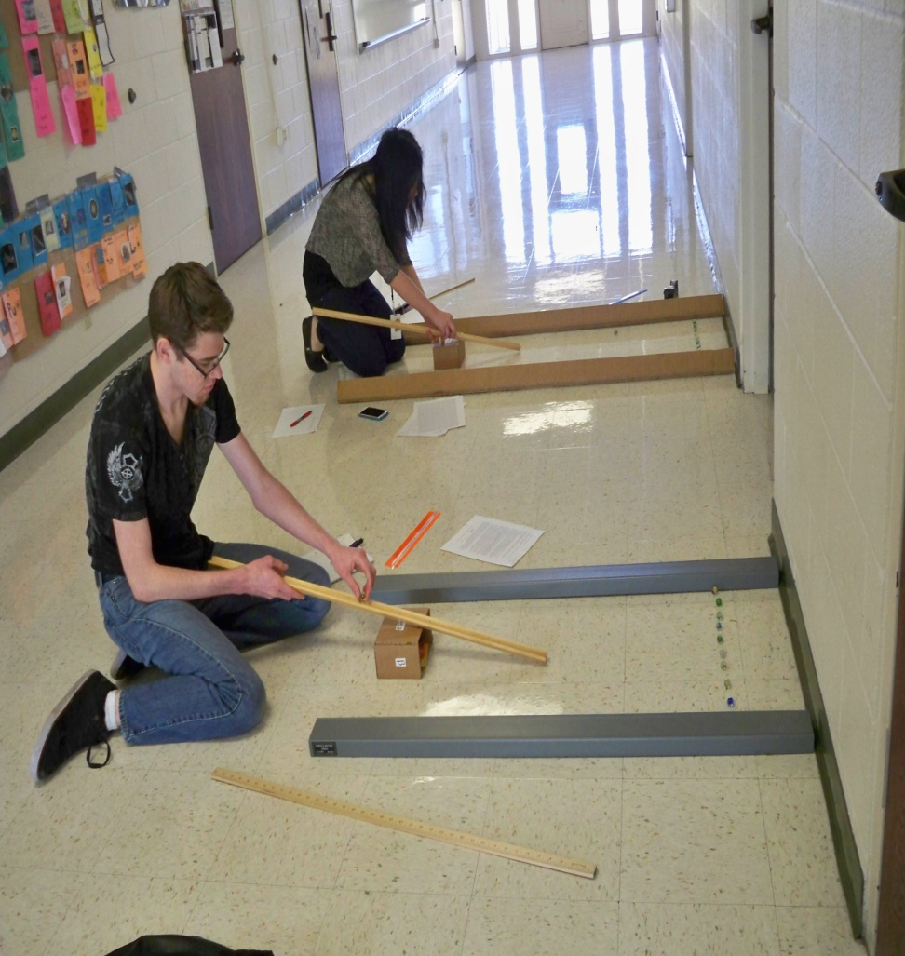
COLLISION SIMULATION

Slide 7
RUTHERFORD’S GOLD FOIL SIMULATION
INTRODUCTION: In 1911, Ernest Rutherford discovered that the atom is mostly space with a small massive center. Rutherford’s original experiment used a very thin piece of accurately measured gold foil placed in front of a fluorescent screen. A device placed on the other side of the foil produced a stream of protons. When the protons struck the screen, a small part of the screen would glow. If a proton came close to the nucleus, the positive charge in the nucleus would repel the proton. Most of the protons would pass through the foil without being greatly affected by the nucleus. This indirect method to measure the area of holes is similar to Rutherford’s method of measuring the size of the nucleus.
PROCEDURE: 1. Place a large container of some type or a ring clamp at the top of three ring stands on the floor with the ring clamps to the inside so that a card stock circle, approximately 60 cm in diameter with five equal sized holes cut in it of approximately 6 cm in diameter, will balance so all of the holes are unobstructed. Or design another set up that will work such as a box or round container. 2. Obtain a small baggie of colored soda straws that have been cut into 1-2 cm pieces or cut your own. 3. Place a chair 2 meters from the circle, sit down in the chair and throw the straw pieces one at a time at the circle. 4. Group members will take turns throwing straw pieces, picking up straw pieces, and recording hits and misses on a data chart. 5. If a piece of straw goes directly through one of the holes, count it as a “hit.” If a piece of straw strikes the circle before going through it counts as a “miss.” If a piece of straw misses the circle it does not count at all. Continue throwing straw pieces until there are at least 30 hits or until the end of the lab period. The greater number of hits and misses, the greater the chance for significant results. Be sure to record both hits and misses. 6. Calculate the total area of the holes by following this formula: Area of holes/Area of circle = hits/misses or Area of holes = hits/hits + misses X Area of circle. Place all calculations on the data chart. 7. Divide by five to get the experimental area of one hole. Measure the diameter of a hole and use this measurement to determine the actual area and compare this number with the experimental area. The area of a circle is equal to the radius times the radius times pi. Using this formula, the area of the circle would be 30 cm X 30 cm X 3.14. The area of the measured hole can be calculated from the radius in the same way. 8. Summarize your findings, explain why a high number of hits are not really important in this experiment and compare your lab results to the real Rutherford’s Gold Foil Experiment. Compare this experiment to Half Life Analogies.

Slide 8
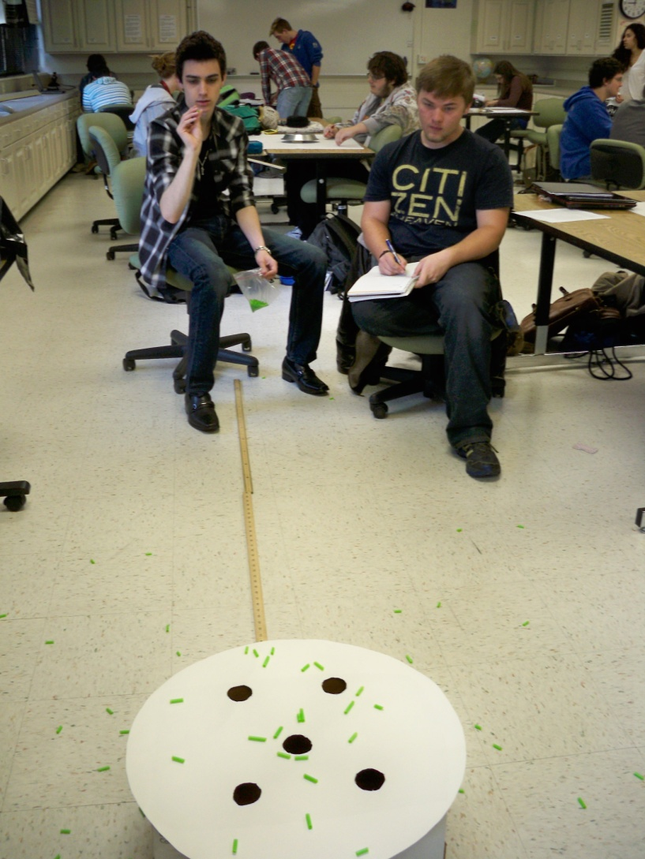
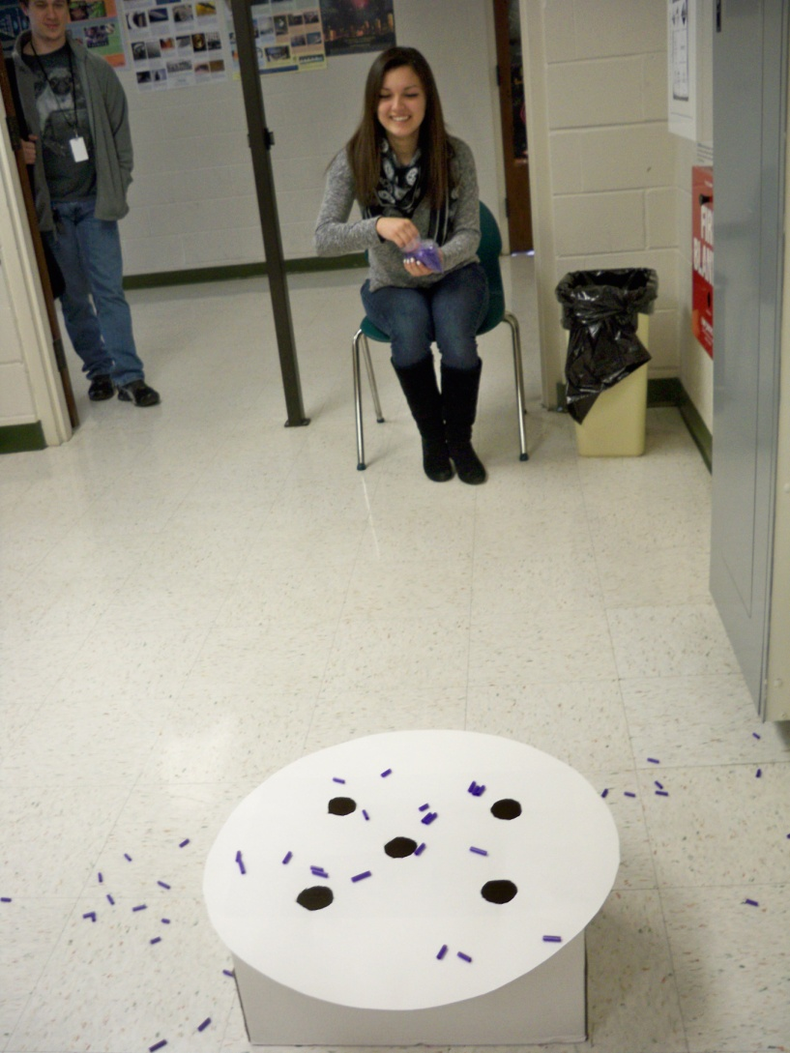
RUTHERFORD’S GOLD FOIL SIMULATION

Slide 9
GELATIN FIELDS FOREVER HIGGS
To provide a simulation technique to represent how Higgs particles might move and react with each other in a Higgs Field.
Materials: Stopwatch; Small bowl or round container of pre-made very thick, clear, light colored gelatin; Aluminum pie or cake pan
Marble or circular candy glued to a straw, wooden dowel or pencil; Several small O shaped cereal (“Cheerios”) pieces or circular candy
Lots of Paper towels
Background information:
In 1966 Peter Higgs proposed that the universe was full of Higgs Fields. Disturbances in this field are seen as particles travel through it causing a change in the motion within the field. From a quantum point of view the field can be stirred or moved only in distinct units. The smallest possible disturbance is due to a Higgs Particle, or more precisely, a Higgs Boson. The field consists of numerous Higgs Bosons that act like a kind of cosmic molasses that fills all of space. As an electron or neutrino move through this space they have to wade through these Higgs particles that cling to them as they go, causing a drag that appears to increase mass. This simulation technique uses the thick gelatin to act as the bosons that make up the Higgs Field. The marble represents an electron as it moves through the field and the O cereal represents a neutrino.
Procedure:
1. Place the aluminum pan on a table or level surface and invert the container of thick gelatin so that the gelatin comes out of the container and falls on the aluminum pan.
2. Take the marble on the straw/dowel/pencil and push it through the gelatin while another person times how long it takes from the entrance into the gelatin to the halfway point. The marble pusher should also notice the force and resistance required to move the marble. Record the time and the observation in a data table.
3. Remove the marble carefully by reversing the direction and pulling the marble from the gelatin.
4. Repeat this procedure, steps 2 and 3, with the O shaped cereal starting from the opposite side of the gelatin.
5. Repeat this procedure 2 more times for the marble and then for the O shaped cereal. Record all data and calculate the average time for both simulations.
Summarize your findings and compare to previous information of the Higgs Boson and Higgs Field.

Slide 10
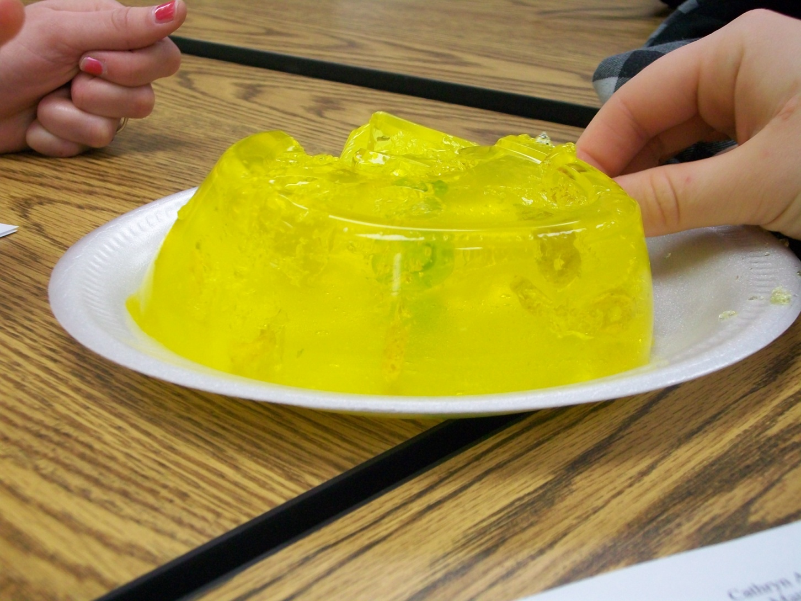
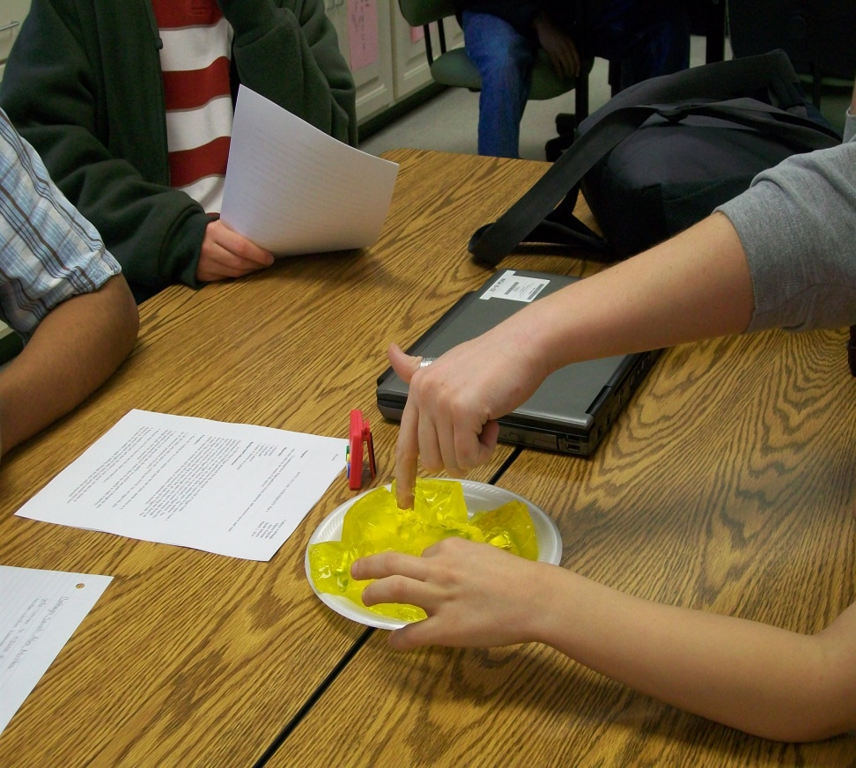
GELATIN FIELDS HIGGS MODEL

Slide 11
SHAPES OF THE UNKNOWN
How can you determine the shape of an object that can’t be seen?
1. Obtain a pie plate with an unknown shape underneath from the facilitator. At no time during the lab are you allowed to look at the shape underneath the pie plate.
2. Place the pie plate shape upside down on a large piece of unlined paper on the table. Be sure that the edge of the pie plate is high enough off the table for a ball bearing or marble to roll under the plate and strike the object and return.
3. Roll a ball bearing or marble under the pie plate and notice the angle at which it returns from underneath.
4. Draw a circular data table on large unlined paper and record the position where each ball bearing or marble is started for each roll, the number of the roll and draw a line for the angle as the ball bearing or marble comes out from under the pie plate.
5. Roll the ball bearing or marbles a minimum of 25 times so that you have a somewhat accurate idea of the shape of the object. If the ball bearing or marble gets stuck under the pie plate, ask your facilitator to remove it for you.
6. When your group has decided the shape raise your hand and the facilitator will remove your pie plate and shape.
7. On your large unlined paper draw in the shape from the lines you have drawn for angles and path lines of the ball bearing or marbles.
8. Compare your shape to each of the other groups and place the information in a table to compare and contrast the shapes for all of the groups. Explain the degree of precision and accuracy of the class data.
9. Explain how using different sizes of ball bearings or marbles might allow more details in the shapes.
10. Explain how more complicated shapes might show more interesting results.

Slide 12
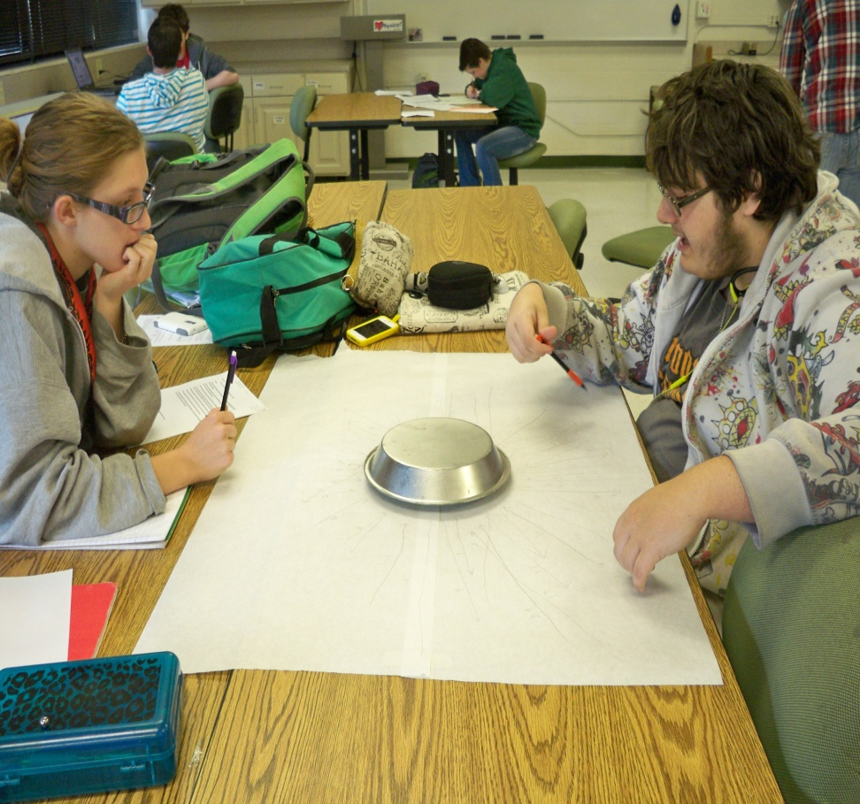
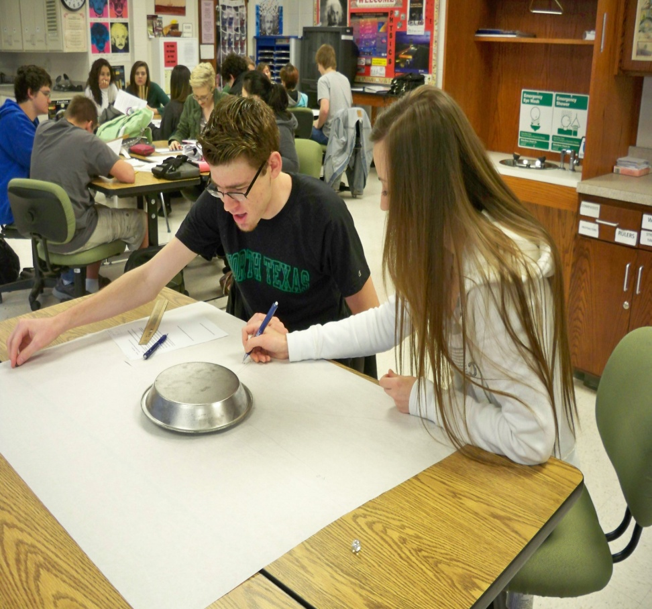
SHAPES OF THE UNKNOWN

Slide 13
Particle Physics Project Ideas
Your task is to develop an interactive physical HIGGS activity that could be used as an engagement assignment in the first 10-20 minutes of a class period. The HIGGS activity should be able to be done with a group of 18-24 students in the classroom to visually and physically explain how Higgs particles (boson, electron, and neutrino) move and react with each other. You must write out the specific rules for the activity, what or how the students will portray Higgs bosons, an electron or a neutrino, or all 3. Your activity must include all background information about Higgs Particles in an easy to read and use format, rules and guidelines for participation in the activity, specific goals for learning with the activity and a scoring rubric. Grades will be determined by the class when they participate in the activity. Some information may be found at: http://www.particleadventure.org
The Compact Muon Solenoid Times is a news letter designed to inform the international members of CERN about new and upcoming events associated with the Large Hadron Collider. For your reference the latest edition of the CMS Times is now available at: http://cern.ch/cms/CMSTimes.html Archive of all editions can be found at: http://cern.ch/cms/Resources/archive.html Your task is to design a news letter with a series of short articles in the style of the CMS Times to help explain the similarities and differences between the reactions that occurred and are occurring in our Universe and the experiments to study the first millionth of a second at the LHC. CERN: The Large Hadron Collider
Your task is to make a miniature, three dimensional, detailed model of one of the detectors designed to study what the universe was like when it was less than a millionth of a second old. A research report will be due along with your model to provide detail and explain how the detector was built and how it will be used. Some information may be found at: http://lhc.web.cern.ch/lhc/

Slide 14
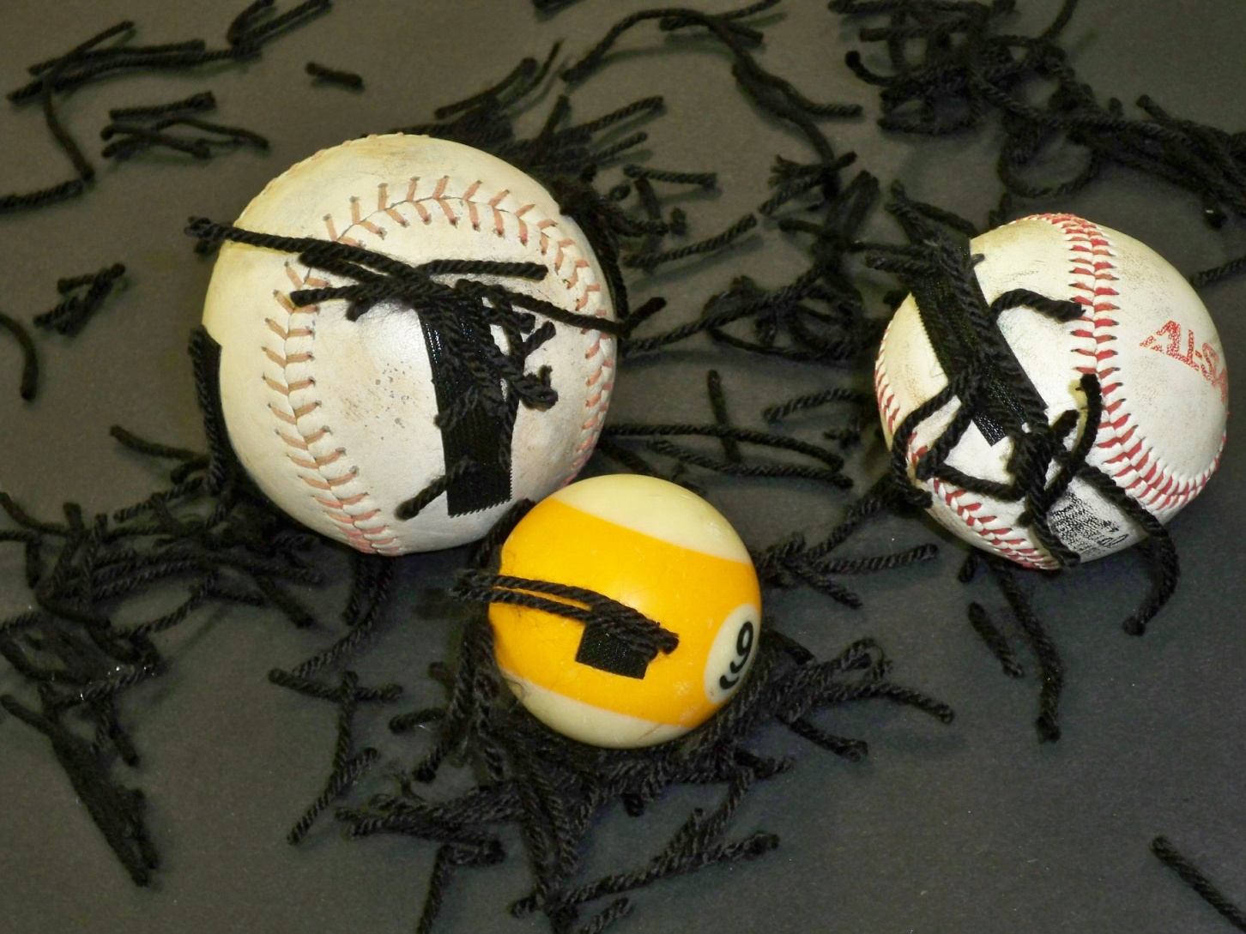
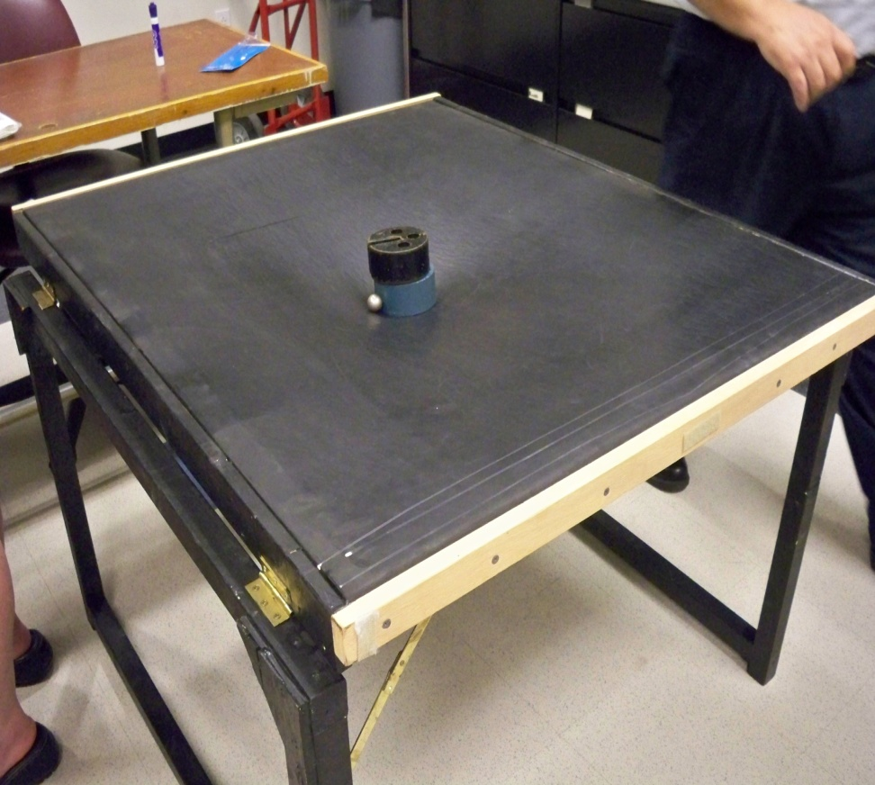
HIGGS FIELD SIMULATION

Slide 15
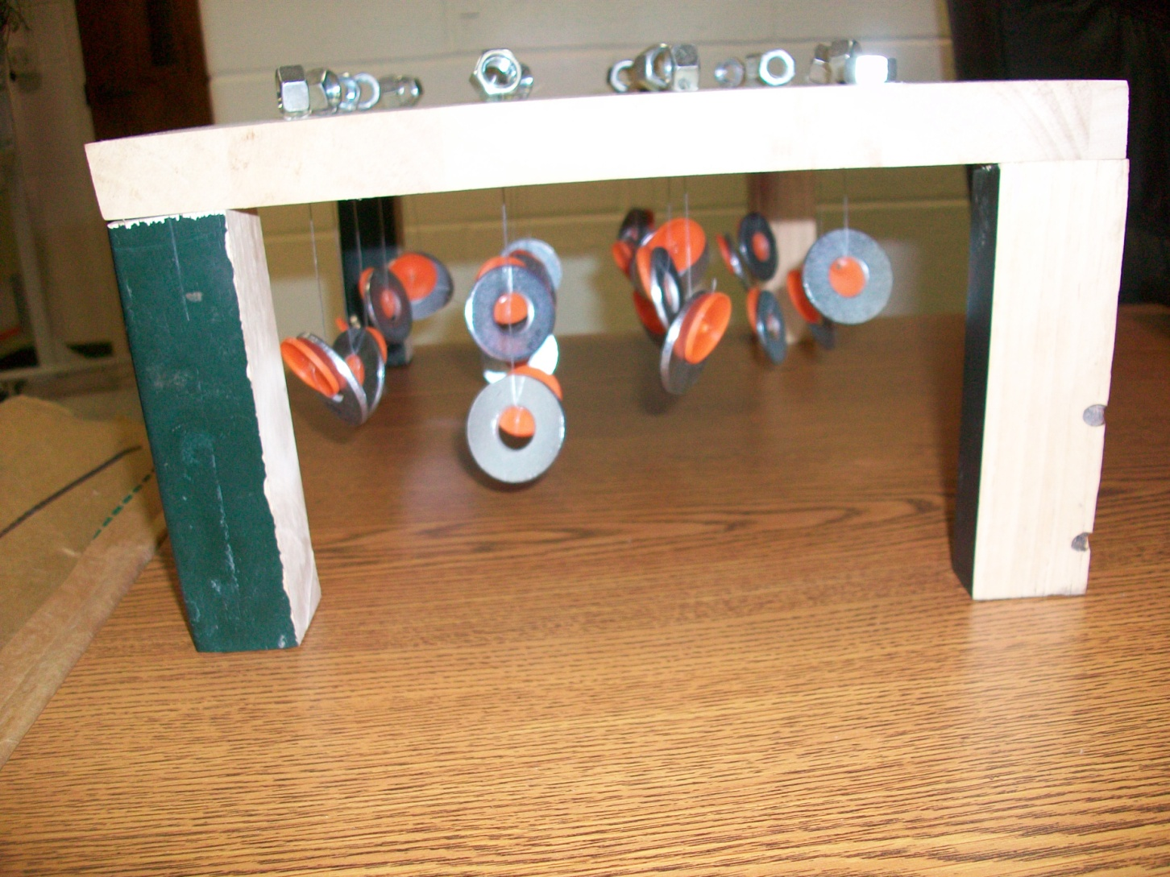
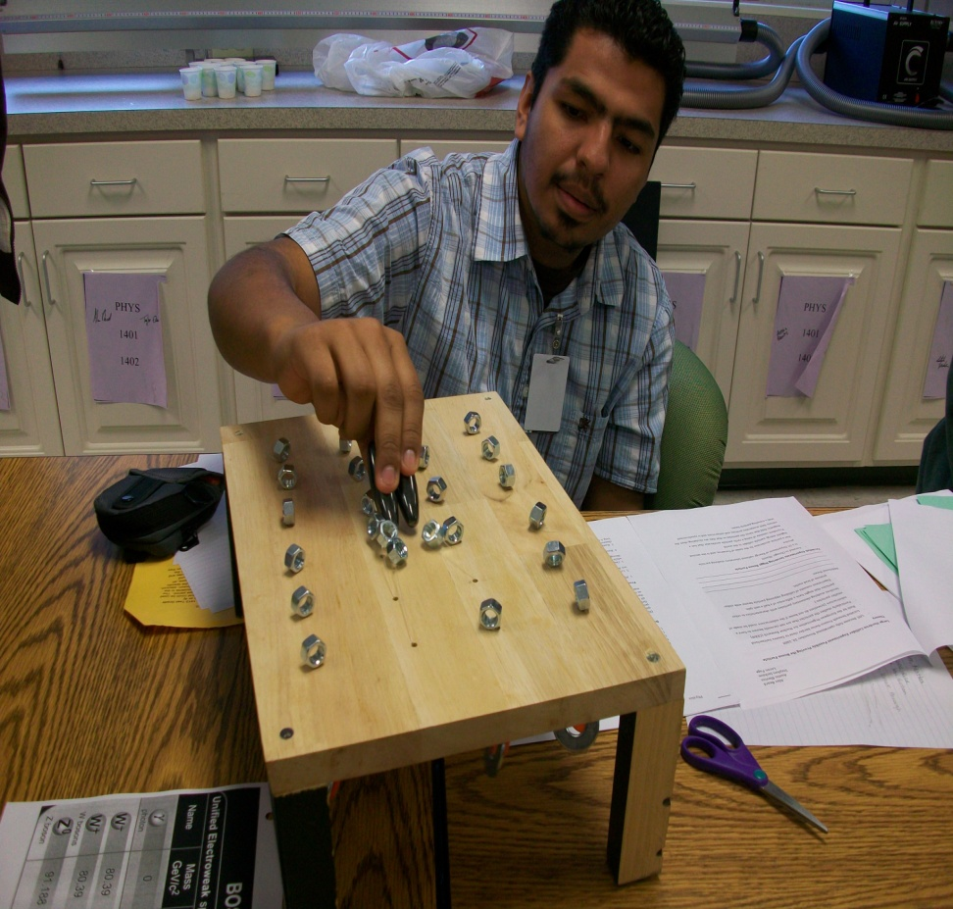
HIGGS FIELD DEMO MODEL

Slide 16
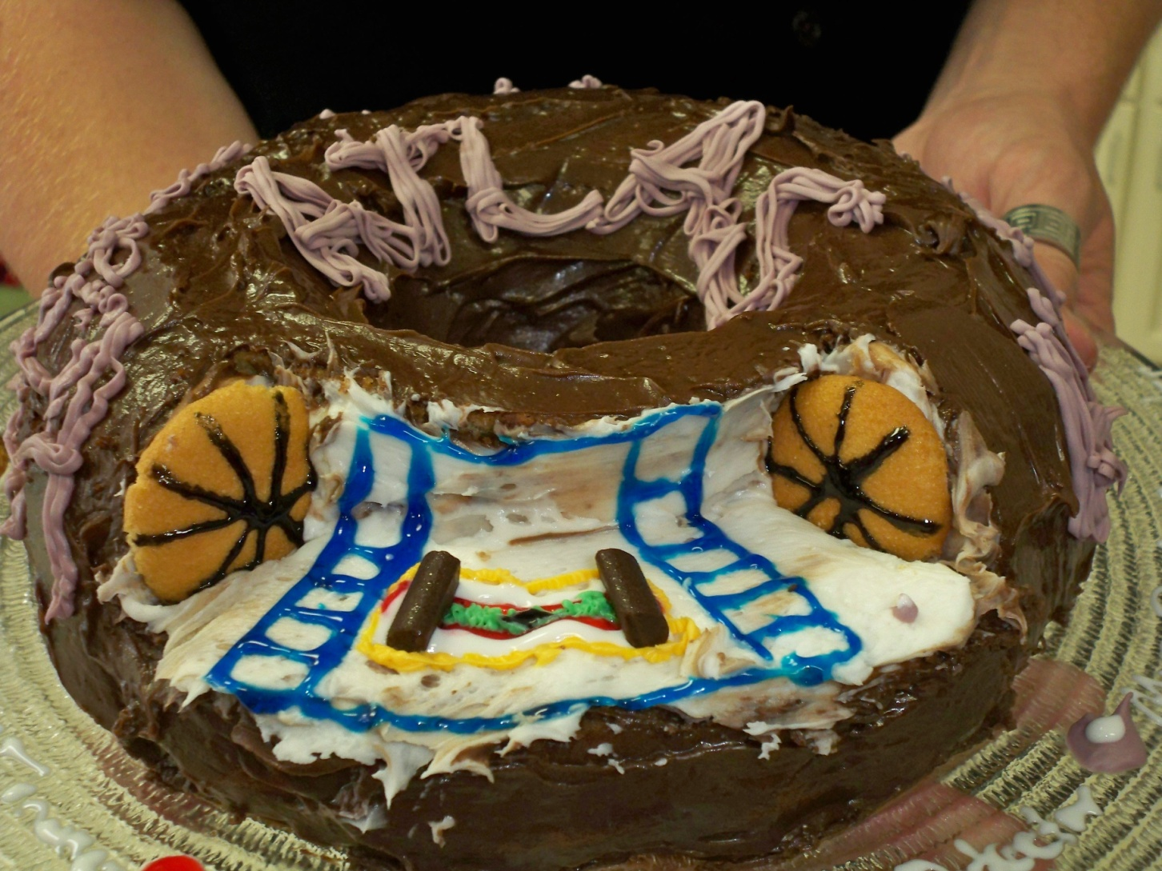
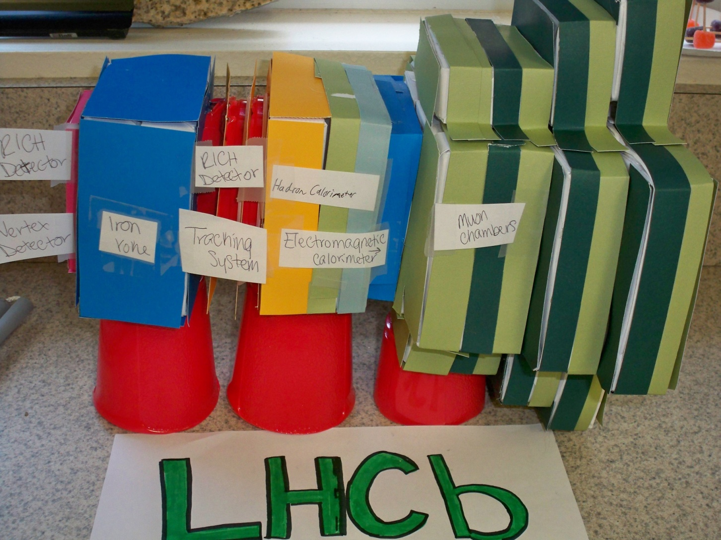
ATLAS CAKE AND LHCb MODEL

Slide 17
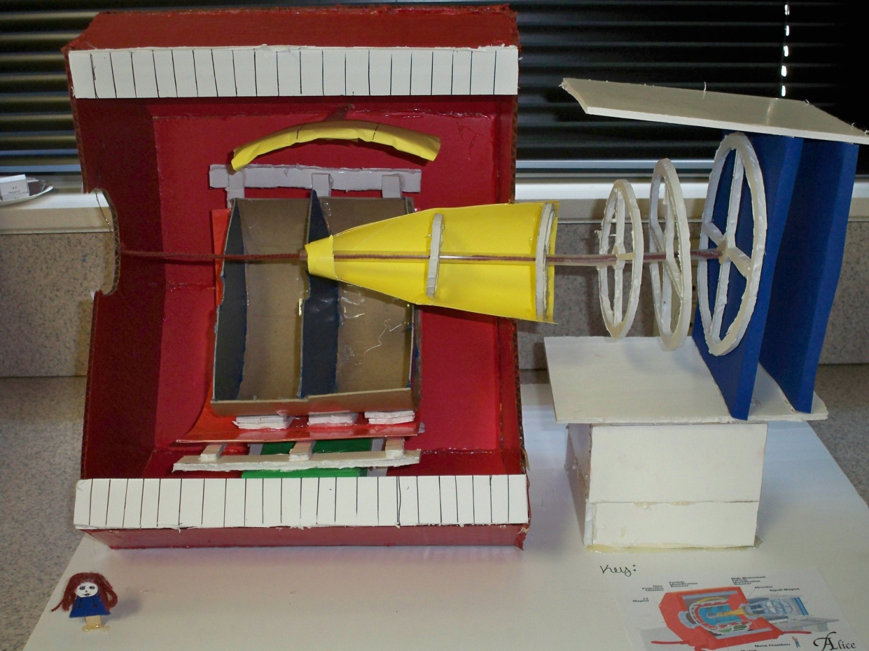
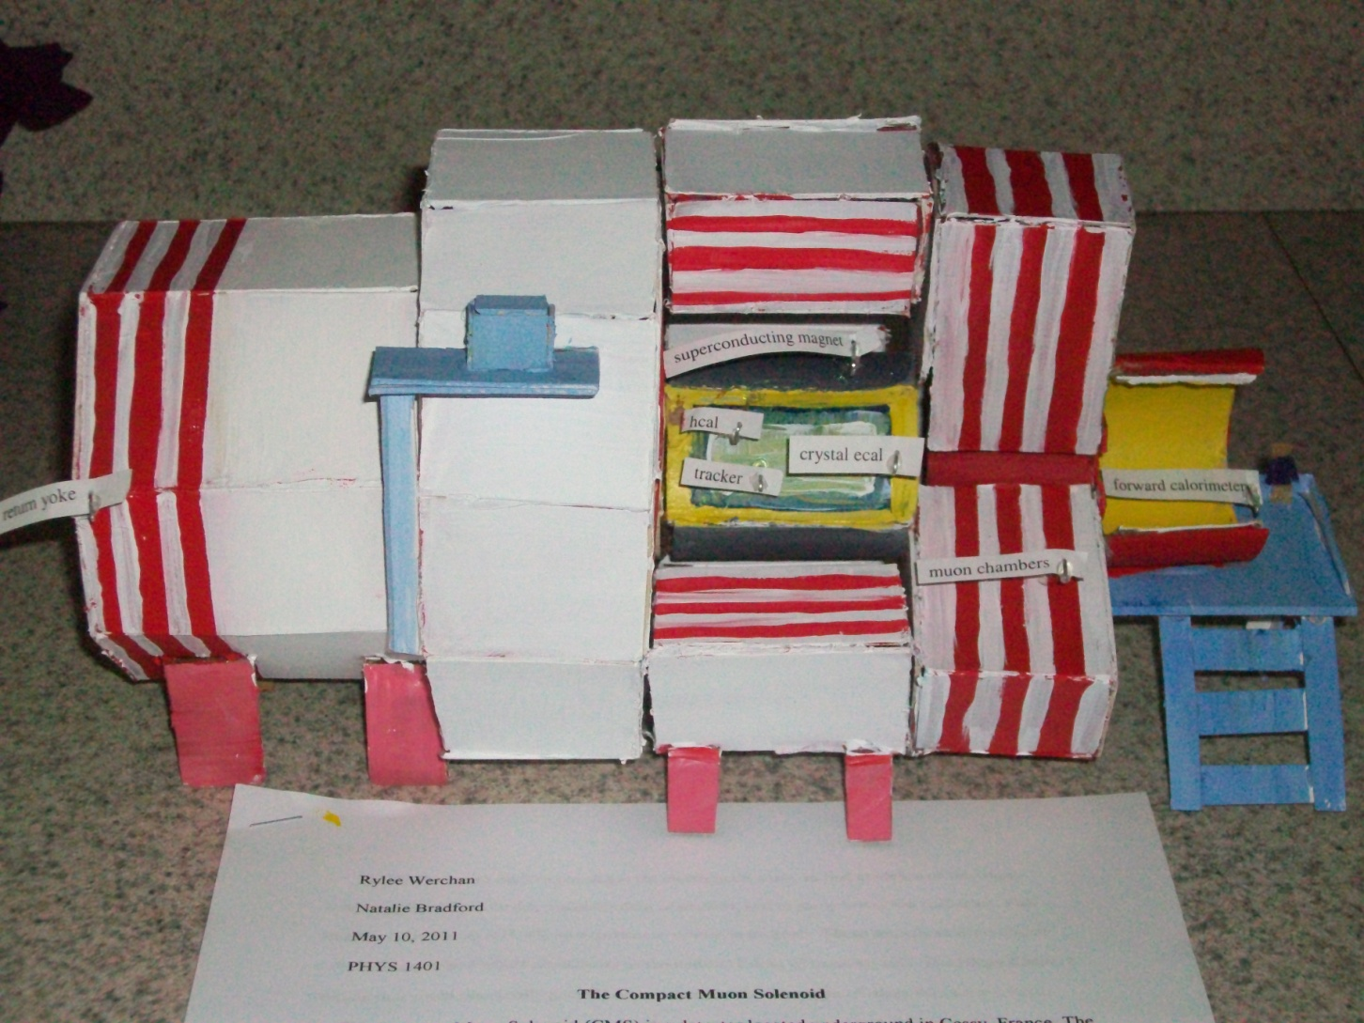
ALICE MODEL AND CMS FRONT VIEW

Slide 18
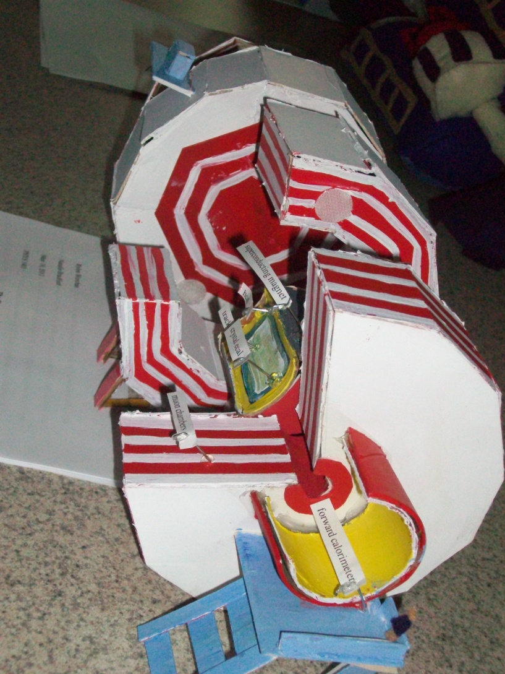
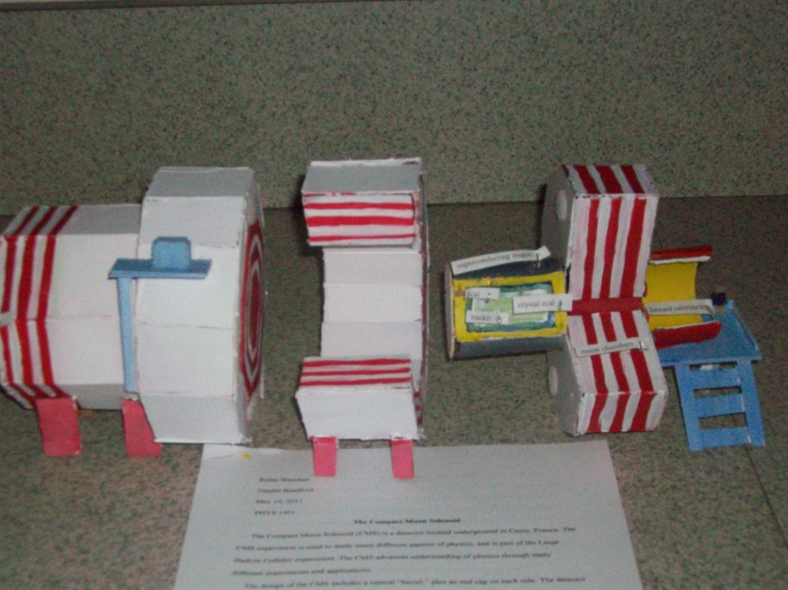
CMS END VIEW AND PULL APART

Slide 19
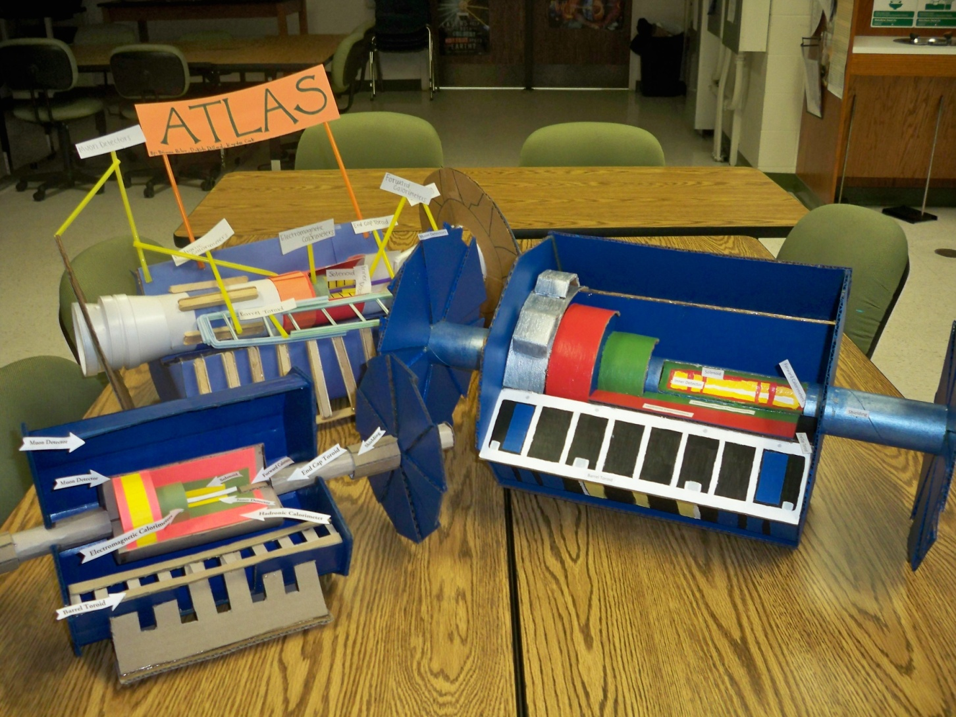
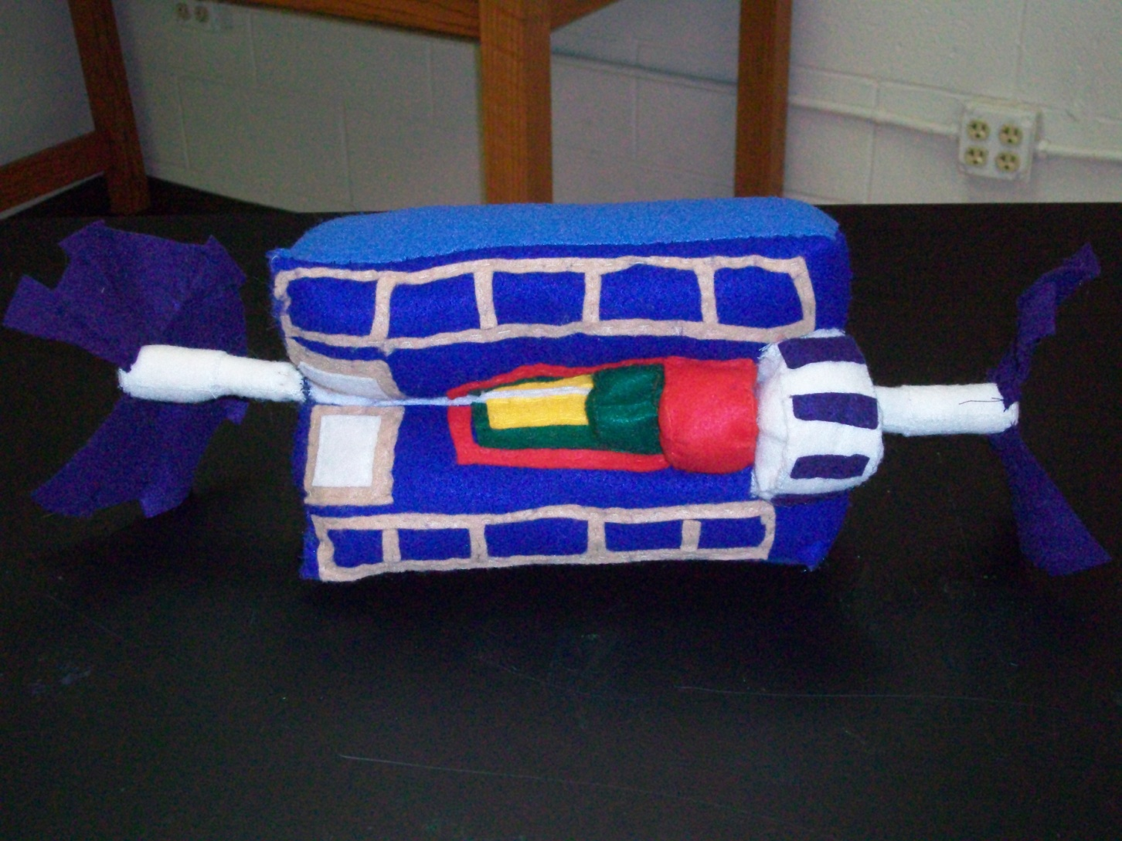
ATLAS MODELS AND PILLOW

Slide 20
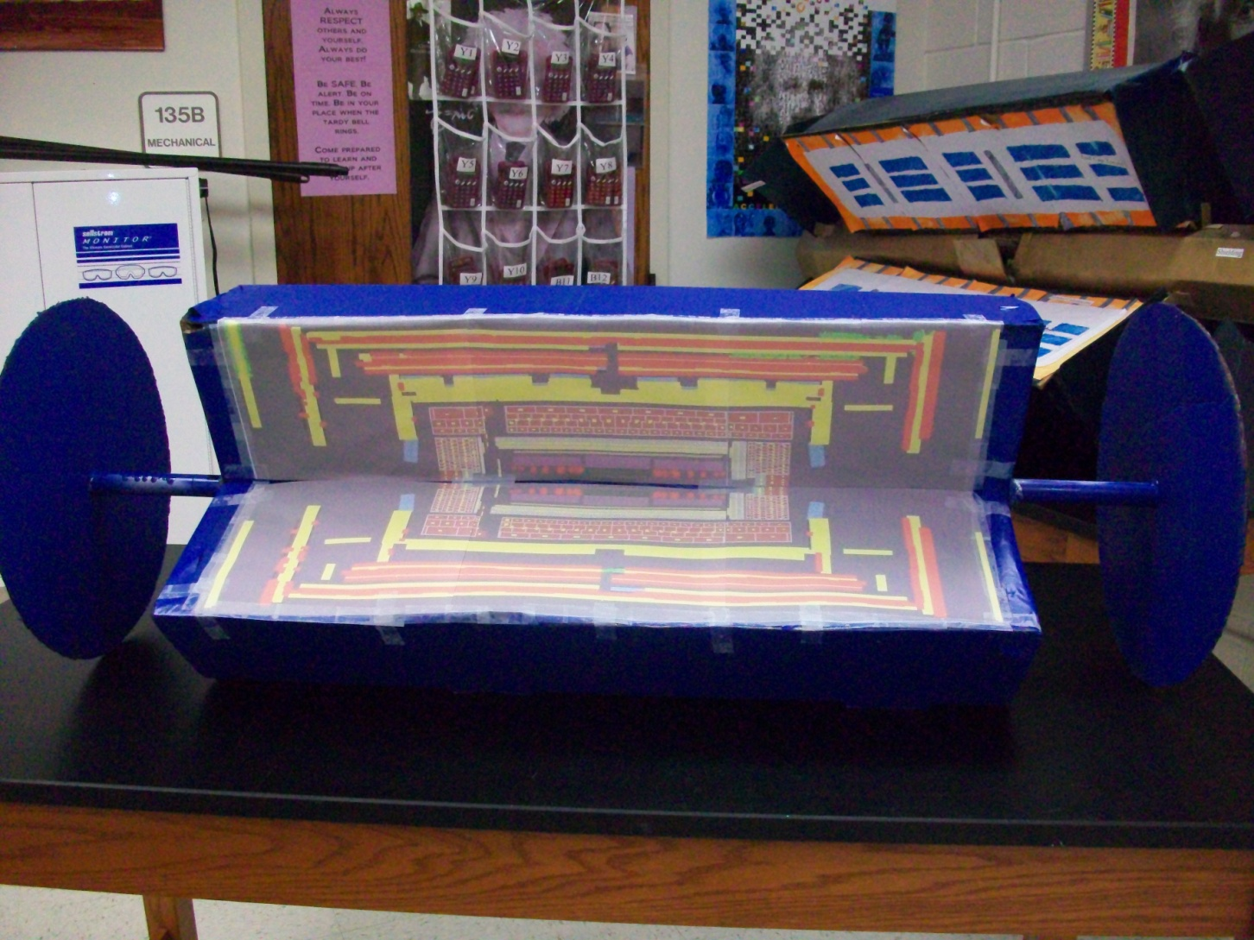
LARGE SIZE ATLAS MODELS

Slide 21
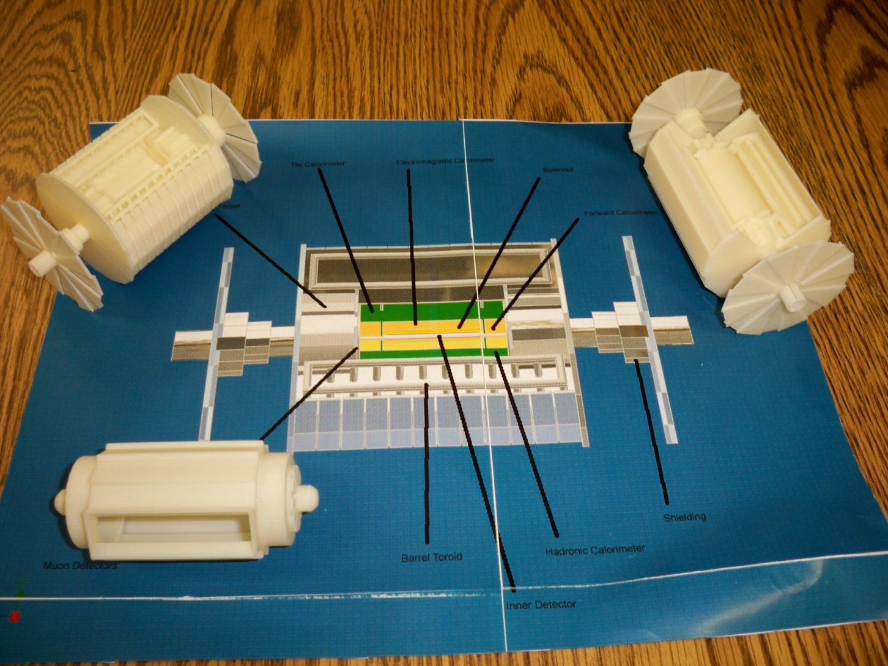
ATLAS 3-D PRINTER MODELS

Slide 22
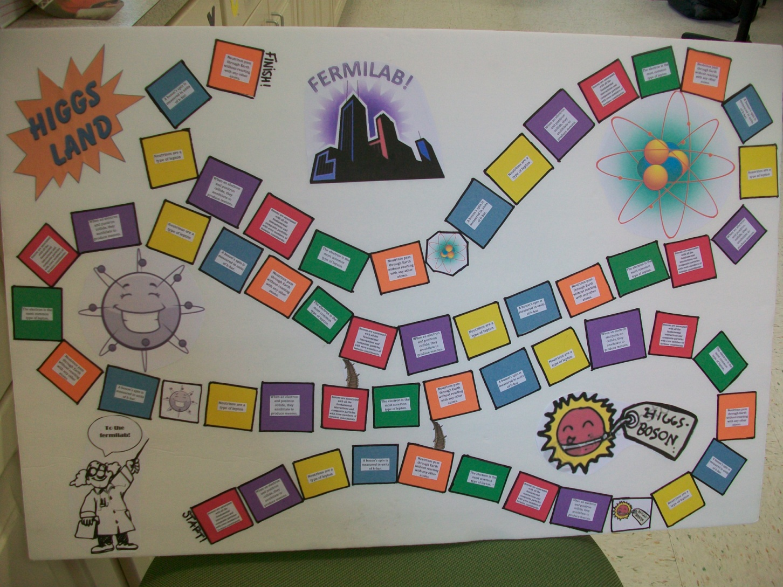
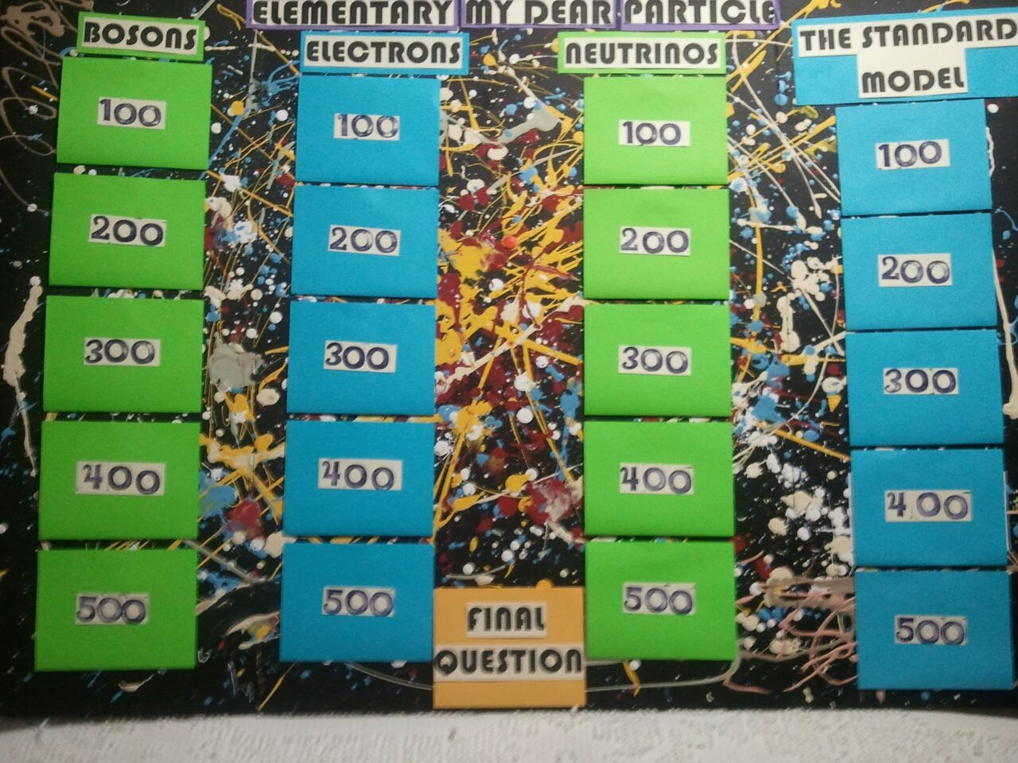
FERMILAB HIGGS LAND ELEMENTARY MY DEAR PARTICLE

Slide 23
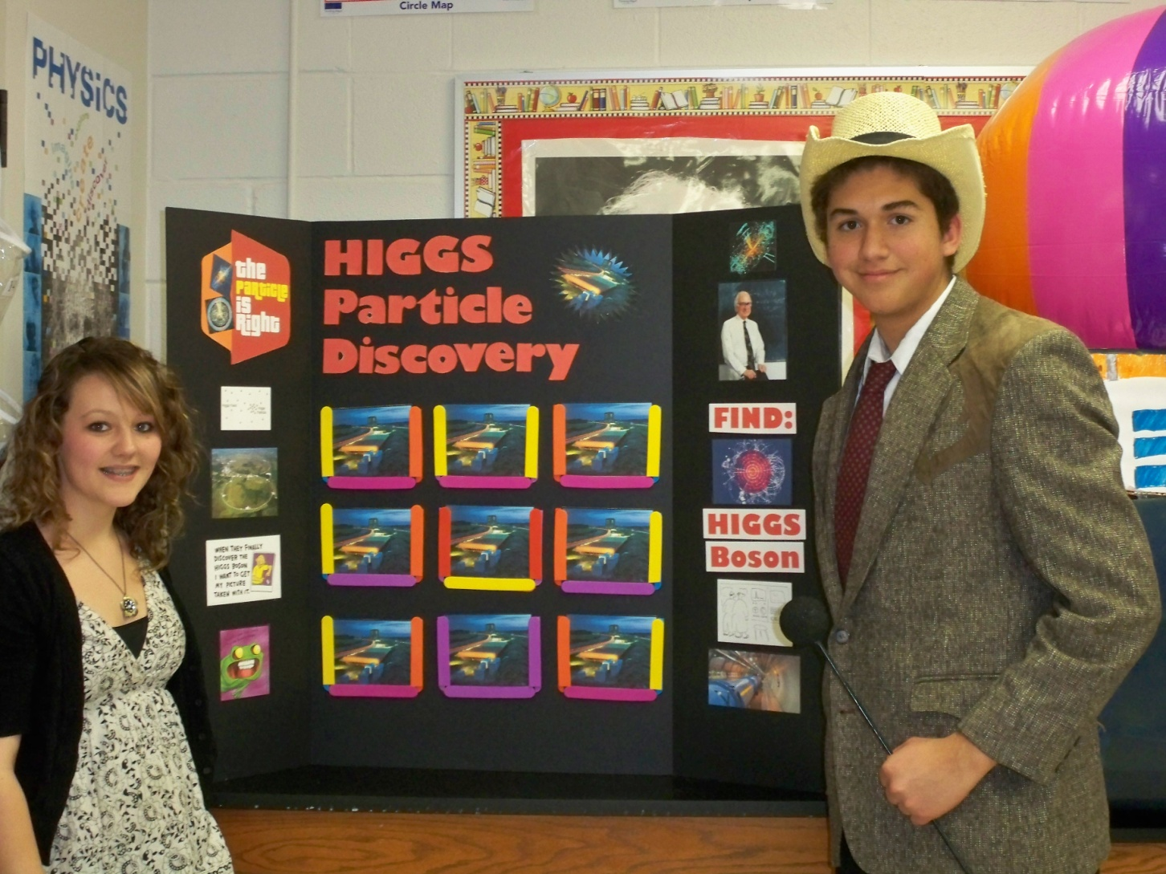
HIGGS PARTICLE DISCOVERY GAME

Slide 24
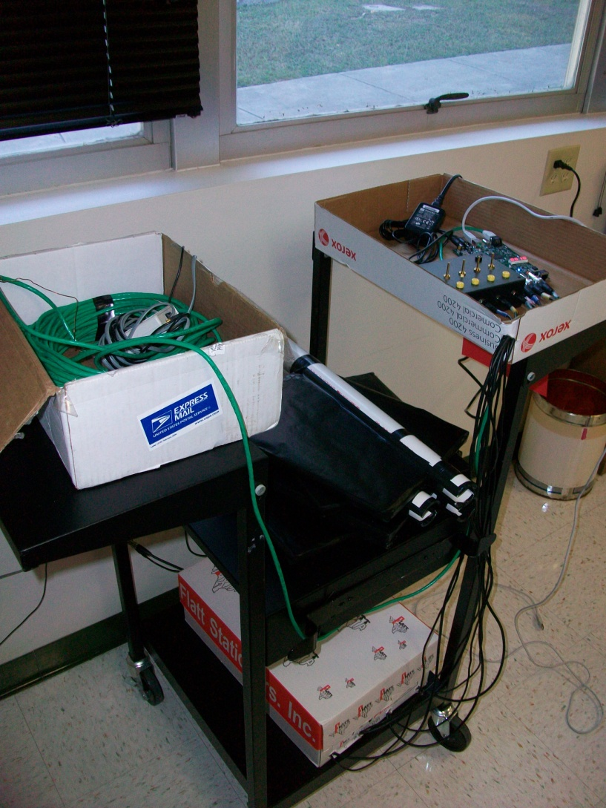
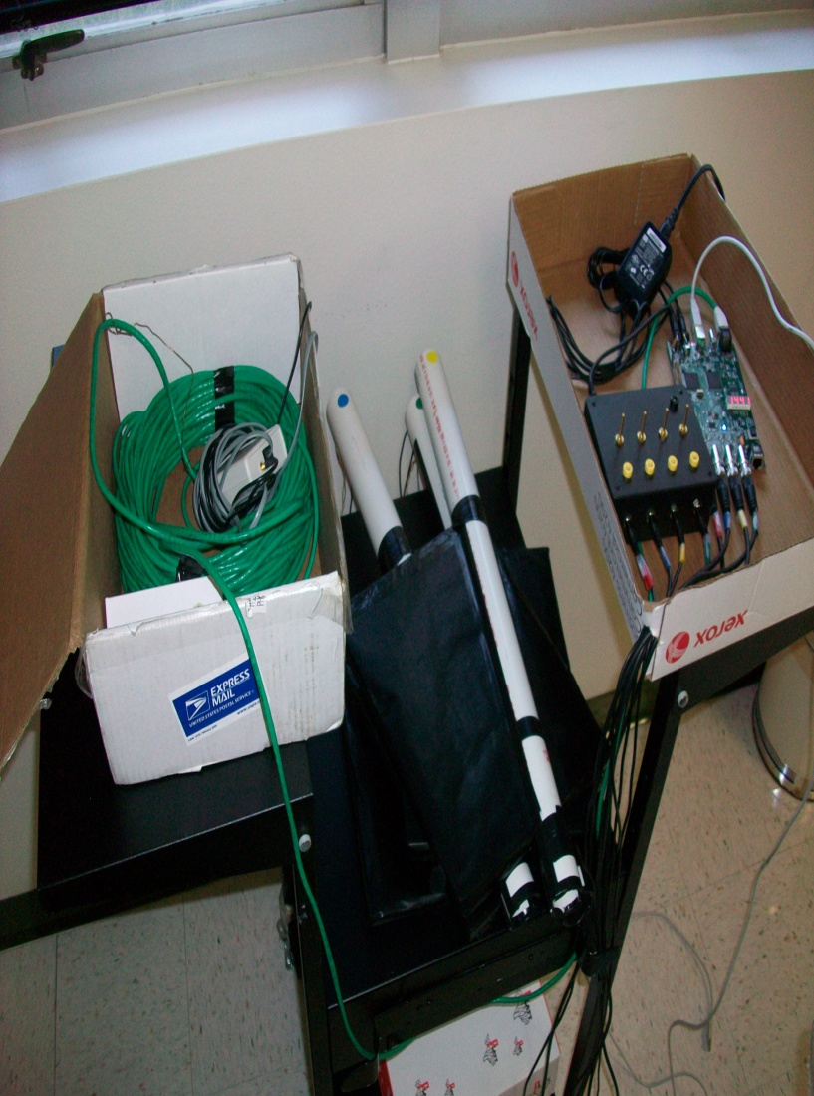
Cosmic Ray Muon Detector

Slide 25
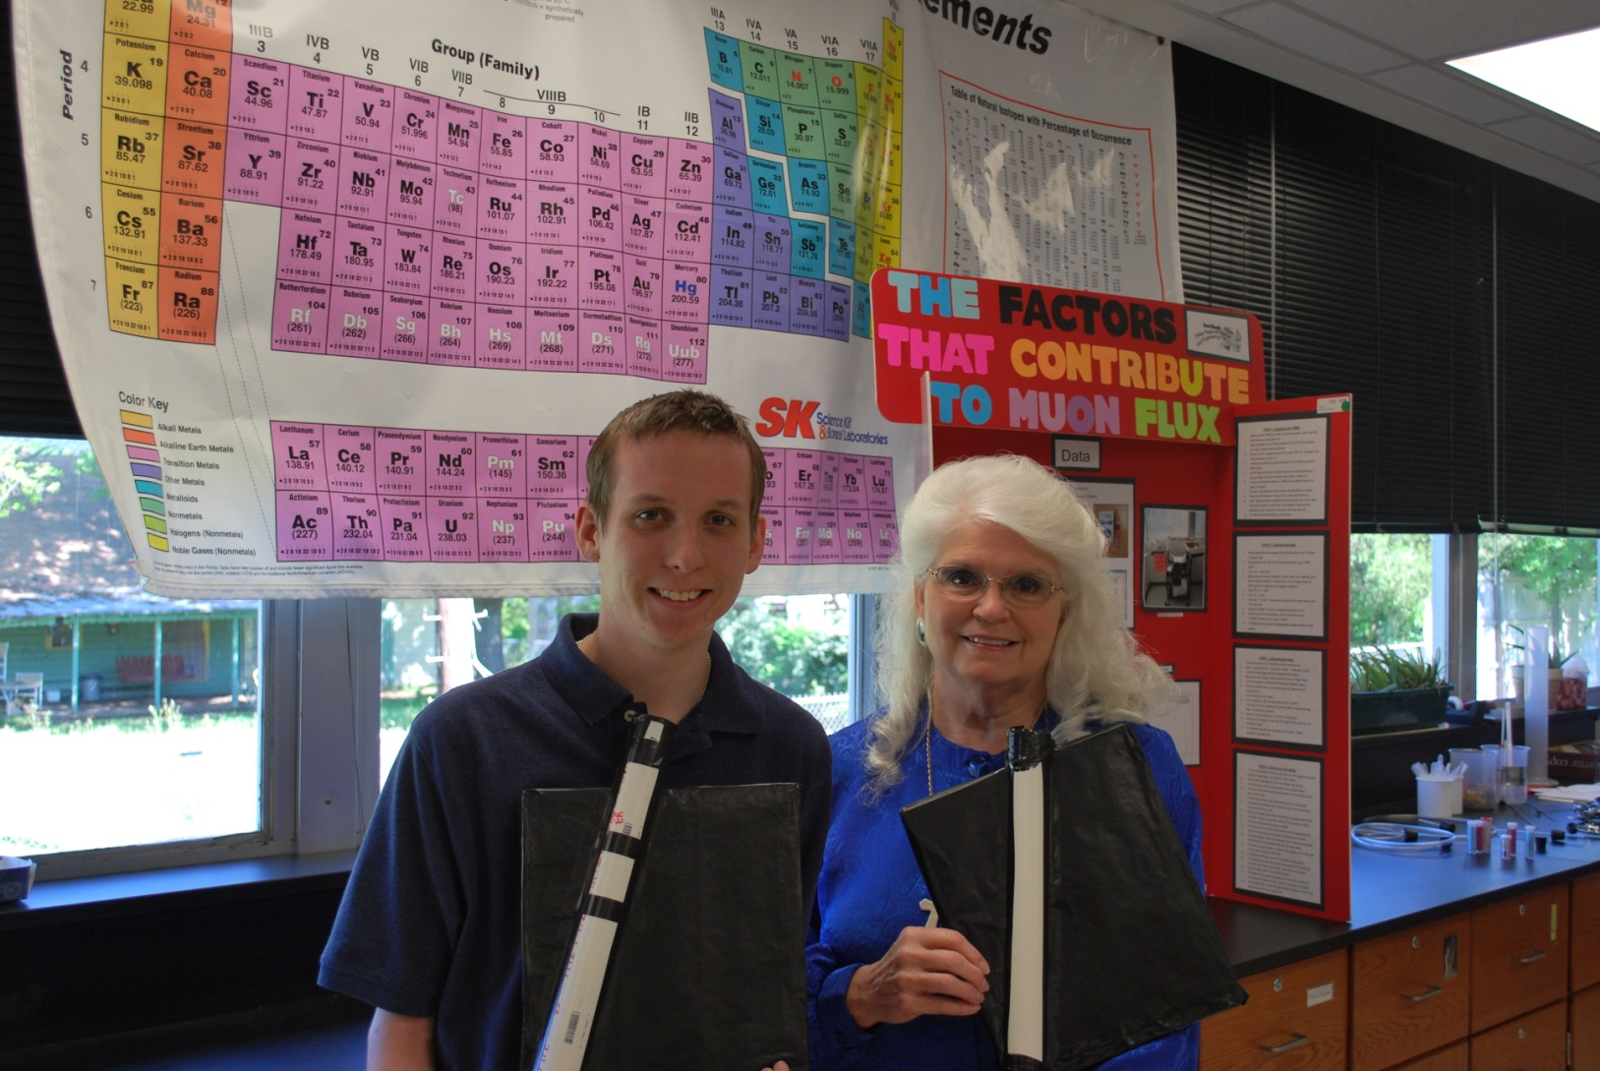
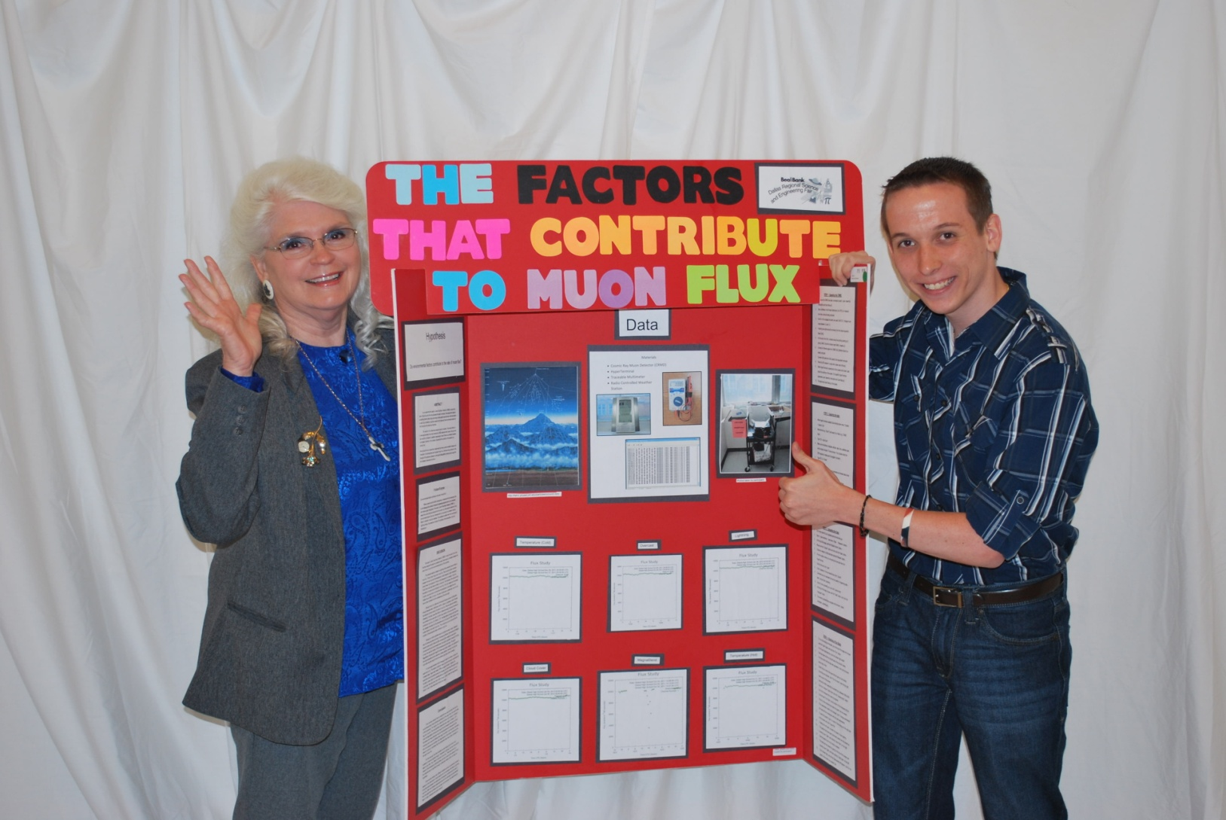
AARON and LUKE CRMD PROJECT

