Slide 1
FermiLab Data Camp 2015
What we did:
Inquiry based calibration data analysis of J/psi meson, W and Z bosons
Tours: webtour of CMS, LINAC, Accelerator Control room, DØ, MINOS, G-2, SiDet
Classroom implementation investigation and plan

Slide 2
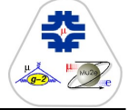
What’s happening at Fermilab?
Muon campus seeks undiscovered particles in the vacuum (Muon g-2) and understanding of CLFV (Charged Lepton Flavor Violation) (Mu2e) under construction
Dark matter and dark energy searches
D zero
Neutrino beams to Sudan and Ashville mines

Slide 3
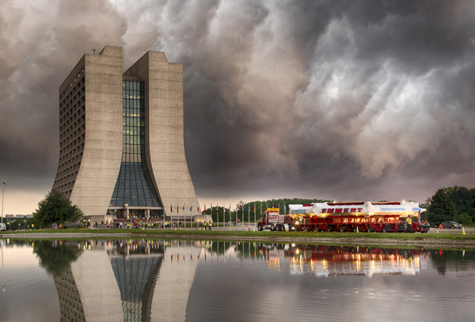
Super ring was transported from Brookhaven
In July 2013, superconducting ring traveled to Fermilab from NY via truck and barge down the East Coast, through the Gulf of Mexico and rivers and Illinois highways saving $$$ over the coast of new construction.

Slide 4
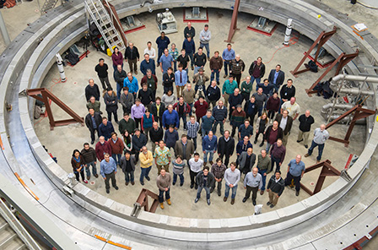
Muon g-2
(pronounced gee minus two)
50 ft diameter superconducting muon storage ring; data collection should begin in 2016
Goal is to find virtual particles in the difference between the muon’s known “g” value associated with its magnetic field by more precise measurements.

Slide 5
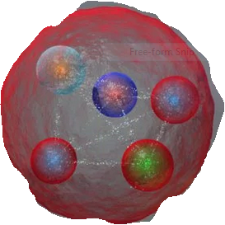
D zero data analysis ongoing
Although Tevatron activity ceased in 2011,
the data is still being assessed for both CDF and DØ. Recent articles conclude a hadron, X(4140) composed of two quarks and two antiquarks produced at CDF in 2009 and also seen at LHCb and D zero. This is interesting in light of the recent pentaquark spottings at the LHC.

Slide 6
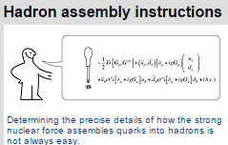
X(4140) Baryon? Meson? something else?

Slide 7
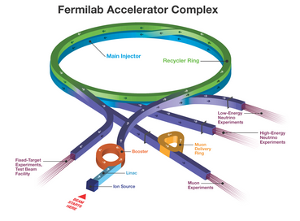
From the LINAC to the Booster to the Recycler to the Main Injector
Seven particle accelerators and storage rings move the proton beam from 35 keV to 120 GeV beams of muons and neutrinos.

Slide 8
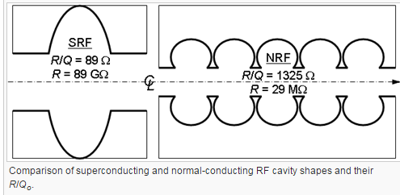
New/old (see notes about Galileo) technology involves superconducting radio-frequency cavity (SRF)

Slide 9
Familiar experiments in the beam
Main injector at Fermilab provides neutrinos for MINOS, MINERvA and NOvA and the future Deep Underground Neutrino Experiment (DUNE)
Some proton beams will supply pions for decay into muons for the Muon campus experiments.

Slide 10
SiDet
DAMIC (Dark Matter in CCDs) located at SNOlab uses silicon detectors at -150 C to look for WIMPs
Development of cooling processes using ADR (Adiabatic Demagnetisation Refrigeration) paramagnetic salts are used instead of pumping on He to achieve temperatures of 50 mK

Slide 11
Possibilities for your classroom

Slide 12
Implementation plans
https://quarknet.i2u2.org/data-portfolio
Plenty of short and long-term activities/projects:
Rolling with Rutherford, Making it around the bend, Calculate the Z mass, Quark workbench, Cosmic Ray e-lab, Totem Data express (calculate mass of proton), CMS Masterclass

