Slide 1
Gauss’s Law &
Parallel Plate Capacitors

Slide 2
Quick Electrostatics Refresher
Coulomb’s Law: |F| = 1 |Q₁||Q₂|
(Electric Force) 4πε₀ d²
Direction: opposites attract, likes repel
₋
F
F
Q₂
+
Q₁
d

Slide 3
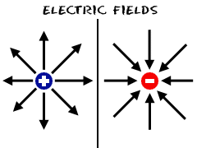
Alternative Approach: Every charge is a source of an electric field, E. Other charges interact with E.
source
E = 1 Q
4πε₀ d²
distance from Q
F = qE (F on q in field E)
KEY: E is the force per charge

Slide 4
Example: Electric Force on Q₂
E₁ = 1 Q₁ (due to Q₁ at location of Q₂)
4πε₀ d²
F₂ = Q₂E₁ = 1 Q₁Q₂
4πε₀ d²
₋
F₂
E₁
+
Q₂
Q₁
d
Note: F on a + charge is in direction of E
F on a - charge is in the opposite direction

Slide 5
What is Gauss’s Law?
Fundamental relationship between charge and flux of the electric field through a surface enclosing the charge
Equivalent to Coulomb’s Law

Slide 6
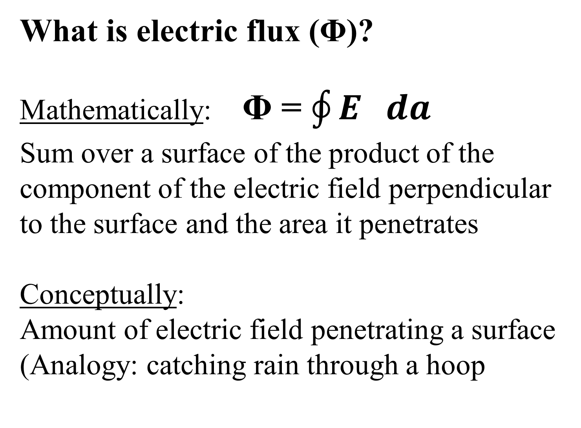
What is electric flux (Φ)?
Mathematically: Φ = $\oint{E da}$
Sum over a surface of the product of the component of the electric field perpendicular to the surface and the area it penetrates
Conceptually:
Amount of electric field penetrating a surface
(Analogy: catching rain through a hoop

Slide 7
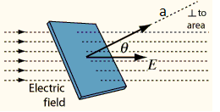
Flux Through Single Surface
Φ = EAcos θ = E A
If E surface, Φ = EA

Slide 8
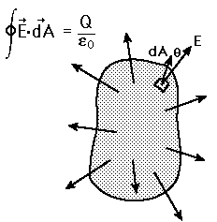
Flux Through A Closed Surface
Add up the flux through each small area
Sign Convention
Outward Flux: +
Inward Flux: –

Slide 9
Gauss’s Law
Φ = Q_{enclosed}
ε₀
Big Idea: Electric flux through a closed surface depends only on the charge enclosed by the surface

Slide 10
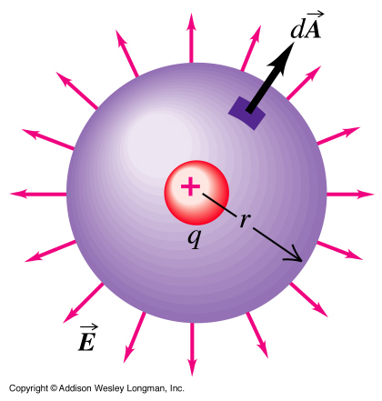
Example: Point charge at center of a sphere
KEY: E is uniform and to surface
E = 1 q
4πε₀ r²
A = 4πr²
Φ = EA = q/ε₀

Slide 11
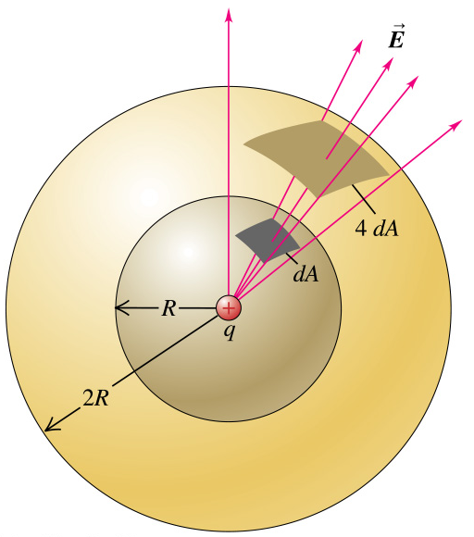

Flux is the same through any sphere!
Area $∝r2$
E $∝\frac{1}{r2}$
Φ = EA → no r dependence

Slide 12
Flux through other surfaces?
Big Idea: Any surface can be created by deforming a sphere by
stretching/compressing
tilting

Slide 13
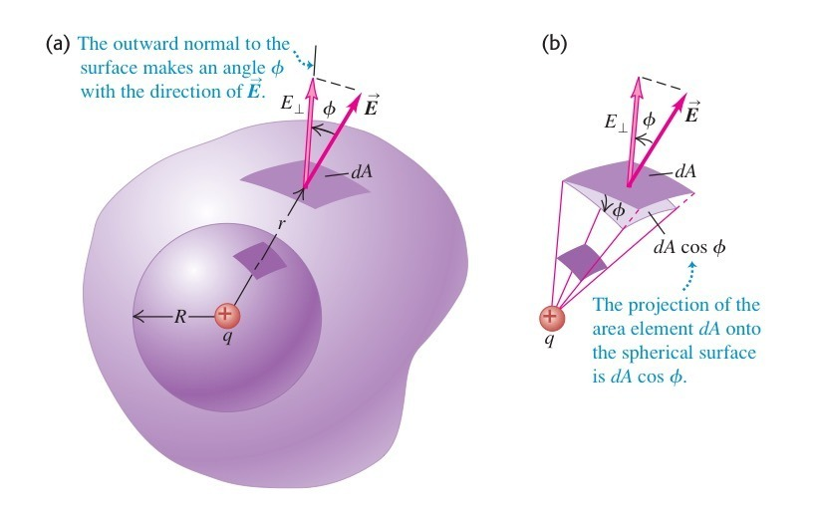

Slide 14
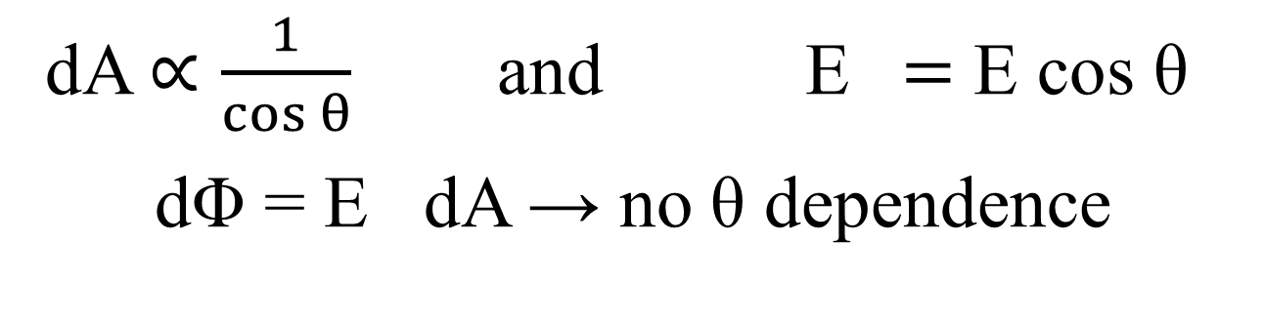
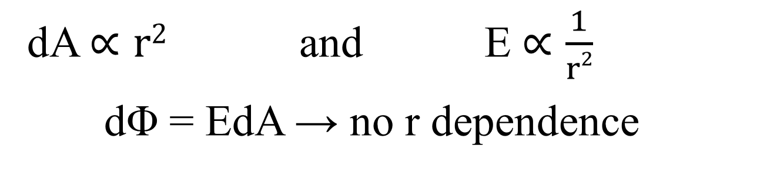
Stretching has no effect on flux!
dA $∝r2$ and E $∝\frac{1}{r2}$
dΦ = EdA → no r dependence
Tilting has no effect on flux!
dA $∝\frac{1}{cos θ}$ and E $=$ E cos θ
dΦ = E dA → no θ dependence

Slide 15
Conclusion: Electric flux through any surface enclosing an isolated point charge is the same!

Slide 16
What is the flux through a closed surface not enclosing charge?
Example: S₁ encloses q but S₂ does not
S₁
S₂
q

Slide 17
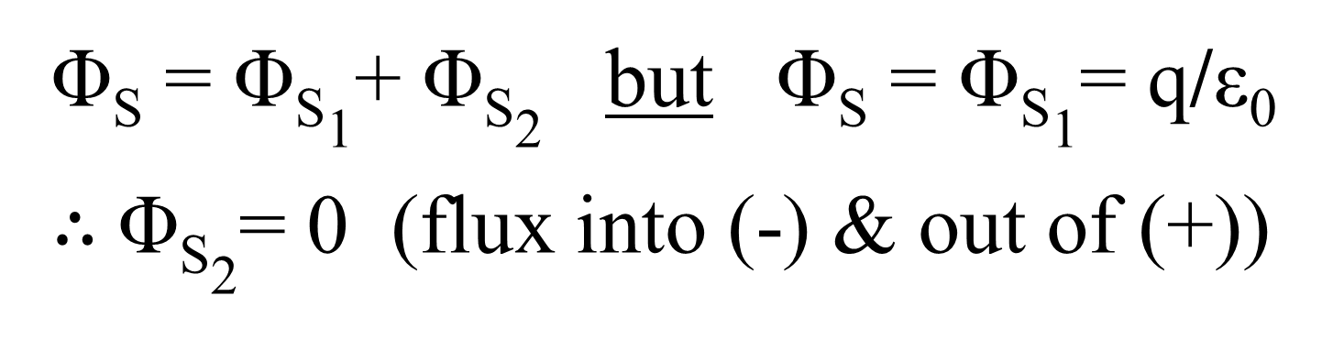
Let S be the entire surface: S₁ + S₂
S₁
S₂
q
Φ_{S} = Φ_{S1}+ Φ_{S2} but Φ_{S} = Φ_{S1}= q/ε₀
$∴$Φ_{S2}= 0 (flux into (-) & out of (+))

Slide 18
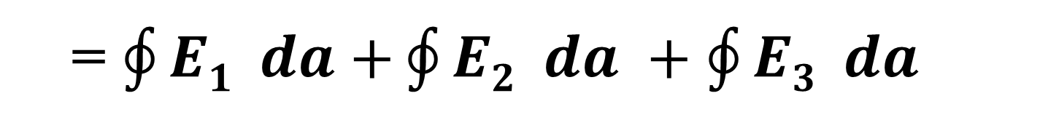
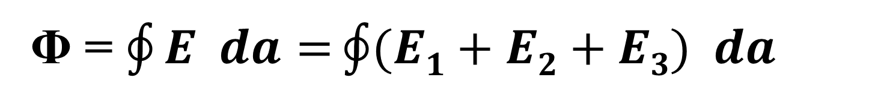
What if there are many charges?
q₃
q₁
q₂
Φ = $\oint{E da=}\oint{(E1+E2+E3) da}$
= $\oint{E1 da+}\oint{E2 da +\oint{E3 da}}$
= q₁/ε₀ + q₂/ε₀ + 0
= q_{enclosed}/ε₀

Slide 19
KEY: Gauss’s Law always holds but is most useful where there is lots of symmetry!
(i.e., where flux can be found without actually doing an integral)

Slide 20
Example: Find E for an infinite sheet of charge density σ (per area)
Gaussian Surface: Pill Box/Cylinder
-Charge enclosed (shaded):
Q_{enclosed} = σA
-Flux (through two ends):
Φ = 2EA
Φ = Q_{enclosed}/ε₀ → 2EA = σA/ε₀
Result: E = σ/2ε₀
E
A
E

Slide 21
Ideal Parallel Plate Capacitor
Area of plate face: A
Charge on inner face: +Q
Plate separation: d
E
voltage: V ≈ Ed
Charge on inner face: -Q
Treat faces like sheets of density: σ = Q/A
E_{total} ≈ 2 E_{sheet} = 2(σ/2ε₀) = Q/Aε₀
C = Q/V = Q/Ed = Q/(dQ/Aε₀) = ε₀A/d

Slide 22
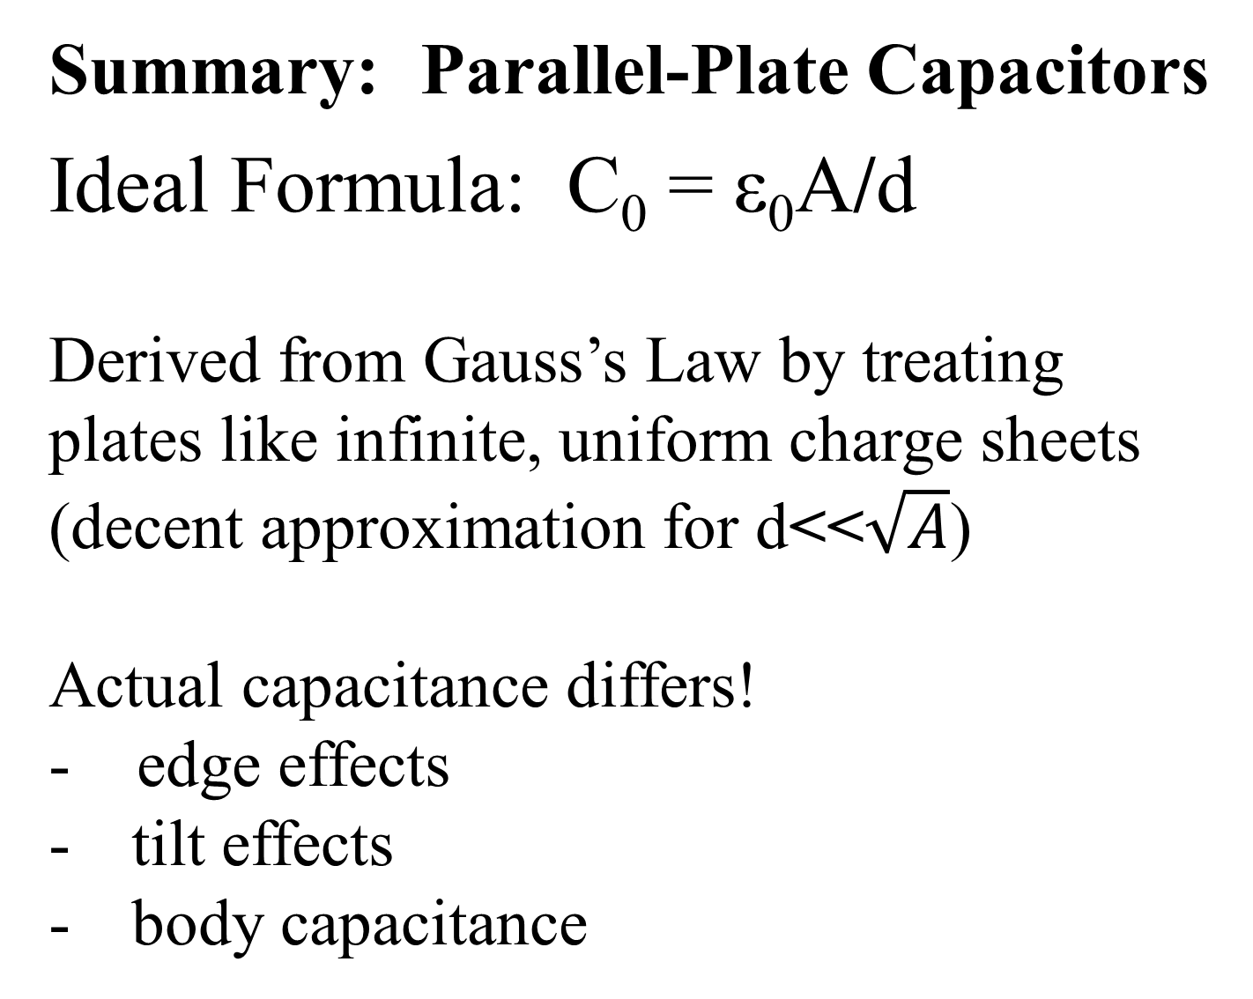
Summary: Parallel-Plate Capacitors
Ideal Formula: C₀ = ε₀A/d
Derived from Gauss’s Law by treating plates like infinite, uniform charge sheets
(decent approximation for d<<$\sqrt{A}$)
Actual capacitance differs!
- edge effects
tilt effects
body capacitance

