Slide 1
Introduction to The Standard Model

Slide 2
The Standard Model
Introduction: What is Particle Physics?
What Questions does it try to answer?
The Standard Model: What it is and what it
is not
Unification of Forces
Unification of Matter
Some examples of combining matter and forces
Creation of the Universe

Slide 3
Particle Physics and its Questions
Particle Physics: The study of the basic building blocks of matter and the interactions between them
Some questions that drive research:
Are there fundamental constituents of matter in the Universe?
If so, what are they and what are their properties?
What are forces and how are they transmitted?
What is mass?
What is anti-matter and where did it all go?
What does this tell us about the origins of the Universe
and its fate?

Slide 5
The Standard Model
What is it? The best theoretical framework we have for particle physics
today
It has been a remarkable success BUT we know it is incomplete
So, what does the phrase “STANDARD MODEL” mean?
A unification of all matter into two types of particles
A unification of the Electromagnetic and Weak Nuclear forces
A description of the interaction between fundamental particles
in terms of the exchange of fundamental force particles
Some things it does not do:
It does not unify the Strong and Electro-Weak forces
It ignores Gravity, so does not tell us anything about how it
might be unified with the other forces
It does not explain why there are so many generations of particles
It does not explain the disappearance of anti-matter in the Universe.

Slide 6
Unification of Matter First Attempt
water
fire
air
earth
earth

Slide 8
How are Forces transmitted?
In the 19-th century the Force Field was proposed
q
m
E
G
Q
M
In Quantum Mechanics a particle associated with each Force Field transmits the force (our most modern view)

Slide 9
How do particles create forces?
e.g. Electromagnetic Force

Slide 10
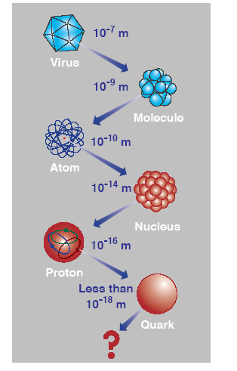
Back to the Unification of Matter

Slide 11
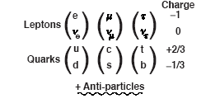
The Fundamental Particles of Nature
Matter Particles: spin 1/2
Force Particles (Bosons): Integer spin
1 Gev = 10⁹ eV, (mc²)_{proton} ≈ 1 GeV
Notes:
≈

Slide 12
Fermions
Fermions are particles that obey the Pauli Exclusion Principle
A fermion is any particle that has a half-integer spin.
Ex. 1/2, 3/2, 5/2
Quarks and leptons, as well as most composite particles, like protons and neutrons, are fermions.

Slide 15
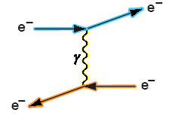
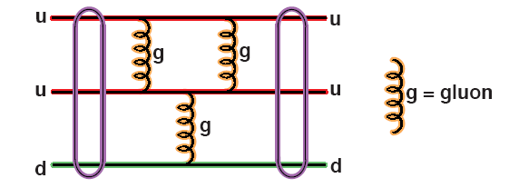
Some Force Diagrams
Electromagnetic
Strong Nuclear
proton

Slide 16
Weak Nuclear
∆E∆t › h/2π:
Uncertainty Principle
e⁻⁻
W⁻⁻
W⁻⁻
ν
d
d
u
neutron
neutron
d
d
proton
u
u
Beta (β) decay: n -> p + e⁻ + ν

Slide 17
How do Forces merge (or Freeze-out) ? e.g. Electro-Weak Unification
Electromagnetic
Weak-Nuclear
At energies ›› 100 GeV the Z⁰ and photon can
be equally produced (i.e. the two forces act the same)

Slide 18
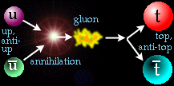
Annihilation and Creation
Annihilation
Creation
e⁻
e⁻
e+
e+
e⁻
μ⁻
e+
μ⁺
Thus should be able to produce μμ in e⁻e+ annihilation
e⁻
μ⁻
e+
μ⁺
or
e⁻
q⁻
E₋ + E₊ › 2mc²
e+
q⁺

Slide 20
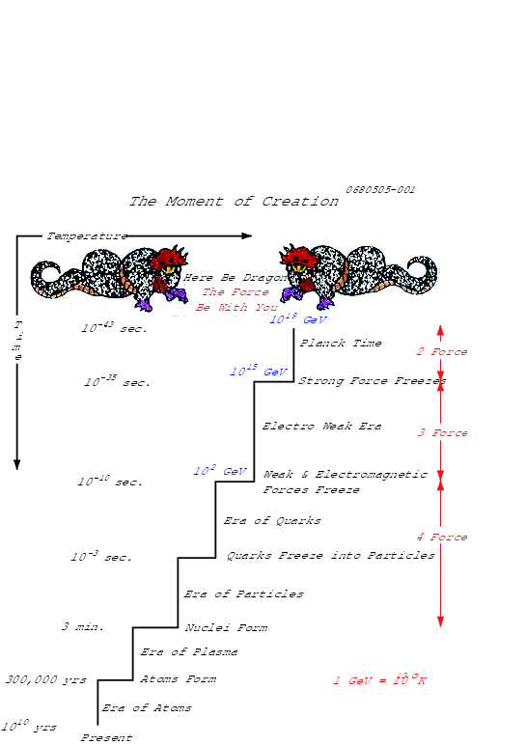
1 GeV = 10¹³ ⁰K

Slide 21
The Standard Model predicts the existence of one more particle known as the “Higgs boson.”
The Large Hadron Collider (LHC) at CERN has confirmed the existence of the Higgs boson.

Slide 22
References
http://en.wikipedia.org/wiki/Standard_Model
http://www2.slac.stanford.edu/vvc/theory/fundamental.html
Google images
.

