Slide 1
Cosmic Rays
The discovery of cosmic rays
Discoveries made with cosmic rays
Cosmic rays in modern physics education
Let’s count cosmic rays around us

Slide 2
Who ordered it? The discovery of cosmic rays
Discovery of radioactivity (1896 by Henri Becquerel and Marie Curie) let people believe that the atmospheric electricity, that is, the ionization of air, was caused by ground based radiation (for example radon and other isotopes). This was even supported by measurements at that time! Talking about measurement errors!
From 1909 (Theodor Wulf) to 1911 (Domenico Pacini) and to 1912 (Victor Hess), people continued the measurements to higher (Eiffel Tower) and higher (hot air balloon) elevations, using Wulf’s invention of an electrometer (measure the rate of ion production in a sealed volume), and found out that air ionization increases with altitude, so the source may come from above. Hess received the Nobel Prize in Physics in 1936.
The efforts (of measuring radiation from outer space) are on-going even today: one of the five frontiers at DOE science office. We now have ground based and space based experiments to study cosmic rays. For example: The Rover measured radiation levels on Mars.

Slide 3
But what is it?
The term “cosmic rays” was coined by Robert Millikan in the 1920s who believed that the primary cosmic rays were gamma rays, that is, very high energy photons.
We now know that “cosmic rays” refer to particles (photons included) in outer space (primary cosmic rays) and particles we measure at the sea level (atmospheric cosmic rays).
Primary cosmic rays travel throughout the Milky Way Galaxy, some originated from the Sun. We do not know all the sources nor do we know all the acceleration mechanisms, but we do know that those reaching the Earth are mostly protons (~85%).
These protons interacting with atoms in the atmosphere produce secondary particles such as pions, muons, electrons, photons and neutrinos. Only muons and neutrinos make to the sea level. When muons decay, we also have electrons and from them we can also have photons. Neutrinos are only detected with specially designed detectors. If we only count muon, electron and photon, muon makes up about 95% at sea level.

Slide 4
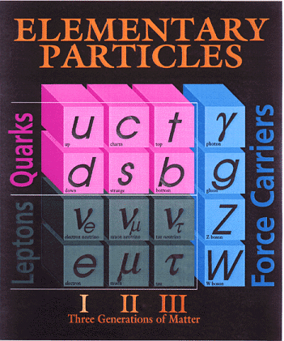
electromagnetic interaction
strong interaction
Weak interaction

Slide 5
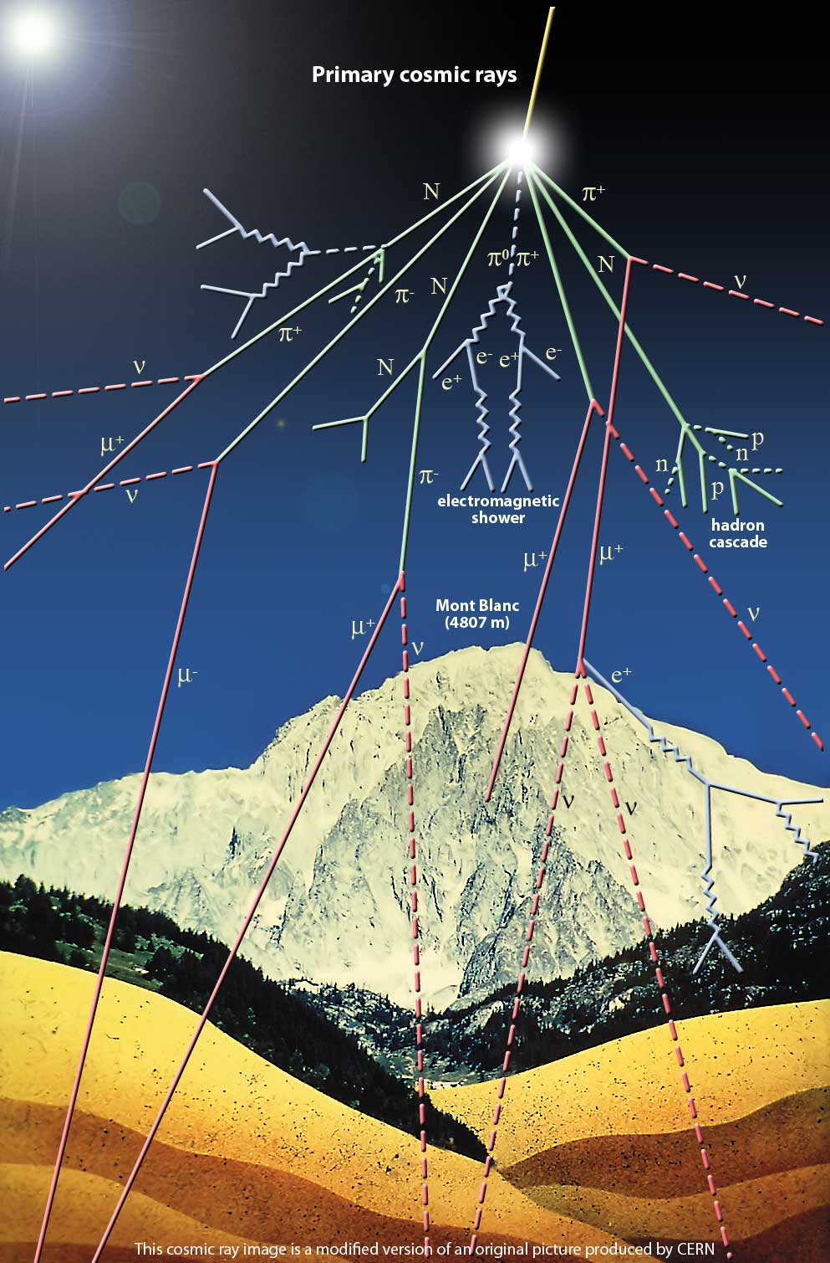
Mainly strong interaction
Strong and electromagnetic interactions
~ 20 km
Weak and electromagnetic interactions

Slide 6
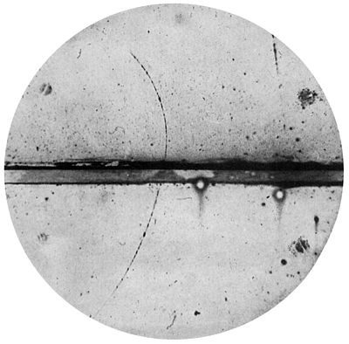
Such a gold mine, the discoveries made with cosmic rays
Discoveries:
Position: theorized by Paul Dirac in 1928 to explain the Zeeman effect (example applications: NMR and MRI); discovered by Carl D. Anderson in 1932 using a cloud chamber (instrumentation).
Muon: discovered by Street and Stevenson in 1937 again using a cloud chamber.
Pion: in 1948.
... ...
Now a tool in astrophysics to investigate the dynamics and compositions of galaxies.

Slide 7
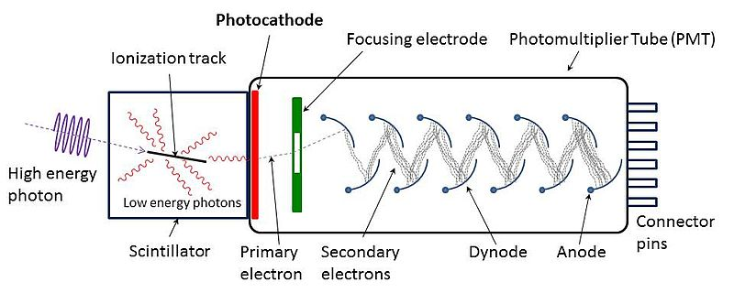
Particle physics experiment in a classroom, cosmic rays in education
One way to detect cosmic rays is
Scintillation and scintillator: a scintillator is a material that emits photons after being excited by ionizing radiation such as photons and charged particles. There are many types (organic and inorganic, crystal and plastic, gaseous, solid and liquid, water based and oil based, ... ) of materials that scintillate. Plastic scintillator is made by adding fluors to a base plastic. It is mostly used for timing, not for energy measurement.
Photomultiplier tube (PMT)

Slide 8
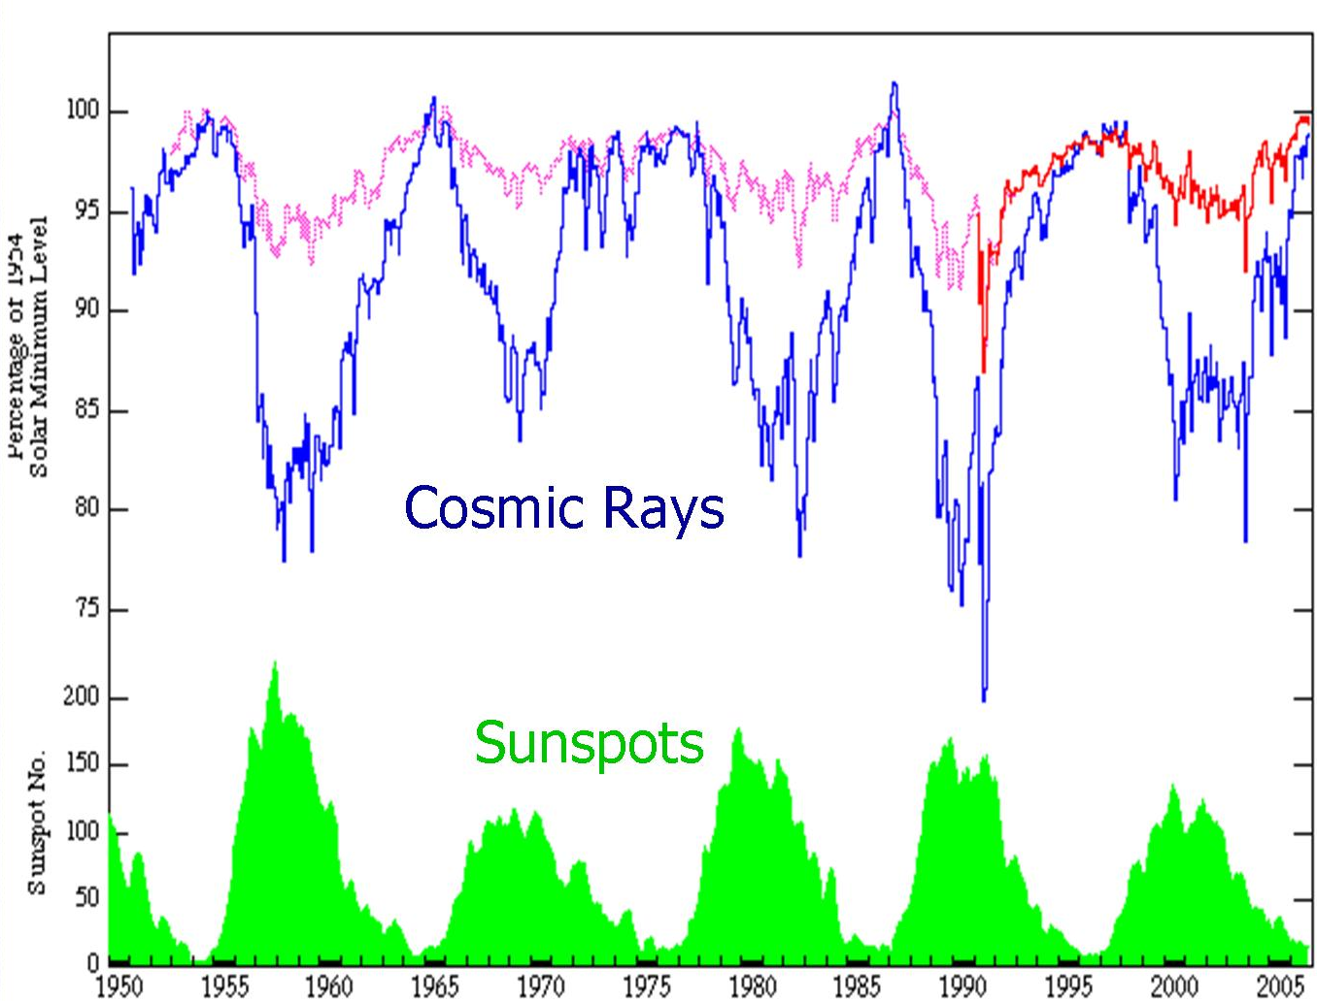
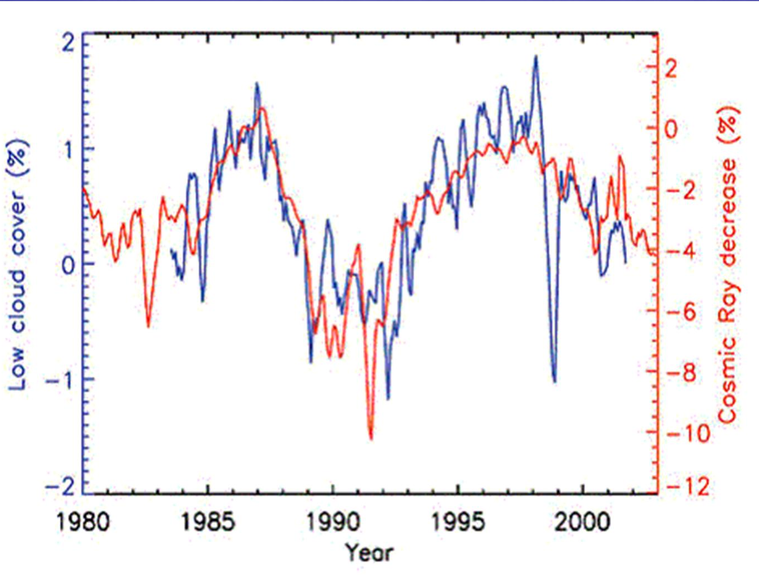
Particle physics experiment in a classroom, cosmic rays in education
What can we learn
Flux, a simple counting experiment
Time structure in the flux: to study solar radiations, low cloud cover, etc (http://arxiv.org/abs/0804.1938)
Direction: the east-west (low energy primary cosmic rays deflected by the Earth’s magnetic field are suppressed from the east compared those from the west) and north-south effects.
And many more

Slide 9
Let’s count it
The mean energy of muons at sea level is about 4 GeV. The flux is about 0.01 particle/cm²/sec/steradian.
Our detector is 15 cm × 15 cm × 2 cm, this leads to a counting rate of
(detection efficiency) ×14.13 particles /sec
+ detection background and instrument noise
Dallas is about 140 meters above sea level, and has a latitude
of 32°46’59” N. Corrections need to apply to get a more
precise rate estimate.
Some reference: http://arxiv.org/ftp/arxiv/papers/1203/1203.0101.pdf
http://www2.fisica.unlp.edu.ar/~veiga/experiments.html

Slide 10
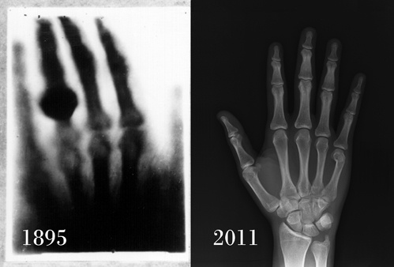
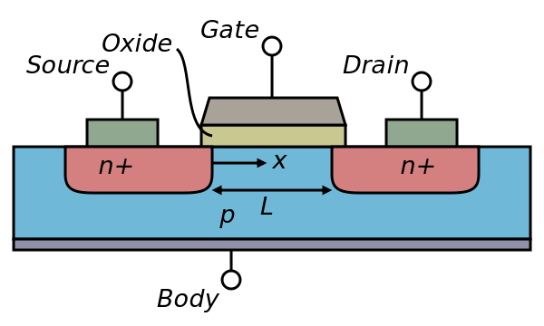
The fun in physics continues
If you are passionate about How’s and Why’s, come and study physics
Field effect transistor was invented by Lilienfeld (physicist and engineer) in 1926 and made a practical device by Shockley (physicist) in 1947 at Bell Labs.

Slide 11
Some practical matters
http://www.aps.org/careers/statistics/bsalaryfield.cfm

Slide 12
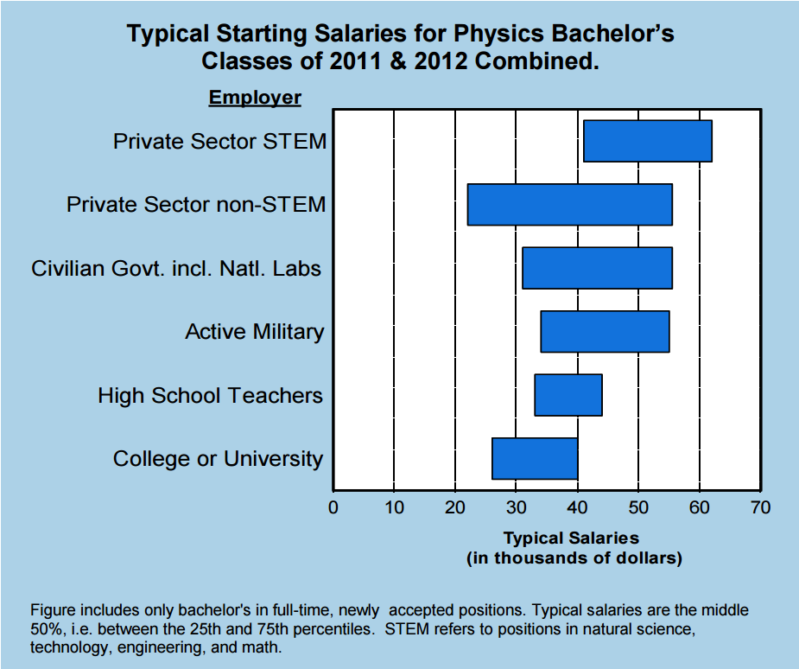
Some practical matters

Slide 13
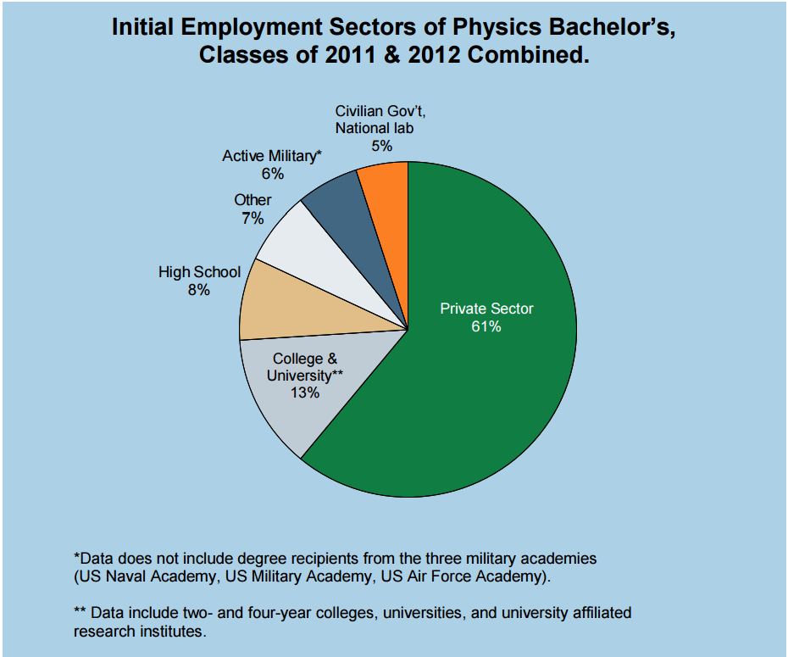
Some practical matters

