Slide 1

***STARS*** & STELLAR BINARY SYSTEMS

Slide 2
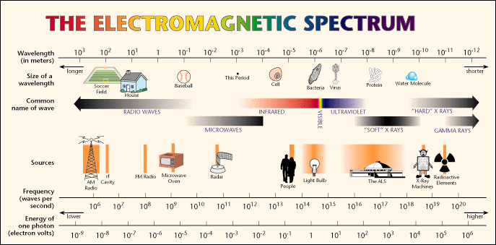
The Electromagnetic Spectrum

Slide 3



Types of Visible Spectra
Continuous Spectrum
Emission Spectrum

Slide 4
Continuous Spectra
A. Bremstrahlung radiation (“braking accel”)
http://en.wikipedia.org/wiki/Bremsstrahlung
https://video.search.yahoo.com/search/video;_ylt=A0SO81ROPOFTNmIAWPhXNyoA;_ylu=X3oDMTB0YnFsaDgwBHNlYwNzYwRjb2xvA2dxMQR2dGlkA1ZJUDIyNl8x?p=bremsstrahlung+radiation+animation

Slide 5
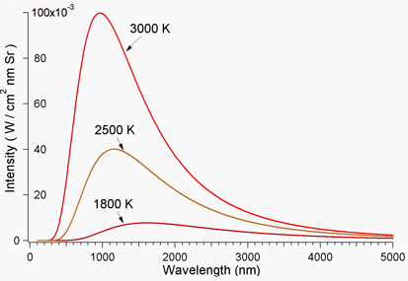
slide continued…
B. Thermal radiation (light bulbs and stars…)

Slide 6


slide continued…
Stefan-Boltzmann and Wien’s Radiation Laws
http://csep10.phys.utk.edu/astr162/lect/light/radiation.html

Slide 7
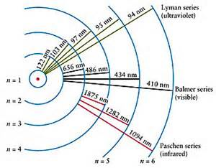
Emission Spectra
Hydrogen atom classical orbits

Slide 8
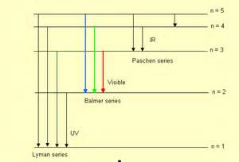
slide continued…
Hydrogen atom energy level diagram

Slide 9
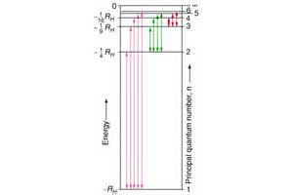
Hydrogen atom absorption

Slide 10
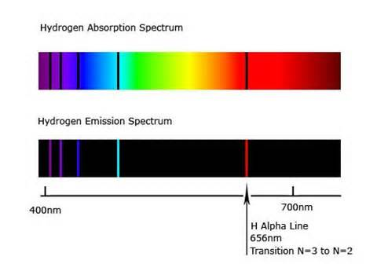
Hydrogen Atom absorption Spectrum

Slide 11
Newton’s Laws of Motion
Property of inertia
F = ma
Action-Reaction ---> F₁₂ = -F₂₁

Slide 12
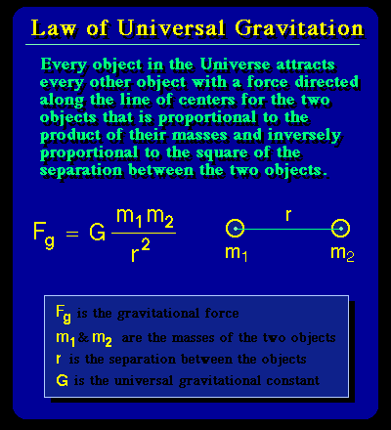
Newton’s Law of Universal Gravity

Slide 13
Kepler’s Laws of Planetary Motion
http://hyperphysics.phy-astr.gsu.edu/hbase/kepler.html

Slide 14
***STARS***
How many?
Lots of them …
The average human body has 50 trillion cells!
The Milky Way has about 400 trillion stars!
And there are perhaps 200 billion galaxies
(large and small)!!
So, how many stars? > 10²⁴ !!!
10 moles of stars --- (AWESOME)⁴

Slide 15
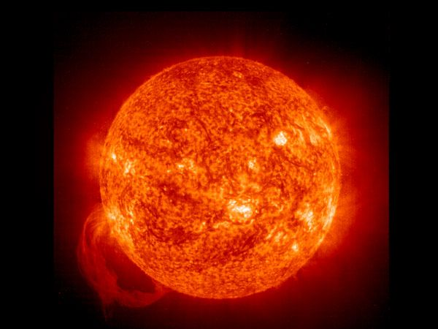
So, how do these cosmological cells do their thing
First, an average, garden-variety star: the SUN

Slide 16
The Sun
Is 1.5 x 10¹¹ m (93 x 10⁶ mi) from the earth
Has a radius of 7 x 10⁸ m (440,000 miles --- earth radius is 4000 miles)
Has a mass of 2 x 10³⁰ kg (earth is 5 x 10²⁴ kg)

Slide 17
the sun continued…
Has an effective surface temp of 5800 K
Has an intensity (power output/unit area) of
σT⁴ = 5.67 x 10⁻⁸ x (5800)⁴ = 6.42 x 10⁷ w/m²
Has a luminosity (power output in watts) of σT⁴ (4πR²) = 5.67 x 10⁻⁸ x (5800)⁴ x
3.14 x (6.98 x 10⁸)² = 3.85 x 10²⁶ watts (J/s)
Power/area reaching the earth (in 8.3 min) is
1340 w/m² at upper atm.

Slide 18
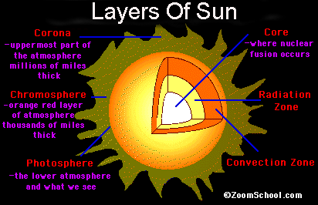
the sun continued…

Slide 19
The Core of the Sun
Energy supplied by nuclear fusion of protons
(E = mc²)
“Burns” approximately 4.3 x 10⁹ kg of protons/sec (3.85 x 10²⁶ J/s)
Temperature about 15 million Kelvin
Radius approximately 200,000 km

Slide 20
Star Brightness and the
Magnitude Scale
The apparent magnitude of a star is a measure of its brightness as seen by the eye.
The brighter the star, the lower the magnitude
Historically, apparent magnitudes ranged from 1 to 6 (with 1 being the brightest and 6 being the dimmest)
Today, the apparent magnitude scale ranges from negative values to values > 6.

Slide 21
apparent magnitudes continued…
In modern times, the scale was modified such that the brightness of a 1-magnitude star was 100 times > than that of a 6-magnitude star.
Hence, a change in magnitude of 1 (e.g., from 2 to 3) corresponds to a change in brightness of 2.516 (since 2.512⁵ = 100, where 5 = 6 – 1 is the total magnitude difference between m = 1 and m = 6)

Slide 22
apparent magnitude continued…
Examples of apparent magnitudes
Barely visible to the naked eye: 5-6th mag.
m_{Sun} = -26.7 m_{Venus} = -4.6 m_{Sirius} = -1.46
m_{Algol} = +2.09 m_{Betelgeuse} = 0.3 to 1.2

Slide 23
The Inverse-Square Law of Light
Inverse-Square Law
The brightness of a point source of light varies inversely with the square of the distance between an observer and the source of light.
That is, brightness varies as 1/r².
Hence, the brightness of a receding car’s tail lights is ¼ as great at 2 blocks down the street as when the car is 1 block down the street.

Slide 24
Absolute Magnitudes
The absolute magnitude, M, of a star is a measure of its intrinsic brightness (luminosity)
It is numerically the same that the apparent magnitude of a star would have if it were located a distance of 10 pc from the earth. (1 pc = 3.26 light years = 1.96 x 10¹³ miles)
Hence, Barnard’s star, with an apparent magnitude of m = 9 (at a distance of about 6 LY) has an absolute magnitude of M = 13.2.
Absolute magnitudes allow true comparison of star brightnesses

Slide 25
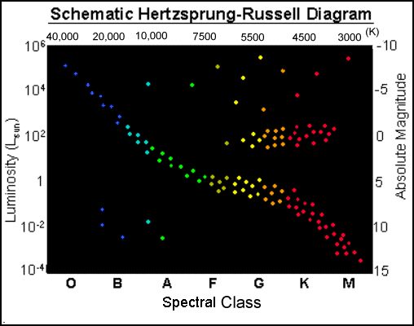
Stellar Classification and the
Hertzsprung Diagram

Slide 26
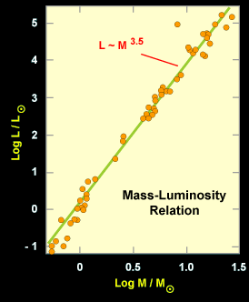
Mass-Luminosity Diagram

Slide 27
Variable Stars
Intrinsically varying stars are those whose magnitudes change periodically; they are known as pulsators since their brightness pulsates (both size and temp of the star varies)
Cepheid variables, discovered by Henrietta Leavett, are among the most valuable classes of variable stars.

Slide 28
Cepheids continued…
Yellow supergiant stars with F6 – K2 classification
Mass range: 4M_{Sun} to 20 M_{Sun}
Luminosity: up to 10⁵ L_{Sun}
Radii change by up to 25% during pulsations
(for longer periods)

Slide 29
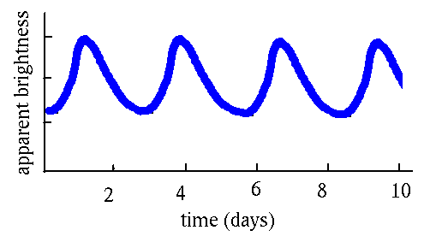
Cepheid variables continued…
Cepheid variable LIGHT CURVE

Slide 30
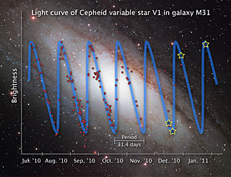
Cepheids continued…
Light curve for Cepheid star V1 in Galaxy M31

Slide 31
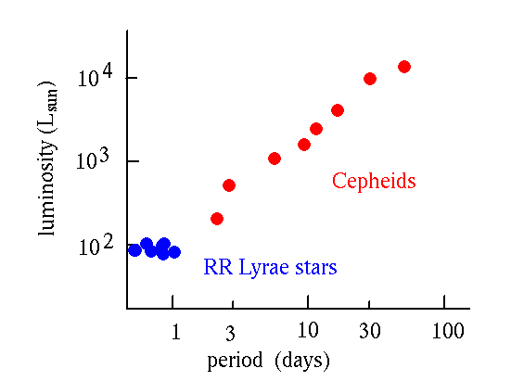
Period-Luminosity Relation for
Cepheid Variables

Slide 32
Cepheids as Standard Candles
Due to the precise relation between the luminosity and period of Cepheid variables, they can be used to determine distances in space.
Based on the apparent magnitude of an observed Cepheid, the relation between apparent and absolute magnitudes can be used to calculate the distance to the variable.

Slide 33
Distance calculations…
Formula for calculating distance d to a Cepheid based on direct measurement of its apparent magnitude m and determination of its absolution magnitude M from its period-luminosity relation.
m – M = 5 Log(d) -5

Slide 34
Extrinsic Variable Stars
Eclipsing Binary Stars
http://astro.unl.edu/naap/ebs/animations/ebs.html
http://www.astro.cornell.edu/academics/courses/astro201/roche_lobe.htm

