Slide 1
QuarkNet 2015 Summer Research at SMU
Emily Baker, Austin Farwell, Harrison Foster, Xiaohan Gao, Benjamin Gruber, Erica Jones, Dennis Vu, Sonya Xu

Slide 2
Parallel Plate Capacitors
C = ε₀ A / d
Goal:
Empirically verify Gauss’ Law through analyzing parallel plate capacitors
Notes:
Goal: Empirically verify a Gauss's mathematical description of electric field.
How: The formula above is a well-known description of capacitance for parallel plate capacitors.
And: It is directly derived from Gauss’s Law.
So: If we prove it, we prove Gauss’s Law (2 for 1).

Slide 3
Instrument
Can adjust down to 10 μm
Width of a human hair is about 15 μm
Notes:
Our goal is possible with this instrument, made by Professor Ye.
It is very accurate (increments less than the width of a human hair).

Slide 4
Adjustments
These effects can greatly alter capacitance:
Body capacitance
Edge effects
Tilt effects
C = ε₀ A / d
Notes:
However: The previous formula is not realistic with unreal assumptions.
Including: Infinite plate area and zero plate width.
Meaning: We need to make adjustments.
Body capacitance, edge effects, and tilt effects can all alter capacitance of the instrument.
These will be detailed in the next few slides.

Slide 5
Body Capacitance
Sources of body capacitance:
Probes
Plates
Frame
Accounts for a small error
Found by separating the plates by a very large distance
C = ε₀A / d
Notes:
By the formula, we can tell that capacitance shrinks as distance between the plates increases.
So: As distance grows to infinity, capacitance should become zero right?
But: Body capacitance gives the plates a non-zero capacitance, even at an infinite separation.
Why: Because the plates are not infinitely thin, as the formula assumes, charge can collect on the sides, storing extra charge, as well as other metal objects around the capacitor, such as the probes storing even more charge
This only accounts for a small percentage of error, but it is not negligible.
We can find this extra capacitance by separating the plates by a large distance, and then measuring this extra capacitance

Slide 6
Edge Effects
Charge collects more around the edges
Approximated using a formula for disk capacitors
Increases capacitance by a multiplier of α
α = 1 + 2.367b^{0.867}
Notes:
Another assumption that is not valid in the real world is an infinite plate area.
In reality the plates have edges.
So: Charge is not evenly distributed on the plates and more charge collects on the edges than the center
This causes the electric field on the outside of the plates to fringe, escaping the gap between the plates
This escaped field lowers the required voltage to store the same amount of charge.
Therefore: Increasing the total capacitance as well as the body capacitance.
This can be quite large as the plate separation become large.
We approximated the edge effects of our capacitor by using a multiplier, shown in the equation on the screen.
This was taken from another paper trying to calculate edge effects using a mathematical model.

Slide 7
Tilt Effects
Ideal
Real
Notes:
The formula for tilt effects can be derived in the same way that the original capacitance formula was, only with a little more calculus.
This effect is different from the previous two in that is decreases capacitance, rather than increasing it.
How: It does this by increasing the average plate separation by a small amount.
Unlike edge effects, this grows as plate separation becomes very small.

Slide 8
Total Correction
Tilt effects are large at short distances, but small at long distances
Edge effects are small at short distances, but large at long distances
Notes:
This is the final equation, accounting for all of the previously mentioned effects.

Slide 9
Notes:
This graph shows the percentage of error between our calculated values, and collected data.
As you can see, before we made corrections, the error was over 15% off and growing.
But: After we applied the corrections to the formula, the differences fell to less than 3% and held fairly constant.
This now shows that the data fits to the equation, verifying the inverse relationship of capacitance to distance.

Slide 10
C ∝ A
Goal:
Confirm that capacitance is directly proportional to area like in the theoretical formula
C = ε₀ A / d
The plates were kept at a distance as to minimize edge and tilt effects
Overlapping area was adjusted
Notes:
The second piece to verifying the Gauss’s Law was proving that capacitance was directly proportional to overlapping area.
This was completed by simply changing the overlapping area between the plates and seeing if the data was linear.
As you can see, the data is extremely linear without any complicated corrections.
Now that we have proven the relationships of both area and distance, the capacitance formula is verified….
Proving Gauss’s Law!

Slide 11
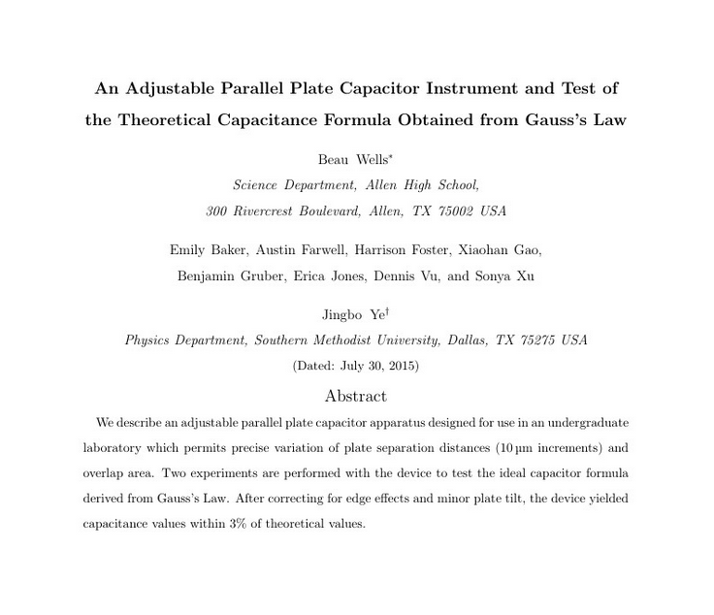
Notes:
This brings the capacitance experiment to an end.
Here is a look at the cover of our paper over the subject that we have submitted to the American Journal of Physics.
It is currently under review and we hope to hear from them soon.
Up next is Austin to talk about another capacitance lab that sets out to test Coulomb’s Law.

Slide 12
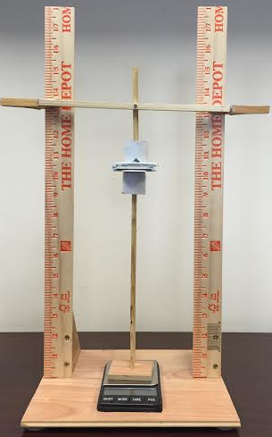
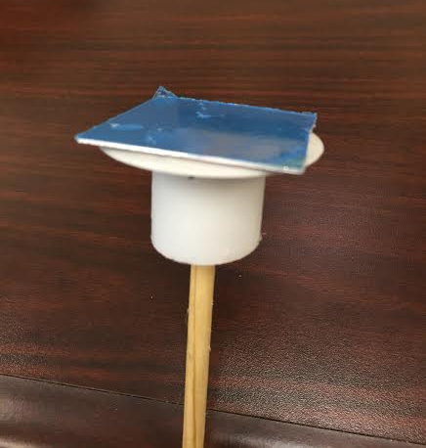
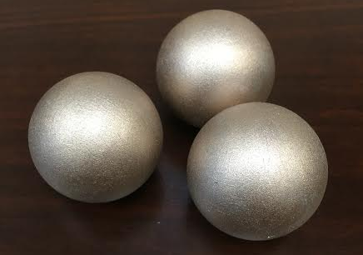
Coulomb's Law Apparatus

Slide 13
Detecting Cosmic Rays
Goals:
Get the multi-wire chamber circuit board in working condition
Measure and analyze cosmic ray trajectories with angle dependency

Slide 14
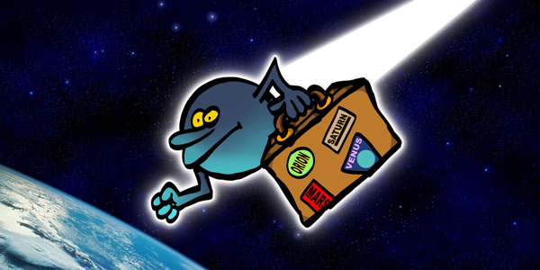
“We are travelers on a cosmic journey…”

Slide 15
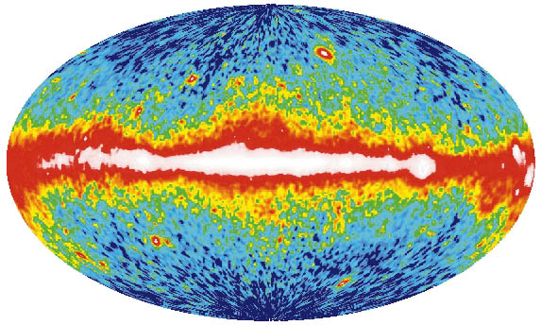
What’s a Cosmic Ray?
High energy particle
(usually a proton)
Arrives from distant galactic events
Collisions similar to those in the LHC
Moves at relativistic speeds
Notes:
Many of you probably are already familiar with cosmic rays, but I will give a brief introduction for those of you who are not.
Cosmic rays are highly energetic particles coming from space, and the bulk of them are protons.
These particles come from distant galactic events, events that are somewhat still unknown.
In the same way that the Large Hadron Collider slams protons together, these cosmic rays slam into the atmosphere and decay into all sorts of particles.
Many of these new particles have extremely short lifetimes
However: Because these cosmic rays are moving at relativistic speeds, time dilation allows them to reach the surface before decaying.

Slide 16
Notes:
Here is quick diagram of the decay process.
The proton turns into pions (the particles denoted by the symbol π), which rapidly decay into muons (denoted by μ).
These muons are what we detect in our chamber, as the electrons are not able to penetrate the chamber barrier.

Slide 17
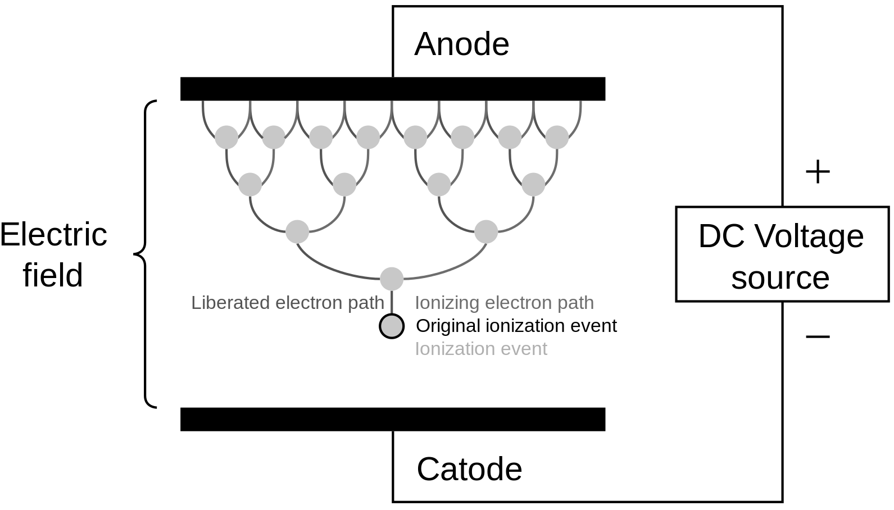
What’s Happening?
Muons ionize gaseous atoms
This ejects electrons at high energies creating...
An electron avalanche
Notes:
Muons slam into atoms of mostly argon with some other gases such as isobutane etc. Emphasis on plural electrons ejected

Slide 18
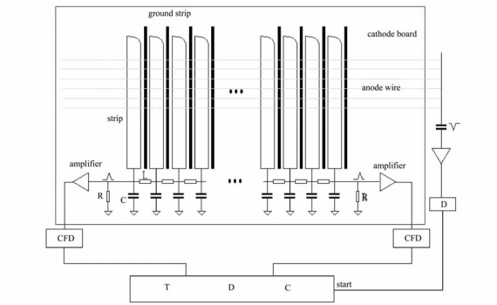
Circuit Board
27 cathode strips
Gives x or y coordinate
27 anode wires
Delay line

Slide 19
Delay Line
A sequence of inductors and capacitors
XY positions of the cosmic ray particle can be traced back knowing the time shift
Shortest time
Longest time
Vout
GND

Slide 20
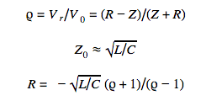
Reflections
Problem:
Reflected voltage can alter the signals
Solution:
PCB internal resistance ≈ Resistance before amplifiers
Notes:
The flow of electrons inside a circuit is very much like a wave.
When waves hit a new medium part of them passes straight through, but some of the wave is reflected backwards.
This same principle can be applied to the flow of electrons,
But: Instead of a new medium, the electrons hit a different resistance.
The entire printed circuit board has an internal resistance, but that resistance is different than inside the amplifier.
So: When the electrons move into the amplifier, if the resistance is not made the same, voltage will be reflected back.
The solution to this problem is simple, make the resistance in the amplifiers the same as the circuit board.

Slide 21
Multi-Wire Chamber
There are two multi-wire units
Each unit has two circuit boards separated by anode wires
Positions from two boards gives a trajectory...

Slide 22
Multi-Wire Chamber
θ

Slide 23
Limitations
Anode wires at the ends too small
Electric Field too great at the ends
The PCB too sensitive at the ends
Data collected was not useful
Notes:
The original design called for slightly thicker wires on the edges of the chamber to even the electric field.
However: Ours used wires that were the same thickness throughout.
So: The electric field was too large at the ends, making the extremities far too sensitive.
Meaning: Our data was not useful.
While the experiment did not work out, as often happens in science, it was a tremendous learning experience.
Up next is Emily and Sonya to talk about testing transistors and exposing them to high amounts of radiation.

Slide 24
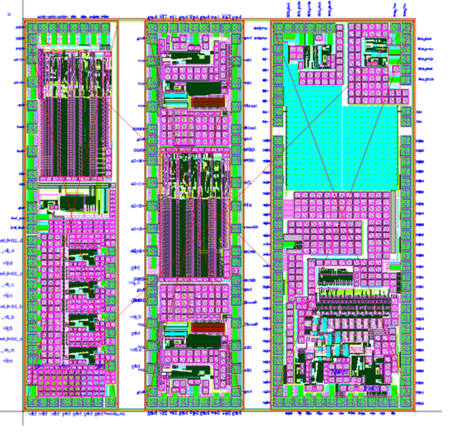
Testing Transistors
Goal:
Analyze transistors before and after exposure to x-ray radiation
Support research for the ATLAS Liquid Argon Calorimeter

Slide 25
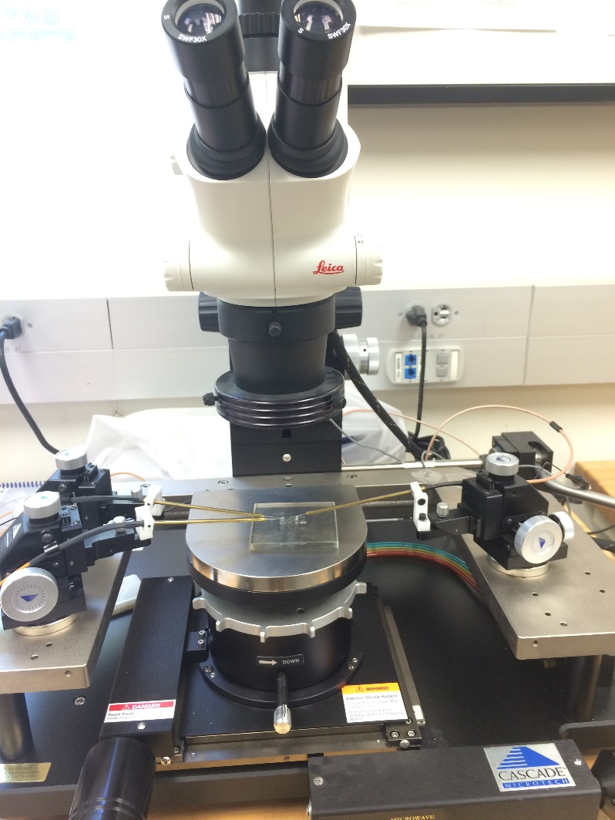
Limitations
Small size
3 x 3 mm chips
80 x 80 μm transistor pads
Probes
Too large
Scratches
Sensitive instrument
Limited depth perception
Notes:
Like any experiment, there were several limitations to our process. explain process For example, the size of our chips were only 3 by 3 mm in size and the transitor which we tested was even smaller at 80 by 80 micrometers. The probes we used were also extremely large relative to the transistor size//bending probes. There was three directions you could move the probes and the up and down caused the transistors to scratch really easily. The instrument was also extremely sensitive and the slightest movement of the apparatus or table could change the current readings. Finally there was very limited depth perception.

Slide 26
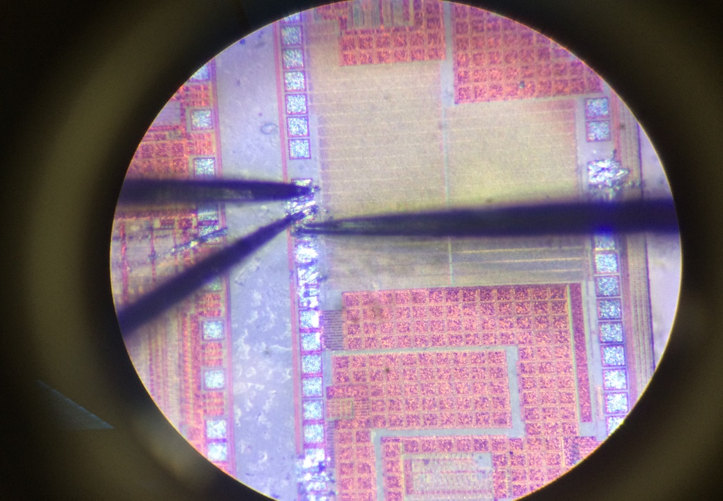
Drain
Source
Gate
Three tungsten probes were matched to their respective drain, gate, and source pads.

Slide 27
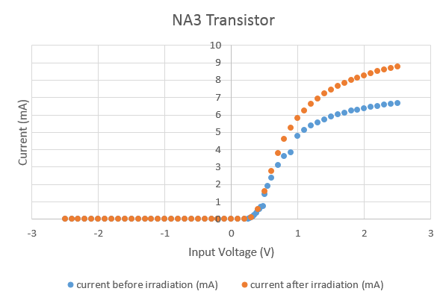
Data Before/After Radiation
The Chip Survived!
Notes:
This is data for our NA3 transistor. We saw how current varied as we changed the input voltage. The blue dots are the currents before radiation and the orange dots are the currents after radiation. It was expected that the graph shift right however and take more voltage to reach a certain current but the performance atually increased which can be attributed to the various measurement errors that we previously mentioned. However, this still means that the chip survived the radiation.
explain linear then plateaus
after radiantion
overcomes threshold

Slide 28
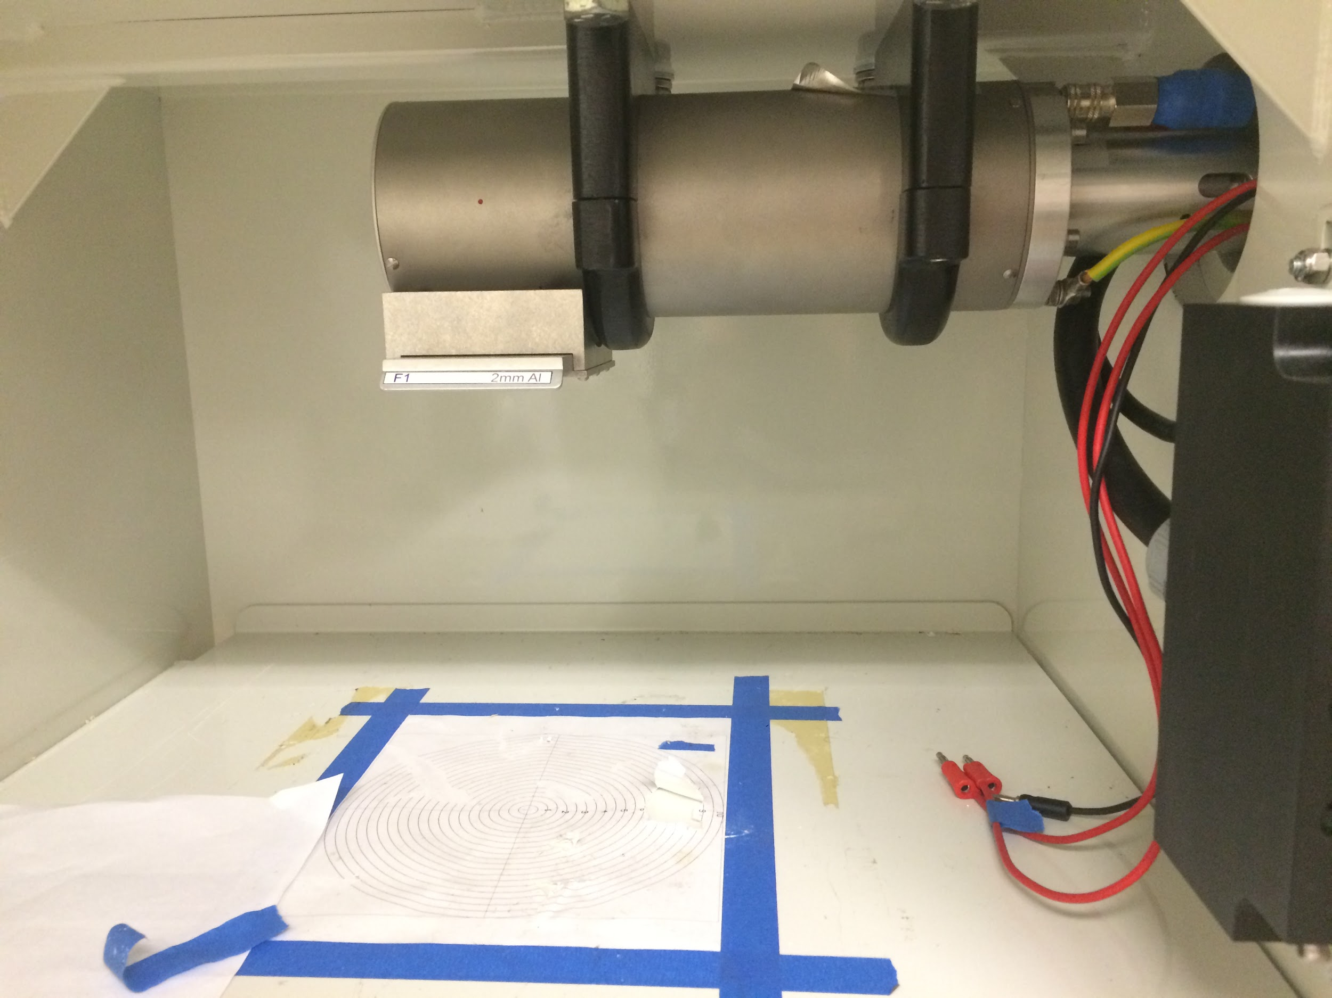
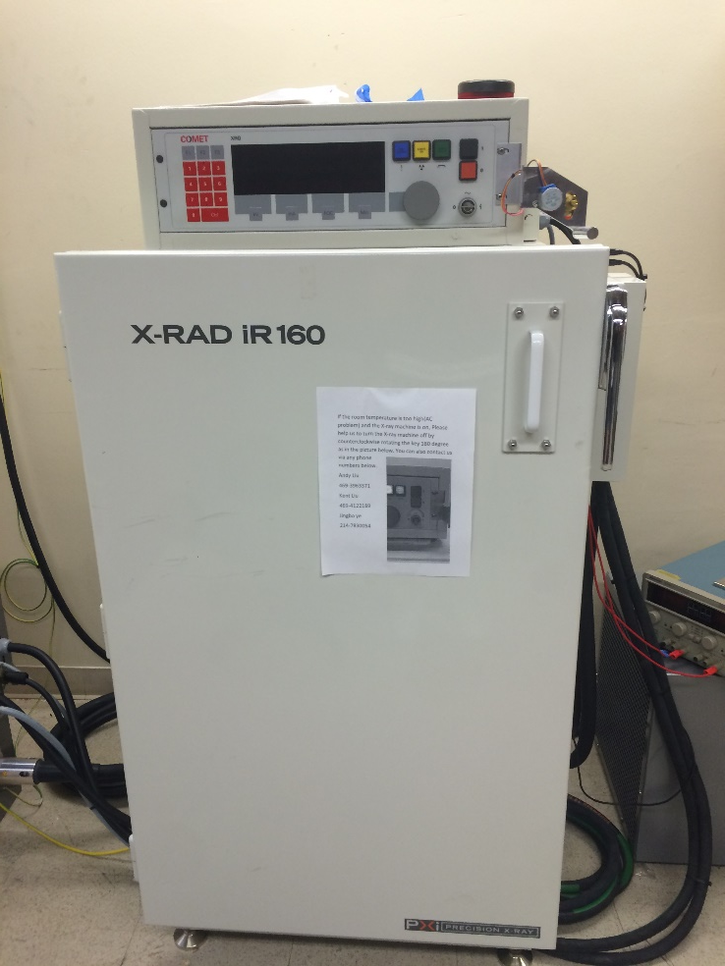
Irradiating the Chips
The chips are exposed to 100 times the lethal dose of radiation at 100,000 Rads for six minutes.

Slide 29
Robotic Arm Project
Goal:
Assemble a robotic arm which can test chips
Create a program to autonomously run the robotic arm
Notes:
SMU is designing chips for high luminosity LHC and our task is to assemble a robotic arm to test the error in these chips and create a program to run the arm

Slide 30
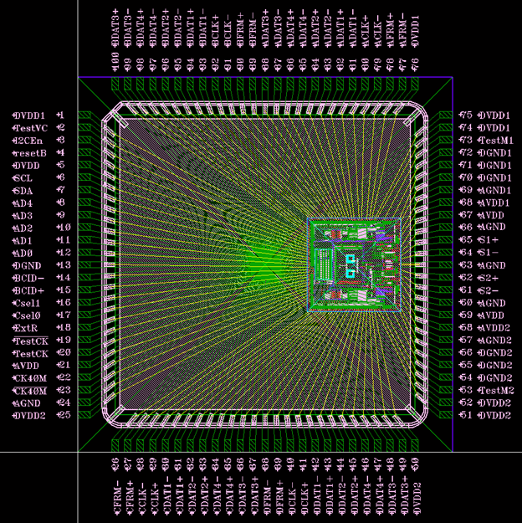
Mission
10,000 chips need to be tested
Error < 1 in a trillion bits
Inside of the LOCx2 chip
Notes:
there are 10,000 chips that need to be tested so it isnt practical to do them by hand
the error has to be less than 1 bit per 1 trillion bits for the chip to pass the test

Slide 31
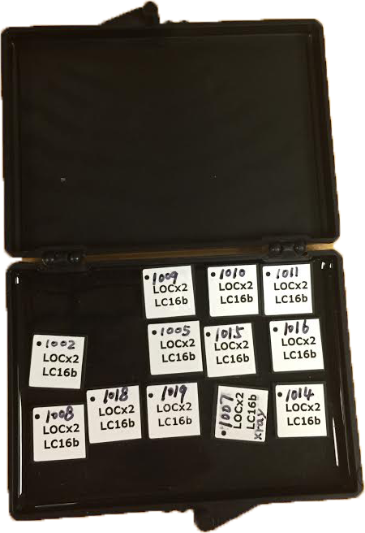
LOCx2 Chip
High Luminosity-Large Hadron Collider
ATLAS Liquid Argon Calorimeter
Data transmission
Components of the LOCx2
Serializer
Encoder
Notes:
called link on chip x2
as i mentioned before these are going into the hl lhc and more specifically the atlas calorimeter and used for data transmission
for every 1 collision now, you will have 10 so you need a lot of chips and they
factor of 10 luminosity increases which means they will have 10 times more collisions

Slide 32
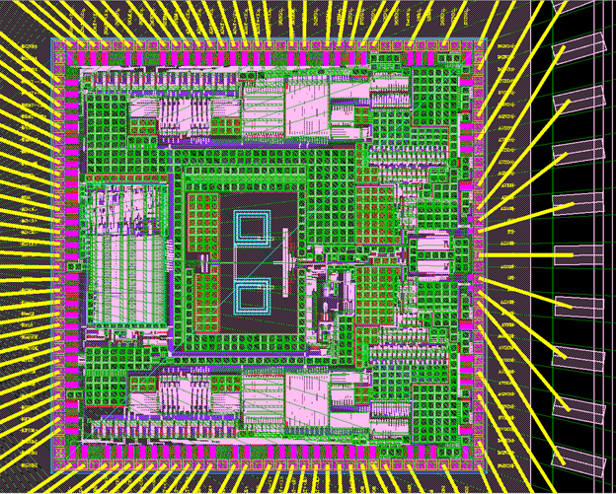
Die Schematic
Serializer
Encoder
Encoder
Serializer
Notes:
encodes the data and ultimately an optical signal is sent
encoder limits consecutive digits and maintains the dc serial data
serializer multiplexes

Slide 33
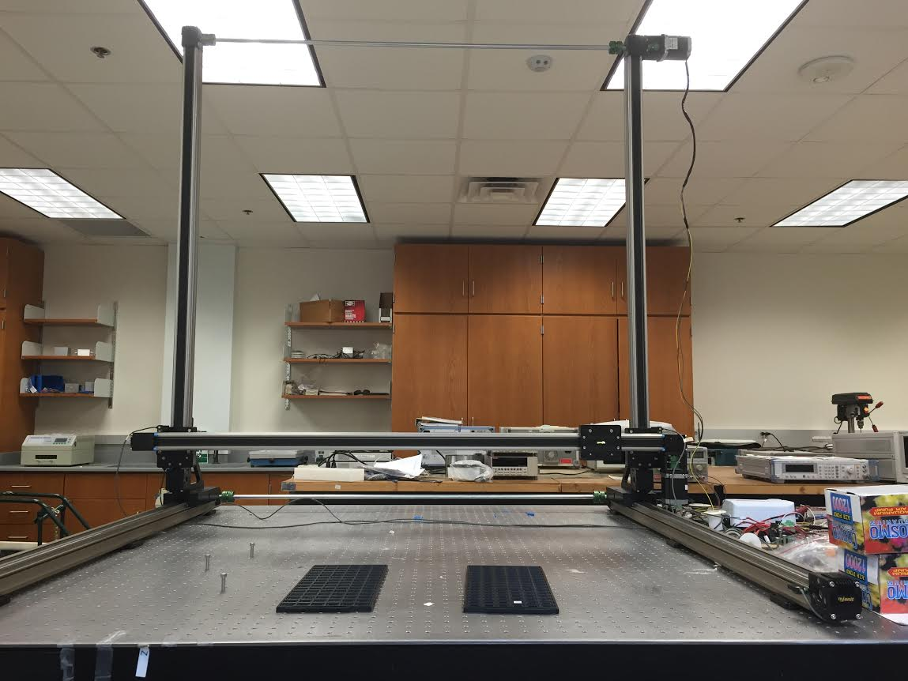
Setup
Motor
Motor
Sensor
Sensor
Sensor
Motor
Sensor
Sensor
Testing Boards
Notes:
3 motors. 5 sensors shut off motors when too close
directions arm move//show the arm and explain vacuum pen
lots of chips to test // 3 piles
lots of chps, area of testing good and bad so we need to
automate the process using this robotic arm
go to location, move it to testing area and sort them out for chips that fiail and chips that fail

Slide 34
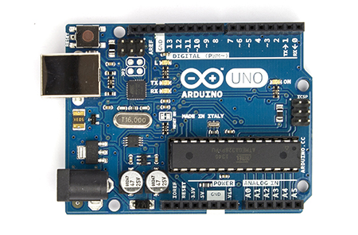
Communication Setup
Motors
Drivers
Microcontroller
Serial/USB

Slide 35
Communication
Arduino
Interface between computer and arm
LabView
Conducts tests on chips

Slide 36
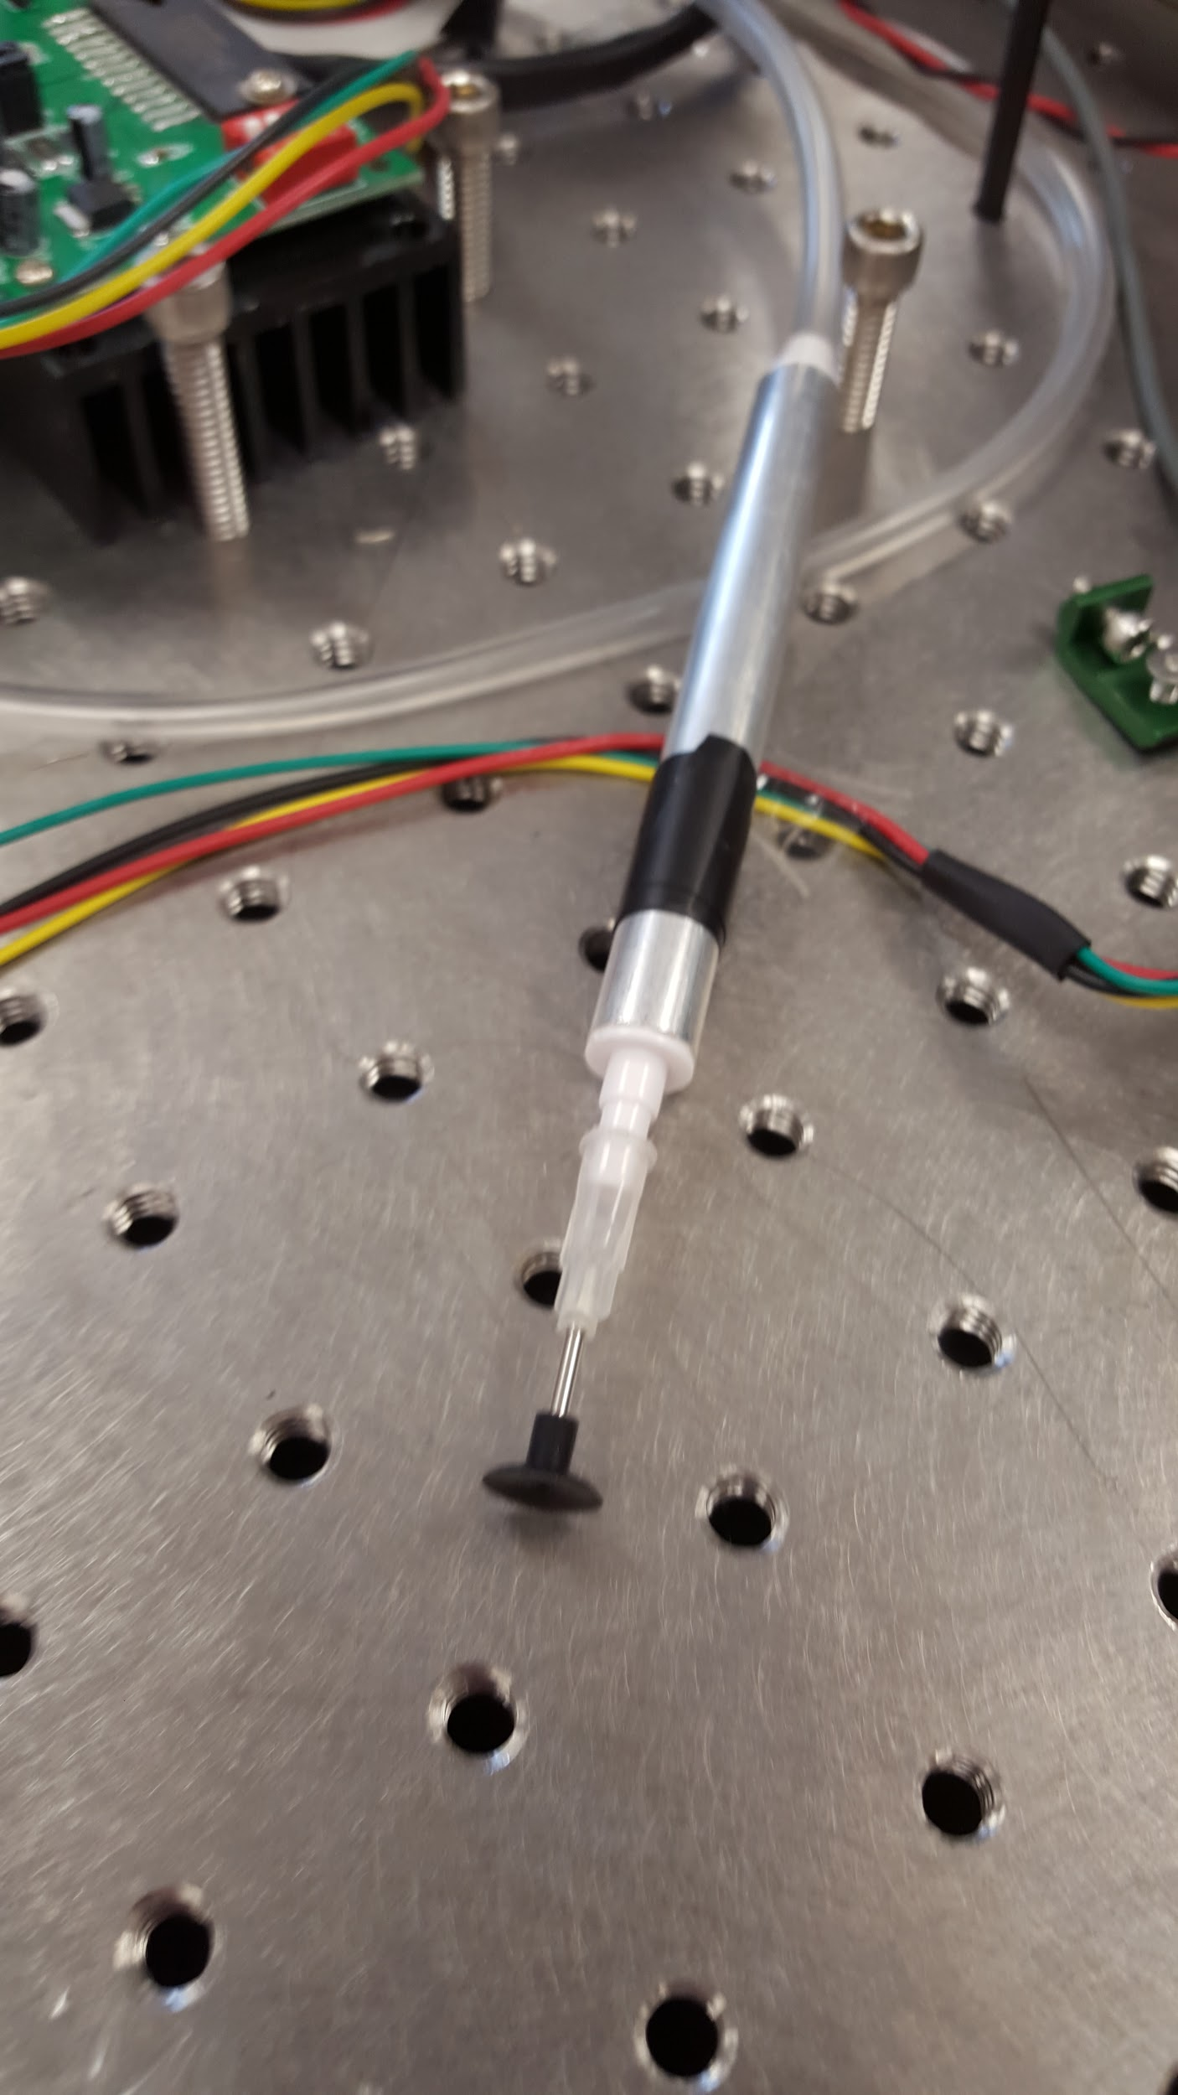
Vacuum Pump
Assembling vacuum pump
Relay
Connecting to Arduino
Notes:
A program was created to send a pulse to a relay which turns off and on the vacuum pen.

Slide 37
Challenges
Arm too heavy to be supported by the motor
Counterbalance
Torsion Spring
Tape Measure Spring

Slide 38
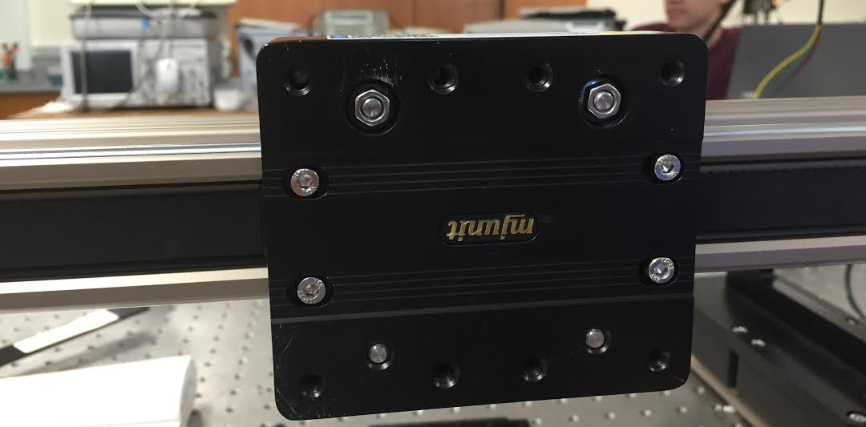
Where are we now?
What’s Next?
What have we accomplished?
Arm movement
Sensors
Vacuum pen
What must be done?
Attach the vacuum pen to the arm
Install spring
Master program
Notes:
move chips to test board tell labview to conduct the test move chips to bins based on if they work

