Slide 1
NUCLEAR PHYSICS or
UNCLEAR PHYSICS
Or
What will they try next?

Slide 2
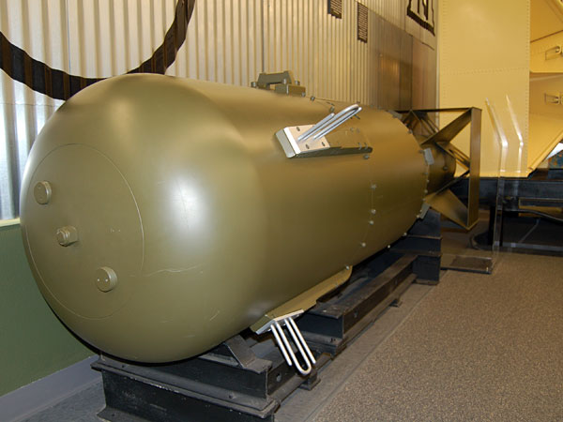
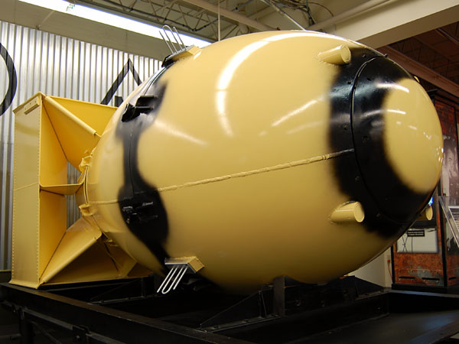
LITTLE BOY
Weight 9,700 pounds
Length 10 feet
Diameter 28 inches
URANIUM-235 140lbs
Yield 15kt
FAT MAN
Weight 10,300 pounds
Length 10 feet 8 inches Diameter 60 inches
Plutonium 14 lbs
Yield 21kt

Slide 3
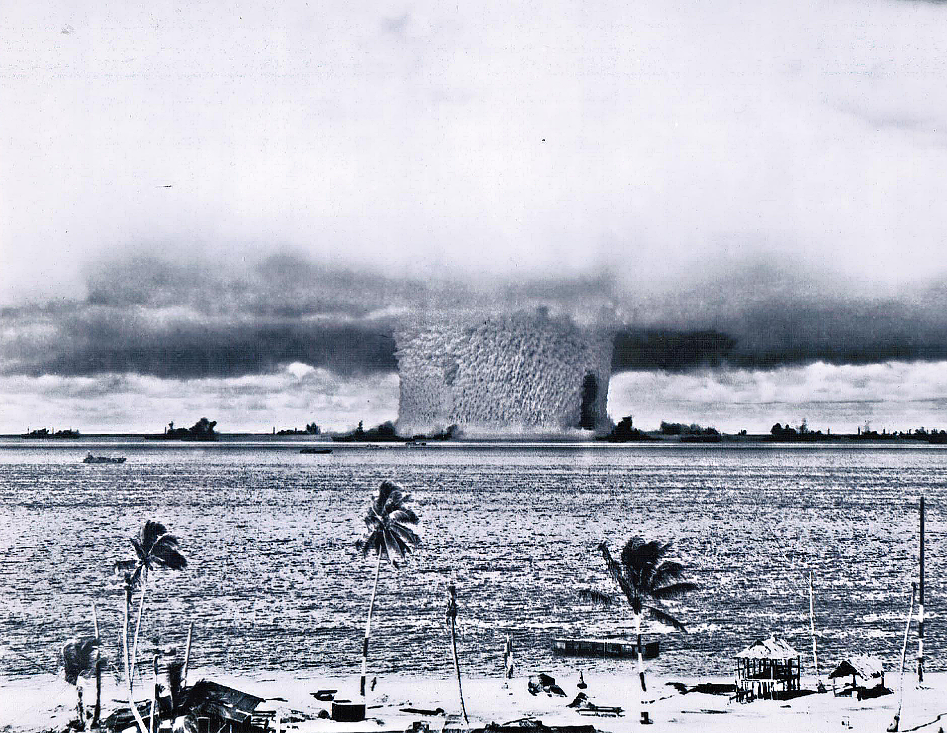
XX71 Baker test Bikini Atoll 7/24/1946 using WWII surplus war ships

Slide 4
Another view of Baker. 21kt Fat Man. Air drop, detonated 90 feet under water, 95 war ships, worst nuclear disaster, Bikini atoll still uninhabitable, only 9 ships could be salvaged because of contamination.

Slide 5
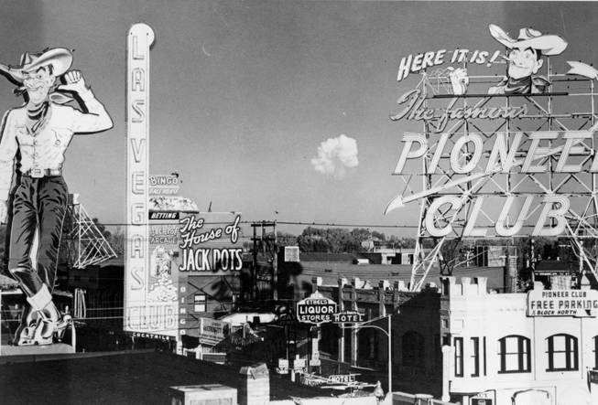
Vegas Vic This is the famous 1951 photo of a distant mushroom cloud as seen from downtown behind the "Vegas Vic" cowboy sign in Las Vegas, Nevada. Many GIs, Reporters and Spectators viewed the atomic explosions at the Nevada Test Site's observation area, a place known as News Nob, the intensity of the white flash and rapidly changing light baffled persons who viewed the blasts, they were in awe and had to look away to avoid eye damage. The explosions that they witnessed was potent enough to break windows in Las Vegas, 75 miles distant.

Slide 6
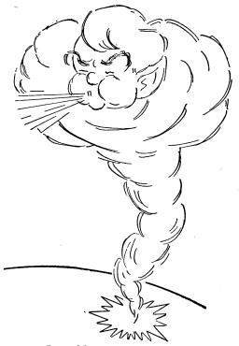
The Phenomenon of Blast
Waves propagated through the troposphere (up to 6 miles high) cause sharp cracks and bangs in the nearby
site region. Off-site damage to buildings or windows within 100 miles has resulted only from waves in the troposphere. The strength of waves hitting in the nearby region depends on temperature and wind structure of the atmosphere, on shot altitude, and on yield. Shot altitude and weather dictate where the shock will strike. Wind direction causes directional variation in blast. If the weather creates a sharp focus in the atmosphere, blast intensity at a particular point may be severe.
Inasmuch as there is a possibility of jarring blast, which can break windows, on any Nevada shot, the effect should be anticipated for every shot and precautions taken throughout the nearby region.

Slide 7
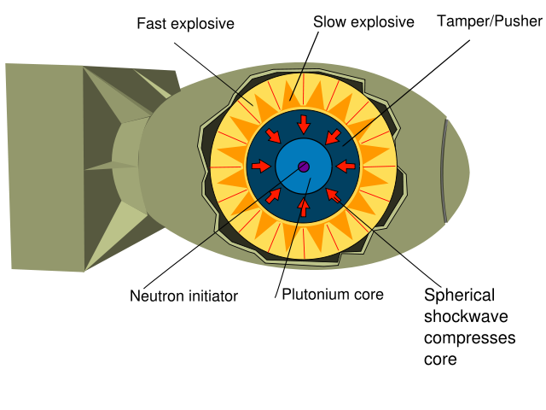
Typical implosion type fission bomb

Slide 8
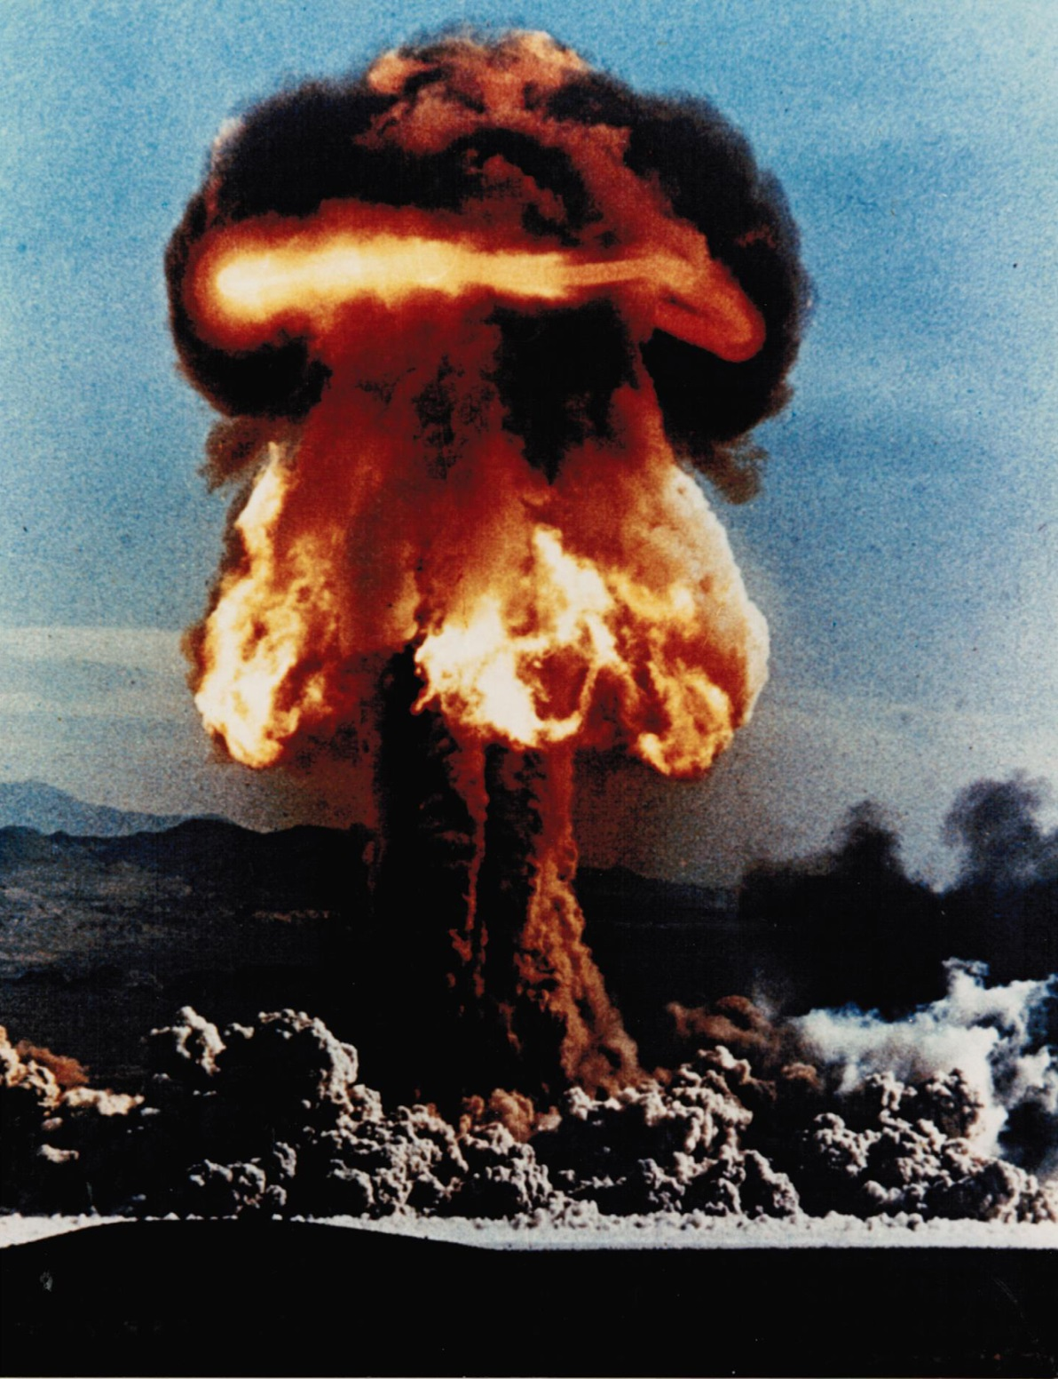
This is an image of the Grable shot fired on May 25, 1953 at the Nevada Test Site.
It was fired from a 280mm cannon for a distance of 7 ½ miles down range. It had a yield of 15 kt, the same as the first atomic bomb dropped on Japan. This was the only time a nuclear artillery shell was ever fired.
1st bomb weighed 10,000 pounds, was 10 feet long and 60 inches in diameter.
This weapon was shot from a cannon with an 11 inch bore.

Slide 9
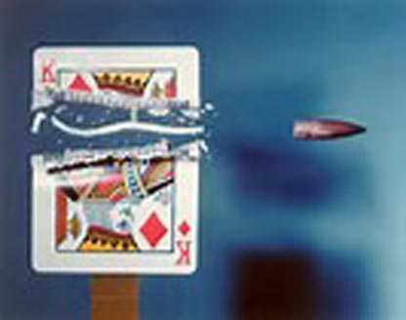
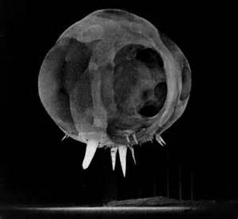
Dr. Edgerton of MIT developed high speed photography, these photos show a bullet passing through a playing card and below, the first fraction of a second of a atomic bomb exploding atop a 500 foot tower in the Nevada desert.
The three MIT professors, Dr. Edgerton, Dr Germeshausen and Dr. Grier were part of the Manhattan project. They formed a company known as EG&G. One of the most powerful company's in atomic testing.
This is who I worked for at the Nevada Test Site from 1957 to 1968

Slide 10
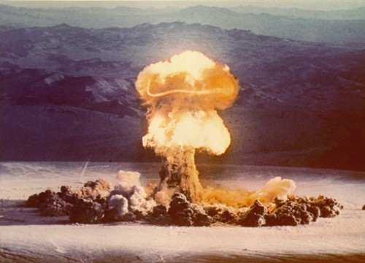
Priscilla, one of the most powerful of the bombs detonated on Frenchman Flat, (37kt),. It was tethered from a 1500 foot high balloon and was designed to test the effects of a nuclear explosion on construction. The military placed a handful of structures downrange from ground zero, including several buildings, bomb shelters, and even a bank vault built by the Mosler Safe Co.
The blast loosened the trim on the 10-inch-thick safe door and peeled away the steel reinforcing bar from the vault. The explosive force collapsed 6-inch-thick concrete domes, flattened aluminum fallout shelters, and displaced the wall of a windowless brick structure facing ground zero.

Slide 11
Priscilla was the first A bomb I witnessed from within the test site. I was approximately 7 miles from the detonation at a microwave site just up the hill from the control point. I had just completed installing the RCAX microwave repeater and a Linkert carrier system. It was about 6 in the morning on a clear Spring morning, late in June of 1957. I was sitting on the roof of the 8 by 8 foot plywood shack that housed the equipment. I had my arm around the 3” diameter steel pole that held up the antenna dish and with high density goggles, I was facing ground zero. A voice came over the PA system, detonation will occur in 2 minutes, observers with high density goggles put the on and face away from ground zero. The announcement continued, H minus 1 minuet and counting …… 10,9,8,7,6,5,4,3,2,1 . I could feel the heat from the blast, the air being suck away and returning with a gust. As I lifted the goggles I could see the desert floor rippling towards me like the wave from a pebble in a pond. Then it hit, with such a force that it knocked me from the roof and I slid down the pole I was holding on to. The stem of the mushroom cloud was sucking dirt from the dry lake bed and feeding the cap. The cap was red and orange with a yellow belt around it. The top of the cloud was starting to see the morning sun rays as they came from behind the mountain range. Tint ice crystals were forming on the top od the cloud as it climbed into the cold spring air. As the ice crystal sparkled like tiny diamonds, the air around the cloud was glowing blue from the ionizing air surrounding it. It was beautiful and frightening at the same time.

Slide 12
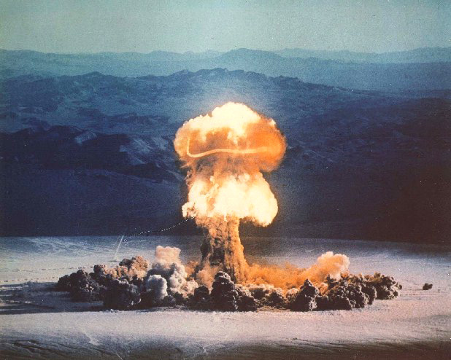

Slide 13
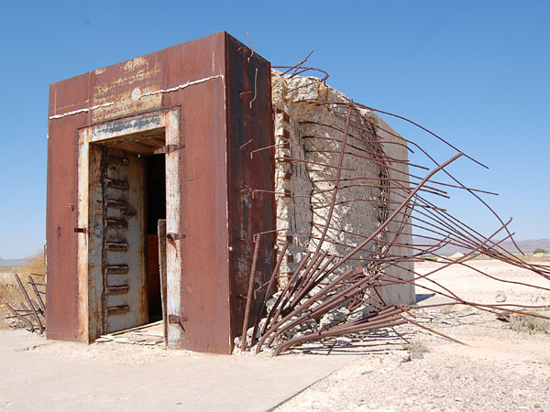
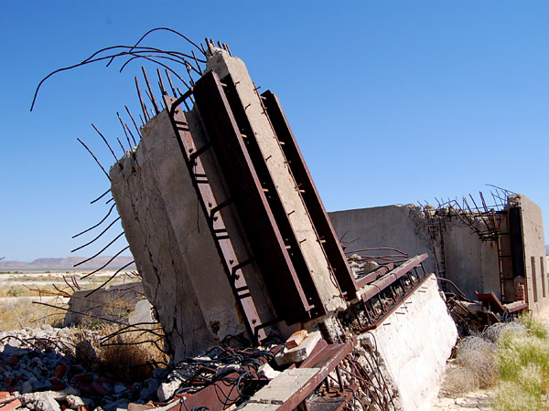
This was the bank vault.
This was a railroad trestle.
What is even harder for me to understand, is that troops were in trenches 1 mile from ground zero.
After the blast they were directed to climb out of the trench and advance toward ground zero. The wind was blowing the cloud away from them, but still.

Slide 14
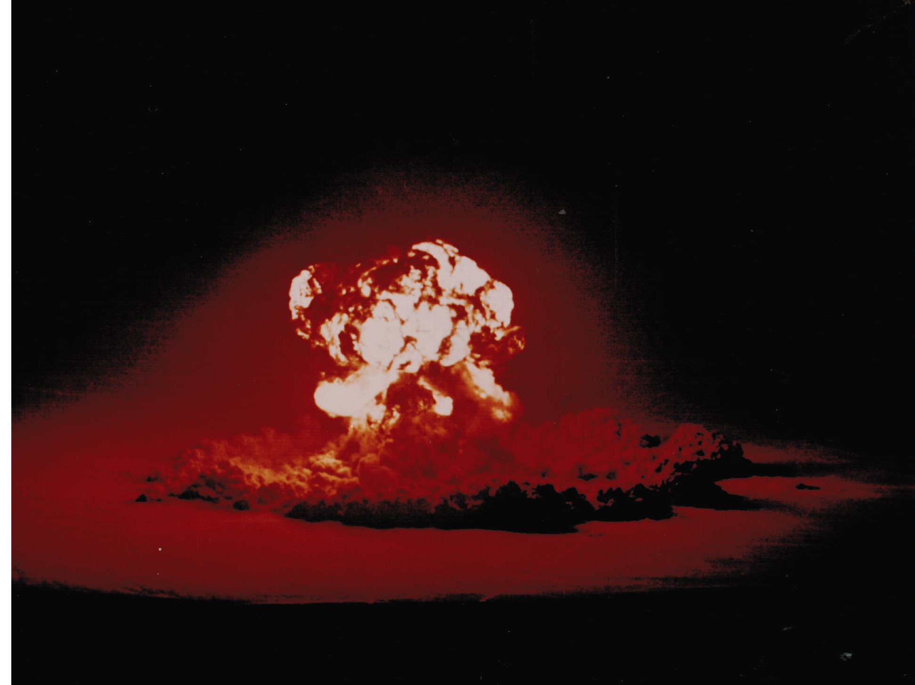
XX-40 BOLTZMANN 12kt, 300 foot tower

Slide 15
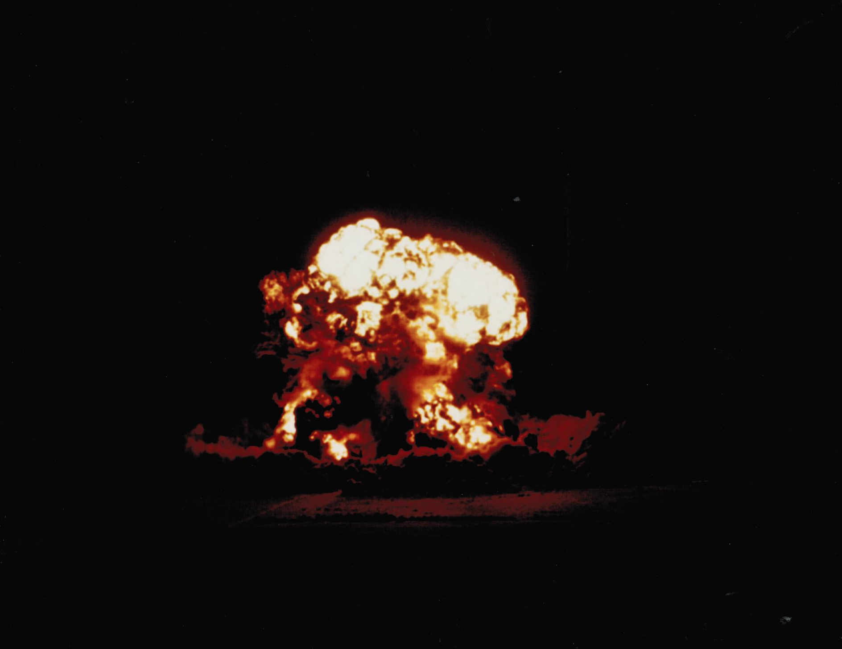
XX-15 DIABLO 17kt, 500 foot tower

Slide 16
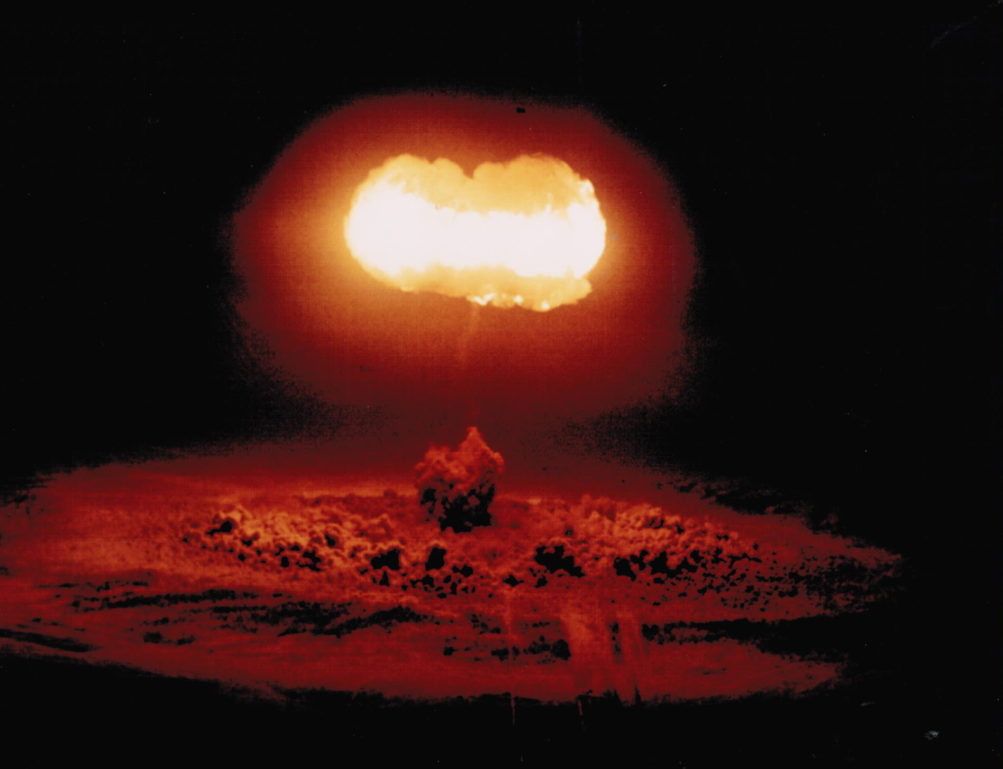
XX-1 STOKES 19kt, 1500 foot balloon shot

Slide 17
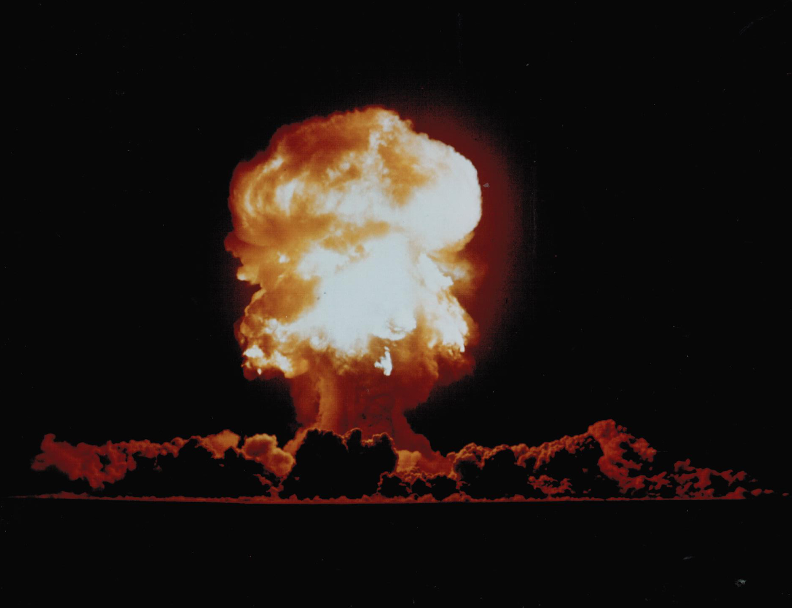
XX-14 FIZEAU 11kt, 300 foot tower

Slide 18
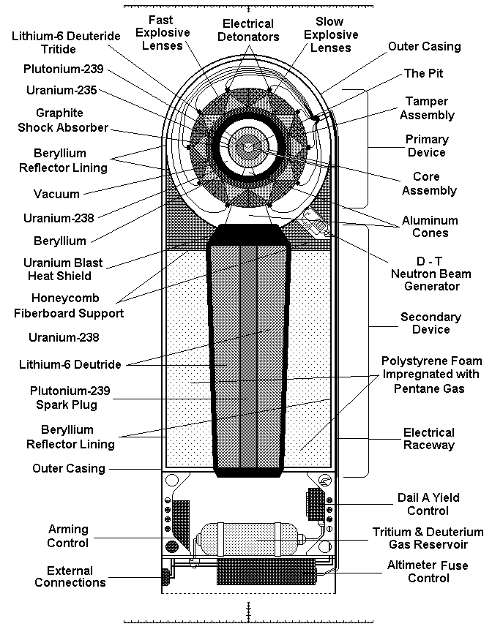
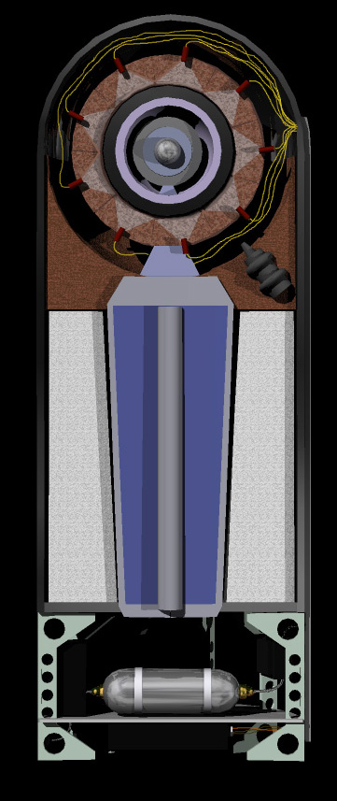
https://www.youtube.com/watch?v=h7vyKDcSTaE
Hydrogen Bomb, Thermo-nuclear fusion device

Slide 19
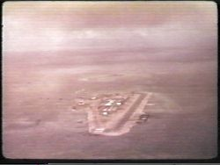
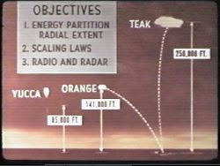
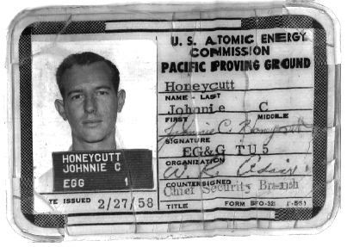
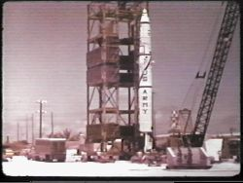
I was assigned to go to Johnston Island July of 1958
Actual declassified data shows that Teak went to an altitude of 77-km (48 miles, 250,000 feet) it had a yield of 3.8 megatons. Orange went to an altitude of 43 km (27 miles, 141,000 feet). Its yield was also 3.8 megatons.
To get a perspective as to how much 3.8 megatons of TNT is, lets first assume one cubic foot of TNT weighs about 38 pounds. 3.8 million tons equals 7.6 billion pounds of TNT. Divide this by 38 and it equals 200 million cubic feet of TNT. Stacked up on a football field 150 feet wide by 300 feet long the pile of TNT would be 7/8 of a mile (4,504 feet) high

Slide 20
I witnessed a barrage of rockets fly skyward as the Redstone missile lifted off. They formed a criss-cross pattern of white smoke trails across the sky like a giant checkerboard. Hundreds of cameras were aimed at the point in space where the missile was programmed to go. When the H-bomb was detonated, the shock wave from the blast was visible as it distorted and displaced the gridwork of smoky trails. Such a large hole was punched through the protective ionosphere that cosmic radiation from space spilled through the rip and disrupted communications for many hours. I recall that much of the Honolulu phone system went down because of the electro-magnetic pulse effect. Even airplanes were unable to talk to the Control Tower in Honolulu for a while.
I guess, all in all, the tests were successful. The birds on Sand Island survived, the rabbits were blinded, and the cosmic radiation disrupted local communications for hours after the tests. James Gibson, author of The History of the US Nuclear Arsenal, states that the EMP blacked out Australian radio for 9 hours.
Every guidance system known to man was defeated either by the intense radiation, the EMP effect, the heat and light, or the shock wave. It was reported that the fireball grew to 10 miles in diameter in just 10 milliseconds that’s about 1.8 million miles an hour.
Now all we had to do, if Russia were to launch an ICBM, is throw one of these things up into the sky within a 100 miles or so of the missile and it would render it useless. I guess the Russians figured this out too, because shortly after these tests they stopped testing their ICBMs. A few years later they tried to move their missile to Cuba where we could not respond quickly enough.

Slide 21
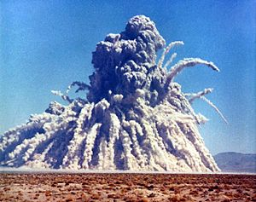
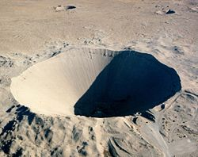
SEDAN SHOT
Part of Plowshare program, A program to study the feasibility of using peaceful atomic detonations for excavation.
The radiation level 1 hour after detonation was 500 rad. fallout from the shot contaminated several counties in Iowa. This approach of using atomic detonations for excavation was quickly abandoned.

Slide 22
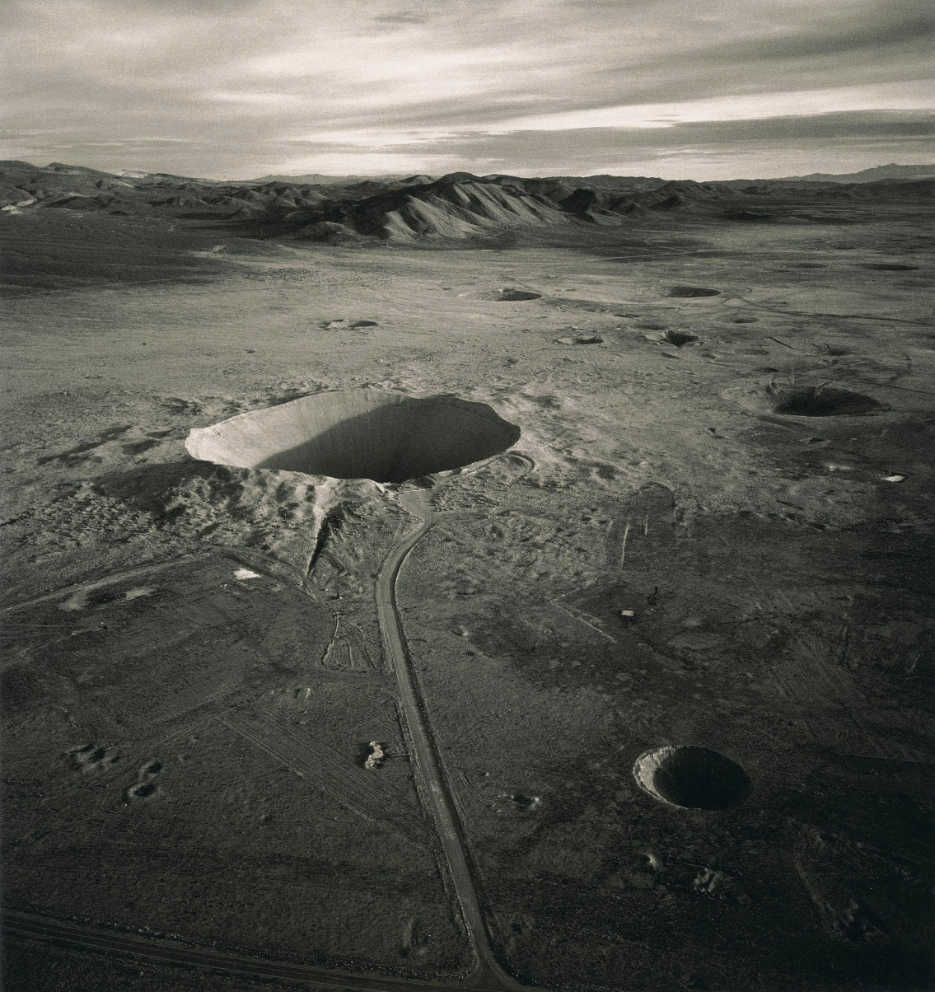
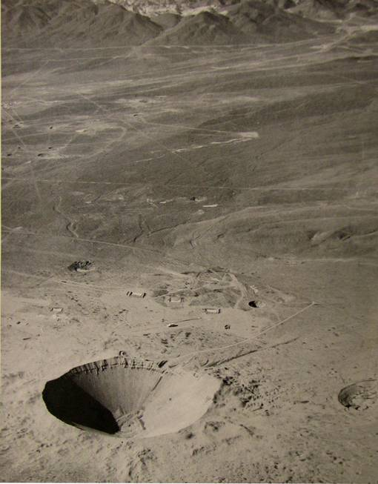
The Sedan Crater was formed when a 104-kiloton explosive buried under 635 feet of desert rock and soil was fired at the Nevada Test Site on July 6, 1962, displacing 12 million tons of earth. The crater is 320 feet deep and has a diameter of about 1,280 feet. The radioactive cloud rose 12,000 feet in the air and headed east then northeast toward the Mississippi River. The crater shown is listed on the National Register of Historic Places.

Slide 23
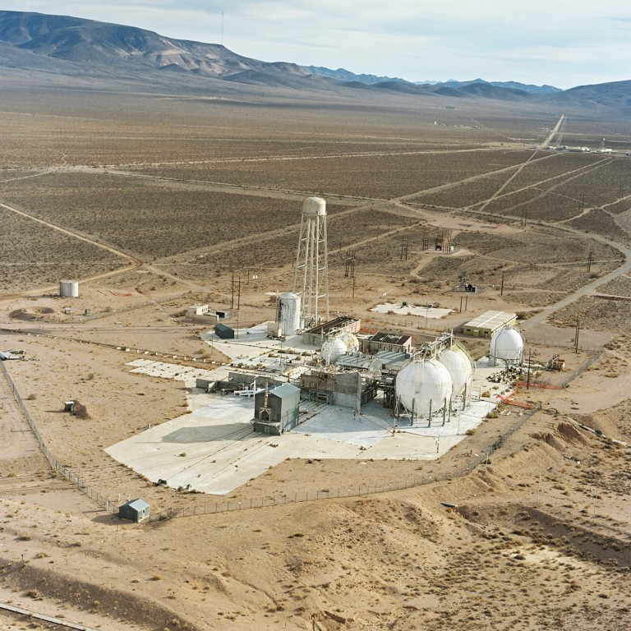
In early 1959, I was assigned to project Rover, A study of nuclear powered rocket engines for space travel.
I was the Nutronics manager of test cell C.
My responsibility was to develop high speed measurement equipment.
I was studying Solid State Physics and I applied some of what I had learned to the work at Rover.
One such experiment was to transistorize the control circuitry. Sending high speed control signals over 2 miles of twisted pair cable. Using a complimentary pair of NPN and PNP transistors connected as emitter followers‘ I was able to match the cable impedance and increase the signal speed.

Slide 24
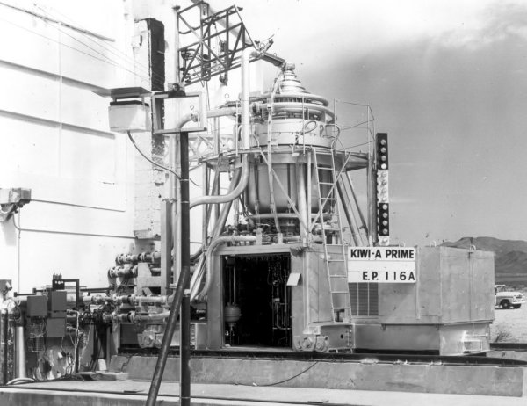
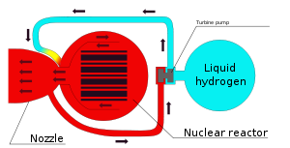
This was KEWI A Prime. Nuclear rocket engine. It replaced an earlier reactor that used as a moderator, deuterium or heavy water 2H2O . They stored the deuterium in 55 gallon drums in the basement of the control center.
Someone suggested we sample a small amount of this “heavy water”. We each filled a shot glass, 1 oz, or $50 worth and drank it. Sometimes you do dumb things when you are young. As far as I know, we suffered no ill effects.

Slide 25
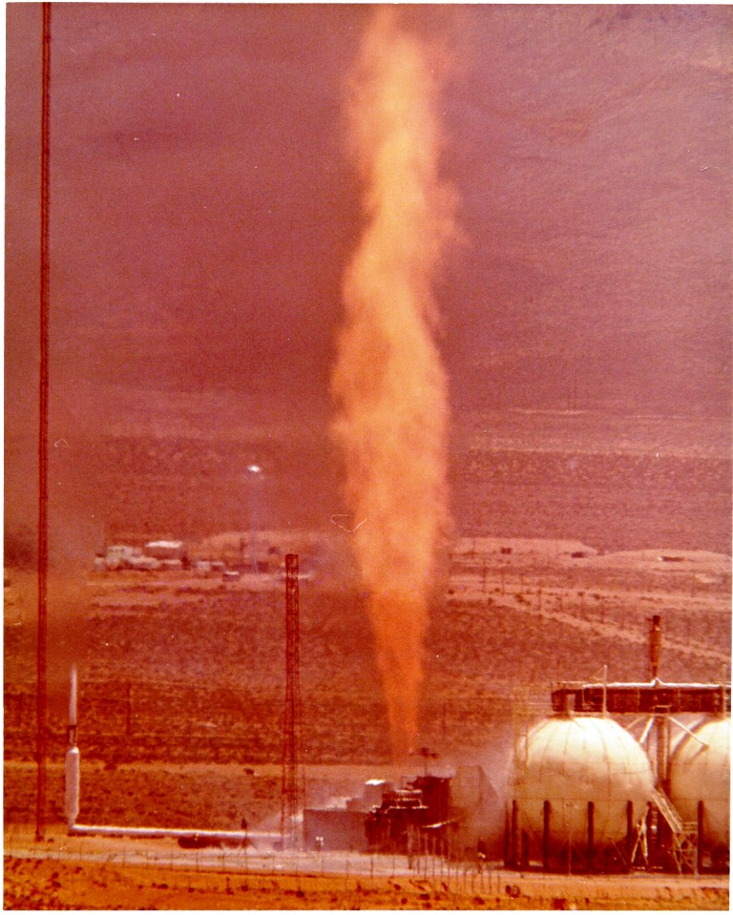
This is the reactor running at full power. Hydrogen gas is used as the propellant and is ignited as it exits the nozzle. The plume of ignited hygrogen is over 250 feet high.

Slide 26
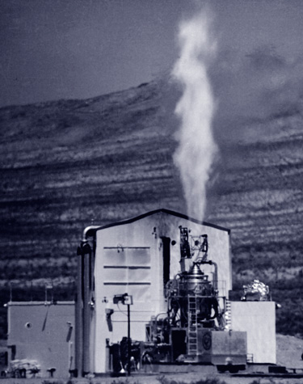
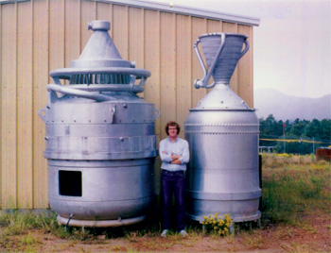
Below is a comparison of the Kewi reactor and the Nerva Reactor. The Nerva is smaller and over twice the power.

Slide 27
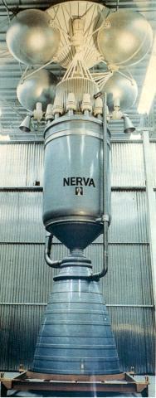
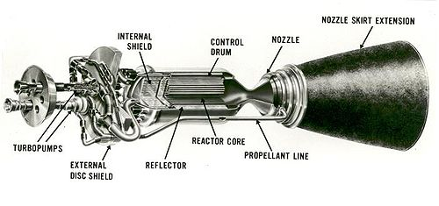
NERVA
the most powerful nuclear reactor ever built – which delivered over 4,000 megawatts of thermal energy

Slide 28
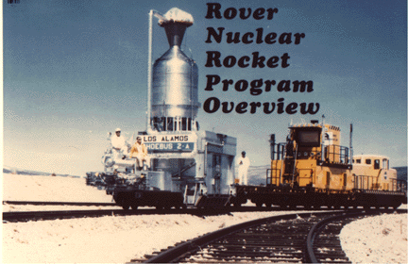
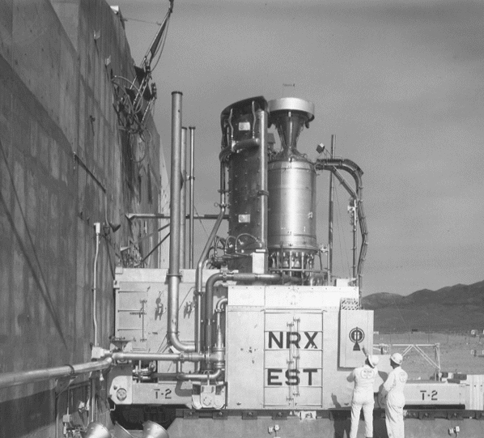
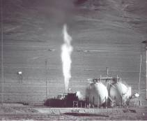
More views of the Nerva Reactor or NRX

Slide 29
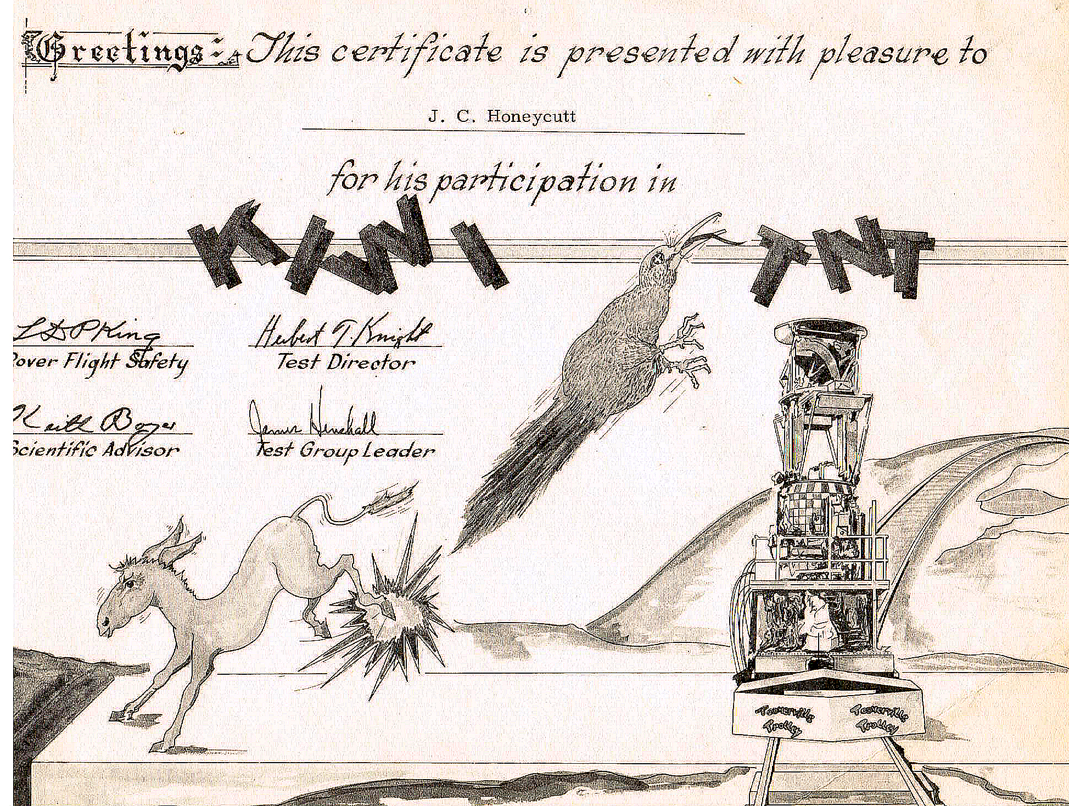

Slide 30
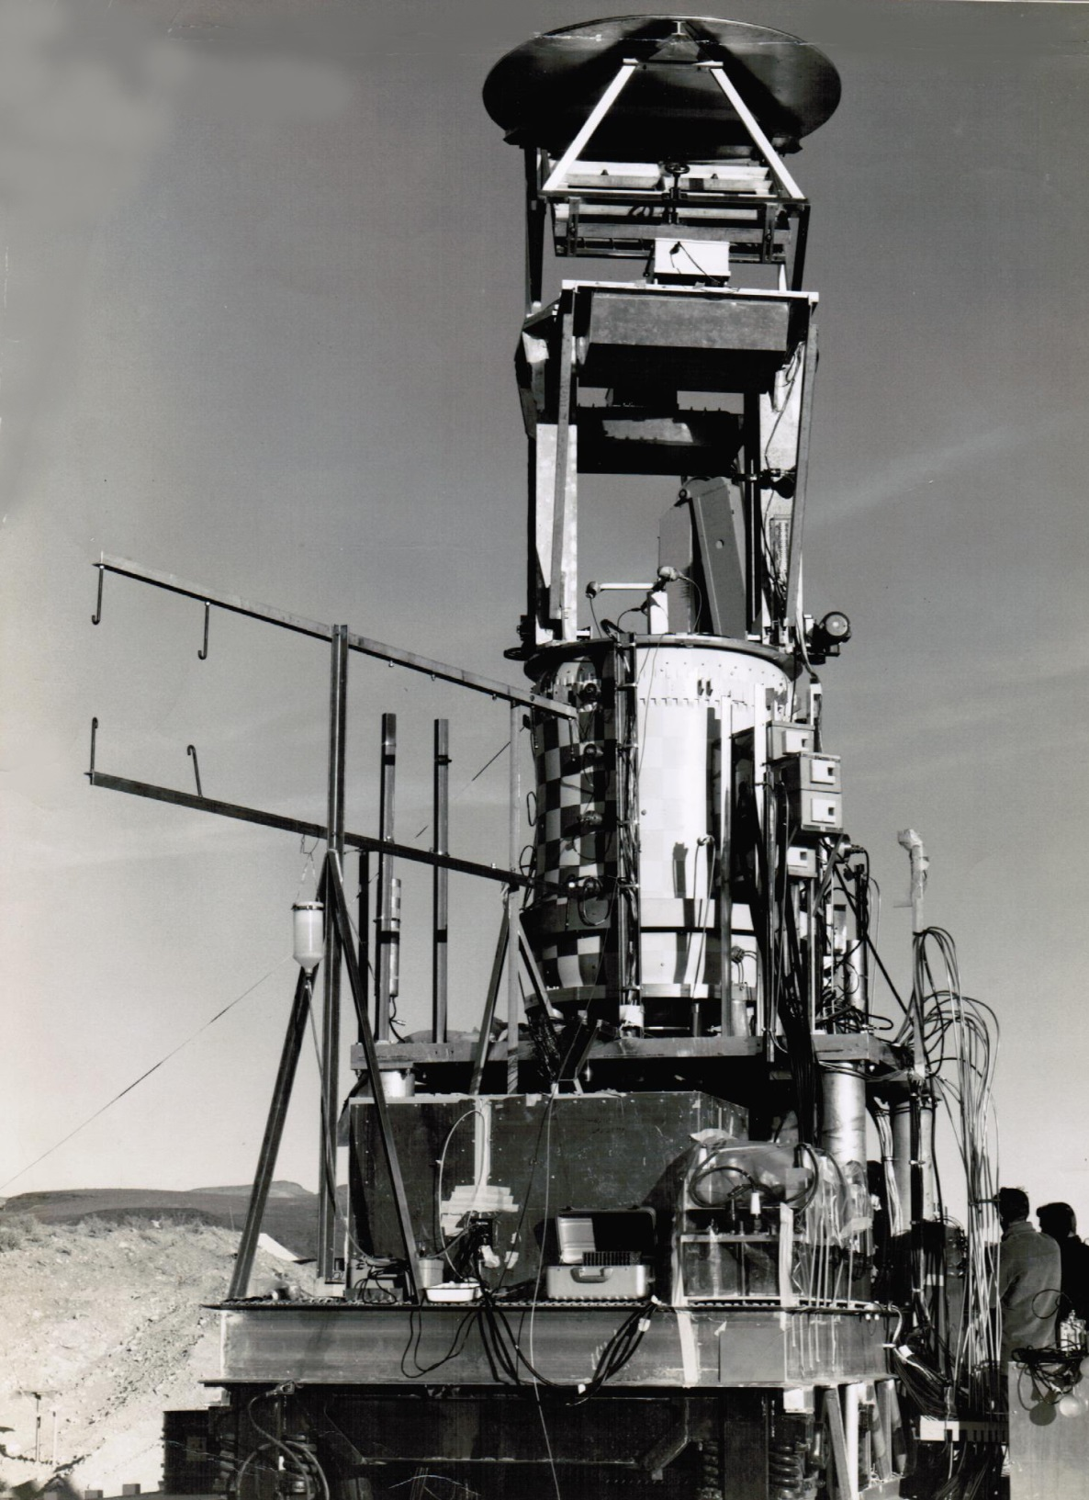
This is the NRX reactor turned nozzle down. This was the referred to as the TNT test. In this test the reactor was placed over a water source that, when the reactor was inactive, as it would be at launch time, and water was shot into the nozzle to simulate a failed launch and high speed entry into the ocean.
It was speculated that the water would act as a moderator for the reactor and cause it to go prompt critical creating a nuclear explosion.
The following picture shows what happened.

Slide 31
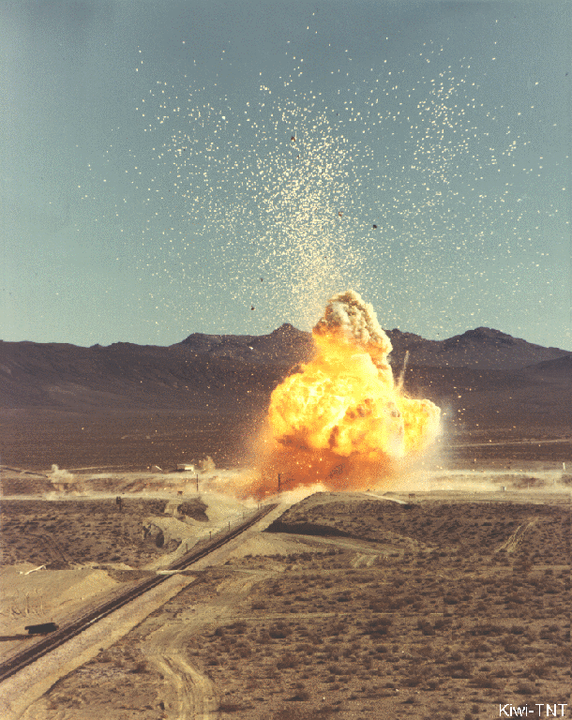
TNT
The explosion sent radio active debris that would have caused fatalities out to 600 feet from the reactor and injuries out to 2000 feet.
In order to capture the event, I designed a high speed log arithmetic amplifier, using germanium diodes mounted to a Peltier junction to keep it at a low temperature and then placed it across a analog operational amplifier. It was referred to as the Honeycutt Log Amplifier.

Slide 32
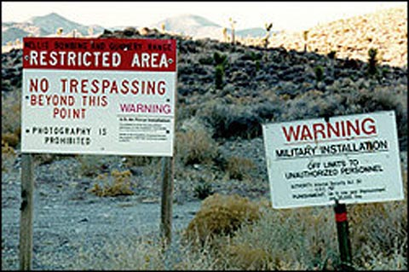
As a result of the developing several solid state designs, I was asked to go to Area 51 ,
Groom Lake , or as it was referred to, Watertown, to convert the radar X/Y plotters to
solid state design. I would fly out to Watertown from McCarren airport in Las Vegas every day.

Slide 33
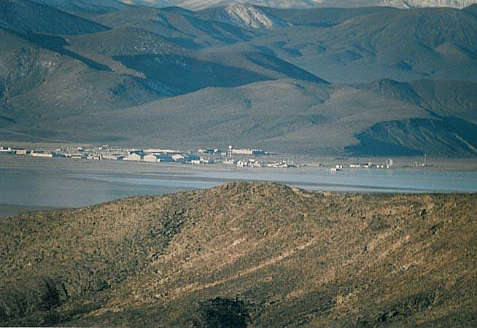

Slide 34
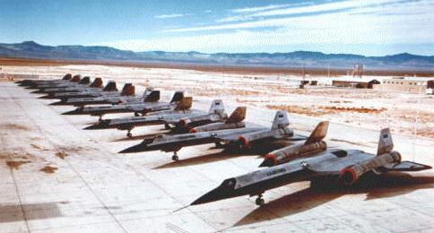
I spent 1 ½ years there, 1962-1963 and witnessed to development of the stealth SR71 Blackbird. I would fly back to Las Vegas Friday night and take a plane to Lincoln Labs in Cambridge Mass. To drop off the weeks test data.

Slide 35
After Area 51, Watertown, I returned to project Rover to continue developing instrumentation for reactor control. In 1965, I was promoted to national product marketing manager for the Las Vegas products. We commercialized the reactor control instrumentation I developed for project Rover

Slide 36
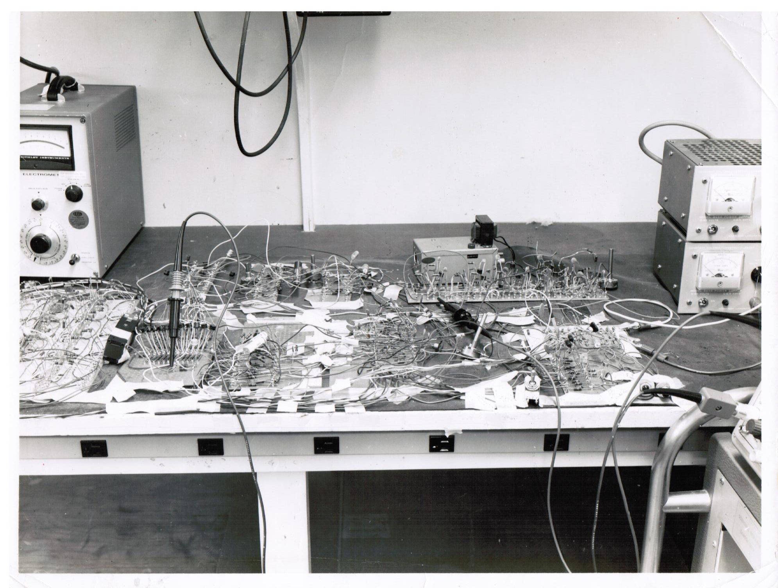

Slide 37
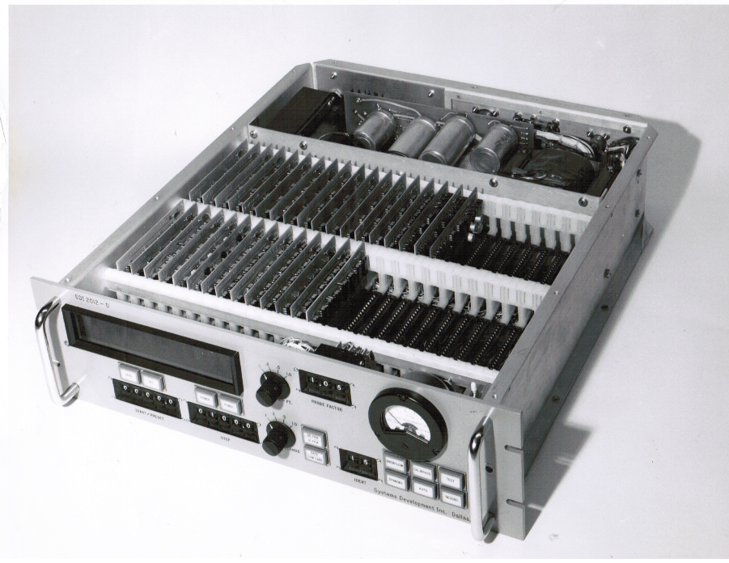

Slide 38
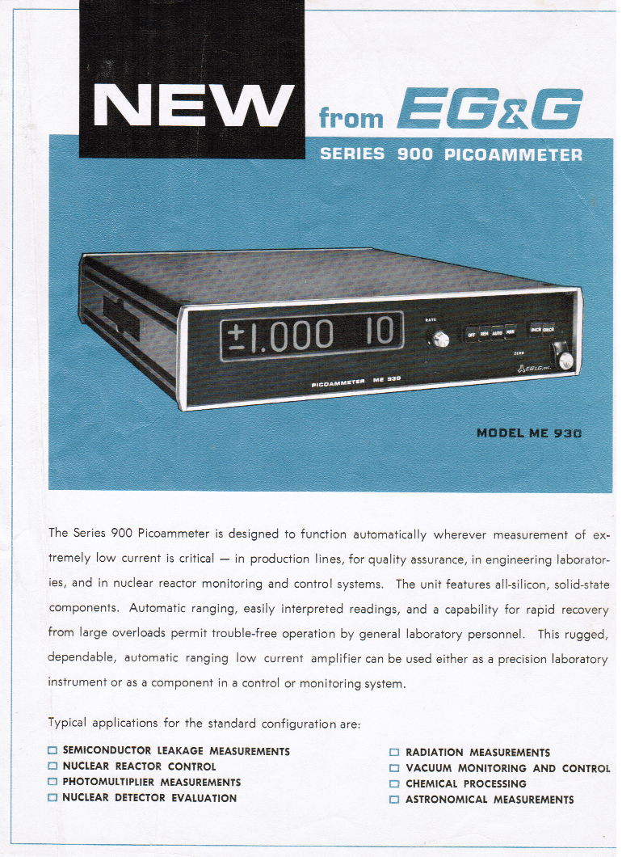

Slide 39
. At the peak of my involvement, I had sales reps all over the country ,two advertising agencies, I would travel from Las Vegas to New York and Boston every week and attended many trade shows to the point where I seldom could spent time with my family. This was not the life for me, I prefer design, not marketing. In August of 1968 I left EG&G and moved to Dallas Texas. Where I spent the next 40 years developing telecom, high speed DSL and bio-medical products. When I look back over my past I am amazed at the science I was involved in. Most of it way beyond my capabilities, some how, be it luck or Devine intervention, it happened.

Slide 40
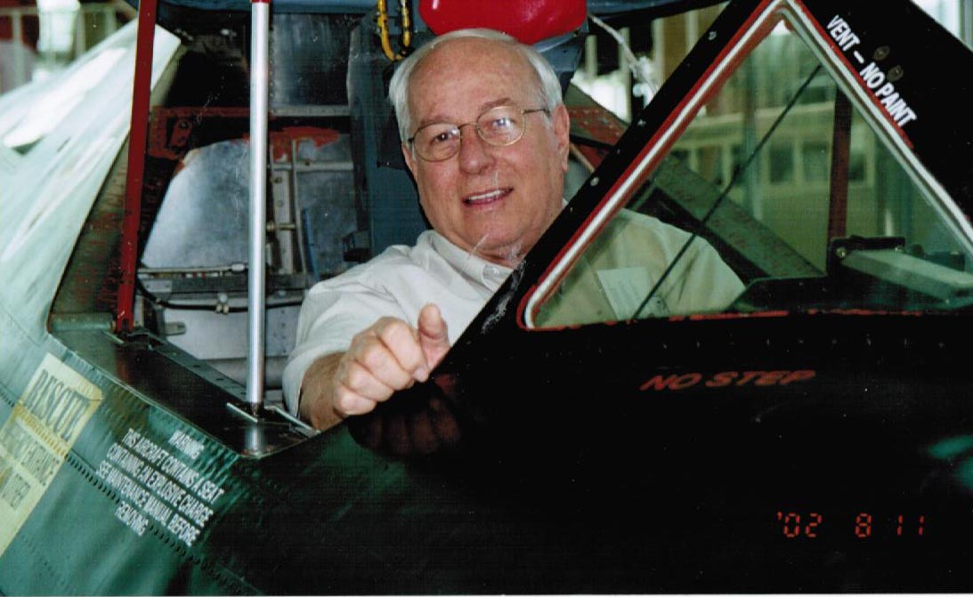
THE END

