Slide 1
Clickers in an introductory physics classroom
Pavel Nadolsky
Department of Physics
Southern Methodist University
March 15, 2010
Presentation given to eight SMU physics faculty

Slide 2
Introducing clickers at SMU Department of Physics
Student response systems (clickers) are electronic devices for rapid feedback from the audience to the instructor
Our department purchased a set of 100 clickers from TurningPoint Technologies using the funds of the Provost’s Instructional Technology grant
I am using clickers in most lectures of the PHYS 1304 course, Introductory Electricity and Magnetism, taught in Fall 2009 and Spring 2010 to 70+ students

Slide 3
In today’s presentation, I will…
share my experience with TurningPoint clickers
give a tutorial on setting up clickers
discuss the role of clickers, and novel instructional technology in general, in advancing physics instruction
Recent research in physics education: what is relevant for SMU?
Interactive instruction vs. a traditional lecture: does it make a difference?
Learning outcomes for SMU undergraduates: what do we want them to learn in the introductory physics courses?

Slide 4
Clickers: basic applications

Slide 5
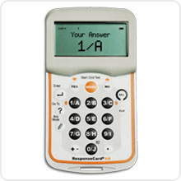
TEST YOUR CLICKER NOW Press 0-9 from your seat
A checkmark appears on the right-hand side if your answer is received
Test your clicker
2
3
4
5
6
50%
25%
25%
0%
0%
0%
A temporary ID of your clicker flickers in the table
1 | 2 | 3 | 4 | 5 | 6 | 7 | 8 | 9 | 10 | 11 | 12 | 13 | 14 | 15 | 16 | 17 | 18 | 19 | 20
21 | 22 | 23 | 24 | 25 | 26 | 27 | 28 | 29 | 30 | 31 | 32 | 33 | 34 | 35 | 36 | 37 | 38 | 39 | 40
41 | 42 | 43 | 44 | 45 | 46 | 47 | 48 | 49 | 50 | 51 | 52 | 53 | 54 | 55 | 56 | 57 | 58 | 59 | 60
61 | 62 | 63 | 64 | 65 | 66 | 67 | 68 | 69 | 70 | 71

Slide 6
Have you used clickers before?
Never
Rarely
Occasionally
Often
Very often
8 of 71
:55

Slide 7
Some applications of clickers
Support interactivity in large classes
Evaluate students’ progress on a frequent basis
Quantitatively assess the quality of instruction to large groups of students
Track attendance
Carry out surveys and demographic studies
Vote

Slide 8
Overview of clicker technology
Clicker systems are sold by several manufacturers (Turning Technologies, eInstruction, iClicker,…) at the price of $25-50 per device
Pros and cons of various brands are compared at http://www.uwec.edu/evansmm/SRS/clickerDecision.pdf
Our clickers…
are bought from Turning Technologies (www.turningtechnologies.com)
are supported by the SMU Office of Instructional Technology
in my experience, are quite reliable; the manufacturer provides helpful support
come with two free Windows programs:
TurningPoint – versatile, fully integrated with PowerPoint 2007
TurningPoint Anywhere – standalone, simple, limited

Slide 9
Interactive lectures with clickers
Clickers are generally incompatible with the “traditional format” of the lecture, delivered “one-way” from the instructor to the audience
They are well-suited for “active learning” lectures, such as peer instruction developed by E. Mazur
With clickers, structure and pace of the lectures, as well as the curriculum must be reconsidered

Slide 10
Active learning in physics education
According to a variety of studies, lectures with active learning components (collective discussions; hands-on activities;…) are more efficient in teaching the sci-tech undergrads than the traditional combination of one-way lectures + problem-solving recitations + labs + homework assignments
Efficiency of active learning varies depending on its specific setup; but active involvement appears to be beneficial in most cases
See e.g., M. Prince, Does Active Learning Work? A Review of the Research, J. Engr. Education, 93(3), 223-231 (2004)

Slide 11
Active learning in physics education
Benefits of active learning are claimed to be enhanced by…
…changing the role of the instructor from being “just a lecturer” (source of all information delivered to passive listeners) to a facilitator of practical learning by students, who spends most time on elucidating essential points and targeting students’ alternative conceptions

Slide 12
Active learning in physics education
Benefits of active learning are claimed to be enhanced by…
… allowing more time for in-class activities and discussions of physics phenomena and demos (at the expense of reduced discussion of abstract laws)
…changing expectations for learning outcomes
…changing the curriculum
…evaluating students’ progress based on standard tests developed by statistical studies at a variety of colleges

Slide 13
How closely are you following recent developments in physics education?
Often
Occasionally
Rarely
7 of 71
:18

Slide 14
How enthusiastic are you about new approaches proposed by physics education papers?
Many of their ideas deserve implementation
Many “novel” suggestions are transient fads, but some are worth considering
Traditional (=time-proven) methods and diligence are quite sufficient
7 of 71
:00

Slide 16
Rank learning outcomes expected from SMU undergraduate students according to their importance. (1st response – most important outcome; 4th response – least important outcome)
Familiarity with essential physics phenomena shown in demos
Knowledge of basic concepts and “expert shortcuts and skills” applicable in a variety of situations
Familiarity with profound, even though challenging, ideas essential for systematic learning of physics (e.g. Gauss and Ampere’s laws)
Ability to solve typical physics problems encountered in practical applications
8 of 71
:85

Slide 17
Normalized gain G
A commonly used figure of merit to characterize
“the teaching efficiency” is the normalized gain,
is the average class score before (after) the instruction, as a percentage of the maximal score
0 < g < 1
Better instructional methods presumably have g values with (a) a higher average and (b) smaller variance due to circumstantial factors like initial preparation of students, instructor’s personality, etc.

Slide 18
A positive electric charge is placed at rest near a north pole of a magnet. The charge will…
Be attracted to the magnet
Be repelled away from the magnet
Move according to the right-hand rule
Stay at rest
7 of 71
58

Slide 19
Students’ responses
Fall’09
First lecture
Midterm lecture
After the home reading assignment, but before my instruction
Spring’10
First lecture
Final exam
36% of correct answers (#4)

Slide 20
Types of clicker sessions
Quick one-time polls
easy to set up (a few minutes)
can be anonymous or not
Recurrent quizzes / in-class discussions/
attendance monitoring /advanced slides
require more careful settings to keep the list of participants, record scores, and backup the results

Slide 21
Setting up a quick poll
Open TurningPoint (starts PowerPoint automatically)
Open the “TurningPoint 2008” menu at the top of PowerPoint; use it to
insert and configure interactive slides (in
the menu “Insert slide->…”)
Choose settings for your session (in “Settings”)
Reset the session, save the session, or continue a prior session (in the corresponding menus)
Insert special TurningPoint objects (like counters of time or responses)

Slide 22
A quick poll (continued)
Run the slide show
Poll the audience
Save the results into a session file (“Save session”) or as a report in the Excel format (“Tools->Reports”)
Important: In Fondren lecture rooms, all local user files are deleted when the computer is rebooted
Restore the TurningPoint configuration files and save all your results to the NFS drive (U:) at the beginning and end of each session

Slide 23
Lists of participants
Anonymous response mode: TurningPoint records only the total tally of answers
Auto/individualized response mode: TurningPoint records a table of individual answers, by associating hex IDs of clickers with the names in the participant’s list (created using the “Participants” wizard)

Slide 24
Efficiency of interactive instruction
Can be assessed with a standardized test tried on a large group of students
Several standardized tests are available to evaluate learning of introductory mechanics (e.g. Force Concept Inventory)
Only a few existing tests were developed to assess learning of E & M

Slide 25
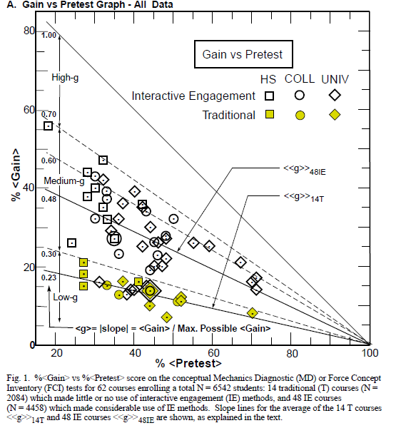
Hake, R.R. 1998a. "Interactive-engagement vs traditional methods: A six-thousand-student survey of mechanics test data for introductory physics courses," Am. J. Phys. 66(1): 64-74
http://www.physics.indiana.edu/~sdi/ajpv3i.pdf

Slide 26
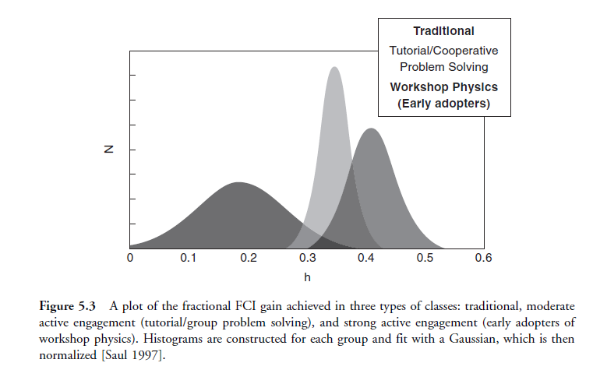
# of
students
g

Slide 27
Brief Electricity and Magnetism Assessment (BEMA)
A 30-question test administered to 2000 students at Georgia Tech, Carnegie Mellon, North Carolina, and Purdue, with the goal to compare
traditional and interactive instruction techniques
learning outcomes based on the traditional curriculum (textbooks by Tipler, Giancoli, Young & Freedman…) and “physics-education”-driven curriculum (Matter & Interactions by Chabay and Sherwood)
Detailed results are published in M. Kohlmyer, 8 more authors, Phys. Rev. ST Physics Ed. Research 5, 020105 (2009), arXiv:0906.0022

Slide 28
BEMA results at Georgia Institute of Technology (1700+ students)
No clickers
Sections
9 different instructors; instructors in Sections T3, T4, T8, and T9 have a reputation for excellent teaching

Slide 29
BEMA results at Georgia Institute of Technology (1700+ students)
No clickers
Comparable improvements in the score result from
- personal skill and experience of the instructor
introduction of clickers
revision of the curicullum

Slide 30
Comparison with PHYS1304 in Fall’2009
Average normalized gain on questions similar to BEMA: g=42%

Slide 31
Structure of interactive physics lectures

Slide 32
Structure of PHYS 1304 lectures
Students must do some preparation before the class by
reading the textbook assignment
watching free video lectures available on the web
reading supplementary material
2 clicker questions at the beginning of the class (2-3 minutes, graded individually) to check the students’ preparation and attendance
1-3 learning units (lecture + demos) with a clicker-based discussion in each unit
Discussion questions are moderately difficult; a collective grade is assigned to all participants based on the final percentage of correct answers

Slide 33
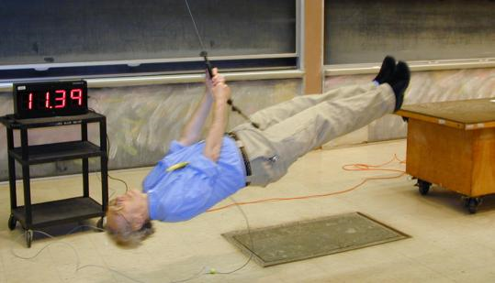
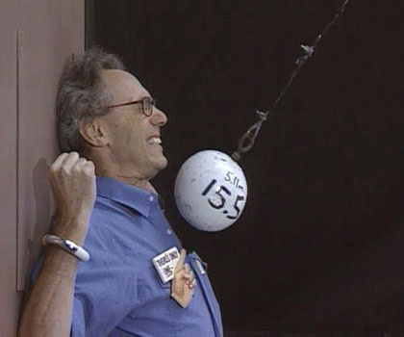
MIT OpenCourseWare
Before each PHYS 1304 lecture, students are encouraged to watch YouTube videos with
MIT lectures by Walter
Lewin – a fantastic
introductory course in
the traditional format

Slide 34
MIT OpenCourseWare
…For each one of my lectures, I dry-run them three times. Once about 10 days before I give the lecture. Then about three or four days before. Then I dry-run at 6 in the morning of the day
that I give the lecture. So it is like
a performance, whereby I
cannot even go wrong [with the
demonstrations] anymore,
even if I tried.
Lewin’s interview
to US News & World Report

Slide 35
Purpose of PHYS 1304 lectures
PHYS 1304 lectures are supposed to cover what students cannot learn on their own from reading or watching videos:
reinforcement of most essential concepts and skills
resolution of typical difficulties
a variety of interactive demonstrations
in-class activities and discussions
learning of problem-solving skills

