Slide 1
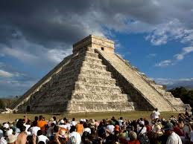
The Acoustics of Mayan Temples: Chichen Itzá
Presented by Caroline Delgado

Slide 2
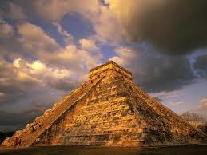
The Acoustics of Mayan Temples: The Temple of Kukulkan
The buildings amplify sound by reflection of the sound waves.
Stucco and limestone are very smooth surfaces that have very low absorption rates.
When at the bottom a person’s voice is echoed from the top.
A speaker at the top can use a normal speaking voice and be heard by the crowd below.

Slide 3
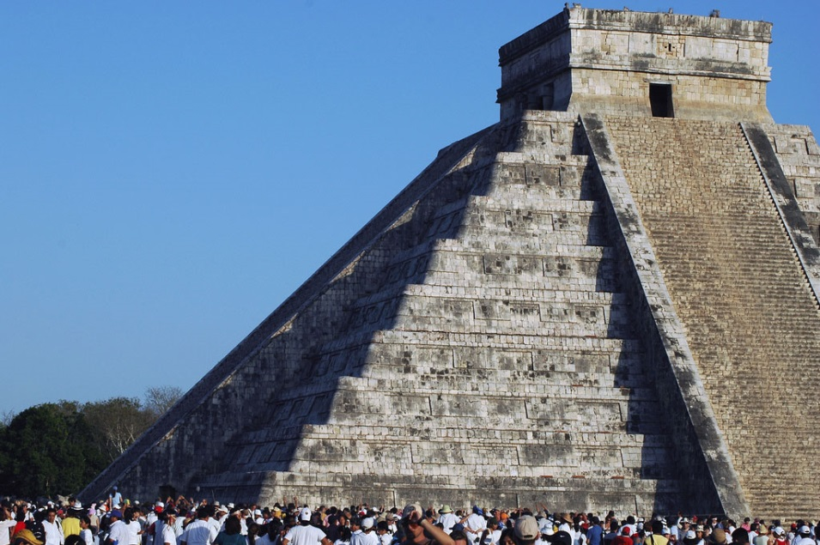
The Acoustics of Mayan Temples: The Temple of Kukulkan
The temple is a four sided stepped pyramid.
When you clap a “chirping bird” is heard.
It is said to be the quetzal which is the bird messenger of the gods.
This happens because of the acoustical properties of the steep staircase.
http://www.youtube.com/watch?v=QxvpZcJSEME

Slide 4
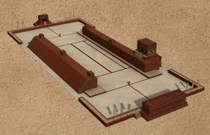
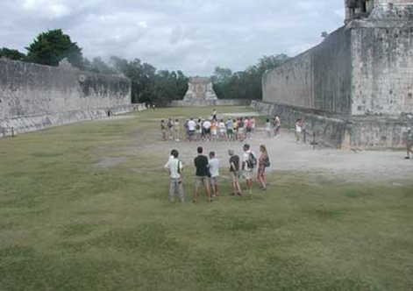
The Acoustics of Mayan Temples: The Great Ball Court
In the ball court, whispers can be heard from one end to the other. Termed “whispering galleries.”
The whispering galleries work by pushing sound waves along the playing field. The effect is like speaking through a long tube.
This conserves sound energy and reduces sound loss.
The court’s two temples are 460 feet apart.
The two parallel walls are 119 feet apart measuring 28 feet tall and 270 feet long.

Slide 5
Acoustical Phenomena
Researchers have not been able to figure out all of the acoustical phenomena of the apparent projection systems of the Mayan temples.
Coats of stucco were applied to the temples to reflect the sound and alter the absorption rates.
The frequency, quality, and volume of sound in certain rooms were most likely used for speakers, musicians, and priests.

Slide 6
Examples of Ancient Instruments
http://www.youtube.com/watch?v=cWjOaZFXo3s&list=PLCCD7D5F9D535D076

Slide 7
References
Edwards, Lin. "Mayan Buildings May Have Operated as Sound Projectors." Mayan Buildings May Have Operated as Sound Projectors. PhysOrg.Com, 21 Dec. 2010. Web. 05 Dec. 2013.
"Acoustic Archaeology Solves a Mystery at Chichen Itza." Archaeology News from Past Horizons RSS. N.p., n.d. Web. 05 Dec. 2013.
Viegas, Jennifer. "Maya Teased Ears Through Architecture." Maya Teased Ears Through Architecture. Discovery Communications, 29 Nov. 2006. Web. 05 Dec. 2013.

