Slide 1


Slide 2
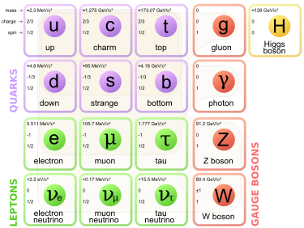
Instead of a summary
What do we know about structure of matter - peal out the onion layers
The smallest components of macroscopic world are atoms
The smallest, long-lived components of the atomic structures are proton, neutron and electron
The smallest components that we have detected inside the proton/neutron are up and down quarks. These two types of quarks together with electron and an electron neutrino form the “lowest mass” family of “fundamental” particles making up matter detected in observable stars and planets in our universe.
In addition there are two other families of quarks and lepton that are heavier
and short-lived.
The combination of 3 quarks or quark-antiquark
pairs make many hundreds of observed hadrons.
The interactions between the fundamental
particles is mediated by the carriers of the
basic forces: photon for electromagnetic force,
W+, W-, Z for the weak force,
8 types of gluons for the strong force,
graviton (if gravity is described by quantum
theory)
Higgs boson is responsible for masses of the
particles via different couplings

Slide 3
Instead of a summary
50 years ago today
Next 50 years
?

Slide 4
Theory - selected steps
Newton law - Classical description of gravity
Maxwell - Classical description of electromagnetic interactions
Einstein - General relativity and attempt to unify gravity and electromagnetism introduced
curvature of space as possible explanation of gravity affecting light rays (lensing)
Friedman - introduced acceleration into the Einstein equations
Klein and Noether – showed the connection between symmetry and conservation laws
Lemaitre - cosmological model of Big Bang
Many - introduction of thermodynamics into the evolution of the Universe
current model - series of phase transitions at decreasing temperature leading to
symmetry breaking between different forces and separation of primordial photon s
and neutrinos from evolution of stars and heavy elements
Higgs - the symmetry breaking between electromagnetic and weak interactions can be explained
as due to existence of a scalar field and corresponding spin 0 particle sometime around
inflationary period (before, during or after).
Today - electroweak theory works BUT Higgs particle mass is too small to explain the difference
between the mass of the photon (carrier of electromagnetic force) and mass of
the Z boson (carrier of the weak force
- lack of understanding of masses has been replaced by the lack of understanding of
Higgs couplings to fermions and bosons

Slide 6
The potential at the origin does not correspond to the lowest potential state of the Higgs

Slide 7
What we know and what do not know
Higgs is a new type of a particle but is this The Higgs particle ?
All parameters seem to be as expected, but there is no indication of new physics effects required by the formalism of unification of forces at early stages of the universe. The mathematics breaks down in extrapolation to higher energies (temperature).
Perhaps it is one of several such new particles and the other ones have much higher masses
Do we really know the shape of the Higgs potential. Perhaps the particle we have discovered represents not a true but a false vacuum during the Big Bang and the true Higgs has much larger mass/
Why do we care? Cosmologist claim that if this is a true Higgs, its mass and the mass of the heaviest quark indicate that our universe may be unstable and would
disappear in a future (may be few or few hundred billions of years)
Plenty of time to build bigger machine and study.

Slide 8
Open questions instead of the summary
The Standard Model provides a unified description for electromagnetic and weak interactions. It also includes description of a part of the strong interactions. It is based on the symmetry group SU(3) x SU(2) x U(1).
Higgs was expected to explain the mass difference between the photon and Z.
There is no theoretical explanation of the structure of the proton, just PDF models based on fits to the data.
There is no theoretical explanation of how quarks “fragment” into hadrons, just phenomenological models based on fits to the data.
What is that we do not know about the structure of matter in 2022?
Do quarks are really fundaments or do they have further sub-structure that is too small to be detected with current technology?
Are there additional families of quarks and leptons that are to heavy to be detected at our accelerators?
Do the new types of particles predicted by various extensions of the Standard Model exist? (supersymmetric particles, righthanded or scalar neutrinos, mirror particles…)
What is that we do not know in general theoretical approach (random selection)
Is gravity a quantum theory on the fundamental level?
Is the symmetry the basic principle governing the physics of the universe?
Do magnetic monopoles exist?
Can we construct Theory of Everything?
What is time? Is time quantized?

Slide 9
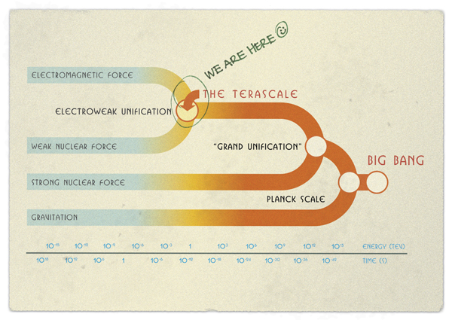

Slide 10
The Future
What are the unexplained observations in particle physics
Why electric dipole moment of the neutron is so small ? (strong CP problem)
What makes the mass and spin of the proton ?
m(up quark) = 2.3 MeV, m(down quark) = 4.8 MeV, m(proton) = 938.2 MeV
What is the origin of mass and why masses differ by up to 17 orders of magnitude ?
m(top) ~ 173.2 GeV = 1.732 × 10¹¹ eV
m(neutrino) < 2 1 eV – estimated to be ~10⁻⁵ eV
……….
What are not yet measured parameters of known particles
Width of the Higgs boson (does it decay to others than known particles)
Precise parameters of the neutrino mixing matrix
What are the glueballs?
Does degenerate strange matter exist? (no Pauli principle for strange quarks/mesons)
………
What are the searches related to extensions of the Standard Model
Do the heavy quarks and leptons exist ?
Do supersymmetric particles exist?
Axions
Magnetic monopoles
Dark matter WIMPs
Compositness
Extra Dimensions
Scalar neutrinos

Slide 11
The Future cnt.
What are the particle physics searches motivated by astronomical observations
Dark Matter particles
Mini-Black Holes
Dark Photons
Dark Energy effects
Tests of conservation laws
Implications of particle physics on other fields
Tests of CPT invariance – do we understand the arrow of time? (Cosmology)
Spin effects (chirality) on creation of biological molecules (Origin of life)
Entropy of the universe (do black holes evaporate?)
Progress in technology
  computing - multivariate analyses (problems with many correlated variables)
  large data handling
  modeling techniques (GEANT, Monte Carlo methods) -> Machine Learning
  development and commercialization of superconducting technology
  pixilation of detector sensors – transfer to medical applications
  application of accelerators in medicine

Slide 12
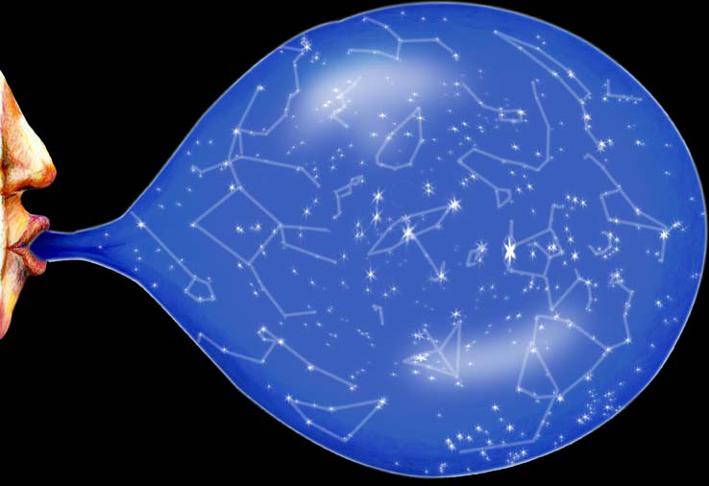

Slide 13
Strange terms used in theoretical physics (experimenters’ view)
Naturalness - An aesthetic criterion (not a physical one) leading to expectation that all free parameters of physical constants appearing in a physical theory should have reltive values “of order 1”. (sometimes called antropocentric view)
This is not a property of the Standard Model where unexplained parameters, e.g., masses of fundamental paticles differ from each other by many orders of magnitude
m(electron) = 0.51 MeV vs m(top quark) = 173.2 GeV
now translated to the size of the corresponding couplings to Higgs boson
In the basic formulation we have few basic constants of nature
for weak interactions
Fermi constant G_{F}/(hc)³= 1.166 10⁻⁵ GeV⁻² for gravitation
gravitational constant G_{N} = 6.67x10⁻¹¹ m³ kg⁻¹s⁻² = 6.7x10⁻³⁹ hc (GeV/c²)⁻²
for electromagnetic interactions
speed of light c = 299 792 458 m/s

Slide 14
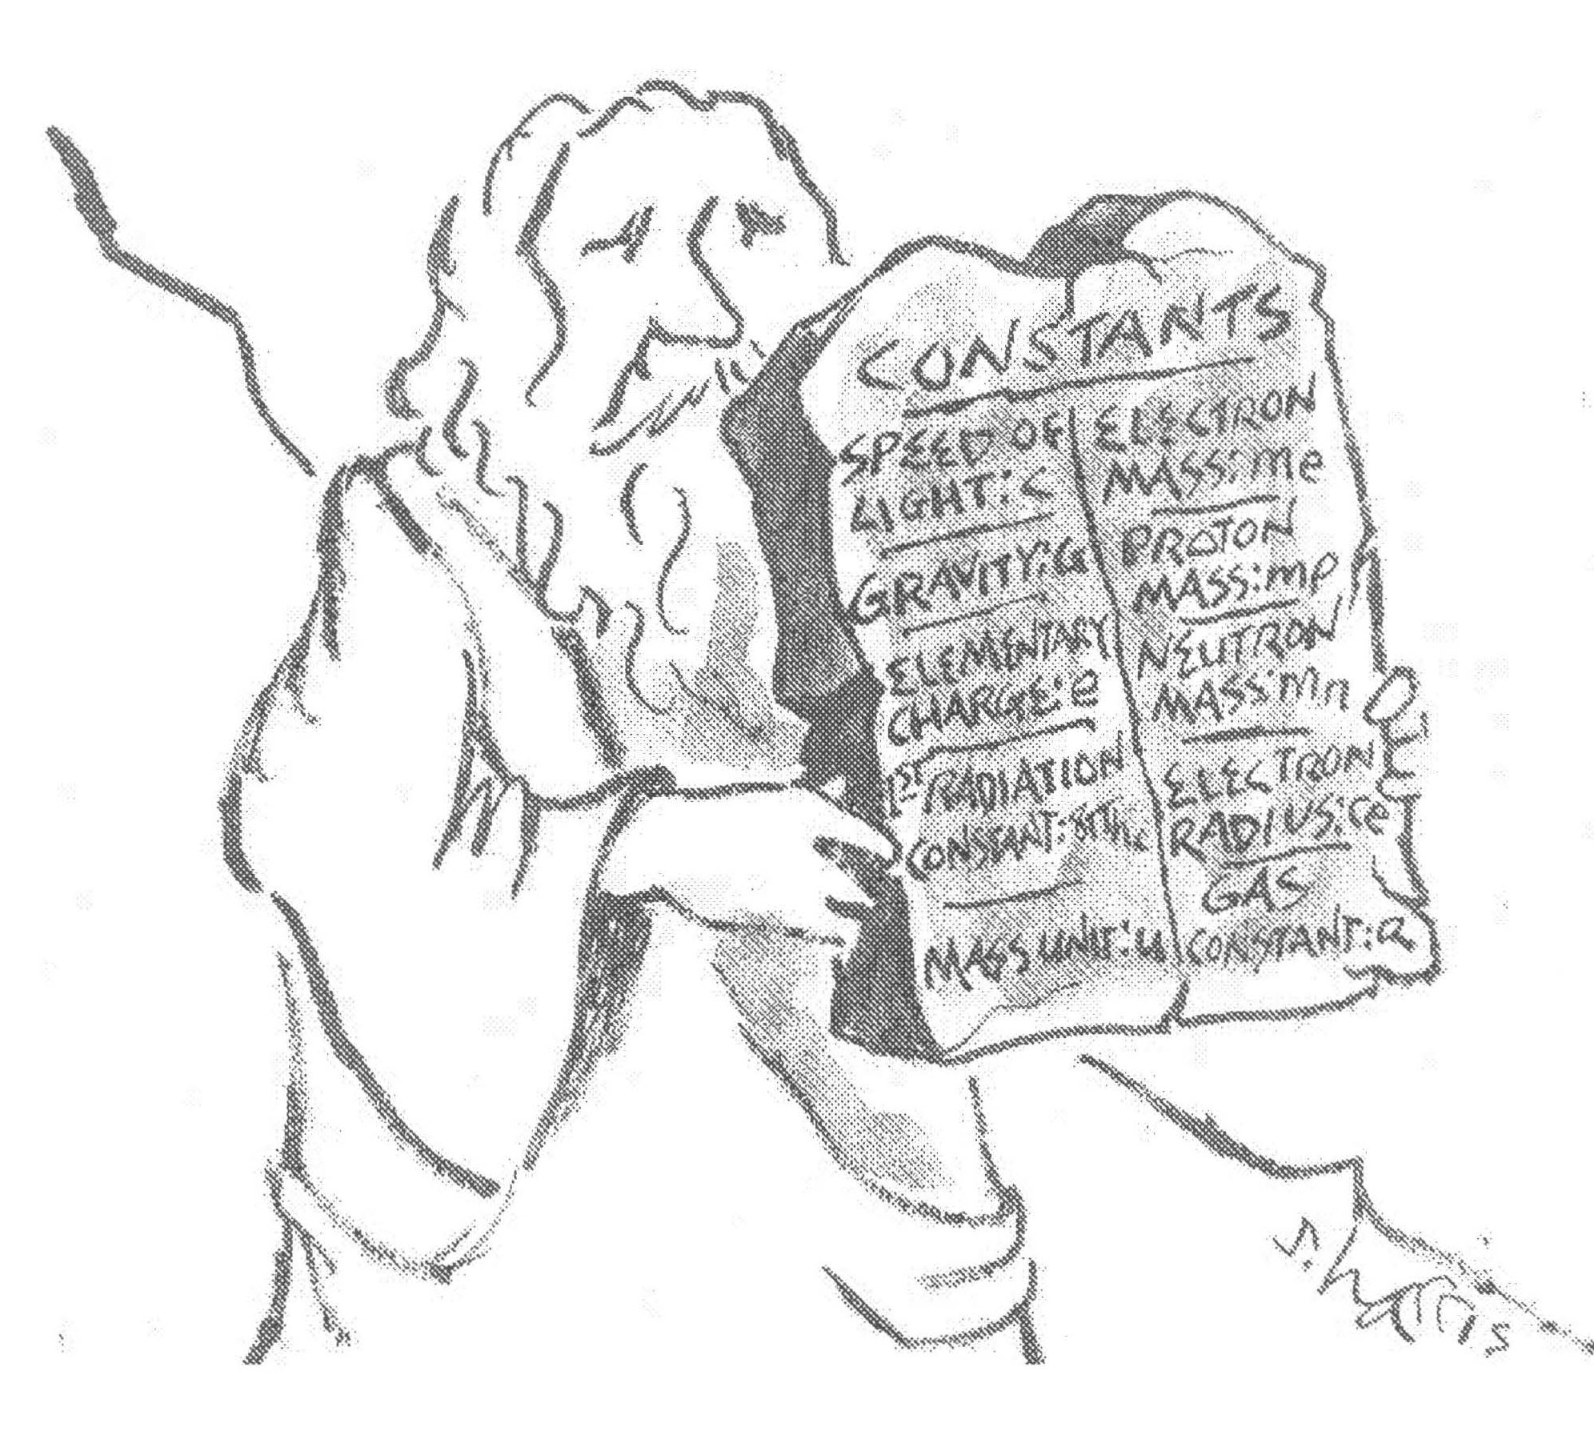

Slide 15
Strange terms used in used in theoretical physics
Fine tuning – occurs when the parameters of a model must be adjusted precisely in order to agree with observtions. Models/theories that require ﬁne-tuning adjustments may indicate that there are missing pieces in the theory. This is particularly important for cosmological models that have no explanation for the size of various constants
(e.g. cosmological constant, inﬂation, etc.)
Hierarchy problem – large discrepancy between, e.g., weak force and gravity. Weak force is 10³² times stronger than gravity.
In general, this problem occurs when fundamental value of a parameter used in Lagrangian is diﬀerent from its eﬀective value measured in experiment. The measured, fundamental value is changed by renormalization that includes quantum corrections.
In theoretical approach – the quantum corrections are usually power-law divergent indicating that the eﬀect is dominated by very small distances that we have not probed with present experiments. Theorists “solve” the problem by inventing theories that provide cancellations between large terms. An example of such theory is
Supersymmetry.

Slide 16
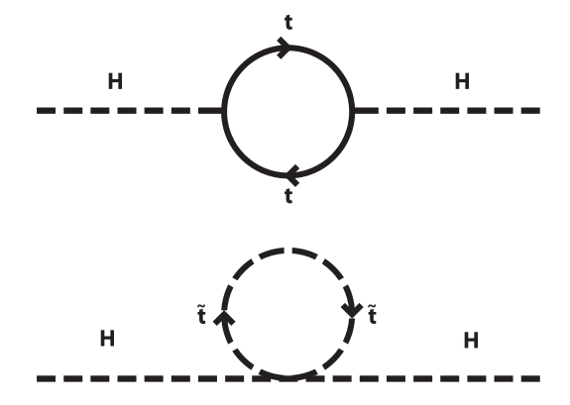
Current theoretical prejudice included in the cosmological models is based on uniﬁcation of
forces at very high energy. This poses a number of problems, e.g., why Higgs mass is so much
smaller than the Planck mass
m(Higgs)=125 GeV /c² vs m_{P}= 1.22 x 10¹⁹ GeV/c²
In cosmology and particle physics the reduced Planck mass is the maximum mass of a point
object that can hold a single elementary charge (?)
where G is the gravitational constant. The Planck mass is approximately that of a mass of a ﬂea – i.e., macroscopic. Larger(point) masses would create a mini black hole.
An example of a theory that provides cancellations of higher order quantum corrections terms is Supersymmetry where the supersymmetric particles have spins shifted by ½ i.e., fermionic quarks and leptons become bosons and gauge particles become fermions.
Since the signs of terms calculated using Feynman rules change going from fermions to bosons the loop corrections would cancel out (exactly if supersymmetric partners would have the same masses as the known particles).

Slide 17
Particle content in Supersymmetry
Each left(right)-handed quark (spin = ½ ) has scalar (spin = 0) partner quark called squark.
sup, sdown, sstrange, scharm, sbottom, stop q_{L}(q_{R})
The subscripts L and R do not refer here to spin chirality but distinguish the corresponding
partner quarks. Similarly leptons have corresponding spin 0 partners called sleptons.
The gauge bosons also have corresponding spin ½ partners:
gluinos (spin ½ supersymmetric gluons)
winos (spin ½ supersymmetric partners of W bosos)
binos (spin ½ supersymmetric partners of Z boson)
gravitino (spin 3/2 supersymmetric partner of graviton)
The model requires an extension of the Standard Model Higgs sector. There would be two separate scalar Higgs doublets leading to 3 neutral and a pair of charged Higgses with their supersymmetric partner spin ½ Higgsino.
The sparticles could have their own decay chains and interactions analogous to those in the Standard Model. The lowest mass sparticle cannot decay and is stable. If charged, is should likely have been seen already so the expectation is that - stable- it escapes detection generating missing energy signature.

Slide 18
Strong CP problem
CP symmetry states that the laws of physics should be the same if a particle were interchanged with its antiparticle (C symmetry) and then left and right ere swapped
(P symmetry).
Parity (P) – space reflection : classical vector changes sign
Axial vector e.g., orbital momentum L = x × p is left invariant -> spin and total angular
momentum do not change sign. In quantum mechanics the wave function of a particle
has an arbitrary phase that is not observable. One can choose the phase so that it becomes 0
for a physical state. Any particular term in the Lagrangian can be therefore conserving CP.
CP violation occurs when two or more terms of the Lagrangian cannot be made invariant
simultaneously resulting in an explicit phase.
In electroweak interactions P symmetry is violated maximally. The CP is violated via phase in
the CKM mixing matrix.

Slide 19
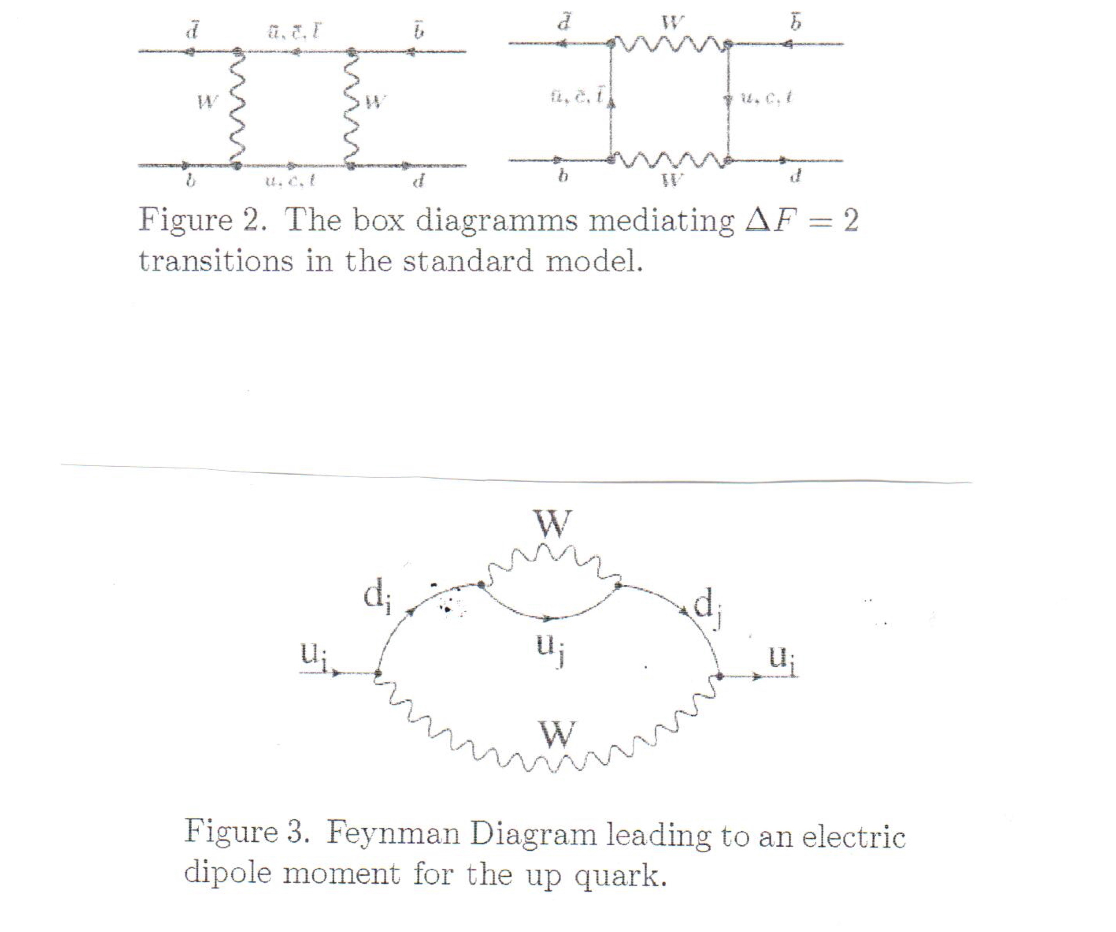
From Nucl. Phys. B167(2007)170

Slide 20
Strong CP problem
One of the underlying assumptions in the particle physics theory is that any process that
is not explicitly forbidden by some conservation law, is mandatory, i.e., must happen
with some probability.
The QCD Lagrangian can have a term that is not excluded by any known law that can
include an arbitrary phase
In contrast to the electroweak interactions QCD gluons couple to (not-chiral) vector currents.
For non-zero value of the angle θ in the chiral quark mass term one expects CP violation.
Experimental data do not indicate any CP violation in strong interactions.
The electric dipole moment of the neutron is estimated in QCD to be ~10⁻¹⁶ × θ e-cm.
The experimental upper limit is [θ] < 10⁻²⁶ e-cm.
A priori θ can have any value between 0 and 2π. So one has to explain why its value is either 0
or very, very small.

Slide 21
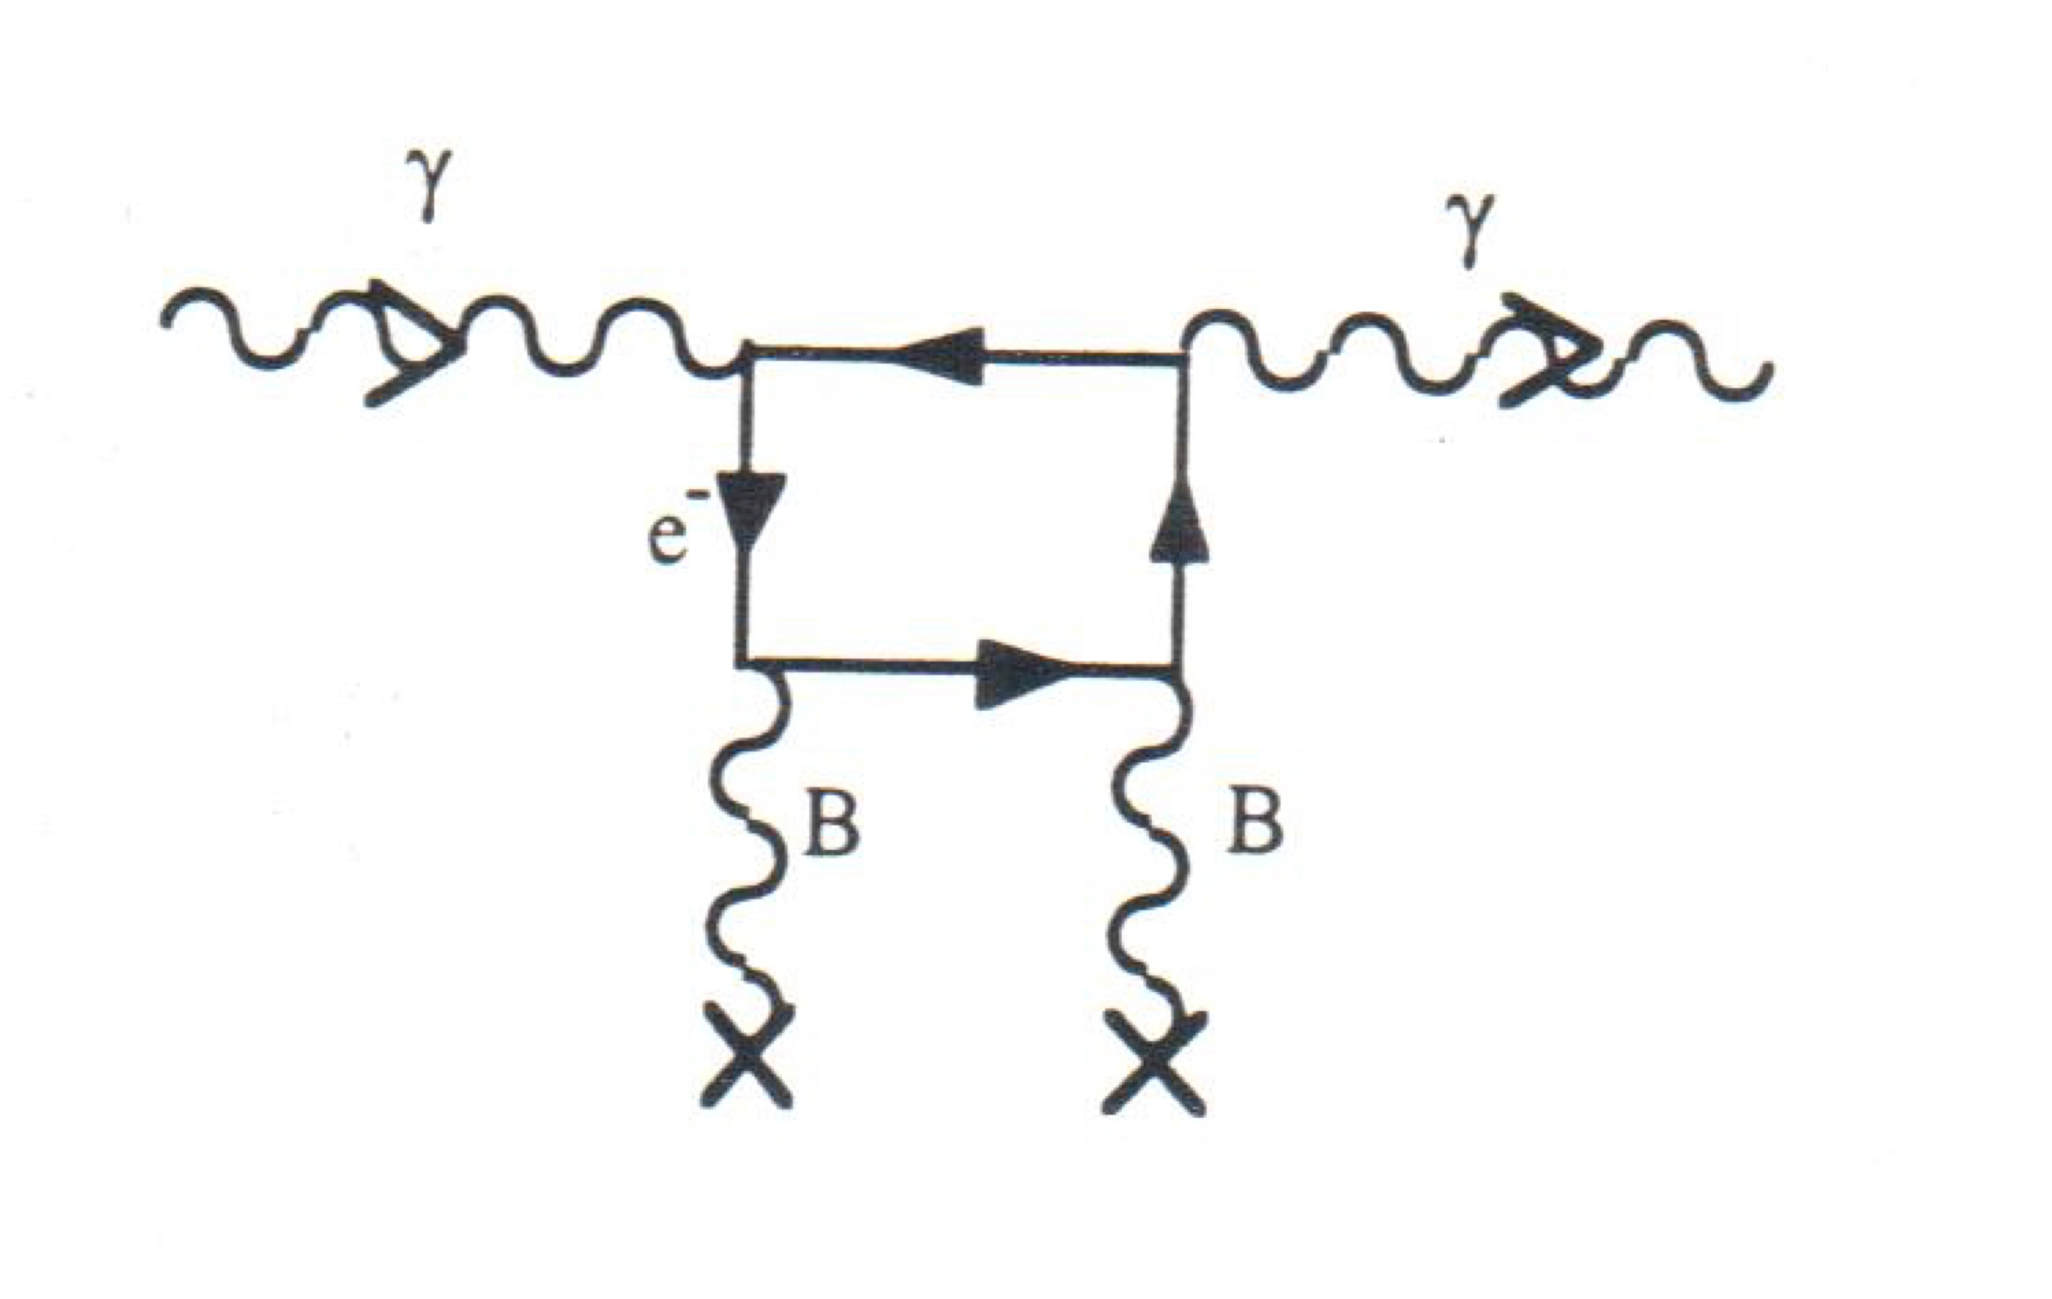
Strong CP problem
Among most popular proposal is the Peccei-Quinn theory that postulates new global U(1)
symmetry with complex, scalar, charged field. This field cancels the term in the Lagrangian that contains phase and eliminates CP violation in strong interactions. It also predicts
existence of a new particles called axions.
Axion mass is not defined by the theory but should be small, much smaller that the mass of electron. Axion is another candidate for dark matter. It can be detected by conversions to two photons in strong magnetic fields.
Searches include light-by-light scattering in magnetic field, axions streaming from the Sun, resonances formed in RF cavities, etc. No positive results have been observed to date.
vacuum birefringence LIRA

Slide 22
Dark photon
A hypothetical elementary particle proposed as an electromagnetic force carrier for dark
matter i.e., a new boson for a new long-range U(1) field
- dark electromagnetism - acting on dark matter. It is expected to carry longitudinal polarization.
Like the ordinary photon, dark photons would be massless.

Slide 23
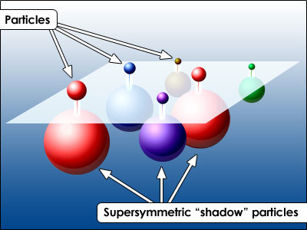
Extra dimensions
Theories with additional spatial dimensions. We detect the 3+1 dimensional space
but some models eg., ADD –Arkani-Hamed, Dimopulous and Dvali – allow
a total of 10 dimensions. This allows the gravity do act in 10 dimension generating
differences of masses of particles observed in 4 dimensions only and “explaining the
apparent smallness of the strength of gravitational interactions. In supersymmetric version
The theory has many versions with number of total dimensions ranging from 10 to 26.
It describes fundamental particles as tiny vibrating strings ~10⁻³² m size i.e., safely outside
possibility of experimental verification.

Slide 24
FUTURE
Short term - approved and funded
Medium term - proposed new projects
Long term - speculative proposals

Slide 25
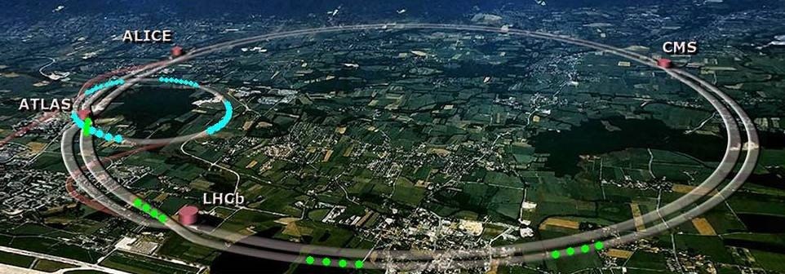
Upgrades: Phase 1 – now, start run 2021: raise energy to 14 TeV, raise luminosity to 10³⁴ cm⁻²s⁻¹
Phase 2 – 2025-2028 : raise luminosity to 10³⁵cm⁻²s⁻¹

Slide 26
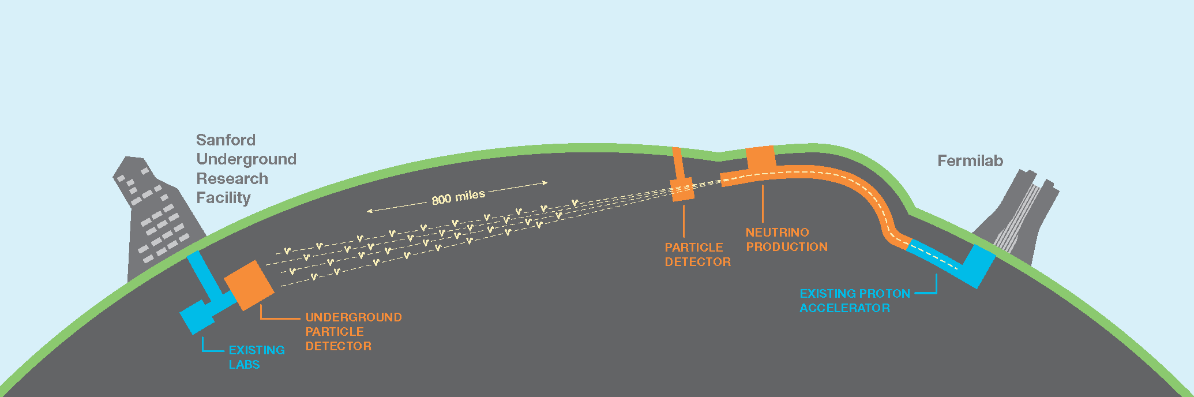
Future
Next few years (based on existing or approved projects that are under construction)
Large Hadron Collider – current run at 13-14 TeV will continue after break until 2023; experiments will accumulate about 5 times more data that we have now. Then,
2nd phase of upgrades of the machine and of the detectors will lead to another factor of 10-100 improvements in amount and quality of data. HL-LHC will operate at least until 2035.
DUNE – Transformation of Fermilab and Sanford underground Research Facility into an International Laboratory for Long-Base Neutrino Facility

Slide 27
Other “small” projects (next few years)
Several second generation (still small) dark mater search experiments
SuperCDMS, LUX ……
Astronomical projects to study dark energy via survey of spectral information
DESI, LSST…….
Search for lepton number non-conservation mu->e+gamma (Fermilab)
Precision measurement of anomalous magnetic moment of the muon (g-2 at Fermilab)
Search for scalar neutrino – microBOONE (Fermilab)
Does antiproton have the same mass as proton (CERN) – ALPHA
Does antiproton has the same gravitation effects as a proton (CERN) - ALPHAg
Properties of anti-hydrogen – antiproton-positron atom (CERN)
Large number of R&D projects to develop new technologies
……..

Slide 28
Far future
It takes 10-20 years to build new large accelerator. This time scale includes
development of technology, development of detailed design and,
most importantly, time to educate/convince politicians who decide on funding.
At this time there are many potential worldwide projects with overall cost estimates
exceeding all money that can be obtained from the conceivable sources
by ~ a factor of 3. Not all of them will be built.

Slide 29
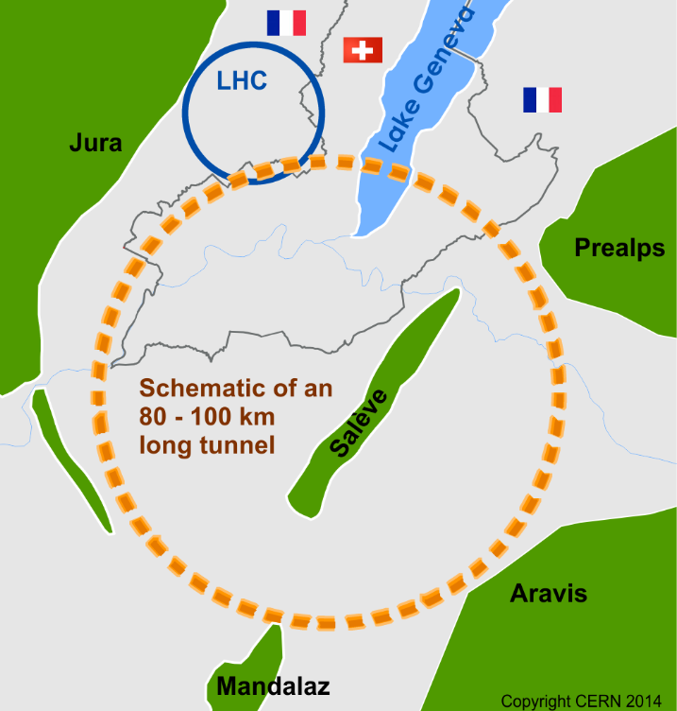
Future Circular Collider
CERN, Geneva
collision energy 50 +50 TeV

Slide 30
The 100 TeV collider design concept is based on the existing dipole magnets
thus requiring a very large ring -> new tunnel.
The other option discussed now at CERN is to stay within the same ring and increase the
strength of the magnets.
The R&D program has succeeded in building a short 16 T magnet -factor of ~1.5 over those
used at LHC. Installation o such magnets in the existing LHC tunnel would allow for an increase
of collision energy to 26 TeV. Such machine would suffer from significant synchrotron radiation
problems requiring continuous acceleration of stored beams to compensate for their energy loss
Europeans have a 2 year discussion program on European Strategy for the future.
One of the options is to insert an electron ring into the LHC tunnel and have electron-proton
Collider. This is the current recommendation, but it will be reviewed again in 2025.

Slide 31
Some of our colleagues, including Olness, are involved in a construction of an
Electron – Ion Collider to study collective phenomena.
Jefferson Laboratory proposal

Slide 32
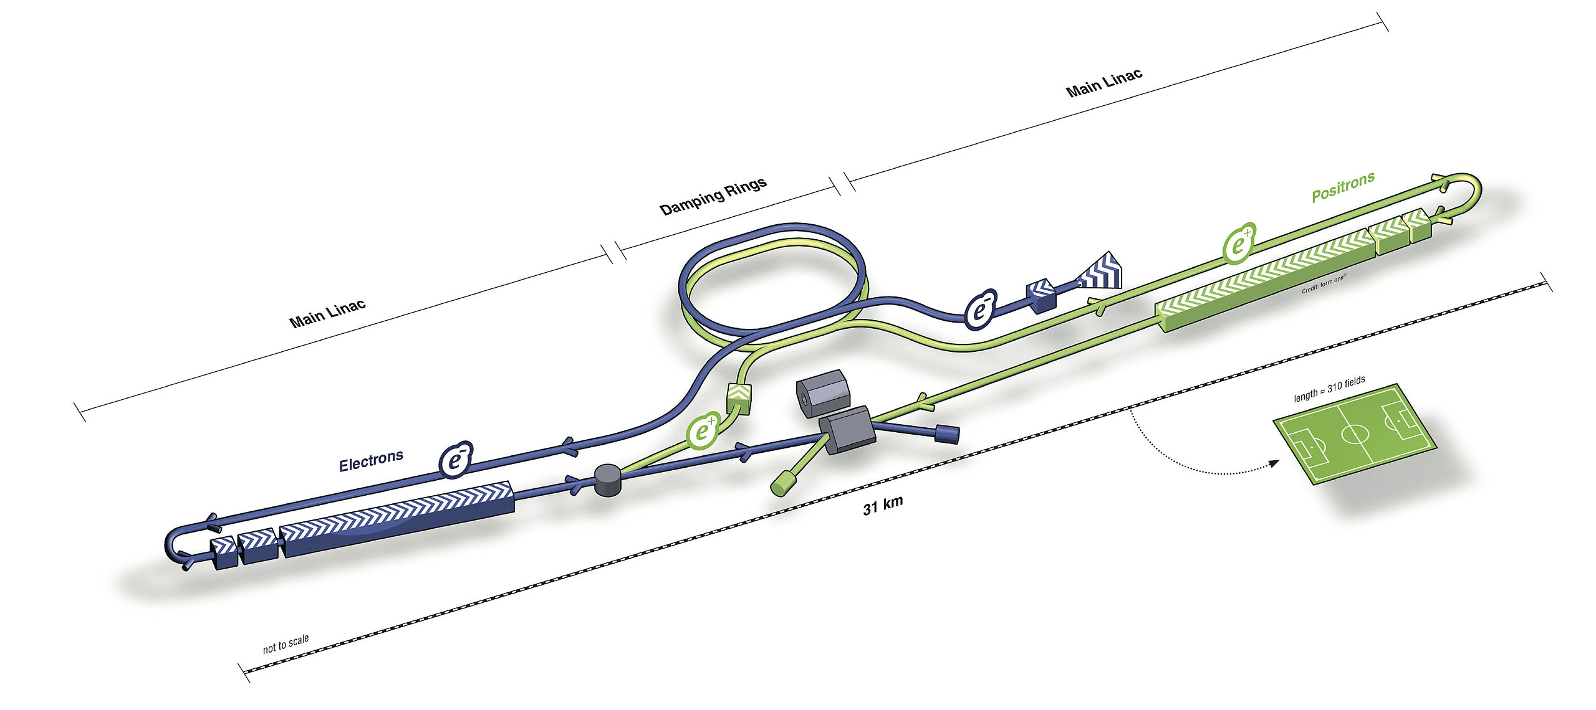
International Linear Collider
electron- positron collisions at 250 x 250 GeV upgradable to 500 x 500 GeV
(Higgs factory)
Japan

Slide 33
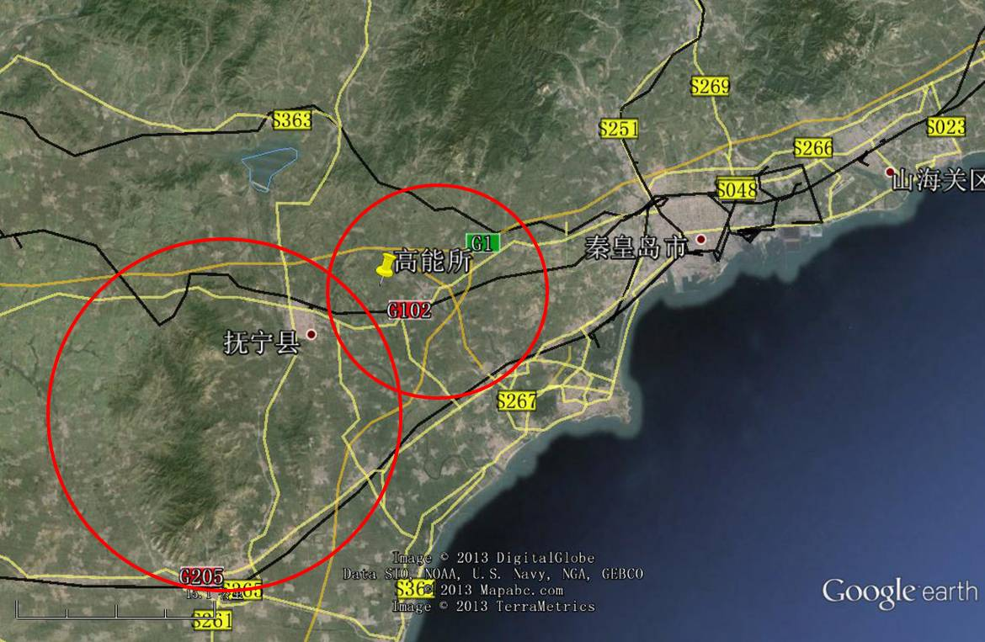
Circular Electron-Positron Collider
Quinghuada, China
collision energy 120 + 120 GeV
(Higgs factory)

Slide 34
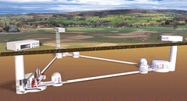
Astrophysical Projects
LSST – Large Synoptic Sky Survey
DESI – Dark Energy Survey Instrument
LIGO 3 – Laser Interferrometry Gravitational Waves Observatories
LISA - Laser Interferrometry, Gravitational Waves in space
Simon Observatory
James Webb Space Telescope (6.5 m primary mirror, infrared)
Einstein Telescope

Slide 35
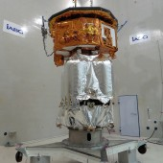
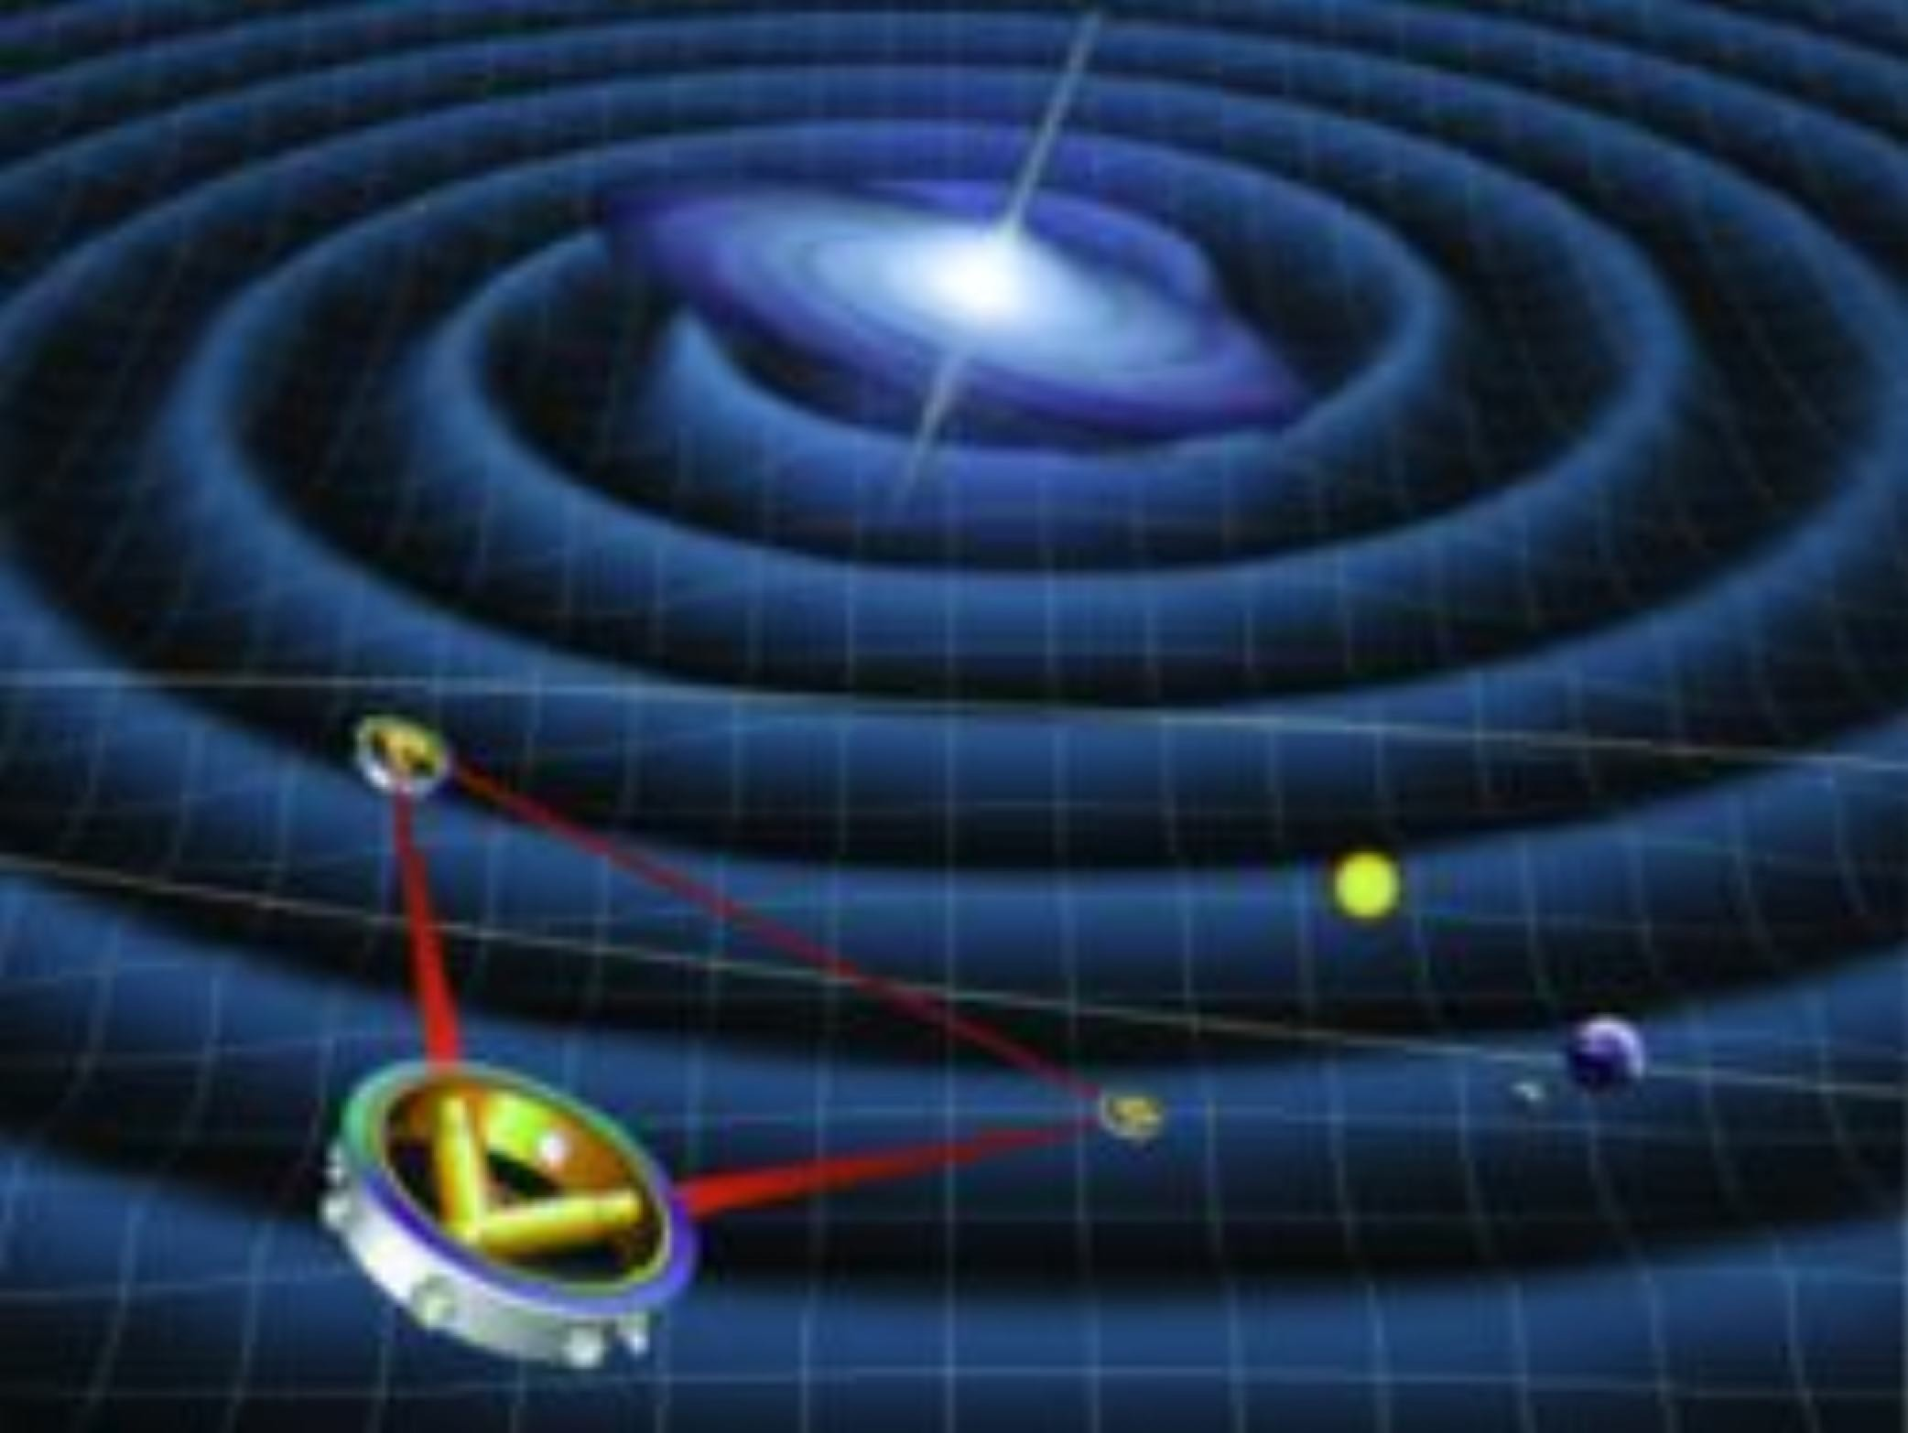
The satellite LISA
The LISA pathfinder satellite (the real thing) successfully launched in December 2015.
The LISA satellite projet (artist’s im- pression). Launch >2025.

