Slide 1
Students’ Lectures - in November
Selection of topics - next week
Outline of presentation - after Fall break
Final review - before the end of October
Some selected subjects of past successful presentations
Particle physics: Antimatter, Neutrino mixing
Proton decay, Higgs, CP violation
CPT theorem, Magnetic monopoles
Cosmic rays
Detector: Calorimeters, Readout electronics
Accelerators: Their use in medicine
Astrophysics: Gravitational waves, Dark Energy
Dark Matter, Big Bang
Cosmic neutrinos
Cosmic microwave background
Nuclear fusion, Neutron stars

Slide 2
Lecture 14 – neutrino oscillations

Slide 3
Color and flavor: a mathematical basis
► Represent color axes mathematically:
ˆr , gˆ → |r > , |g>
(8)
(in linear algebra, |i> represents a column vector, <i| a row
lime
green
vector, with the property | <i|i> | = 1)
► Represent flavor axes:
cherry
θ
|c> , |l>
► Write one set in terms of the other:
(9)
red
|c> = cos θ |r > + sin θ |g>
|l> = − sin θ |r > + cos θ |g>
(10)
(11)
18

Slide 4
Color and flavor: a mathematical basis
|c> = cos θ |r > + sin θ |g>
|l> = − sin θ |r > + cos θ |g>
(12)
(13)
For those of you with linear algebra experience, the above pair of equations will look more simple if represented as a 2 × 2 rotation matrix acting on a column vector to produce another column vector:
19

Slide 5
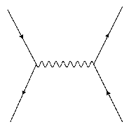
Predictive power
We know now that weak interactions like K ⁺ → µ⁺ν occur when quarks interact via a charged, weak boson (in this case, W ⁺) creating a virtual current that quickly decays to other things (in this case, µ⁺ν_{µ}). The Feynman diagram pictorially representing this is:
In terms of ONLY the interaction strength (ignoring kinematic factors), the probability of this process goes like this:
u
ν
μ
_{W}*+
P(π⁺(ud¯) → µ⁺νµ)
P(K ⁺(us¯) → µ⁺νµ)
∝ cos² θ
∝ sin² θ
s
_{μ}+
u
ν_{μ}
Thus,
_{W}*+
P(K ⁺(us¯) → µ⁺νµ)
sin² θ
∝
2
+ ¯ +
cos θ
= tan θ
P(π (ud ) → µ ν )
2
µ
d
_{μ}+
The elements of the mixing matrix are determined from data
Can be checked by testing ratios of rates for various processes.

Slide 6
The Full Cabibbo-Kabayashi-Maskawa (CKM) Quark Mixing Matrix
Why extend to at least 6 quarks? Such a matrix is the minimum size needed to add a complex component to the otherwise real number components of the matrix. That complex component – phase - leads to CP violation.
θ₁₂ = 13.04 ± 0.05◦; θ₁₃ = 0.201 ± 0.011◦; θ₂₃ = 2.38 ± 0.06◦; δ₁₃ = 1.20 ± 0.08rad.
The first angle is the Cabibbo Angle. δ₁₃ is the complex phase. These are not predicted; they must be measured.

Slide 7
Quarks - CKM Matrix – Cabibbo-Kobayashi-Maskawa
Introducing unitarity – requirement that the total probability of decay
is equal to 1, one can rewrite it in terms of sins and cosines and add
an arbitrary phase.
The phase δ is responsible for the asymmetry in the decays of particles
versus antiparticles i.e., CP violation.
Rate not sufficient to explain matter-antimatter asymmetry.

Slide 8
► The weak interaction has a universal strength, usually written as the Fermi Coupling Constant, G_{F} = 1.16639(1) × 10⁻⁵ GeV⁻²
► However, that is modified by how the quark flavor changes in a weak interaction; the degree of modification is given by the CKM Matrix.
► This simple picture has remarkable power. It has been used since 1973 to successfully predict as-yet unmeasured parameters of the theory of nature (the Standard Model), specifically the parameters of the CKM matrix. Measured in a few processes, they have well-predicted then-unseen behaviors of quark matter that would later be observed and confirm this picture.

Slide 9
In weak processes the d, s and b quarks can be treated as superposition of all three charge -1/3 quarks - mismatch of quantum states of quarks when. Again analogy to rotation of reference frame. They are eigenstates of flavor in the production, but oscillate when propagate freely.
For two quarks
d’ = cosθ_{c} d + sinθ_{c} s θ_{c} – Cabbibo angle
s’ = -sinθ_{c} d + cosθ_{c} s d, s – mass eignenstates
d’, s’ – weak eigenstates
In matrix notation

Slide 10

All observed W mediated processes indicate left-handed
spin polarization of W±. So far there is no evidence for
right-handed W current. That leads to the uncomfortable list of
quarks and leptons from the perspective of their spins:
left-handed doublets, right-handed singlets and no info
whether right-handed neutrino exist.
d, s and b quarks can be treated as superposition of all three
charge -1/3 quarks - mismatch of quantum states of quarks when
they are involved in weak interactions. They are eigenstates of flavor
in the production, but oscillate when propagate freely.

Slide 11
Trouble with neutrinos
Three flavors of neutrinos, each associated with charged lepton
ν_{e} - electron neutrino
ν_{μ} – muon neutrino
ν_{τ} – tau neutrino
Lepton number conservation →
interactions/decays conserve “electronic”, “muonic” and “tauonic” characteristics
Experiments measuring electron energy spectrum from radioactive decays to electron
and neutrino have not been able to establish any deviation of the shape of the spectrum
from that expected for massless neutrino
conclusion valid until 1990ties: “neutrino have mass = 0” and move with
the speed of light
Theoretical arguments about neutrino mass come from cosmology. Big Bang model
predicts a ratio of number of photons (cosmic microwave background) to the total
energy of the neutrinos providing an upper limit on the sum of the three neutrinos
masses of 20 MeV. More recent stringent analysis of cosmological data set upper
limit at 0.3 eV. Note – mass of electron is ~500,000 eV. Do they really have a mass?

Slide 12
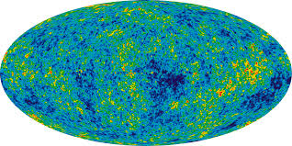
Sources
Big Bang – there is a neutrino cosmic background like there is a microwave background – but they are too low energy to be detected

Slide 13
Sources on Earth
Big Bang ~300-400/cm³ in the universe
Sun and stars (~ 65 billions/cm² per second)
day and night
Secondary products of cosmic rays interactions
Reactors
Neutrinos from Hell (heavy elements in earth
core, magma and mantle)

Slide 14
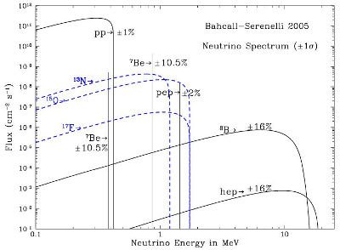
Neutrino flux on Earth predicted by Standard Solar Model
Neutrino flux at Earth predicted by the standard solar model of 2005.
The neutrinos produced in the pp chain are shown in black, neutrinos produced by
the CNO cycle are shown in blue. The solar neutrino spectrum predicted by
the BS05(OP) standard solar model. The neutrino fluxes from continuum sources are
given in units of number cm⁻² s⁻¹ MeV⁻¹ at one astronomical unit, and the line fluxes
are given in number/cm⁻² s⁻¹.

Slide 15
Aside - How does our SUN work ?
→ nuclear physics
Three main sequences of proton-proton fusion with relative rates depending on the
temperature and pressure at the core – Standard Solar Model
→ copious production of photons who’s outwards pressure counteracts gravitation forces
→ most of the energy from the star dominated by type-1 pp reaction
is carried out by neutrinos
Star is stable as long as the there is sufficient amount of hydrogen to sustain pp fusion.
Our Sun formed ~4.6 billion years ago and will remain stable for another ~5 billion years.
The future of a star after pp fuel is exhausted depends on its mass. Our Sun will become
red giant with radius expanding perhaps to the Earth orbit.
The nuclear processes inside all stars are assumed to be the same. In all scenario the cosmos
is full of neutrinos from fusion process.

Slide 16
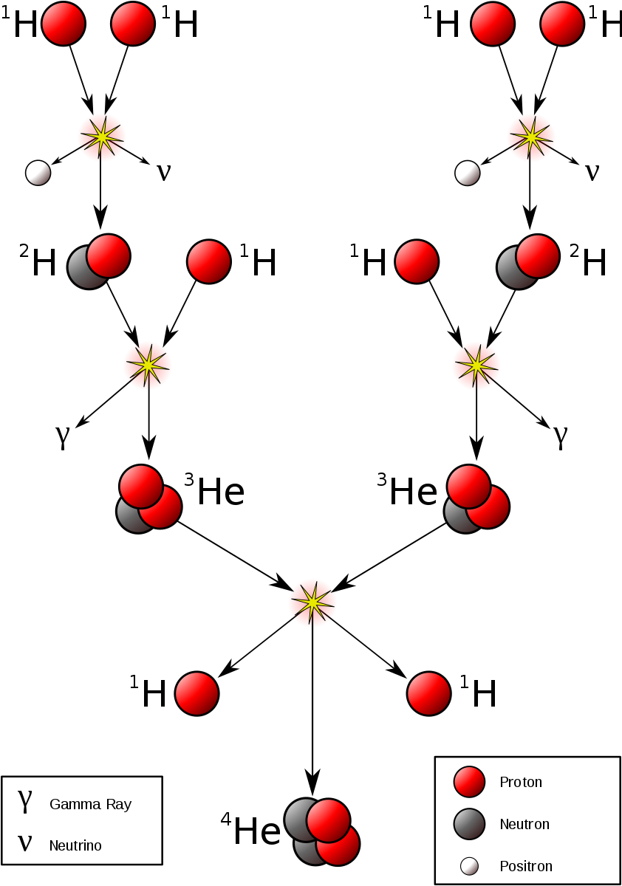
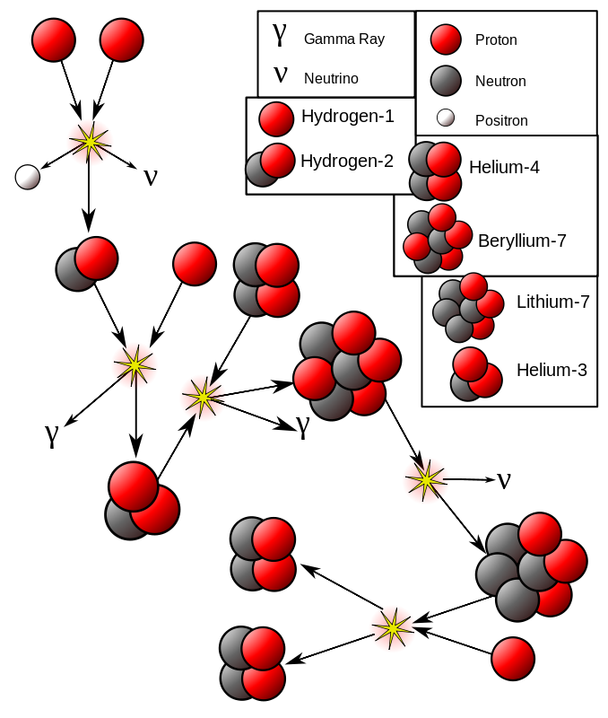
Three pp reaction chains
Expect electronic neutrino

Slide 17
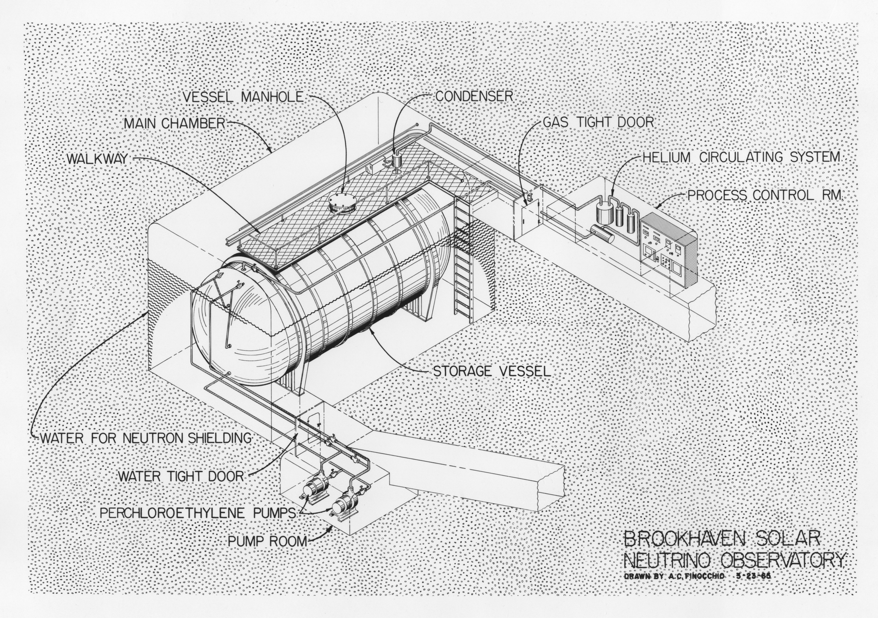
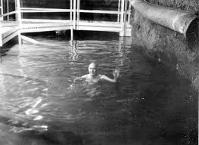
First indications of troubles: Davis experiment in Homestake mine.
Davis searched for neutrinos coming from the fusion processes in the SUN using
a radiochemical method where charged current neutrino interaction with a nucleus of ³⁷CL
(via W exchange) would result in a creation of ³⁷Ar atom. He used a tank filled with a cleaning
fluid named tetrachloroethylene. The threshold neutrino energy for this reaction is 0.814 MeV
– well in the middle of the expected solar neutrino spectrum for pp fusion reactions. The fluid
was periodically purged with helium gas that removed the argon. The argon was then separated
out by cooling.(Liquid helium ~4K, liquid argon ~70K). The argon atoms were counted via electron
capture radioactive decays (nuclear physics effect of proton rich nucleus capturing an electron
from an inner shell crating neutron and electron neutrino.
Cl(17 protons), Ar(18 protons) p + e- → n + ν_{e}
Water tank shielding
from external neutrons

Slide 18
Davis results during first 15 years of operations varied between 8 and 15 events per year
and were largely ignored. Eventually, it became a problem as the Solar Model became
established and its predictions for luminous flux, and heavy nuclei production (metalization)
that can be detected on the Sun’s surface became confirmed by spectral measurements.
Davis experiment has indicated deficit of ~50% of the expected electron neutrinos.
Solar neutrino problem
There have been several later experiments confirming this deficit. Wikipedia always emphasizes
the latest experiment with largest data samples, but these just repeat original ideas at larger
scales.
The explanation of this deficit is that neutrino does not remain fixed to one flavor. It changes
flavor with time (or equivalently a distance of travel from its origin). This explanation assigns
a non-zero mass to the neutrino, but their most likely mass range today is of the order of 10⁻⁵ eV,
i.e., about 10 orders of magnitude smaller that the mass of electron.
Consequence of neutrino flavor oscillation:
Neutrino in the Sun start as ν_{e} . During the passage through the Sun and to the Earth a
fraction of these neutrinos oscillates to become ν_{μ} .
The electron neutrino has typical energy (<10 MeV) sufficient to produce an electron in
flavor conserving interaction can with a nucleus of a detector on Earth. However a ν_{μ} with
energy 10 MeV cannot produce a muon since m_{μ} = 105.6 MeV
→ it cannot be detected

Slide 19
40 “ bubble chamber

Slide 20
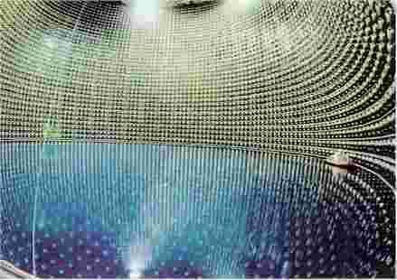
Super-Kamiokande
cylinder ~40m diameter, 40 m tall with 50,000 tons of purified water
>11,000 phototubes 20” diameter
muon neutrino beam from KEK Laboratory (π⁺ → μ⁺ ν_{μ}) → appearance of
electron neutrinos

Slide 21
Super-Kamiokande

Slide 22
Neutrino oscillations: each neutrino is a superposition of 3 neutrino states with definite mass.
Neutrinos are produced in weak process in flavor eigenstates – definite flavor
As neutrino propagates in space, the quantum mechanical phase advances differently due to
different masses. Neutrino produced as an electron neutrino can become after some distance
a muon neutrino.
Since mass differences are small, the effect becomes visible only at large distances.
neutrino with definite flavor: α = e, μ, τ
neutrino with definite mass: i=1, 2, 3
Unitary transformation

Slide 23
General Derivation
Where are the flavor eigenstates, are the mass eigenstates with mass and is the neutrino analogue of the CKM matrix, i.e., the mixing matrix.
Gives the eigenstates at a later time t and position .

Slide 24
Intensity
Let us assume the neutrino interacts weakly at time t, and we tag it as a flavor eigenstate . Then we have an intensity:
We use the ultra-relativistic limit so that:

Slide 25
Mixing Equation
So that:
Which will serve as the standard mixing equation.

Slide 26
Two Generation Mixing
If only two generations (say, electron and muon) participate, then:
Setting for the initial state, there are two intensities, one for each value of related by:

Slide 27
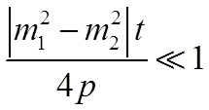
Two Generation Mixing
And
Which has three important limits:
1)
When we are close to the source (small t) , no oscillations are noticeable.

Slide 28
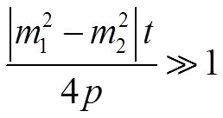
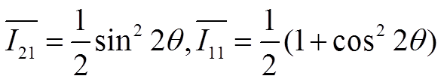
Other Cases
2)
A pattern is noticeable as t varies, so the precise calculation of is possible.
3) The experiment will average over the
rapid oscillations, resulting in
We have oscillations, but cannot measure the mass difference.

Slide 29
Three Generation Mixing
For three generation mixing, oscillations can be described in terms of four angles: one CP-violating phase and three differences of masses squared, only two of which are independent.
Experimental evidence suggests that two of the mass eigenstates are more degenerate with each other than they are with the third:

Slide 30
Three Generation Mixing
This simplifies the mixing equation so that:
Which can be rewritten as:

Slide 31
The Grand Finale
Where from experiment evidence so far.

Slide 32
The dependence of the oscillation phase on the distance travel and neutrino energy
can be written as
The probability of a neutrino changing its flavor is (2-neutrino oscillations):
General case
Δm² ~ 10⁻⁴ eV

