Slide 1
Lecture 16

Slide 2
Accelerators Ideal Case
Goal of an accelerator: increase energy of CHARGED particles
Increase energy
The particle trajectory direction dr parallel to v
Increase of energy via electric fields
Magnetic fields are used for control of trajectories

Slide 3
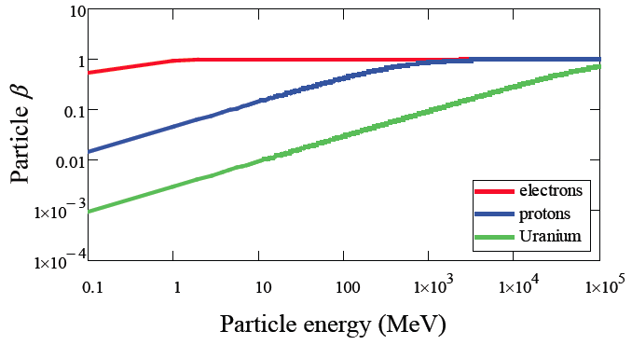
Energy vs velocity
Acceleration increases velocity of a particle at small β = v/c.
For high β the velocity does not change. There is a change of momentum/ energy that can be expressed as a change of effective mass
1 MeV
1 GeV
Particle rest mass:
electron 0.511 MeV
proton 938 MeV
²³⁹U ~220 000 MeV

Slide 4








Electrons
Electrostatic accelerator
Set up electrostatic potential along particle trajectory.
Charged particles go through the accelerating voltage gap
Target
Particle Source
T
Power supply
E-­‐ Field
Limited by the maximum reachable voltage: ~ 10 MV
(For potentials above 10 MeV the electrostatic force may strip orbital electrons from the atoms of the material from which the accelerator is constructed creating sparks, breakdowns of the material and general mayhem).

Slide 5
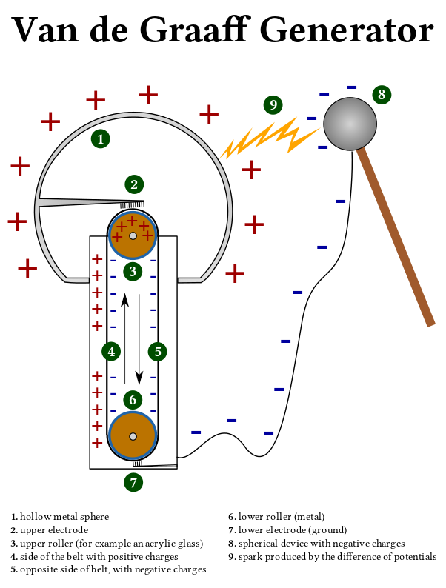
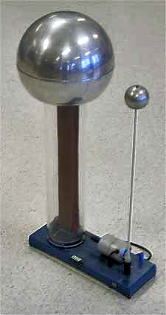
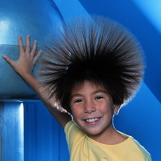
van de Graaf Accelerator
Creation of high voltages by mechanical transport of charges
Terminal Potential: U ≈ 12 ...28 MV
(use of high pressure gas to suppress discharge)
Particle energy limited by high voltage discharges
High voltage can only be applied once per particle

Slide 6
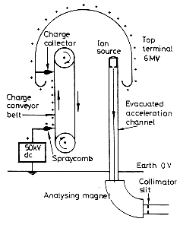
van de Graaf Accelerator
Creation of high voltages by mechanical transport of charges
Terminal Potential: U ≈ 12 ...28 MV
(use of high pressure gas to suppress discharge)
Particle energy limited by high voltage discharges
High voltage can only be applied once per particle

Slide 7
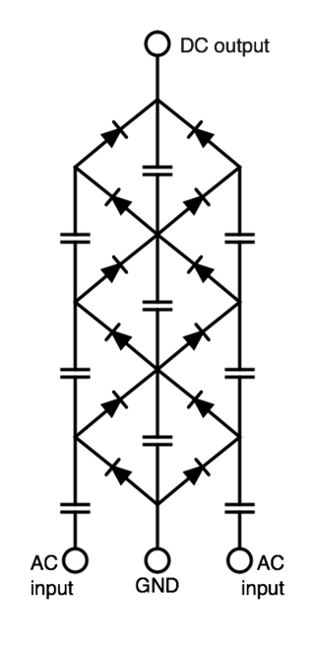
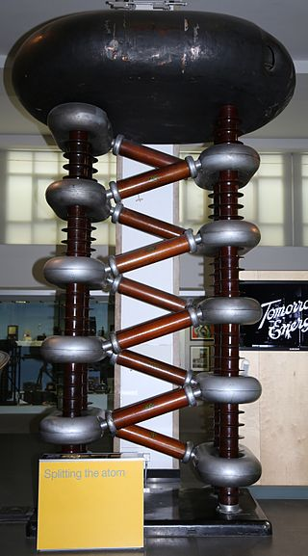
1928-1932 Cockcroft-Walton Generator
Electric circuit that generates a high DC voltage from a low voltage AC
or pulsing DC input
Technically: rectifier circuit, built of capacitors and diodes
Particle source – hydrogen discharge tube at 400 kV
Used to split Li nuclei by bombardment with protons with 400 keV
Simple, cheap and robust.
Limitation: electric discharge
due to too high voltage.
Practical limit ~ 1MV

Slide 8
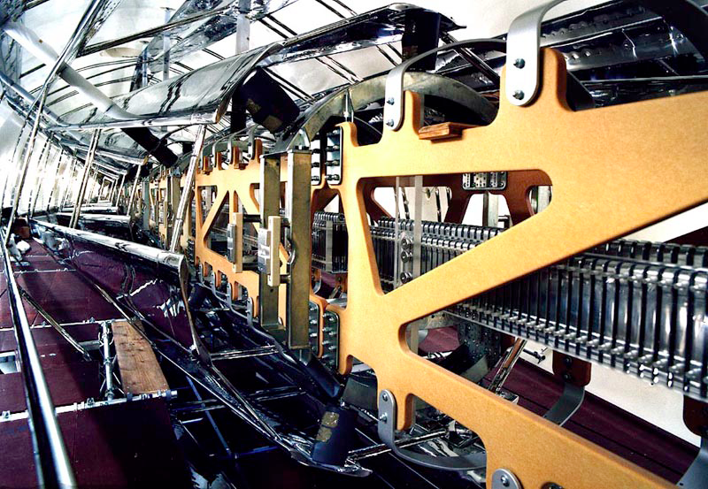
Tandem
Tandem principle: Apply the accelerating voltage twice by working with negative
ions (e.g. H-) and stripping the electrons in the centre of the structure.
- negatively charged ions are accelerated through one potential difference before being
stripped of two or more electrons inside a high voltage terminal and accelerated again
12 MV-Tandem van de Graaff
accelerator at MPI Heidelberg
Accelerating structure

Slide 9


Slide 10
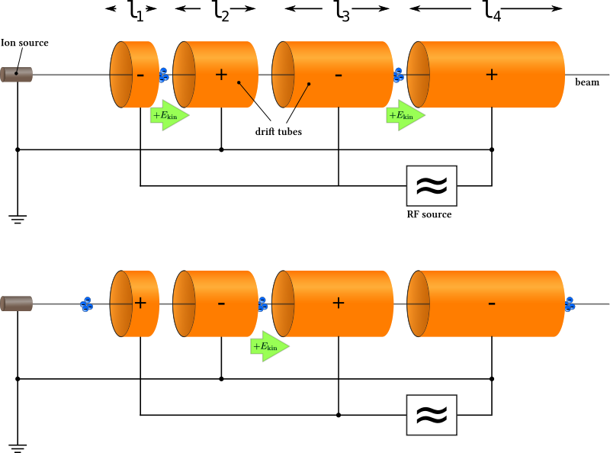
1928 Wideroe Linac – First RF Accelerator
Acceleration voltage applied several times to the particle beam
Acceleration in the gap
RF – voltage has to be flipped
to get the right sign in the next gap
Shield particle in a drift tube during the
negative half-wave of the RF voltage
Energy after n gaps ~ n * q * U * ψ
U - peak voltage of the RF system
ψ – synchronous phase of the particle
drift tube

Slide 11
Alternating RF Field
Apply the same voltage through acceleration gap many times.
Particle synchronous with field. In shielding tube when field has opposite sign. Voltage across each cell the same.
Shielding tubes have to become longer and longer, as particles become faster and faster or frequency must become higher λ = c/f_{RF}
Problem - radiation power loss: P = ω_{RF}CV_{RF}², C - gap capacitance
Energy gain per gap:
E = q V_{RF}sin(φ_{s})
φs…phase wrt to RF field

Slide 12
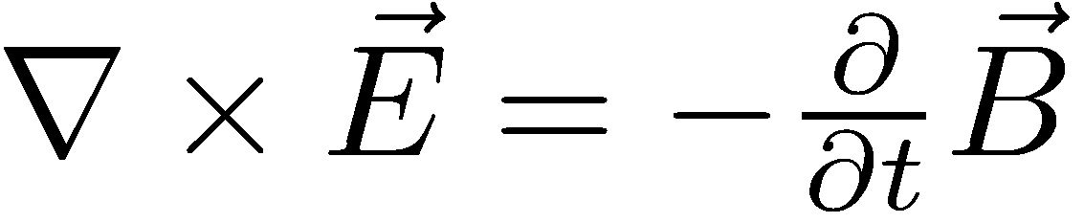
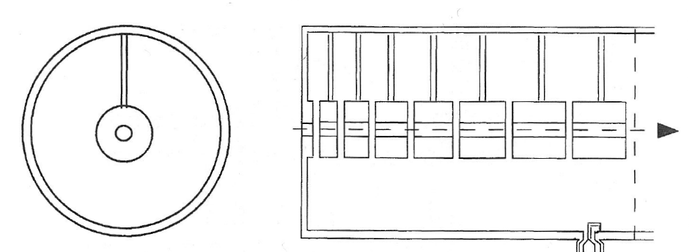
Drift Tube Linac (Alvarez)
• To eliminate power loss place drift tubes in a RF cavity
– Electromagnetic field oscillating in cavity. Standing wave, TM mode
TM – transverse magnetic mode of electromagnetic wave propagation
imposed by the boundary condition – no magnetic field in the direction
of propagation
longitudinal E Field, transverse B Field
– Resonant frequency of cavity = accelerating field frequency!
– Reduces power loss
– Exploit Farraday’s law:
Longest electron linac - SLAC 2 miles, can reach 50 GeV
Proposed International Linear Collider - ~20 miles can reach ~300 GeV

Slide 13
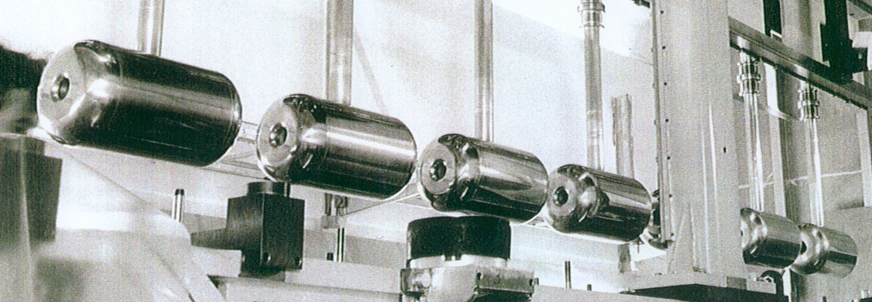
Accelerating structure of the proton linac at DESY
Proton rest mass m₀c² = 938 MeV
Total Energy E_{tot} = 988 MeV
Momentum p = 310 MeV/c
Kinetic energy E_{kin} = E_{tot} – m₀c² E_{kin} = 50 MeV
Relativistic relation: E² = p²c² + m₀²c⁴

Slide 14
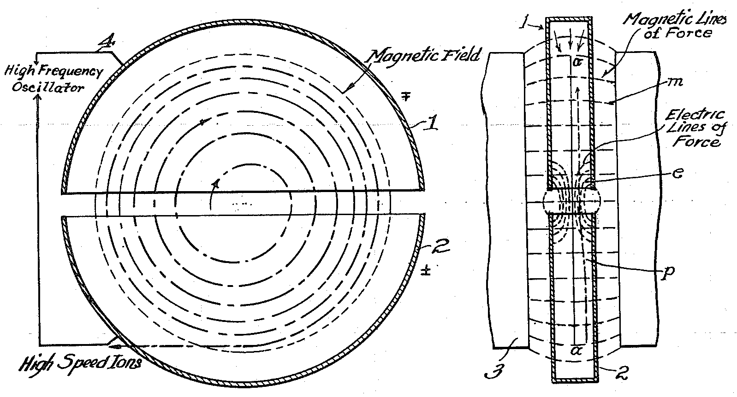
Cyclotron
1930 –Livingston/Lawrence
A cyclotron is a type of particle accelerator in which charged particles accelerate outwards from the center along a spiral path. The particles are held to a spiral trajectory by a static magnetic field and are accelerated by a rapidly varying electric field.
Diagram of cyclotron operation from Lawrence's 1934 patent. The "D" shaped electrodes are
enclosed in a flat vacuum chamber, which is installed in a narrow gap between the two poles
of a large magnet.

Slide 15
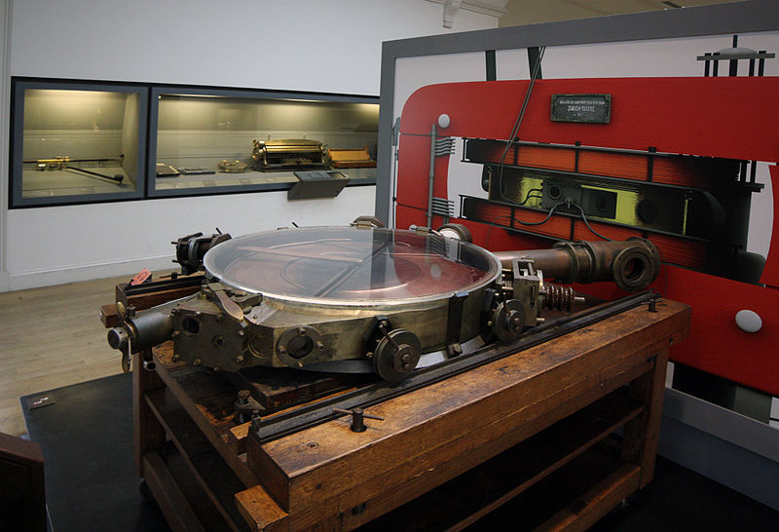
Lorentz force
Circular orbit qvB=mv²/R implies R= p/(qB) i.e., increasing radius for increasing momentum
-> spiral trajectory
Revolution frequency (rf) is independent of the momentum
Need huge magnets
proton/ion acceleration up to ~60MeV
used for radiation therapy
At low energy frequency does not
depend on the radius – mass is constant
1937 cyclotron in Zurich

Slide 16
Principle of RF acceleration
V -potential
Negative
charge
velocity of the wave front
velocity of the charge
x - position
Developed during WWII for radar – uses high frequency E field in GHz range

Slide 17
Relativistic effects
Lorentz factor
Relativistic mass m = γm₀
Relativistic cyclotron frequency f = f₀/γ
Here, m₀ is the rest mass and f₀ is the frequency in classical approximation.
To correct for relativistic effects synchrocyclotron has a frequency of the electric field
varied to compensate for the apparent “increase” of mass.
Another solution is isochronous cyclotron where the magnetic field is increasing with radius
and time.

Slide 18
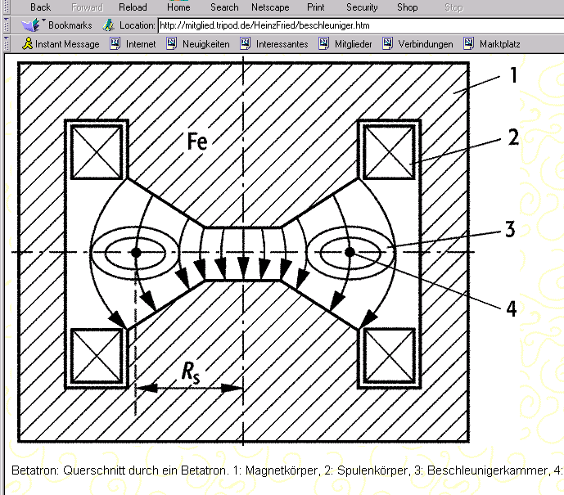

1934 Wideroe, 1940 Kerst
Betatron
Transformer with a torus-shaped vacuum tube as its secondary coil. An alternating current
in the primary coils accelerates electrons in the vacuum around a circular path.
Time varying magnetic field induces a voltage that accelerates the particles. No RF system, just
changing magnetic field.
schematic design
Magnetic guide field
Accelerating electric field
Initially used to accelerate electrons up to about 300 MeV (limited by synchrotron radiation).
Also used in medical applications: energetic electrons impinging on a metal plate are a source
of hard X-rays.

Slide 19
1952 Courant, Livingston, Snyder
Synchrotron
The guiding magnetic field (bending the particles into a closed path) is time-dependent,
being synchronized to a particle beam of increasing kinetic energy.
Idea: define a circular orbit of the particles, keep the beam there during acceleration,
put magnets at this orbit to guide and focus.
Derivatives:
Storage rings – synchrotron in which the kinetic energy of the particles is kept constant
Colliders – combination of two storage rings with beams circulation in opposite directions
Synchrotron light sources – combination of different accelerators to produce intense source
of synchrotron radiation and X-rays.

Slide 20
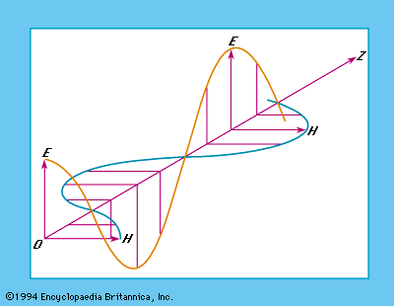
Time Varying Fields
Plane electromagnetic wave
Wave equations
No acceleration in the direction of propagation

Slide 21
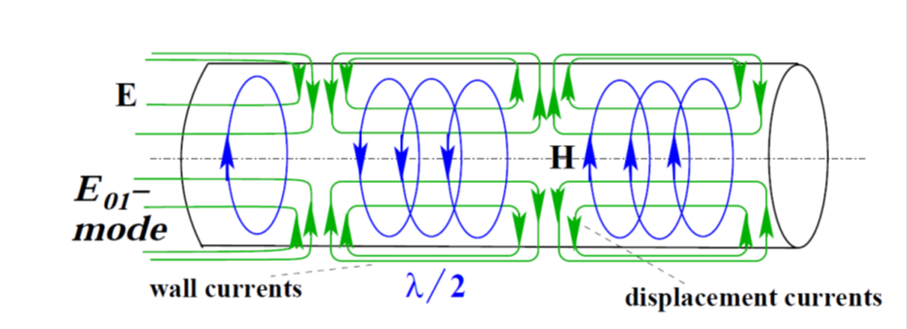
Boundary conditions
Transverse electric waves (TE)
E_{z} = 0 everywhere
at boundary
Transverse magnetic waves (TM)
B_{z} = 0 everywhere
E_{n}|_{s} = 0 at boundary

