Slide 1
Lecture 15
Mixing of three neutrinos
New ideas about neutrino sector

Slide 2
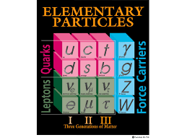
Reminder
Electric charge
q = +2/3
q = -1/3
q = +1
q = 0

Slide 3
The Full Cabibbo-Kabayashi-Maskawa (CKM) Quark Mixing Matrix
Quark mixing
”down”-like quarks are produced as mixture of flavor eigentastes
decay as fixed eigenstates with a probability give by CKM matrix elements
Why extend to at least 6 quarks? Such a matrix is the minimum size needed to add a complex component to the otherwise real number components of the matrix. That complex component – phase - leads to CP violation.
θ₁₂ = 13.04 ± 0.05◦; θ₁₃ = 0.201 ± 0.011◦; θ₂₃ = 2.38 ± 0.06◦; δ₁₃ = 1.20 ± 0.08rad.
The first angle is the Cabibbo Angle. δ₁₃ is the complex phase. These are not predicted; they must be measured.

Slide 4
Neutrino oscillations: each neutrino is a superposition of 3 neutrino states with definite mass.
Neutrinos are produced in weak process in flavor eigenstates – definite flavor
As neutrino propagates in space, the quantum mechanical phase advances differently due to
different masses. Neutrino produced as an electron neutrino can become after some distance
a muon neutrino.
Since mass differences are small, the effect becomes visible only at large distances.
neutrino with definite flavor: α = e, μ, τ
neutrino with definite mass: i=1, 2, 3
Unitary transformation can be treated as a product of transformations between two flavors

Slide 5
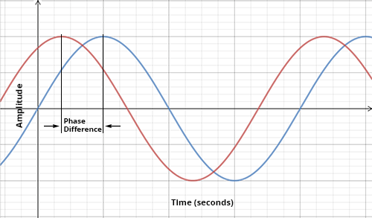

Slide 6
General Derivation mixing as function of time, distance and difference of masses
Where are the flavor eigenstates, are the mass eigenstates with mass and is the neutrino analogue of the CKM matrix, i.e., the mixing matrix.
Gives the eigenstates at a later time t and position .

Slide 7
Intensity
Let us assume the neutrino interacts weakly at time t, and we tag it as a flavor eigenstate . Then we have an intensity:
We use the ultra-relativistic limit so that:

Slide 8
Mixing Equation
So that:
which will serve as the standard mixing equation.

Slide 9
Two Generation Mixing
If only two generations (say, electron and muon) participate, then:
Setting for the initial state, there are two intensities, one for each value of related by:

Slide 10
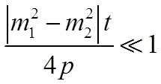
Two Generation Mixing
And
Which has three important limits:
1)
When we are close to the source (small t) , no oscillations are noticeable.

Slide 11
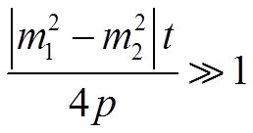
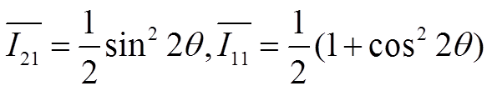
Other Cases
2)
A pattern is noticeable as t varies, so the precise calculation of is possible.
3) The experiment will average over the
rapid oscillations, resulting in
We have oscillations, but cannot measure the mass difference.

Slide 12
Three Generation Mixing
For three generation mixing, oscillations can be described in terms of four angles: one CP-violating phase and three differences of masses squared, only two of which are independent.
Experimental evidence suggests that two of the mass eigenstates are more degenerate with each other than they are with the third:

Slide 13
Three Generation Mixing
This simplifies the mixing equation so that:
Which can be rewritten as:

Slide 14
The Grand Finale
Where from experimental evidence so far.

Slide 15
Translation to variables that can be controlled in experimental tests
The dependence of the oscillation phase on the distance travel and neutrino energy
can be written as
The probability of a neutrino changing its flavor is (2-neutrino oscillations):
General case
Δm² ~ 10⁻⁴ eV

Slide 16
Neutrinos – what know (assume) today
The number of light neutrinos from the combination of 4 LEP experiments
with data collected at energy corresponding to mass of Z⁰ (~90 GeV).
At LEP – Electron-Positron collider with c.m. energy up to ~130 GeV run at energy
equal to mass of Z and measure partial decay width to all known charge particles.
The difference of the production width and sum of the measured decay width’s limits the
Rate for decays to invisible particles i.e. neutrinos to Nν = 2.984 ± 0.008
Neutrinos are produced in weak decays with the definite lepton flavor
They are detected via charged current (W±) weak interactions again with a definite
lepton flavor.
Between production and detection neutrino oscillate between flavors.
mass < 1 eV
mass difference (m₂ - m₁)² = (7.53 ± 0.18) × 10⁻⁵ eV²
mass difference (m₃ - m₂)² = (2.444 ± 0.034) × 10⁻³ eV²
mass ordering unknown
All ν’s measurable quantities – mass, magnetic moments, etc. depend on the mixing
matrix and the detection technique. They can be different for each flavor.
Most of the observables cannot distinguish between Dirac and Majorana neutrinos
Mean lifetime/mass limit > 10⁷ s/eV (based on solar neutrinos)
Magnetic moment μ < 0.29 x 10⁻¹⁰ of Bohr Magneton of electron - eħ/2m_{e}

Slide 17
Production rate
decay rates
Z can decay to a pair of particles with mass < Z/2
→ the limit of the number of neutrinos applies only to light objects

Slide 18
Phase δ is non-zero only if neutrino oscillation violates CP symmetry
-> different rates of oscillations
Neutrino is called a Majorana neutrino if it is identical to its own antiparticle.
Otherwise it is called a Dirac neutrino.
Oscillation becomes complicated for thee neutrinos
We do not know
what are the neutrino masses or even an ordering of their values
whether the oscillations are two-ways or three-ways
whether neutrinos are Dirac or Majorana
We know from precision measurements of Z boson decays that there are
only 3 light neutrinos associated with 3 families of quarks and leptons.
We cannot exclude existence of heavy neutrinos with masses above m(Z/2) ~ 45 GeV/c²
Dune
Major US national program centered at Fermilab (produce intense neutrino beams)
with near detectors at Fermilab and Homestake mine in Lead, South Dakota 810 miles
from Fermilab.

Slide 19
Theoretical hypotheses of new physics
Sterile neutrinos - another attempt to explain the problem of
chirality i.e., spin of the neutrino
Neutrino oscillations indicate that neutrinos have non-zero mass
and therefore move with velocities less than speed of light c.
Their helicity is therefore non-invariant because now it is possible
to move faster than they and observe opposite helicity. But right
handed neutrinos have not been observed.
Postulate – the right handed neutrinos exist but interact only via gravity
which is very weak. They may have any mass and if they are
sufficiently heavy they may be an explanation for the “dark mass”
problem.

Slide 20
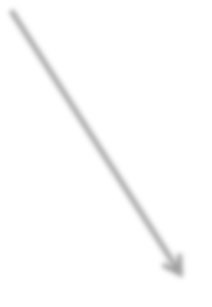

Higgs and neutrino mass
In general, the Standard Model provides a mechanism for particles to acquire mass through interactions with Higgs boson. Higgs boson has spin zero thus it is neither left‐handed nor right‐handed. Quantum Field Theory plus Lorenz invariance shows that a particle interaction with Higgs boson results in a left‐handed particle becoming right‐handed and then again left‐handed over the second interaction with Higgs and so on. The frequency of such interactions is proportional to particle mass.
γ
Extensions od the Standard Model with Dirac right handed neutrinos → right-handed W is heavy and has weak coupling,
e
L
⋅
⋅
e
R
e
e
⋅
e
R
L
∝_{L}
⋅
∝_{R}
∝
⋅
∝
26
10 weaker then with ordinary neutrino
∝
L ⋅
∝
R
⋅
R
⋅
⋅
∝_{L}
→Arkani‐Hamed, Dimopoulos, Dvali – superstring theory: – right‐handed neutrinos may move in extra dimensions while all other particles do not
t
L
⋅ ⋅ t_{R}
⋅
t
_{t} ⋅ ⋅⋅
L
R _{⋅ t}
ν_{L}
ν
Majorana neutrinos – are their own antiparticles. The left‐handed neutrino interacting with Higgs produces a very heavy right‐handed allowed by Heisenberg uncertainty principle. That one interacts right away with Higgs producing another left‐handed state. → left-handed neutrinos are very heavy
ν_{L}
⋅
ν_{R}
ν_{L}
ν
⋅
ν_{L}
⋅⋅
1/M
ν_{L}
ν
time

