Slide 1
HH->bbyy kinematics
Maddie McKay
Phys 8361
4/5/16

Slide 2
Outline
Selection Criteria
Comparison of variables between bb parent H and yy parent H
LO and NLO comparison
Next steps

Slide 3
Selection Criteria
Use MC15 HH->bbyy LO (MadGraphPythia8)
Loop over all events (100,000)
In each event, loop over all Truth Particles in TruthParticleContainer to find Higgs (require PdgId = 25)
If there are fewer than 2 Higgs in an event, move on to next event
Select Higgs with 2 gamma children (require child PdgId = 22)
Select Higgs with 2 b children (require child Abs(PdgId) = 5)
Require that the two Higgses share a production vertex
Find kinematics between those two Higgs for each event
Repeat using MC15 HH->bbyy NLO (Herwig - 200,000 events)

Slide 4
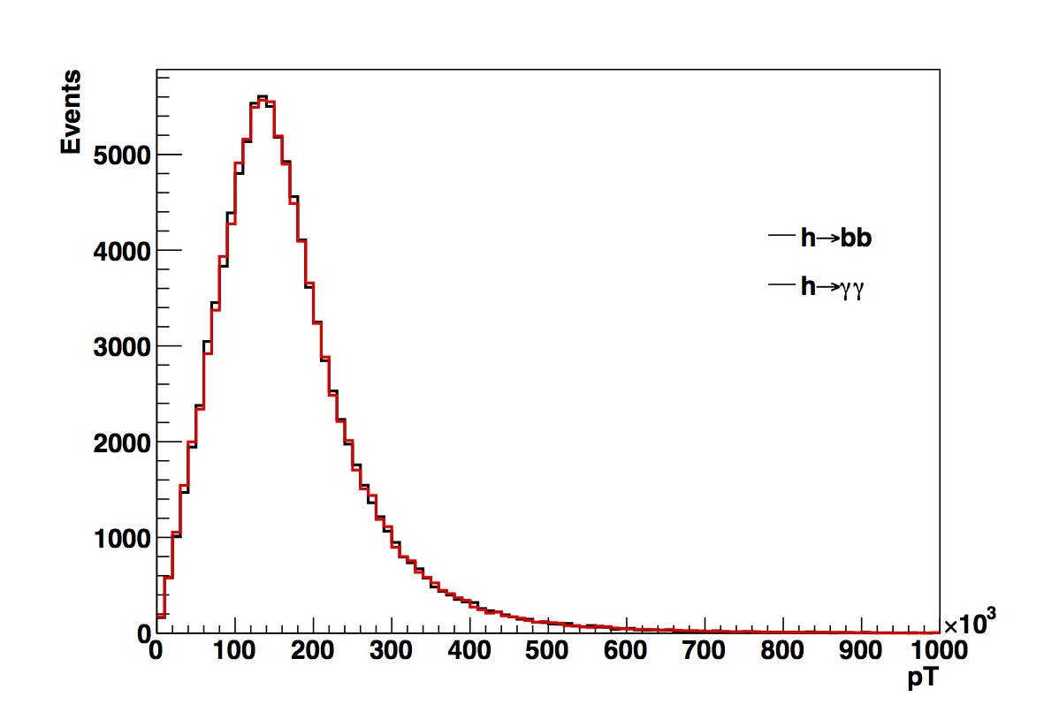
pT Distributions - LO
[GeV]

Slide 5
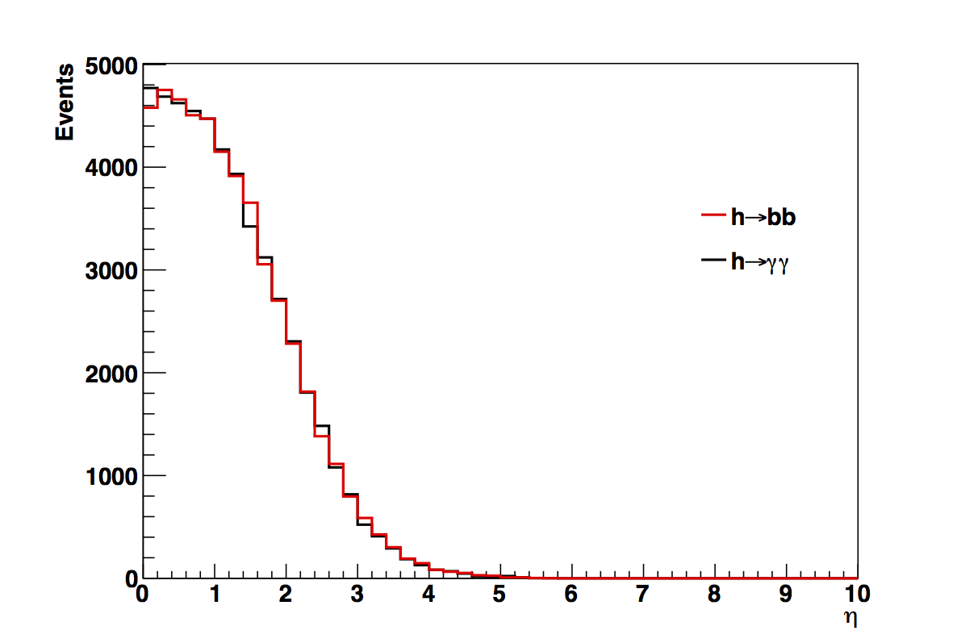
Eta Distributions - LO

Slide 6
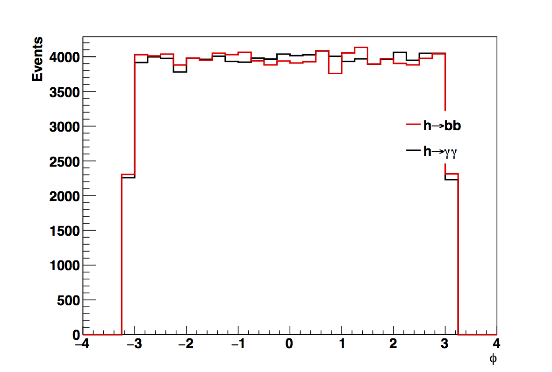
Phi Distributions - LO

Slide 7
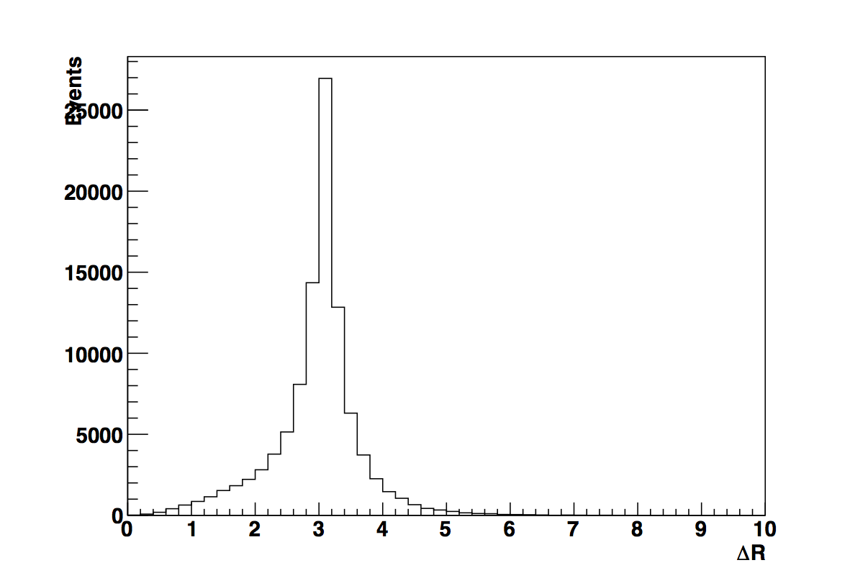
Delta R distribution - LO
Used DeltaR function in TLorentzVector. Defined as square root of dEta^2 + dPhi^2

Slide 8
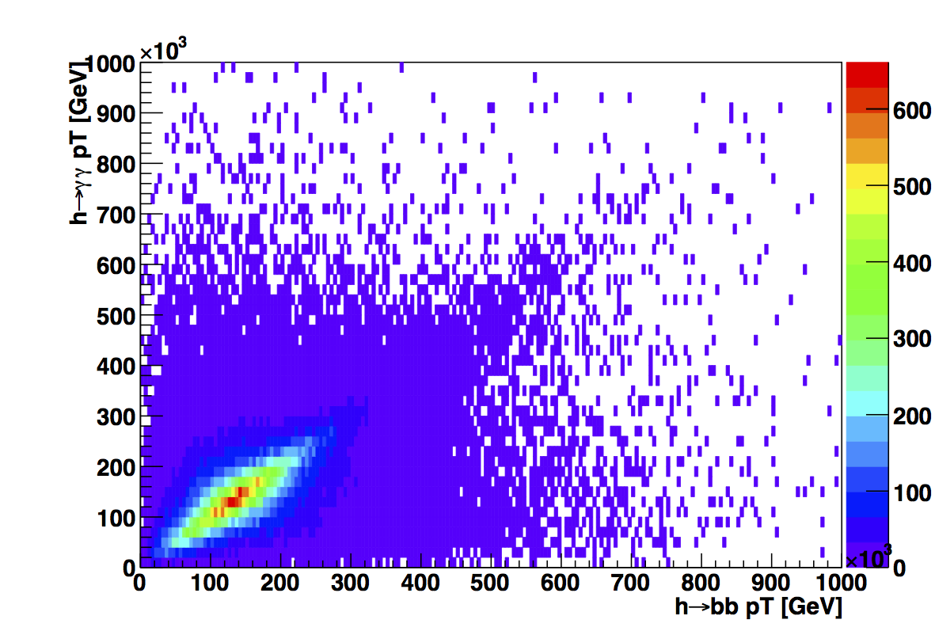
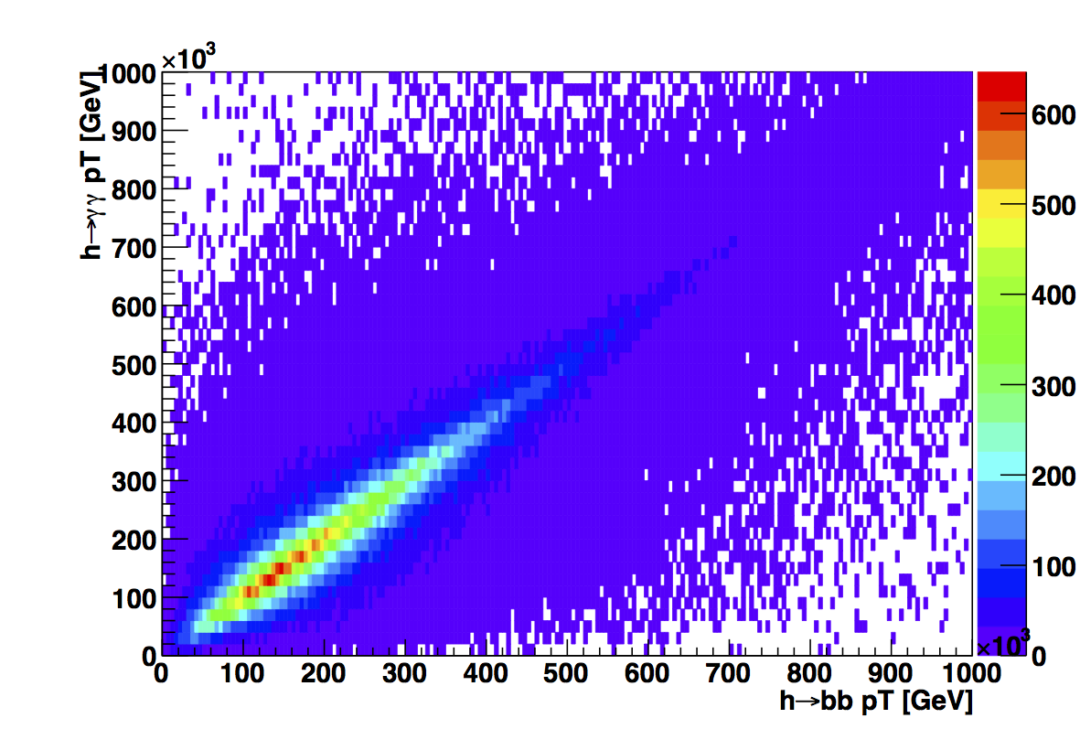
pT of yy parent H vs. pT of bb parent H
LO (99937 entries)
NLO (199899 entries)

Slide 9
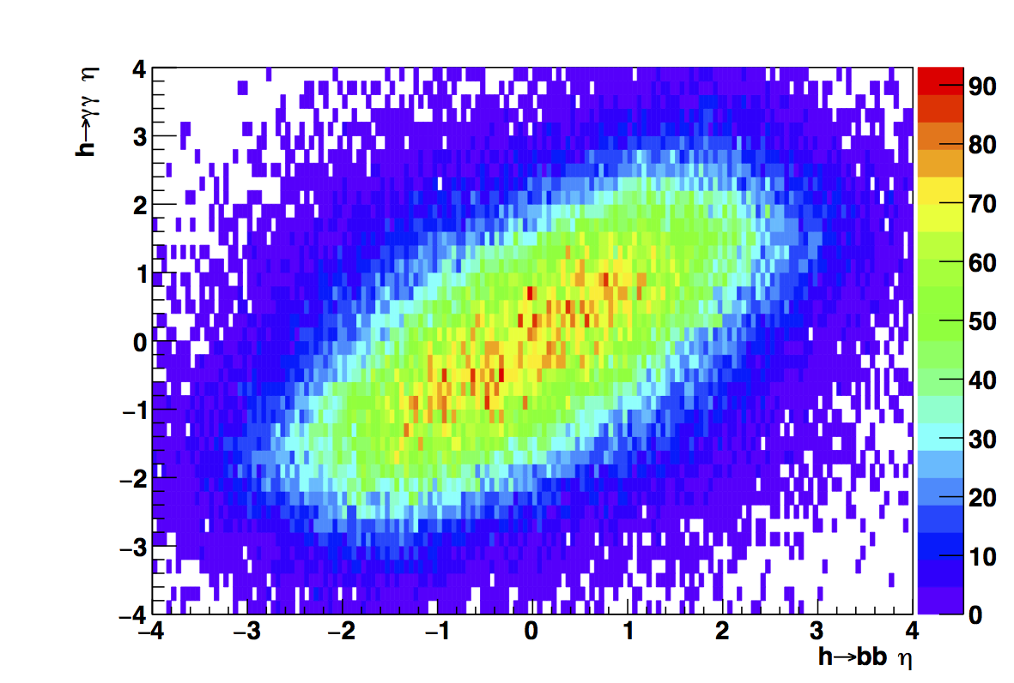
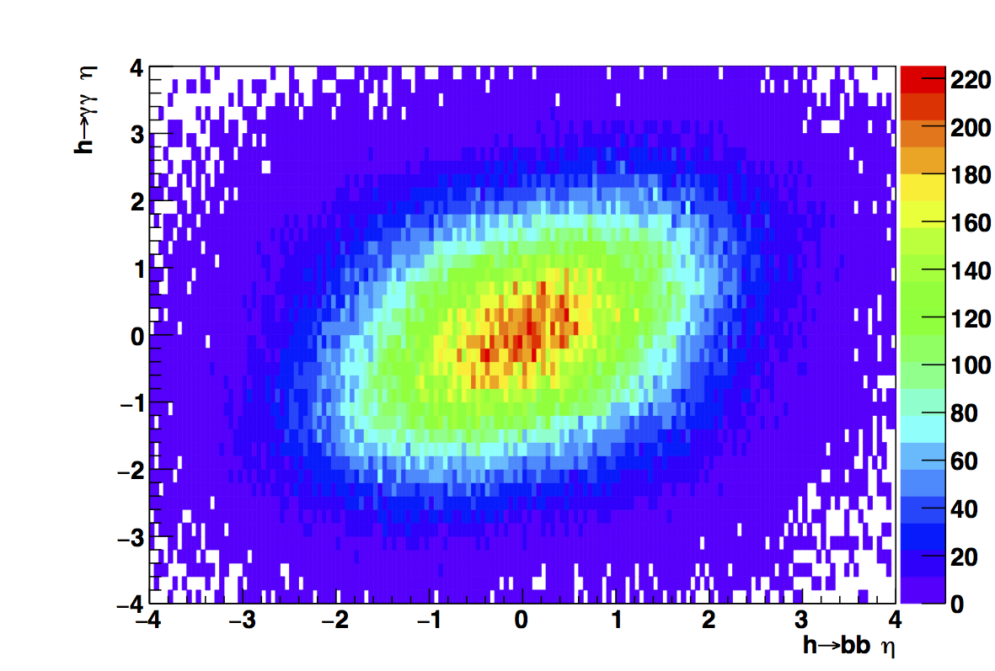
2D Eta Distribution
LO (99937 entries)
NLO (199899 entries)

Slide 10
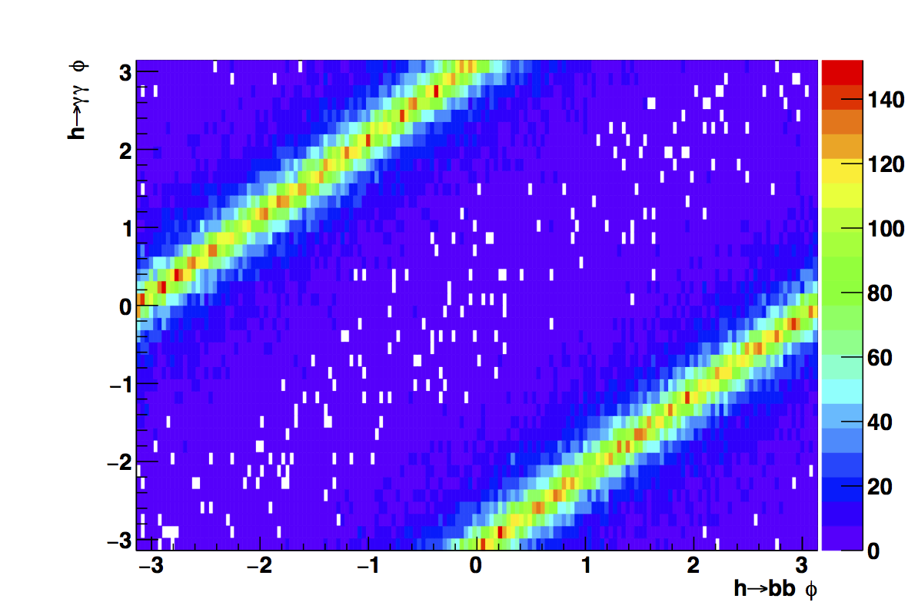
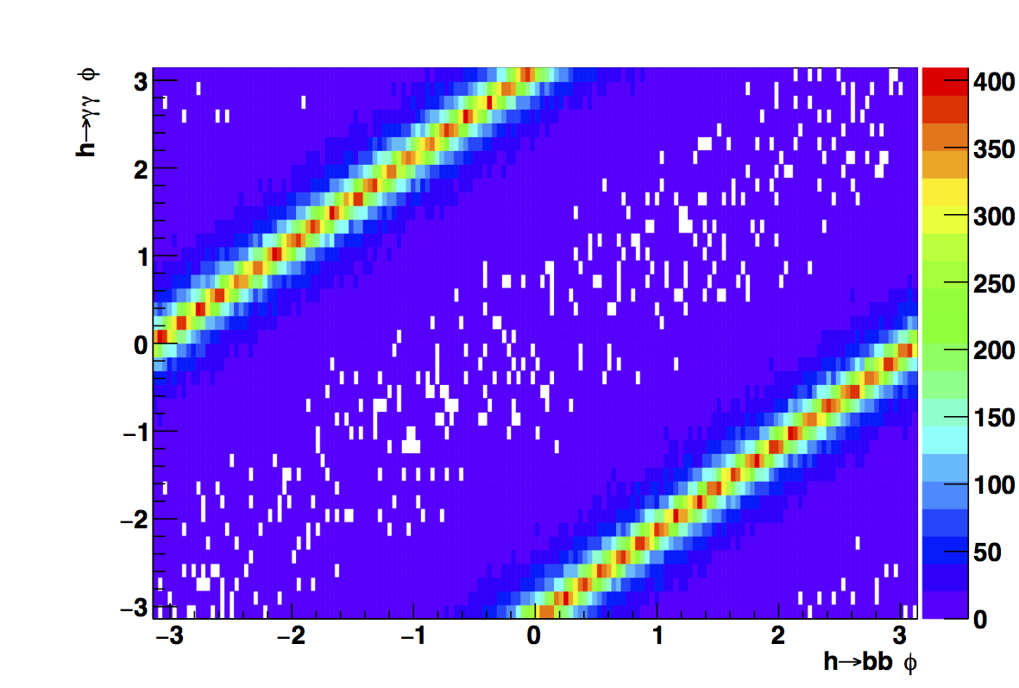
2D Phi Distribution
LO (99937 entries)
NLO (199899 entries)

Slide 11
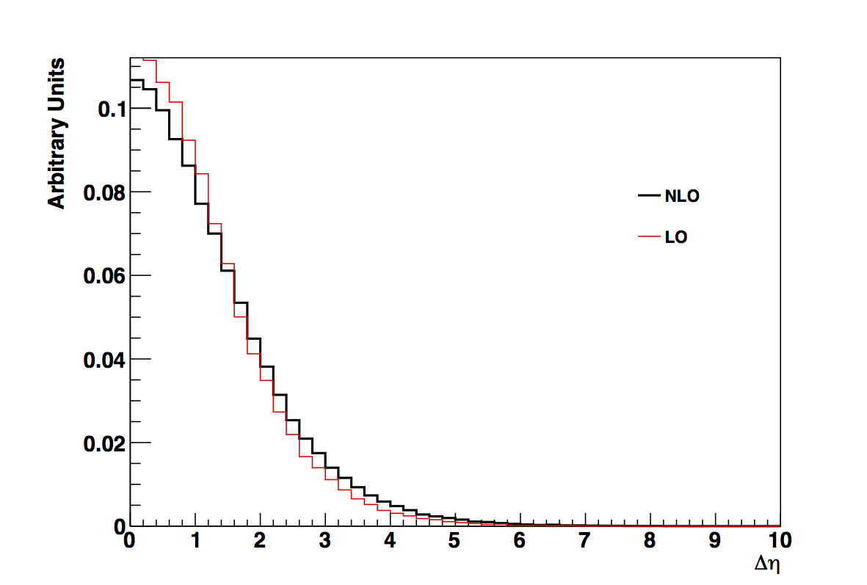
Delta Eta

Slide 12
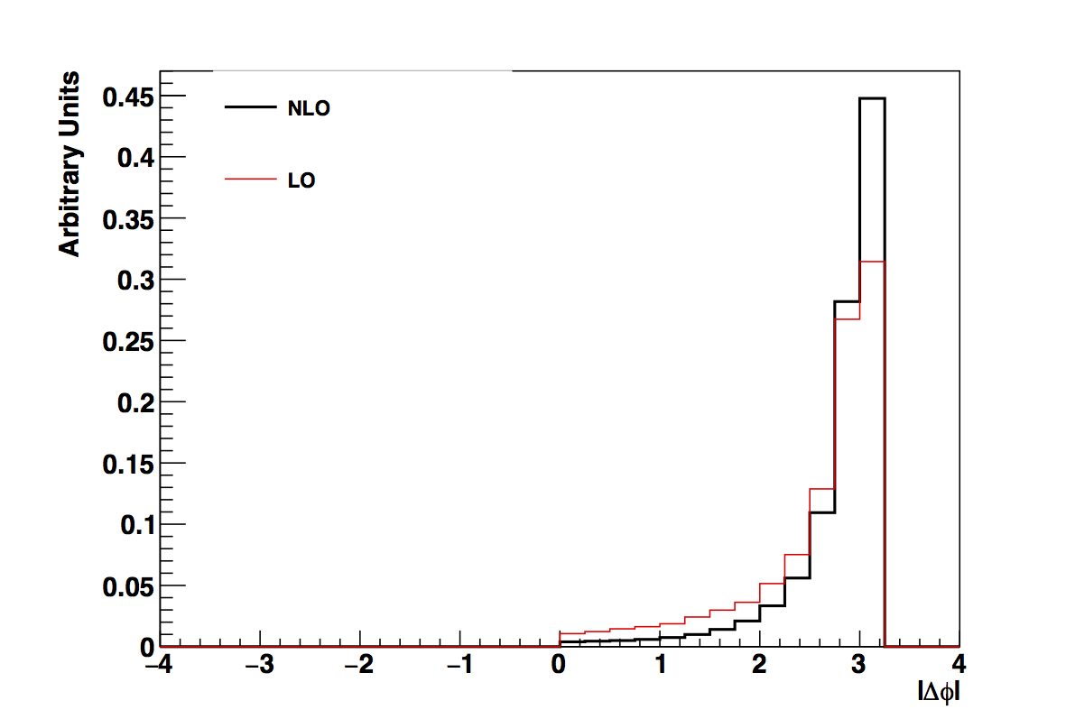
Delta Phi

Slide 13
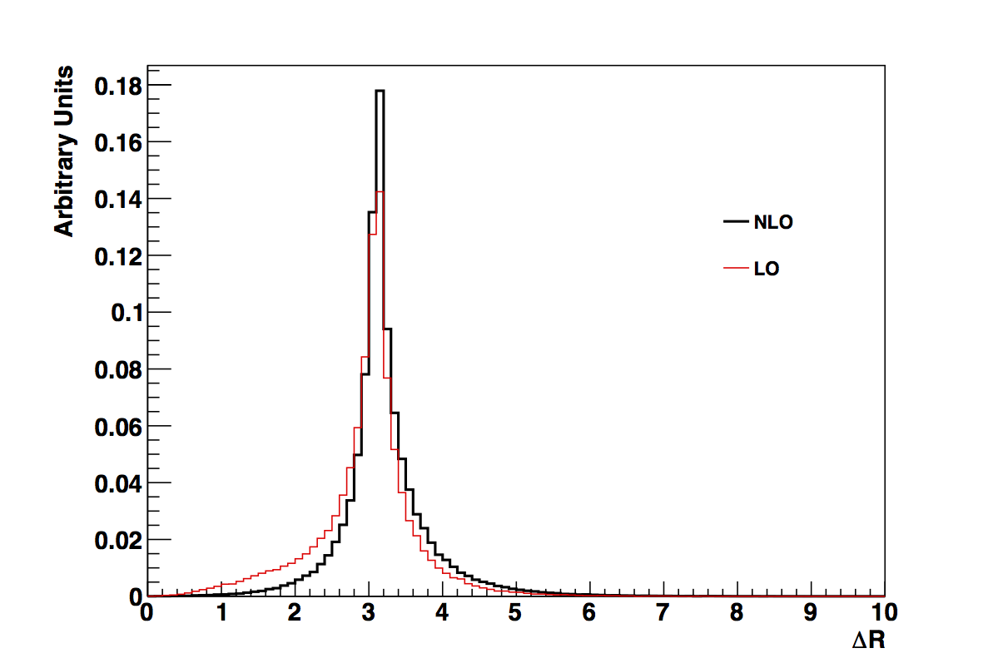
Delta R

Slide 14
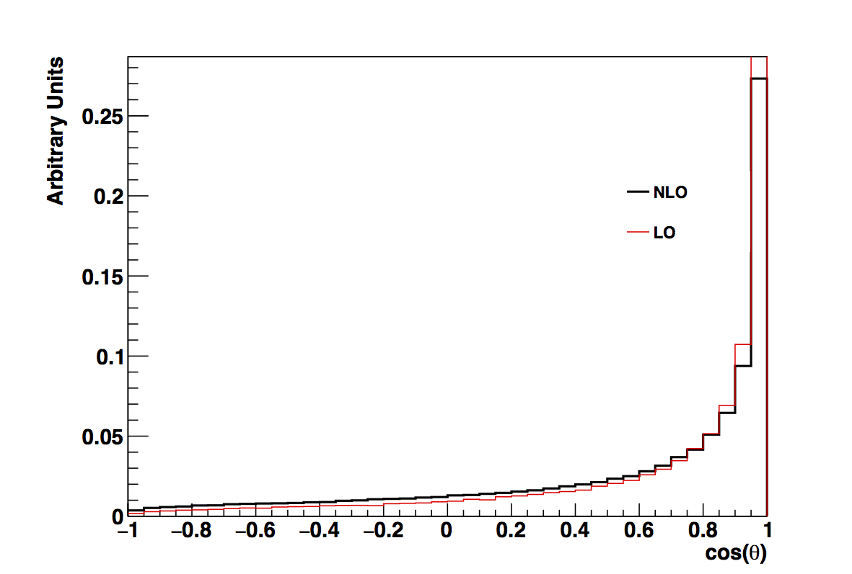
Opening angle between HH

Slide 15
Next Steps
Make ratio plots for LO/NLO
Fix cos(theta)?
Look at kinematics of bb, yy
Suggestions?

Slide 16
Backup

Slide 17
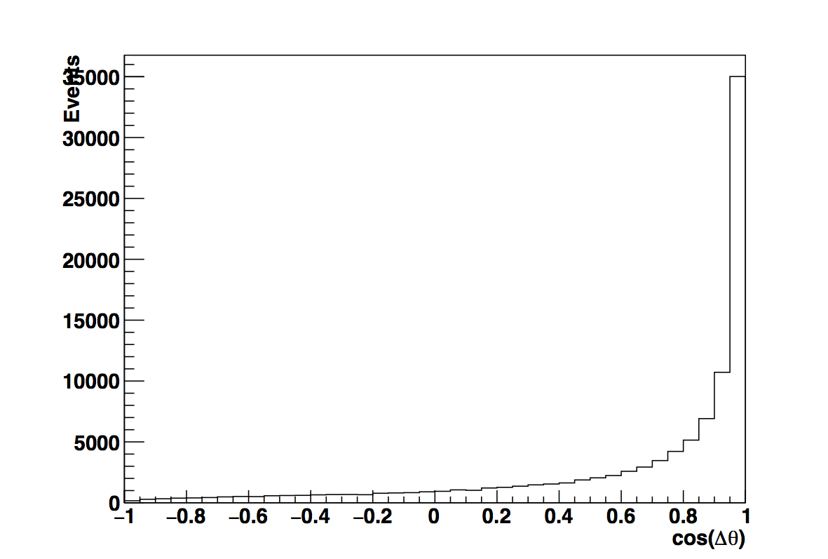
Cos(Delta Theta) Distribution

