Slide 1
Neutrino oscillation physics
Alberto Gago
PUCP
CTEQ-FERMILAB School 2012
Lima, Perú - PUCP

Slide 2
Outline
Introduction
Neutrino oscillation in vacuum
Neutrino oscillation in matter
Review of neutrino oscillation data
Conclusions

Slide 3
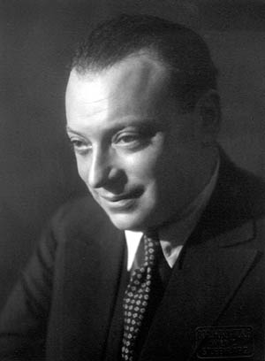
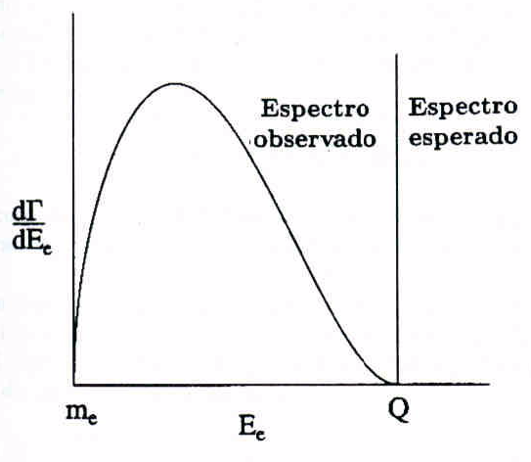
Historical introduction ν
(1930) W. Pauli propose a new particle for saving the incompatibility between the observed electron energy spectrum and the expected.
Observed Spectrum – Continuos
three body decay
Expected Spectrum-Monoenergetic
two body decay

Slide 4
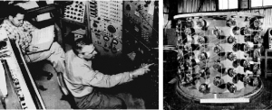
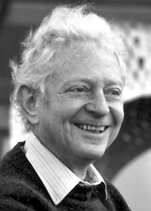
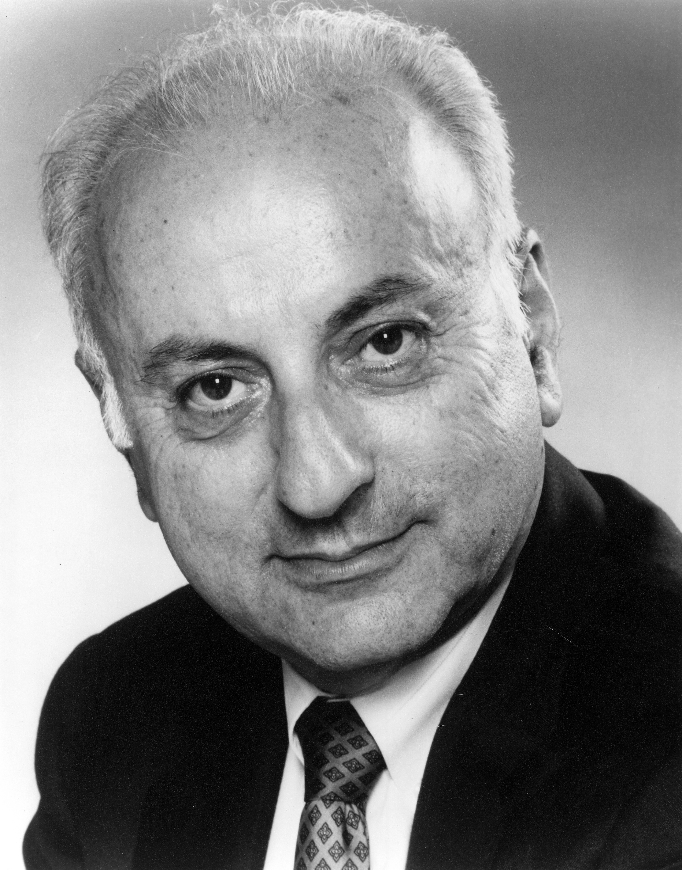
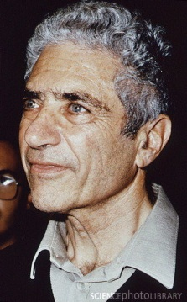



Historical introduction ν
(1956)- F. Reines y C.Cowan detected for the first time a neutrino through the reaction
This search was called as poltergeist project.
First reactor neutrino experiment
(1962)-Lederman-Schwartz-Steinberger, discovered in Brookhaven the muon antineutrino through the reaction:
they did not observe:
Confirming that
First neutrino experiment that used

Slide 5
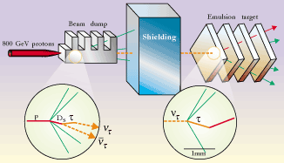
Historical introduction ν
(2000) In Fermilab the DONUT collaboration observed for the first time events of ν_{τ} . They detected four events.

Slide 6
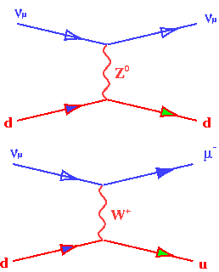
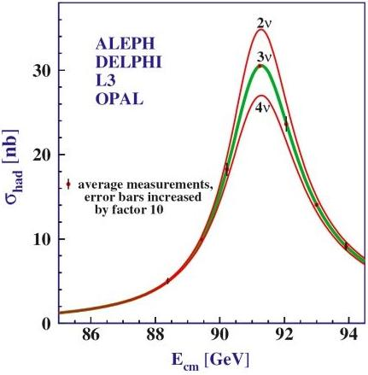
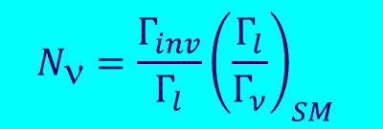
Neutrinos
Active neutrinos
Notes:
6

Slide 7

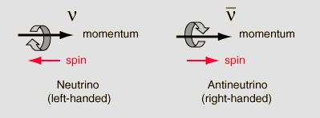
Neutrinos -SM
Therefore in the Standard Model (SM) we have:
Left-handed doublet
Neutrinos are fermions and
neutrals
Only neutrinos of two kinds have been seen in nature:
left-handed –neutrino
right-handed- antineutrinos

Slide 8
Neutrino –SM
In the SM the neutrinos are consider massless (ad-hoc
assumption)
….BUT we know that they have non-zero masses
because they can change flavour or oscillate …

Slide 9
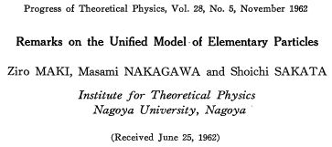
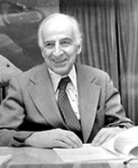
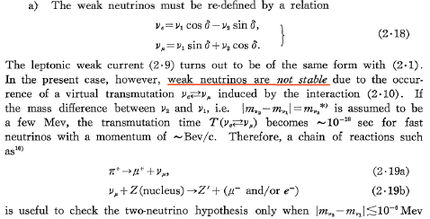
Neutrino oscillations -history
(1962) Maki, Nakagawa and Sakata proposed the
mixing

Slide 10
Neutrino oscillation in vacuum
Flavour conversion
Non-diagonal
The flavour (weak) eigenstates are coherent superposition of
the mass eigenstates

Slide 11
Neutrino mixing
The mixing matrix is appearing in the charged current interaction of the SM :
analog to the quark mixing case
PMNS=Pontecorvo-Maki-Nakagawa-Sakata
D= down quarks
U= up quarks

Slide 12
Neutrino oscillation in vacuum the scheme
Flavour states
Flavour states
Detector
Source
Propagation
Mass eigenstates
Coherent superposition of the
mass eigenstates
The flavour conversion happens
at long distances!

Slide 13
Neutrino oscillation in vacuum
Starting point :
Evolving the mass eigenstates in time and position (Plane wave approximation):

Slide 14
Neutrino oscillation in vacuum
Analyzing:
We are using L instead of x

Slide 15
Neutrino oscillation in vacuum
constant term
oscillating term
Oscillation wavelength
Valid if there is no sterile neutrinos

Slide 16
Neutrino oscillation in vacuum

Slide 17
Neutrino oscillation in vacuum
For the antineutrino case:
This is the only difference…we will return to this later

Slide 18
Two neutrino oscillation

Slide 19
Two neutrino oscillation
I
In the two neutrino framework we have:

Slide 20
Two neutrino oscillation
Introducing units to L and E

Slide 21
Oscillation regimes
Oscillation starting
Ideal case
Fast oscillations
No oscillation

Slide 22
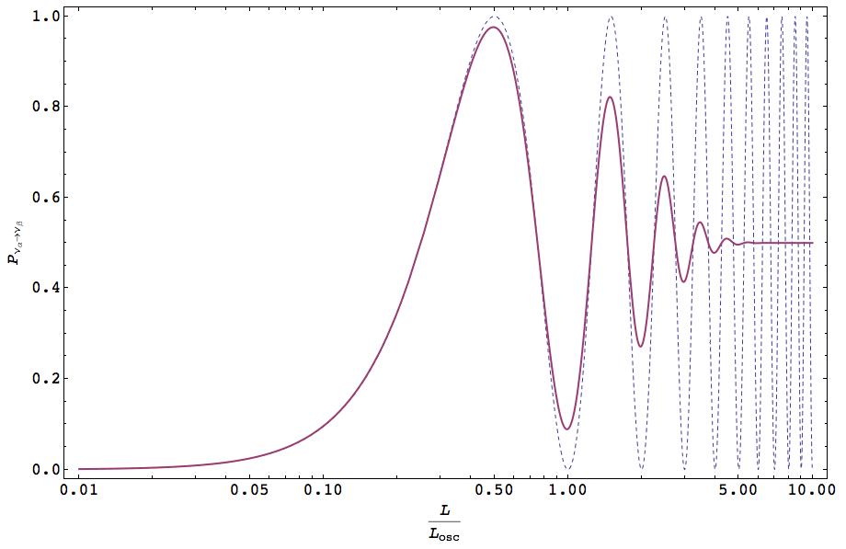
Oscillation regimes
Long distance
Ideal distance
Short distance
Fixed E

Slide 23
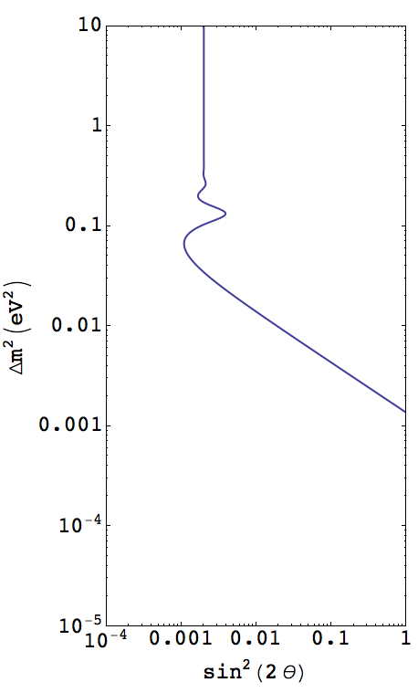
Sensitivity plot
a
sensitivity
b
c
Not sensitivity
lower probability limit for having a positive signal in a detector

Slide 24
Exclusion plot
excluded
upper limit of the
oscillation probability
allowed

Slide 25
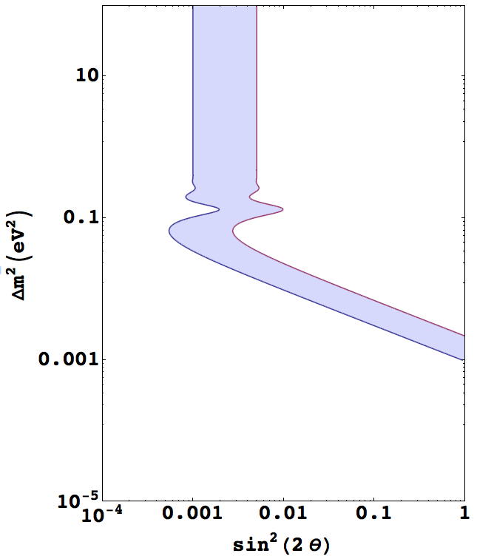
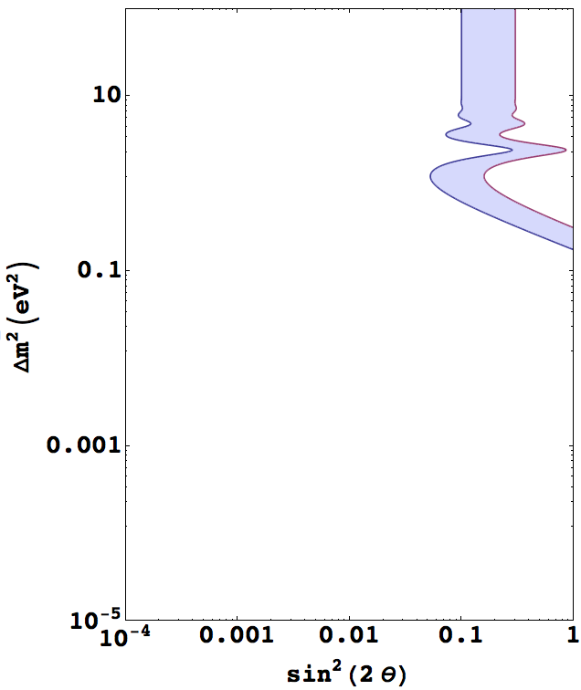
Positive signal
0.001< P < 0.005
0.05 < P < 0.15
⟨L/E⟩ = 18km/GeV
⟨L/E⟩ = 1km/GeV

Slide 26
The mixing matrix

Slide 27
The mixing matrix

Slide 28
The mixing matrix
If neutrinos are equal than antineutrinos
Charge conjugation operator

Slide 29
3ν-mass scheme
Normal Hierarchy
Inverted Hierarchy

Slide 30
The mixing matrix in 3ν scheme
Dirac CP phase
Majorana phases
…Tomorrow we will see the current measurements of these angles done by the experiments

Slide 31
Majorana phases and neutrino oscillations
Only the dirac phase is observable in neutrino oscillation

Slide 32
CP violation

Slide 33
CP violation
What does CP mean in neutrino oscillation ?:

Slide 34
CP violation
Jarlskog invariant
Independent of the mixing matrix parameterization =rephasing invariant

Slide 35
CP violation
CP violation phase
All the mixing angles have to be
non-zero to have CP violated.
In particular we just found out that

Slide 36
CP violation
It is interesting to note that :
Checking for CPT

Slide 37
Useful approximations
In the three neutrino framework we have:
Case 1 : sensitive to the large scale :
Case 2: sensitive to the small scale

Slide 38
Useful approximations
Case 1: sensitive to the large scale
Similar structure to the two generation formula

Slide 39
Useful approximations
Case 1: sensitive to the large scale
Explicit formulas

Slide 40
Useful approximations
Case 2: sensitive to the small scale
averaged out
Similar structure for the two generation formula

Slide 41
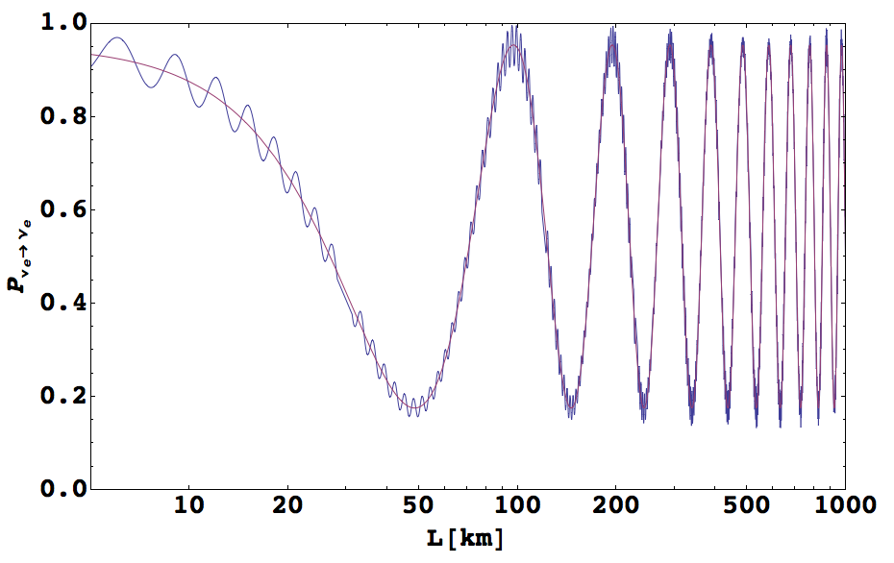
Useful approximations
Case 2: sensitive to the small scale
Approximation
Full Probability

Slide 42
Useful approximations
We can get a better approximation for the oscillation formula when we expand this in small parameters up to second order. We are in the case of
sensitivity of the large scale.
These small parameters are :
leading term –P_{2ν} approximation
Now it is appearing
δ and

