Slide 1
Neutrino oscillation physics II
Alberto Gago
PUCP
CTEQ-FERMILAB School 2012
Lima, Perú - PUCP

Slide 2
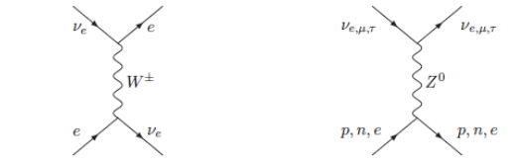
Oscillation in matter
When neutrinos go through matter they can suffer coherent forward elastic scattering (e.g its four momentum is unchanged) which modifies the mixing angle.
L. Wolfenstein, Phys. Rev. D 17, 2369 (1978); ibid. D 20, 2634 (1979)
S. P. Mikheyev, A. Yu Smirnov, Sov. J. Nucl. Phys. 42 (1986) 913.
Neutrino interactions
The inelastic and absorption
neutrino Interactions are
negligible . They produce a
mean free path of the order
of

Slide 3
Oscillation in matter
The low-energy charged current hamiltonian is given by:
We can rearrange this using Fierz identities
If we average out the electron current in a medium of electrons we have
Since the electrons of the medium are non-relativistic, unpolarized and isotropically distributed only the electron density term survives.

Slide 4
Oscillations in matter
Then :

Slide 5
Oscillation in matter
Since the matter potential is a time like component:
Similar to the vacuum part

Slide 6
Oscillation in matter
The vacuum hamiltonian:

Slide 7
Oscillation in matter
Evolution equation in matter

Slide 8
Oscillation in matter
From:
We have for constant density:
Evolution equation in the diagonal basis

Slide 9
Oscillation in matter
We get for a constant density:
Vacuum angle
Mixing angle in matter

Slide 10
Oscillation in matter
Similar form to the vacuum oscillation formula for 2ν:

Slide 11
Oscillation in matter
MSW effect

Slide 12
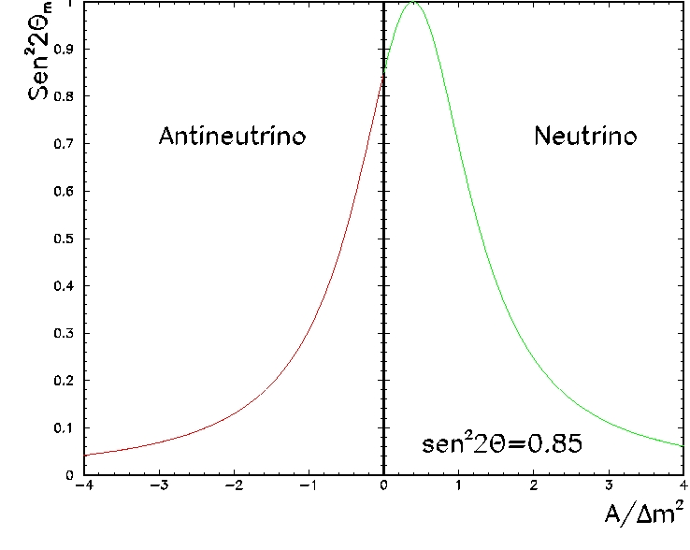
Oscillation in matter
Cos2θ=0.38
Matter suppresion
We can deduce the sign of Δm²

Slide 13
Oscillation in matter
For varying density the evolution equation is described by:
Non – diagonal hamiltonian

Slide 14
Oscillation in matter
Adiabatic regime: slow varying density

Slide 15
Oscillations in matter
The survival probability in the adiabatic case is:
Fast oscillations -(averaged out) large source-detector distance
production
detection

Slide 16
Oscillations in matter
Non- adiabatic regime: fast varying density
Within an interval around the resonance.

Slide 17
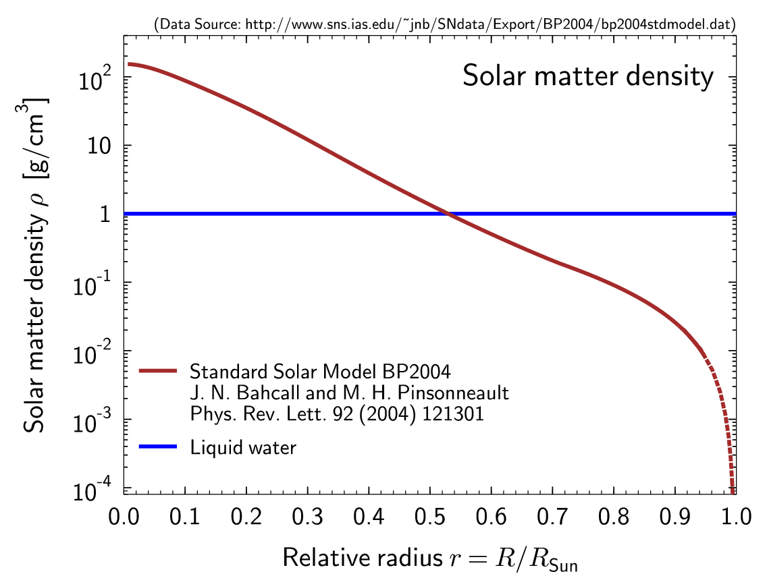
Oscillation in matter
Crossing probability:

Slide 18
Oscillation in matter
The survival probability is given by:
Low Energy (adiabatic)
High Energy(adiabatic)
Matter effects can be neglected
Matter effects are important

Slide 19
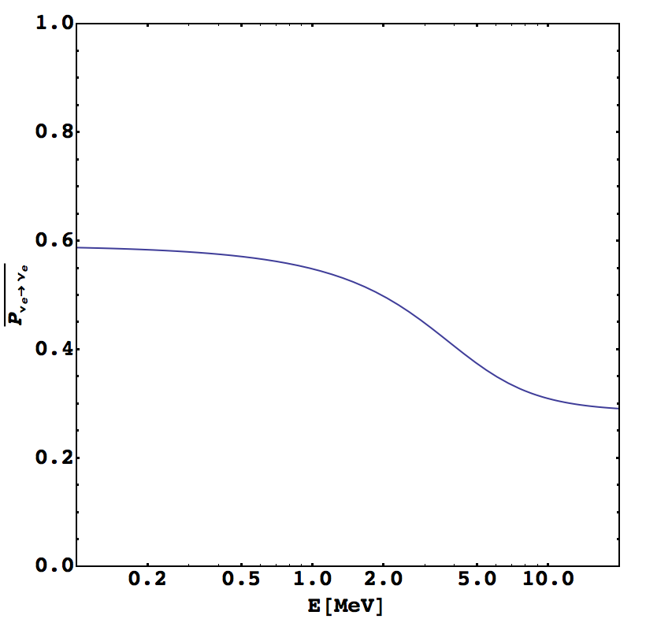
Oscillation in matter
How this probability looks like:
Keep on mind this plot!

Slide 20
Three neutrino scheme
The 3ν framework within the experimental context:
LBL & atms
Reactor & atms
Solar & reactors
* mainly sensitive

Slide 21
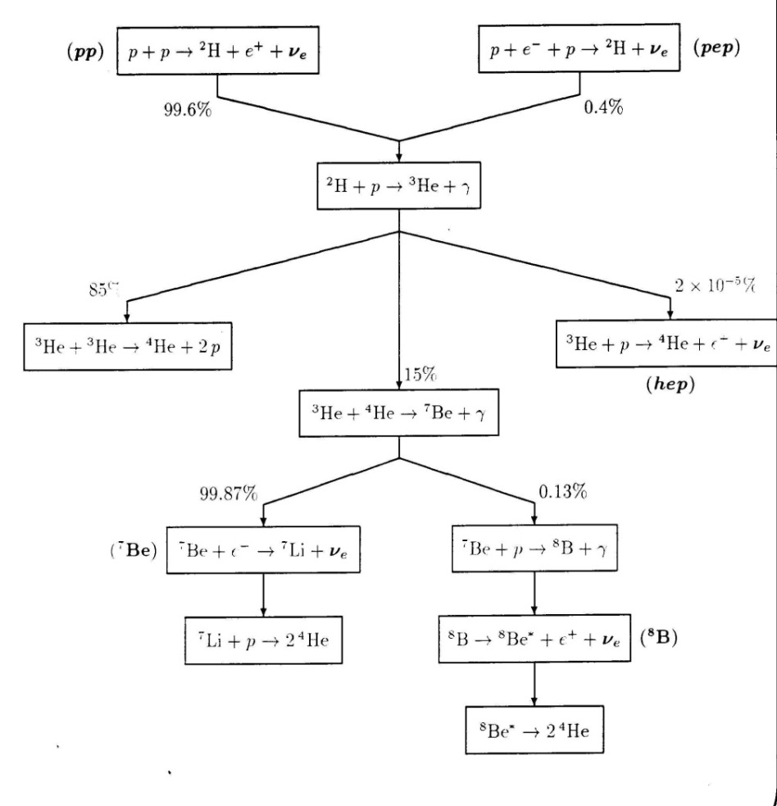
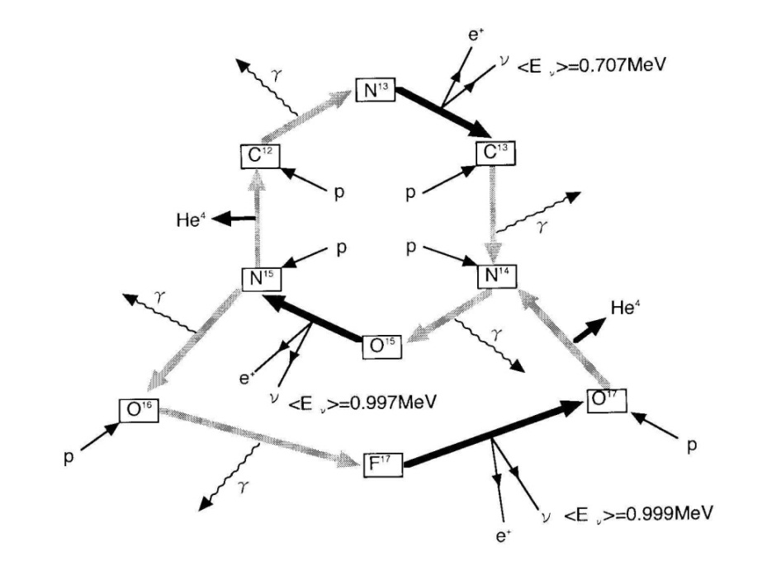
Solar neutrinos
Solar net reaction
CNO-chain
pp - chain

Slide 22
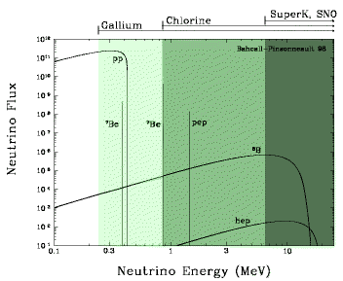
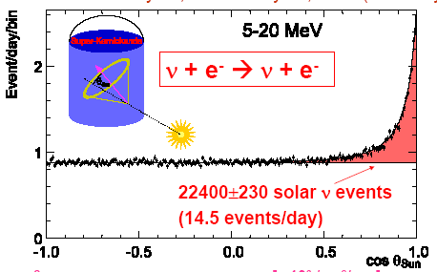
Solar neutrino problem
Objective of the first solar neutrino experiment
To demonstrate that the Solar Standard model
was correct
Borexino
Notes:
complicated spectrum meant that a variety of solar nu experiments could sort out oscillations as a function of energy and thus measure masses and mixings. note evidence from super-K that nus point to the sun.

Slide 23
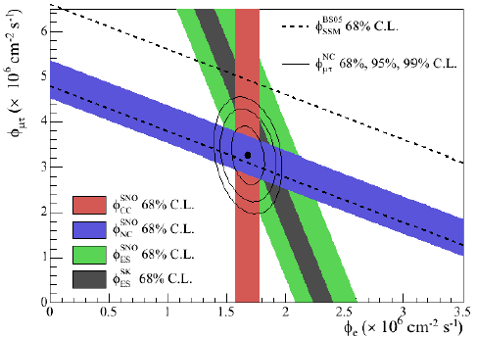
Solution to the solar neutrino problem
SNO ( D₂O phase) observes:
Charged current
  Neutral current
ν_{x}e → ν_{x}e
Measurement of the solar neutrino flux compatible with the SSM
This confirms that neutrinos suffer a
flavour conversion
Notes:
SNO added a new capability… see all active neutrino flavors. and in fact they find they can account for all neutrinos we think should originate from the sun… it’s just that few remain as electron flavor neutrinos!

Slide 24
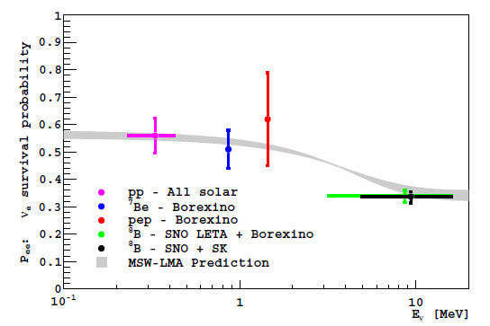
Solar neutrinos
Borexino
Do you remember this probability plot?
..MSW transition
vacuum dominated
Matter dominated
By the way the survival probability in 3ν

Slide 25
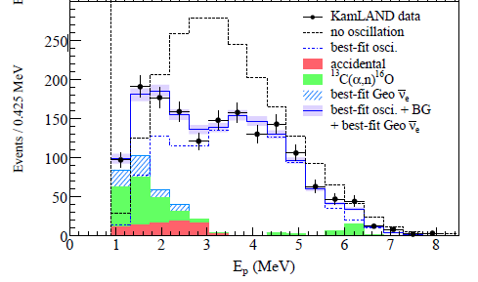
Solar neutrinos
Reactor-experiments:
KamLAND
53 reactors
disappearance

Slide 26
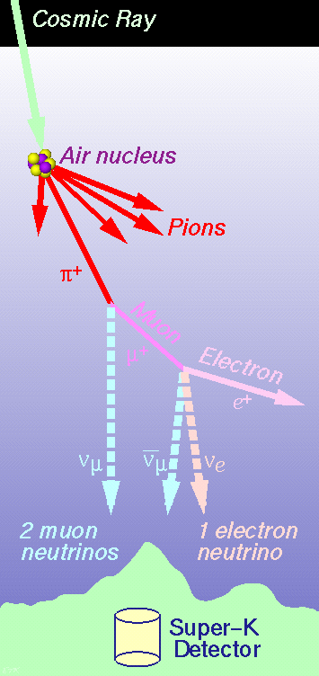
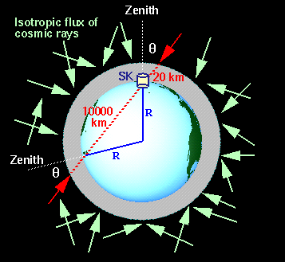
Atmospheric neutrinos

Slide 27
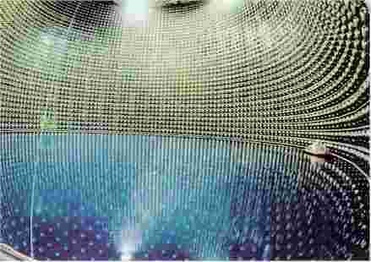
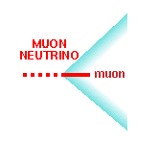
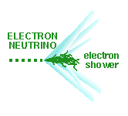
Atmospheric neutrinos
The atmospheric neutrino anomaly was found trying to understand the background involved in nucleon decay searches
Then the Super-Kamiokande experiment
came into the game and…

Slide 28
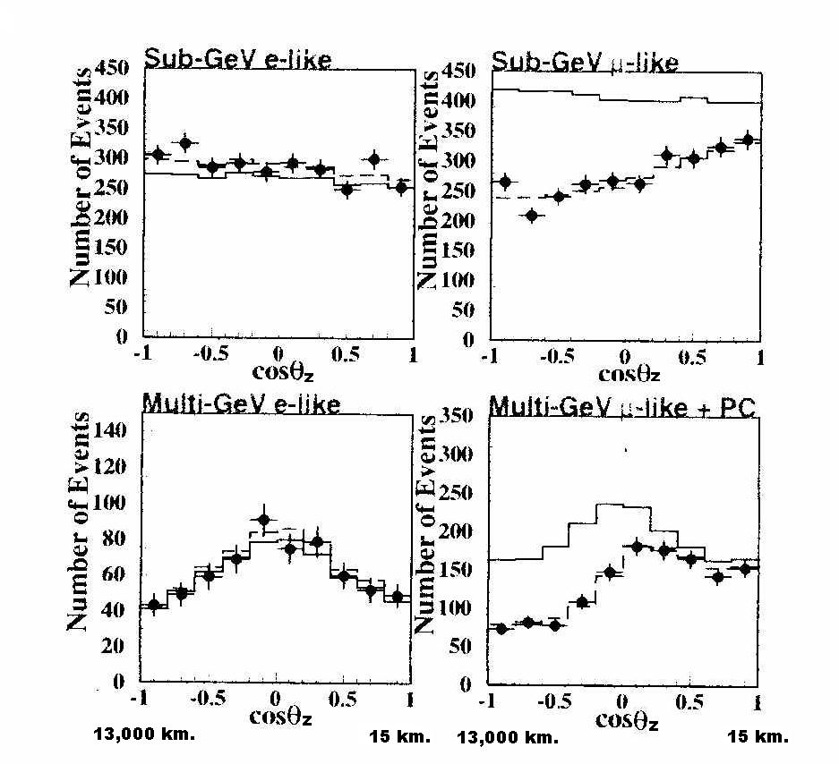
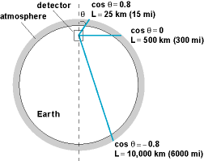
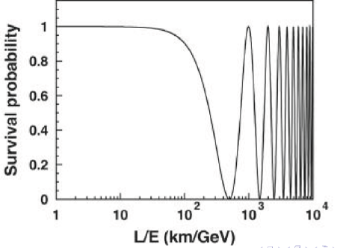
Atmospheric neutrinos
….observed in 1998 neutrino oscillations
No oscillations hypothesis

Slide 29
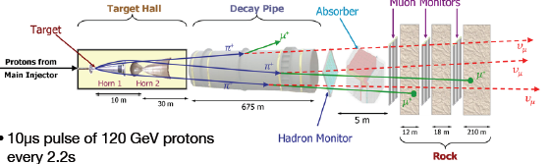
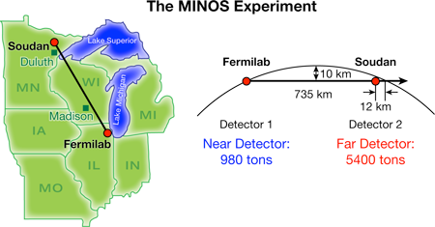
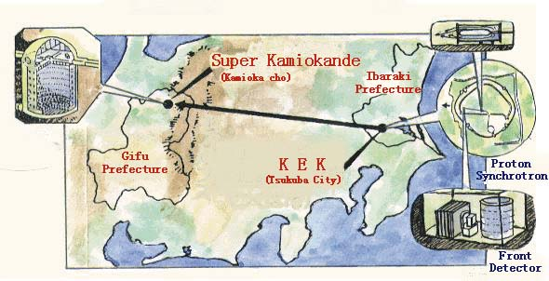
Long-Baseline experiments(LBL)
Disappearance experiments
The MINOS experiment
The K2K experiment

Slide 30
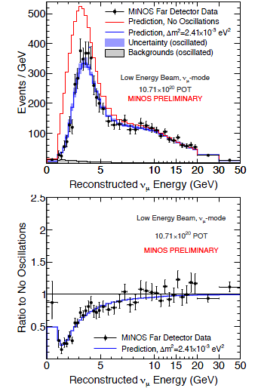
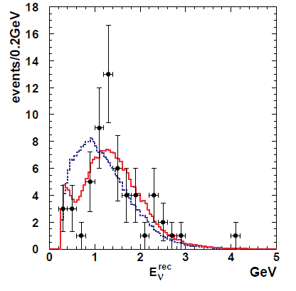
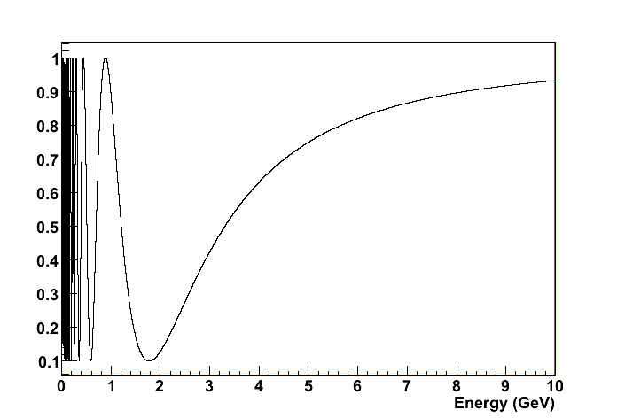
Long-Baseline experiments(LBL)
MINOS experiment
K2K experiment
No oscillations
hep-ex/0606032
No oscillations
R. Nichol -Neutrino 2012

Slide 31
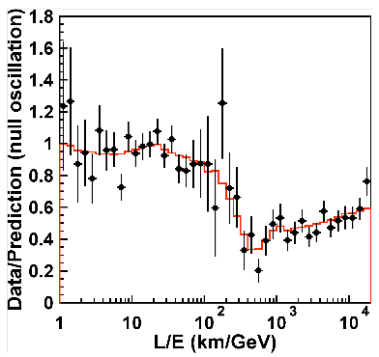
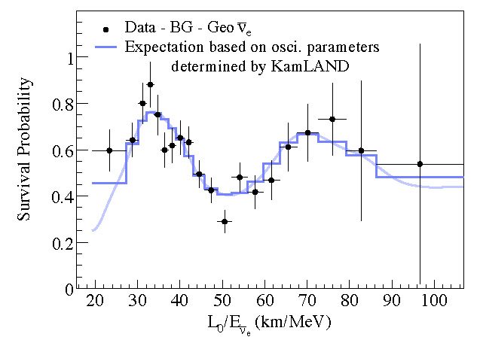
Why we believe in neutrino oscillation due to mass?
Oscillation maxima
Oscillation pattern depends on L/E (not a minor detail in the confirmation of oscillation due to mass)

Slide 32
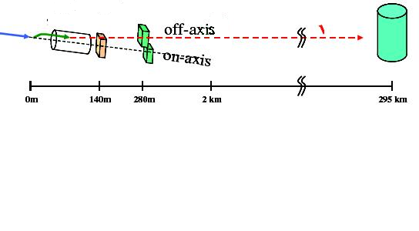
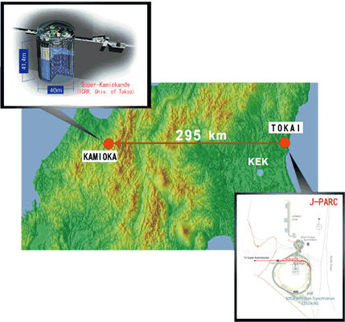
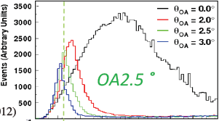
Searches for -LBL
T2K
T. Nakaya – Neutrino 2012

Slide 33
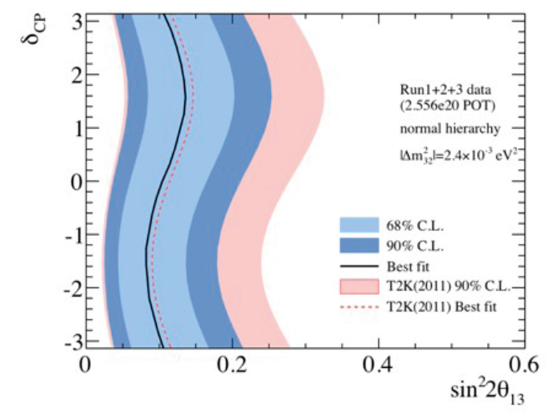
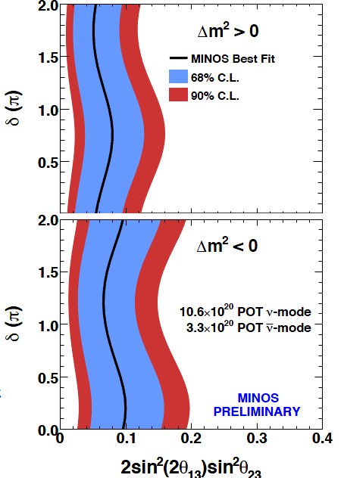
Results of
T2K
MINOS
R. Nichol Neutrino 2012
T. Nakaya -
Neutrino 2012
This term explains the periodic behaviour in δ

Slide 34
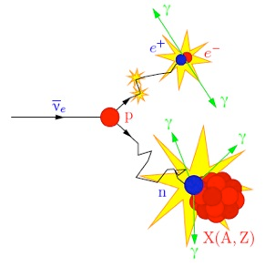
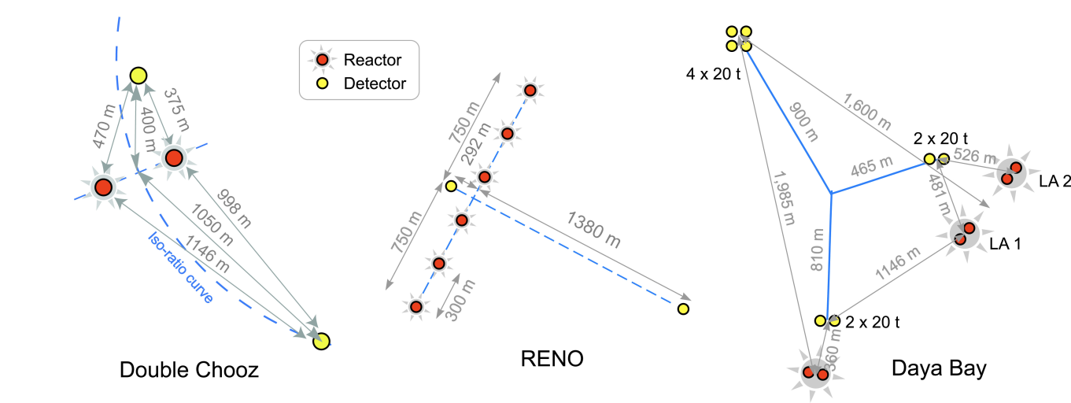
Search for
Reactors : Source of
2013
coincidence
Similar detection concept
in KamLAND
France
Korea
China
E. Lisi

Slide 35
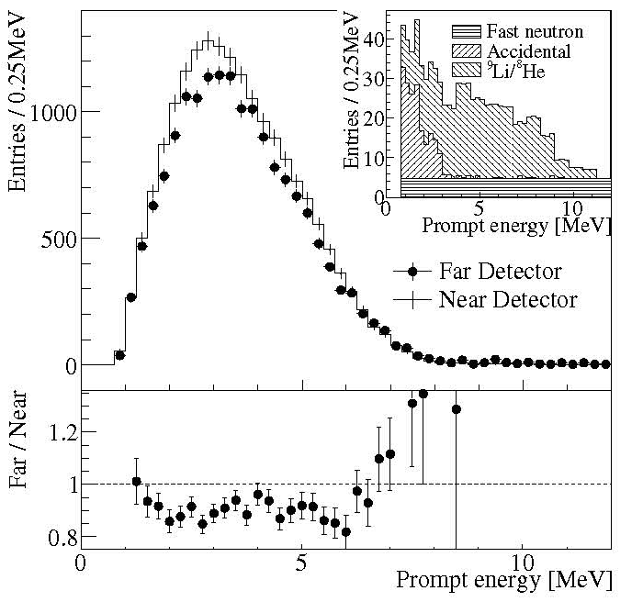
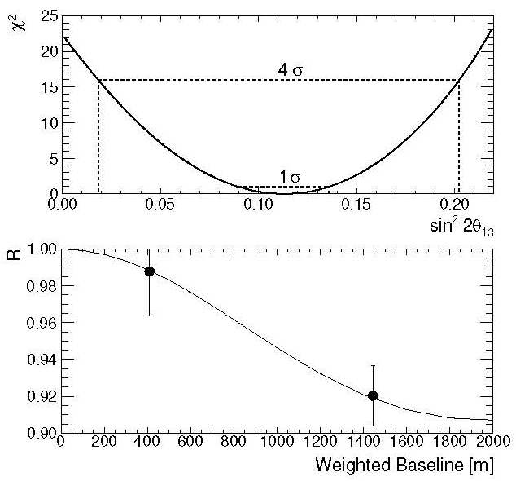
Results of - Reno
4.9σ signal significance
FD-8% deficit
ND-1.8% deficit
Only rates
Soo-Bong Kim – Neutrino 2012

Slide 36
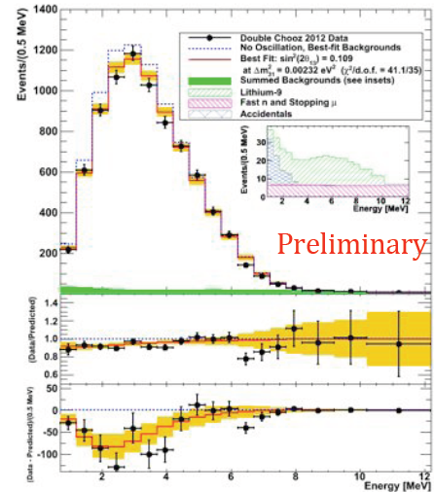
Results of - Double Chooz
Rates + Shape
depletion
M. Ishitsuka – Neutrino 2012

Slide 37
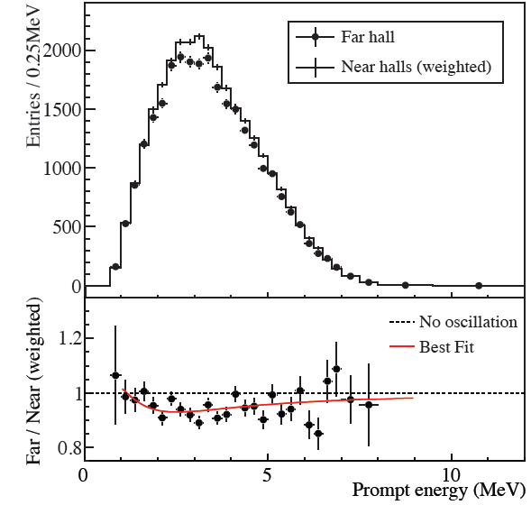
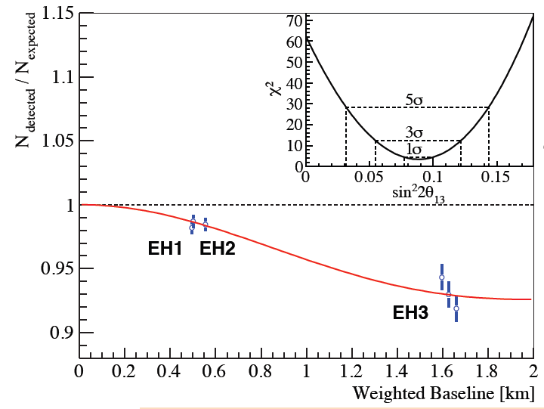
Results of - Daya Bay
No oscillation
>8σ from null hyp.
deficit
D. Dwyer- Neutrino 2012
Only rates

Slide 38
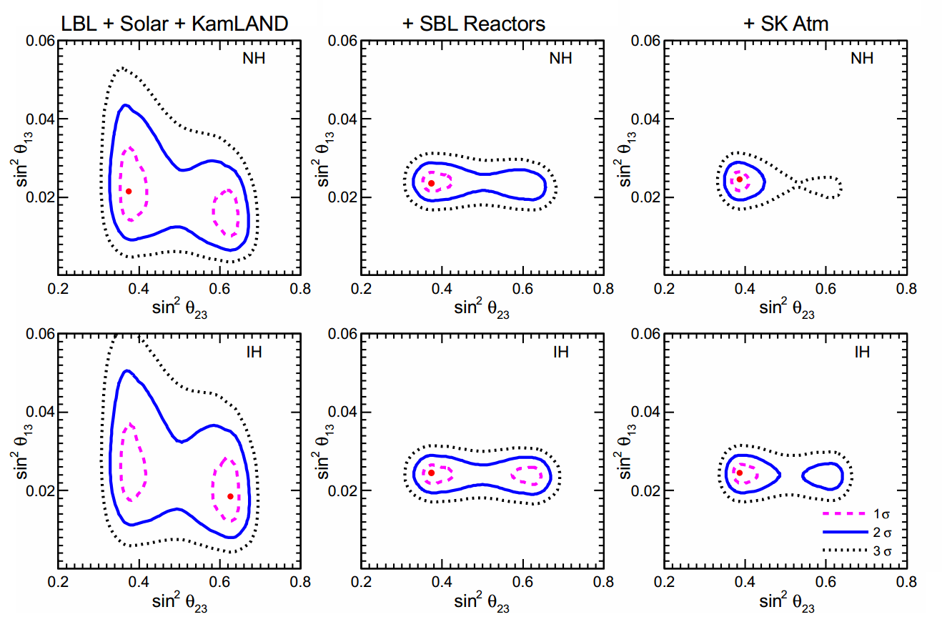
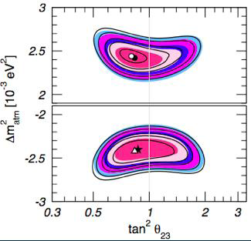
Global analysis-3ν
Normal Hierarchy
Degeneracy in
Inverted Hierarchy
Fogli et. Al. Neutrino 2012

Slide 39
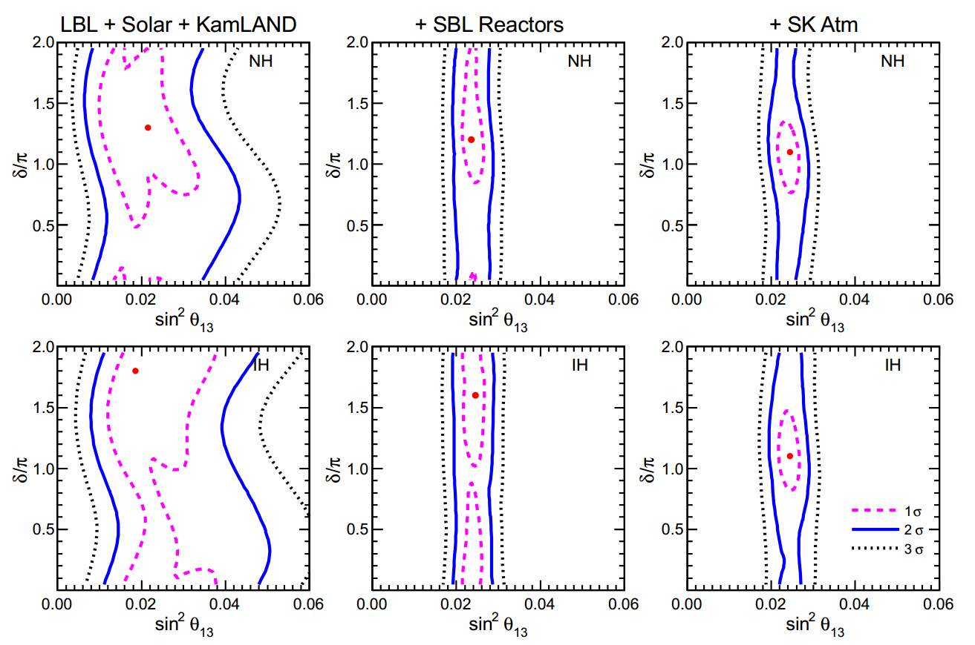
Global analysis-3ν

Slide 40
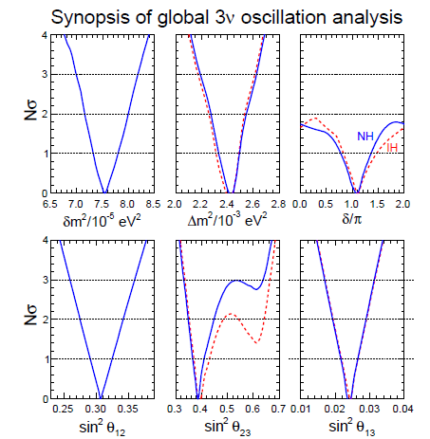
Global analysis-3ν
Precision era
arxiv: 1205.5254 G.L. Fogli, E. Lisi, A, Marrone, D. Montanino, A. Palazzo, A. M. Rotunno

Slide 41
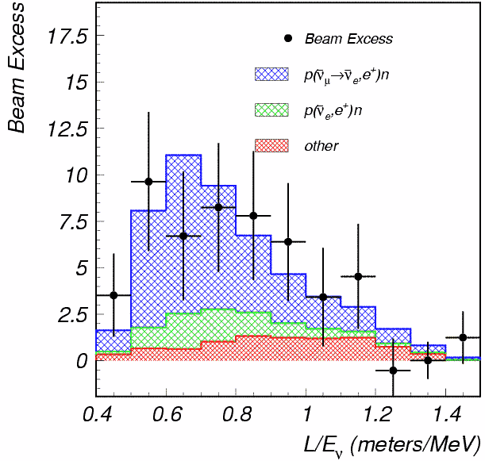
LSND anomaly
LSND anomaly (muon decay at rest)

Slide 42
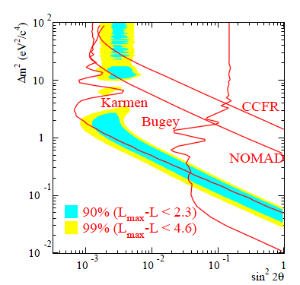
LSND anomaly
There are various experimental results
that constrained the LSND signal :
LSND
Allowed region
negative results

Slide 43
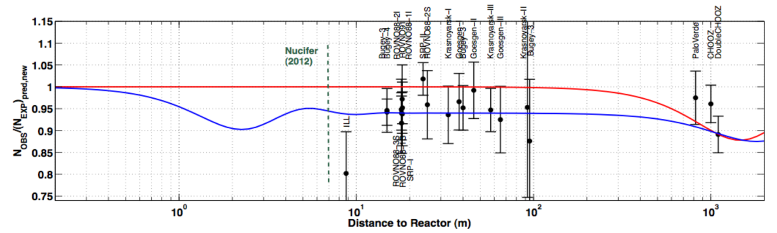
Hints for sterile neutrinos
Reactor anomaly :
New estimation of flux produced by beta decay from the fission products of
Reactor anomaly
Mention et al 1101.2755

Slide 44
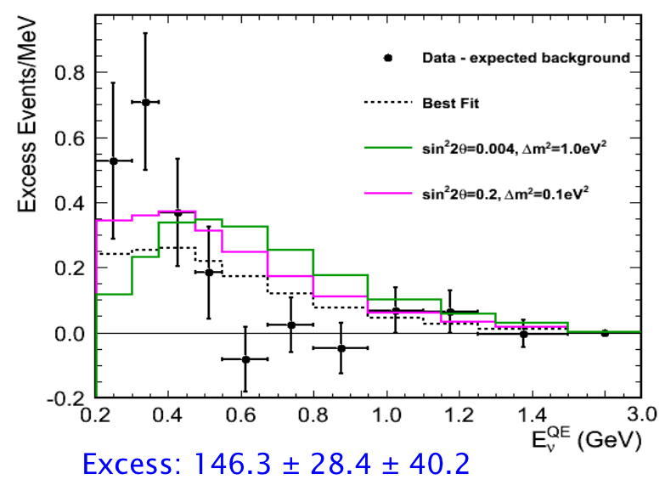
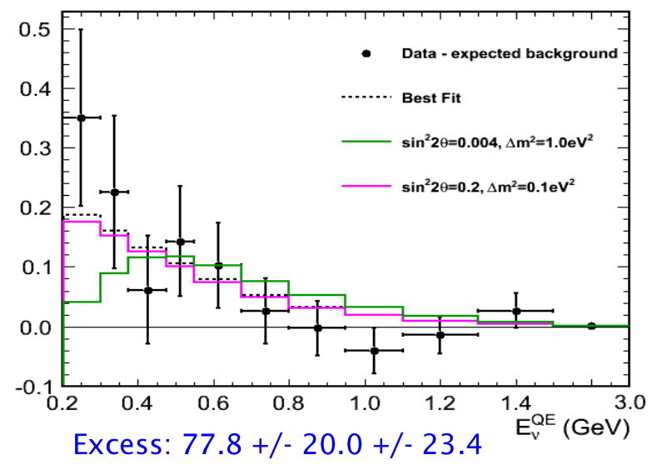
Hints for sterile neutrinos
MiniBooNE:
tension
C. Polly -Neutrino 2012

Slide 45
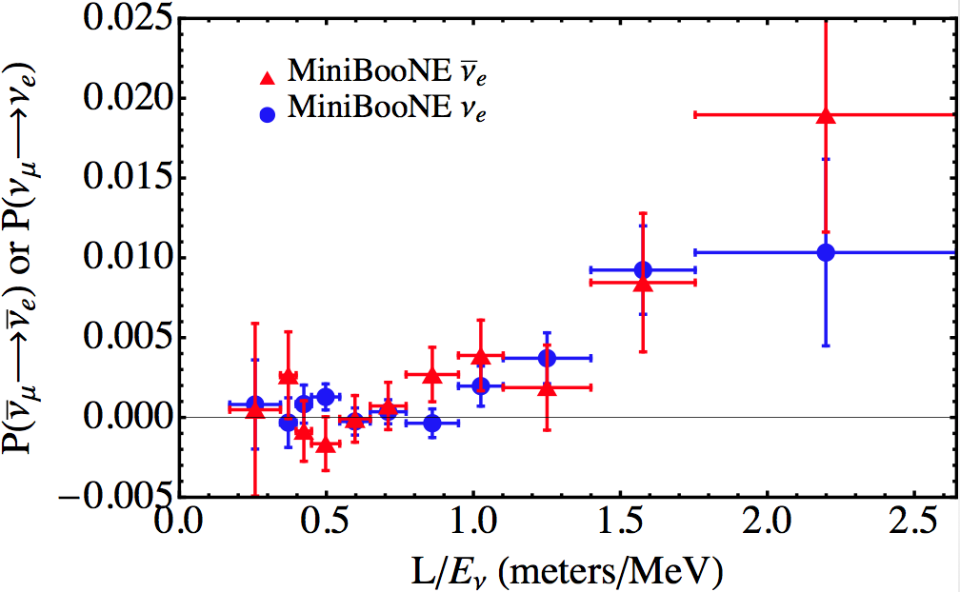
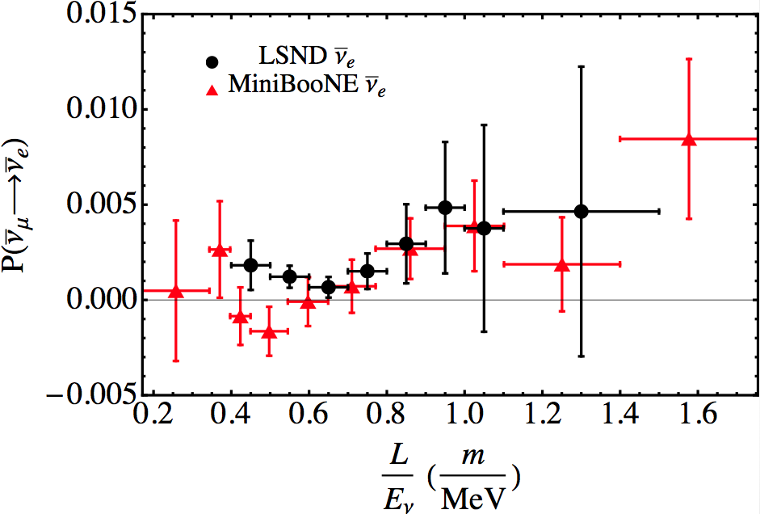
Hints for sterile neutrino
MiniBooNE
neutrino vs antineutrino data
MiniBooNE vs LSND
antineutrino
C. Polly -Neutrino 2012

Slide 46


Sterile neutrino schemes
3+1
3+2
The sterile does not feel the
SM interactions

Slide 47
Sterile neutrino 3+1
Short Baseline experiment oscillation probability formula:
Only one oscillation
frequency is present
two neutrino system

Slide 48
Sterile neutrino 3+1
In particular for :

Slide 49

Sterile neutrino 3+1-global analysis
T. Schwetz -Neutrino 2012
excluded
excluded
Consistency between appearance vs disappearance data P=10⁻⁵

Slide 50

Sterile neutrino 3+2 analysis
There is also tension in 3+2 between disappearance and appearance bounds.
Giunti, Laveder, 1109.4033

Slide 51
Conclusions
We are in a precision era of the measurements in the PMNS matrix.
Mass hierarchy is still unknown.
Some tendencies in the value of CP violation.
Sterile neutrinos ?
Dirac or Majorana

