Slide 1
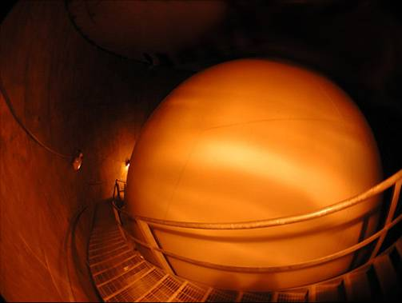
MiniBooNE, a neutrino oscillation experiment at Fermilab
Teppei Katori for the MiniBooNE collaboration
Massachusetts Institute of Technology
Southern Methodist-U HEP seminar, Dallas, September, 27, 2010

Slide 2
MiniBooNE, a neutrino oscillation experiment at Fermilab
Outline
Introduction
2. Neutrino beam
3. Events in the detector
4. Cross section model
5. Oscillation analysis
6. Neutrino oscillation result
7. New Low energy excess result
8. Anti-neutrino oscillation result
9. Neutrino disappearance result

Slide 3
1. Introduction
2. Neutrino beam
3. Events in the detector
4. Cross section model
5. Oscillation analysis
6. Neutrino oscillation result
7. New Low energy excess result
8. Anti-neutrino oscillation result
9. Neutrino disappearance result

Slide 4
1. Neutrino oscillation
The neutrino weak eigenstate is described by neutrino Hamiltonian eigenstates, ν₁, ν₂, and ν₃ and their mixing matrix elements.
The time evolution of neutrino weak eigenstate is written by Hamiltonian mixing matrix elements and eigenvalues of ν₁, ν₂, and ν₃.
Then the transition probability from weak eigenstate ν_{μ} to ν_{e} is
So far, model independent

Slide 5
1. Neutrino oscillation
From here, model dependent formalism.
In the vacuum, 2 neutrino state effective Hamiltonian has a form,
Therefore, 2 massive neutrino oscillation model is
Or, conventional form

Slide 6
1. Neutrino oscillation
Neutrino oscillation is an interference experiment (cf. double slit experiment)
light source
slit
screen
ν_{μ}
ν_{μ}
If 2 neutrino Hamiltonian eigenstates, ν₁ and ν₂, have different phase rotation, they cause quantum interference.

Slide 7
1. Neutrino oscillation
Neutrino oscillation is an interference experiment (cf. double slit experiment)
ν_{μ}
U_{μ1}
ν₁
U_{e1}∗
ν₂
ν_{μ}
ν₂
ν₁
If 2 neutrino Hamiltonian eigenstates, ν₁ and ν₂, have different phase rotation, they cause quantum interference.
For massive neutrino model, if ν₁ is heavier than ν₂, they have different group velocities hence different phase rotation, thus the superposition of those 2 wave packet no longer makes same state

Slide 8
1. Neutrino oscillation
Neutrino oscillation is an interference experiment (cf. double slit experiment)
ν_{μ}
U_{μ1}
ν₁
U_{e1}∗
ν_{e}
ν₂
ν₂
ν₁
ν_{e}
If 2 neutrino Hamiltonian eigenstates, ν₁ and ν₂, have different phase rotation, they cause quantum interference.
For massive neutrino model, if ν₁ is heavier than ν₂, they have different group velocities hence different phase rotation, thus the superposition of those 2 wave packet no longer makes same state

Slide 9
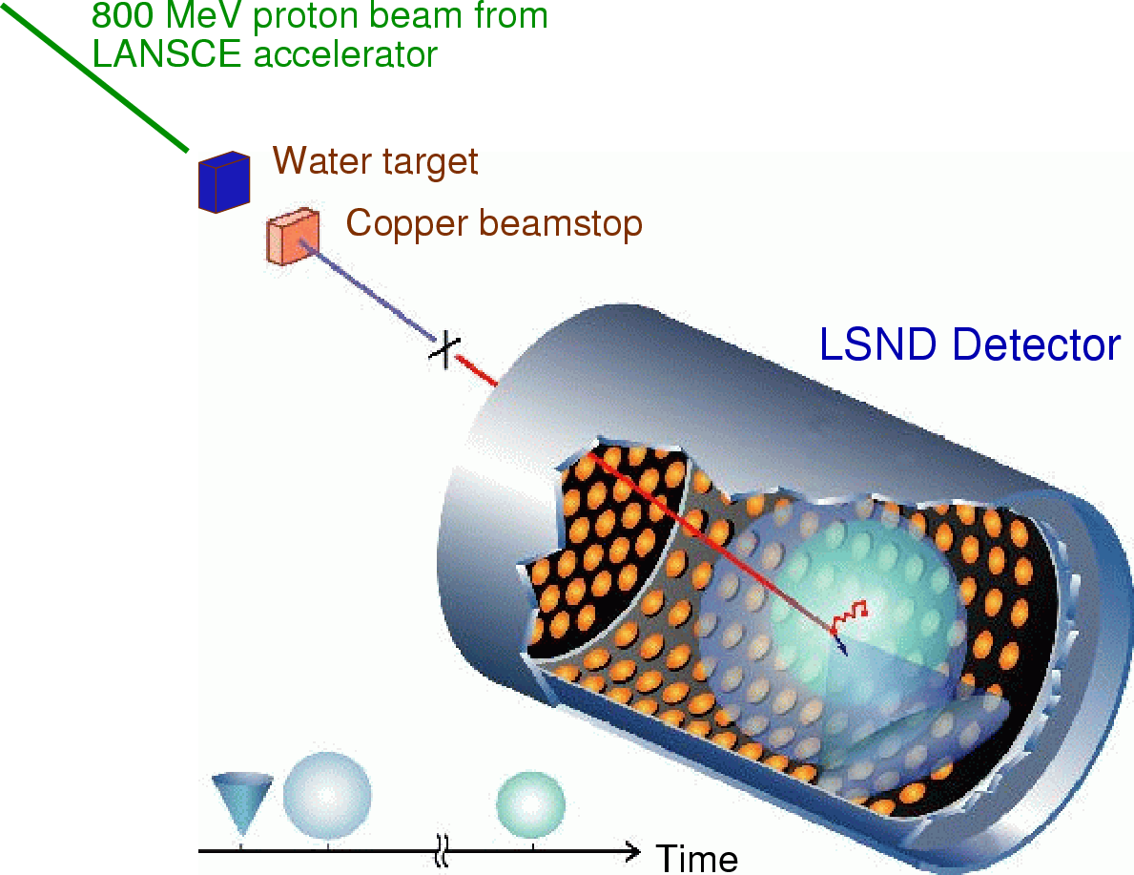
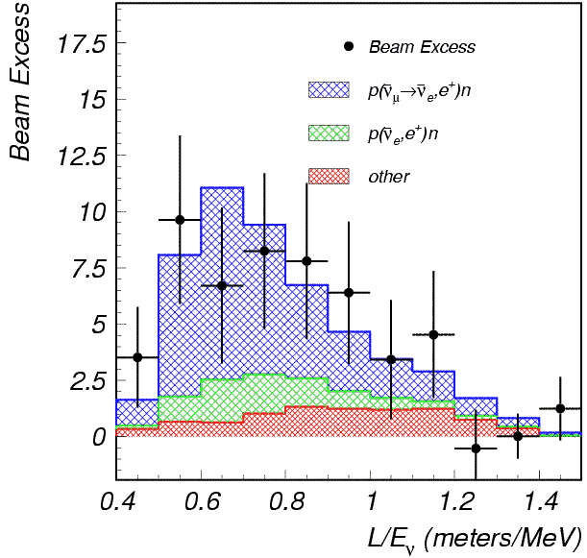
1. LSND experiment
LSND Collaboration,
PRD 64, 112007
LSND experiment at Los Alamos
observed excess of anti-electron neutrino events in the anti-muon neutrino beam.
87.9 ± 22.4 ± 6.0 (3.8.σ)
L/E~30m/30MeV~1
LSND
signal

Slide 10
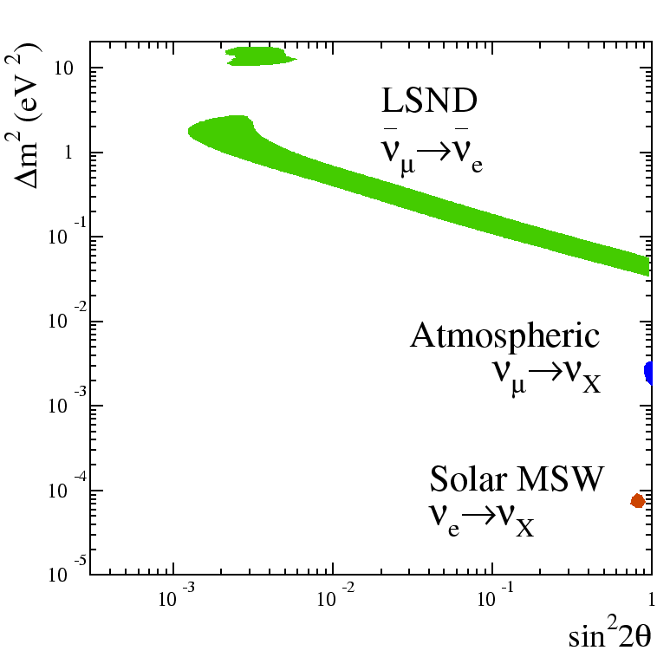
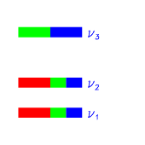
1. LSND experiment
3 types of neutrino oscillations are found:
LSND neutrino oscillation: Δm2~1eV2
Atmospheric neutrino oscillation: Δm2~10-3eV2
Solar neutrino oscillation : Δm2~10-5eV2
But we cannot have so many Δm2!
Δm₁₃² = Δm₁₂² + Δm₂₃²
increasing (mass) ²
We need to test LSND signal
MiniBooNE experiment is designed to have same L/E~500m/500MeV~1 to test LSND Δm2~1eV2

Slide 11

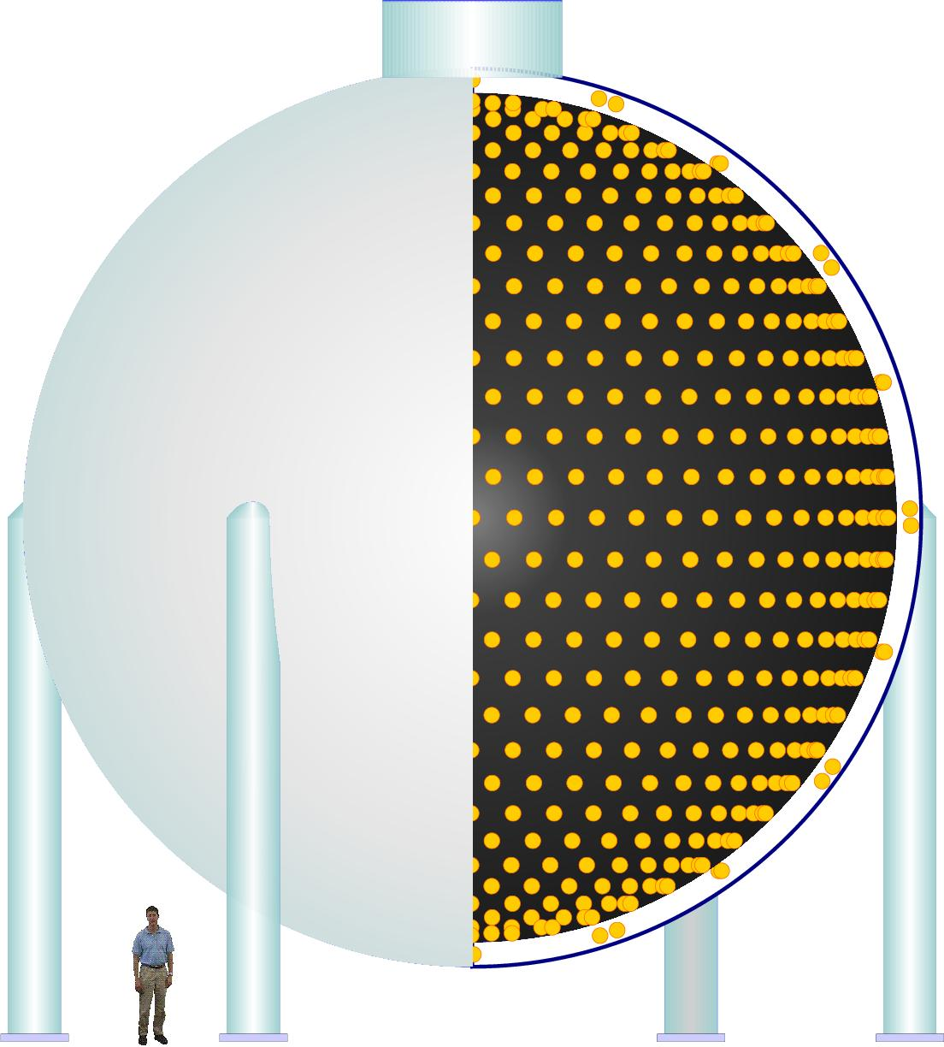
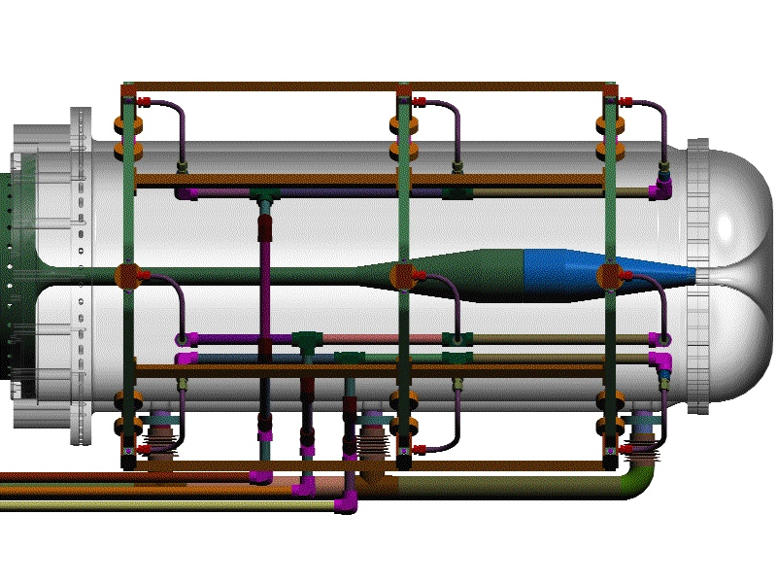
1. MiniBooNE experiment
Keep L/E same with LSND, while changing systematics, energy & event signature;
P(ν_{μ}−ν_{e})= sin²2θ sin²(1.27Δm²L/Ε)
MiniBooNE is looking for the single isolated electron like events, which is the signature of ν_{e} events
FNAL Booster
target and horn
decay region
absorber
dirt
detector
K⁺
ν_{μ} → ν_{e} ???
Booster
π+
primary beam
secondary beam
tertiary beam
(protons)
(mesons)
(neutrinos)
MiniBooNE has;
- higher energy (~500 MeV) than LSND (~30 MeV)
- longer baseline (~500 m) than LSND (~30 m)

Slide 12
1. Introduction
2. Neutrino beam
3. Events in the detector
4. Cross section model
5. Oscillation analysis
6. Neutrino oscillation result
7. New Low energy excess result
8. Anti-neutrino oscillation result
9. Neutrino disappearance result

Slide 13
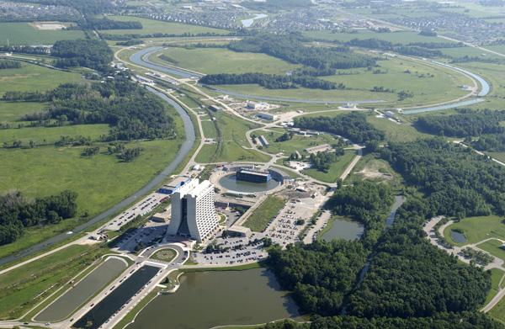
2. Neutrino beam
MiniBooNE collaboration,
PRD79(2009)072002
MiniBooNE extracts beam
from the 8 GeV Booster
Booster
Target
Hall
FNAL Booster
target and horn
decay region
absorber
dirt
detector
K⁺
ν_{μ} → ν_{e} ???
Booster
π+
primary beam
secondary beam
tertiary beam
(protons)
(mesons)
(neutrinos)

Slide 14
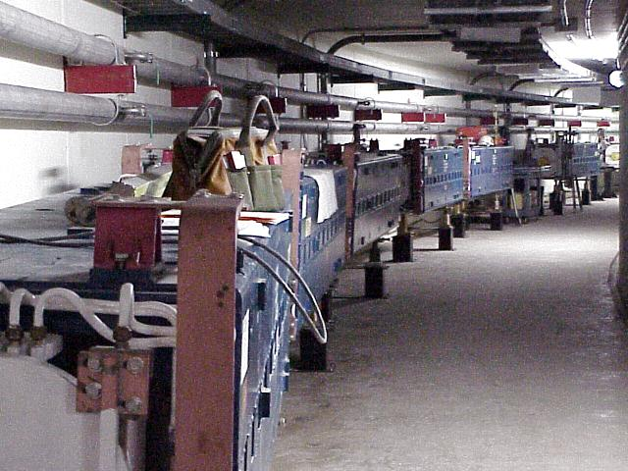
2. Neutrino beam
MiniBooNE collaboration,
PRD79(2009)072002
4 ×1012 protons per 1.6 μs pulse
delivered at up to 5 Hz.
5.58×1020 POT (proton on target)
Booster
Target
Hall
FNAL Booster
1.5ns
1.6μs
19ns
20μs
Beam micro structure
Beam macro structure

Slide 15

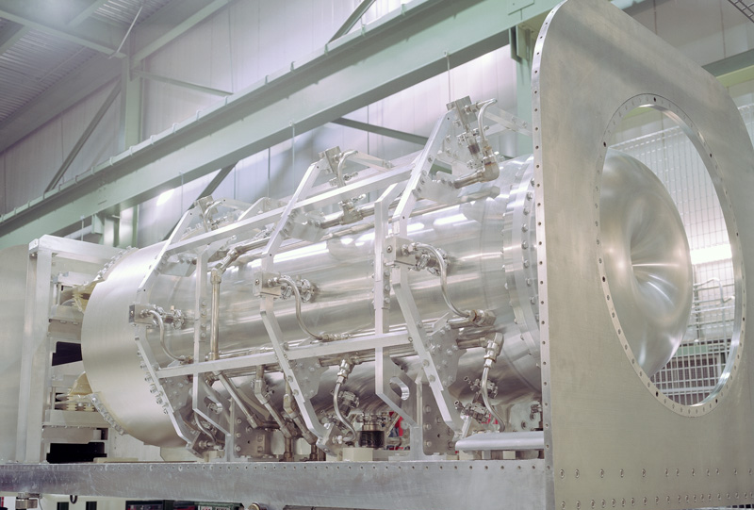
2. Neutrino beam
MiniBooNE collaboration,
PRD79(2009)072002
Magnetic focusing horn
8GeV protons are delivered to a 1.7 λ Be target
within a magnetic horn
(2.5 kV, 174 kA) that
increases the flux by × 6
FNAL Booster
target and horn
decay region
absorber
dirt
detector
π−
π+
K⁺
ν_{μ} → ν_{e} ???
Booster
π+
π−
π+
primary beam
secondary beam
tertiary beam
(protons)
(mesons)
(neutrinos)

Slide 16
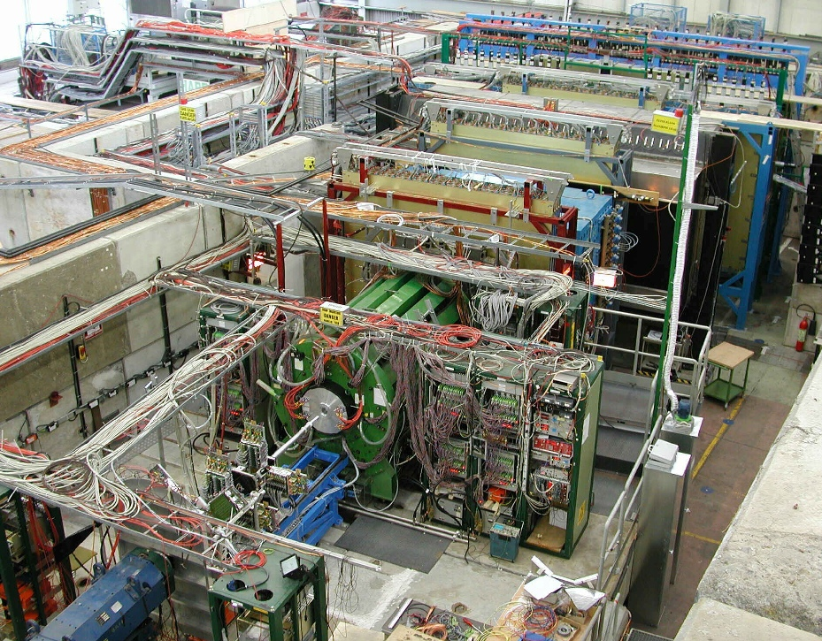
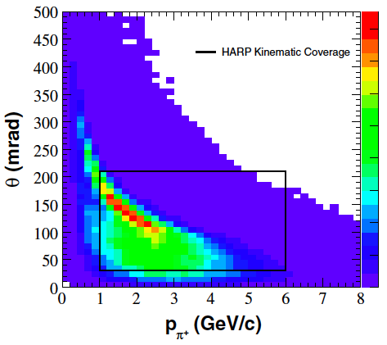
2. Neutrino beam
MiniBooNE collaboration,
PRD79(2009)072002
Modeling of meson production is based on the measurement done by HARP collaboration
- Identical, but 5% λ Beryllium target
- 8.9 GeV/c proton beam momentum
HARP experiment (CERN)
HARP collaboration,
Eur.Phys.J.C52(2007)29
Booster neutrino beamline pion kinematic space
HARP kinematic coverage
Majority of pions create neutrinos in MiniBooNE are directly measured by HARP (>80%)

Slide 17
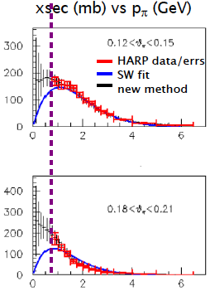
2. Neutrino beam
MiniBooNE collaboration,
PRD79(2009)072002
Modeling of meson production is based on the measurement done by HARP collaboration
- Identical, but 5% λ Beryllium target
- 8.9 GeV/c proton beam momentum
HARP experiment (CERN)
HARP collaboration,
Eur.Phys.J.C52(2007)29
HARP data with 8.9 GeV/c proton beam momentum
The error on the HARP data (~7%) directly propagates.
The neutrino flux error is the dominant source of normalization error for an absolute cross section in MiniBooNE, however it doesn’t affect oscillation analysis.

Slide 18
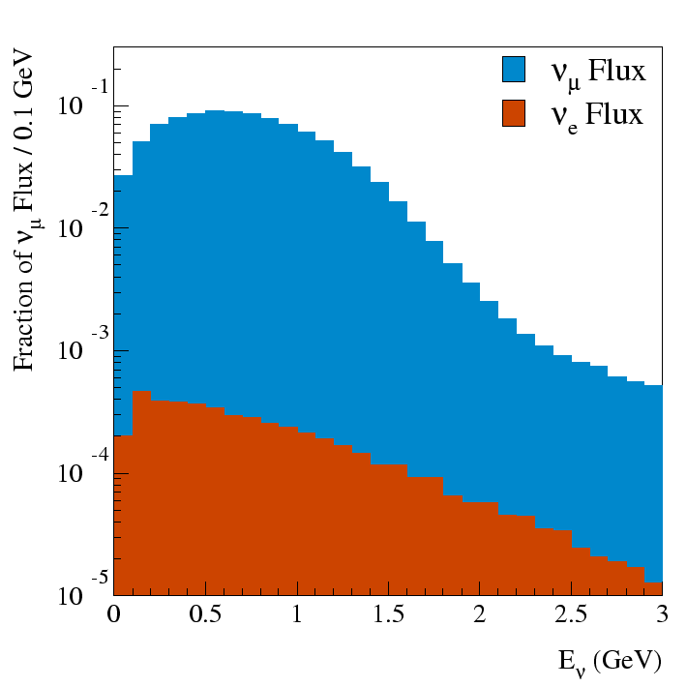
2. Neutrino beam
MiniBooNE collaboration,
PRD79(2009)072002
Neutrino Flux from GEANT4 Simulation
MiniBooNE is the ν_{e} appearance oscillation experiment
“Intrinsic” ν_{e} + ν_{e} sources:
  μ+ → e+ ν_{μ} ν_{e} (52%)
  K+ → π0 e+ ν_{e} (29%)
  K0 → π e ν_{e} (14%)
  Other ( 5%)
π → μ νμ
K→ μ νμ
μ → e νμ νe
K→ π e νe
ν_{e}/ν_{μ} = 0.5%
Antineutrino content: 6%

Slide 19
1. Introduction
2. Neutrino beam
3. Events in the detector
4. Cross section model
5. Oscillation analysis
6. Neutrino oscillation result
7. New Low energy excess result
8. Anti-neutrino oscillation result
9. Neutrino disappearance result

Slide 20
MiniBooNE collaboration,
NIM.A599(2009)28
3. Events in the Detector
The MiniBooNE Detector
- 541 meters downstream of target
- 3 meter overburden
- 12 meter diameter sphere
(10 meter “fiducial” volume)
- Filled with 800 t of pure mineral oil (CH₂)
(Fiducial volume: 450 t)
- 1280 inner phototubes,
- 240 veto phototubes
Simulated with a GEANT3 Monte Carlo

Slide 21
MiniBooNE collaboration,
NIM.A599(2009)28
3. Events in the Detector
The MiniBooNE Detector
- 541 meters downstream of target
- 3 meter overburden
- 12 meter diameter sphere
(10 meter “fiducial” volume)
- Filled with 800 t of pure mineral oil (CH₂)
(Fiducial volume: 450 t)
- 1280 inner phototubes,
- 240 veto phototubes
Simulated with a GEANT3 Monte Carlo
541 meters
Booster

Slide 22
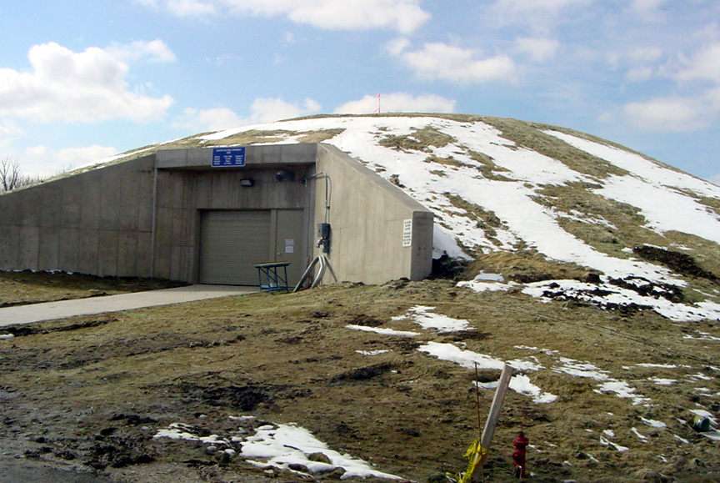
MiniBooNE collaboration,
NIM.A599(2009)28
3. Events in the Detector
The MiniBooNE Detector
- 541 meters downstream of target
- 3 meter overburden
- 12 meter diameter sphere
(10 meter “fiducial” volume)
- Filled with 800 t of pure mineral oil (CH₂)
(Fiducial volume: 450 t)
- 1280 inner phototubes,
- 240 veto phototubes
Simulated with a GEANT3 Monte Carlo

Slide 23
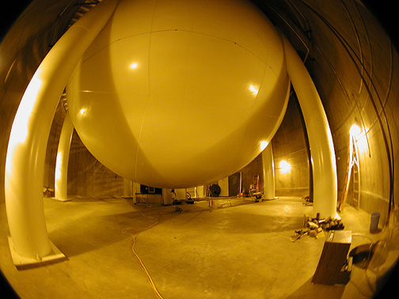
MiniBooNE collaboration,
NIM.A599(2009)28
3. Events in the Detector
The MiniBooNE Detector
- 541 meters downstream of target
- 3 meter overburden
- 12 meter diameter sphere
(10 meter “fiducial” volume)
- Filled with 800 t of pure mineral oil (CH₂)
(Fiducial volume: 450 t)
- 1280 inner phototubes,
- 240 veto phototubes
Simulated with a GEANT3 Monte Carlo

Slide 24
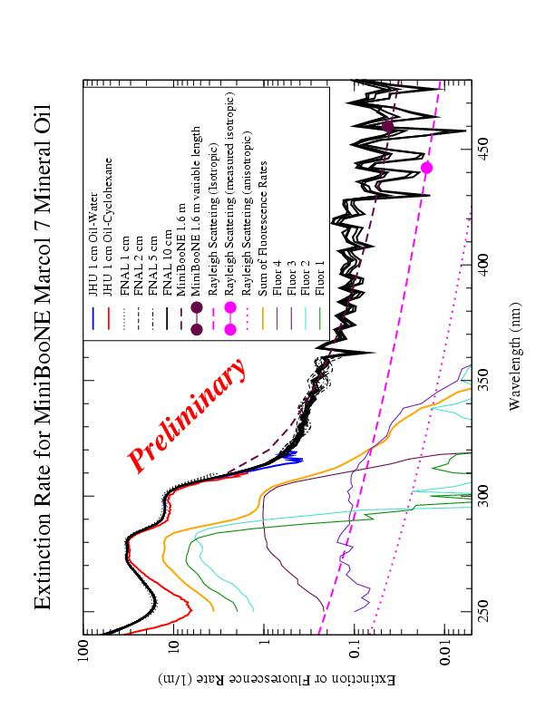
MiniBooNE collaboration,
NIM.A599(2009)28
3. Events in the Detector
The MiniBooNE Detector
- 541 meters downstream of target
- 3 meter overburden
- 12 meter diameter sphere
(10 meter “fiducial” volume)
- Filled with 800 t of pure mineral oil (CH₂)
(Fiducial volume: 450 t)
- 1280 inner phototubes,
- 240 veto phototubes
Simulated with a GEANT3 Monte Carlo
Extinction rate of MiniBooNE oil

Slide 25
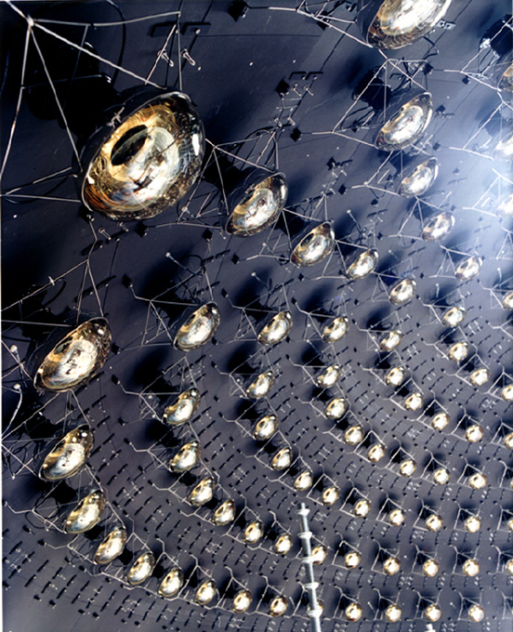
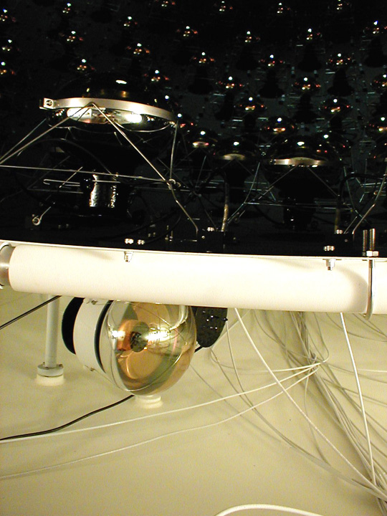
MiniBooNE collaboration,
NIM.A599(2009)28
3. Events in the Detector
The MiniBooNE Detector
- 541 meters downstream of target
- 3 meter overburden
- 12 meter diameter sphere
(10 meter “fiducial” volume)
- Filled with 800 t of pure mineral oil (CH₂)
(Fiducial volume: 450 t)
- 1280 inner phototubes,
- 240 veto phototubes
Simulated with a GEANT3 Monte Carlo

Slide 26
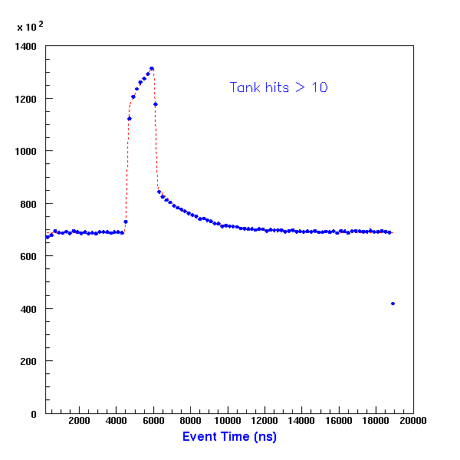
MiniBooNE collaboration,
NIM.A599(2009)28
3. Events in the Detector
Times of hit-clusters (subevents)
Beam spill (1.6μs) is clearly evident
  simple cuts eliminate cosmic backgrounds
Neutrino Candidate Cuts
  <6 veto PMT hits
    Gets rid of muons
  >200 tank PMT hits
    Gets rid of Michels
  Only neutrinos are left!
Beam and
Cosmic BG

Slide 27
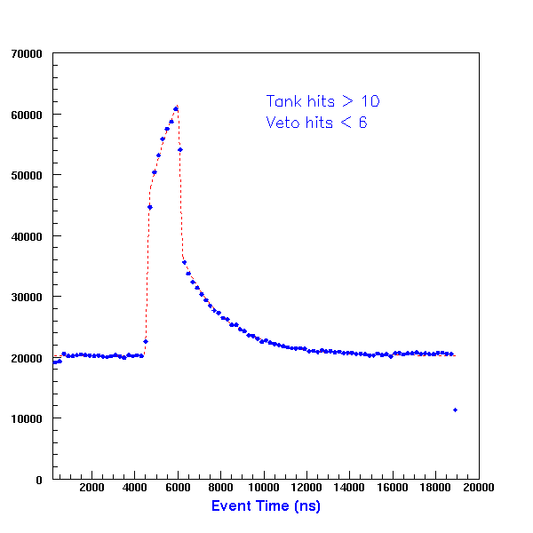
MiniBooNE collaboration,
NIM.A599(2009)28
3. Events in the Detector
Times of hit-clusters (subevents)
Beam spill (1.6μs) is clearly evident
  simple cuts eliminate cosmic backgrounds
Neutrino Candidate Cuts
  <6 veto PMT hits
    Gets rid of muons
  >200 tank PMT hits
    Gets rid of Michels
  Only neutrinos are left!
Beam and Michels

Slide 28
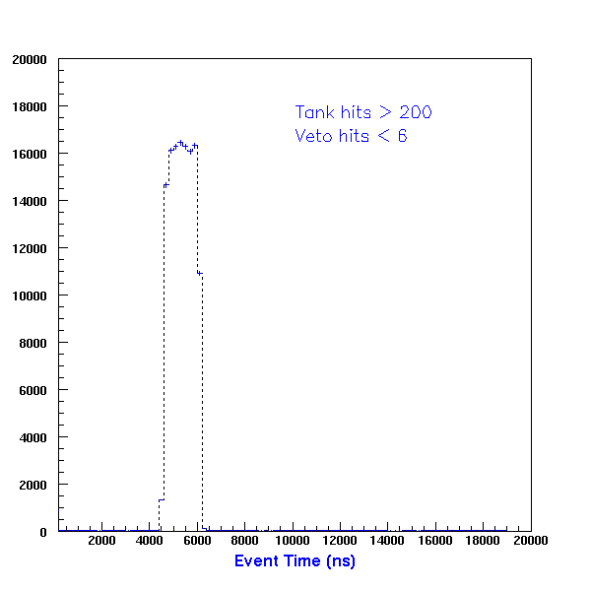
MiniBooNE collaboration,
NIM.A599(2009)28
3. Events in the Detector
Times of hit-clusters (subevents)
Beam spill (1.6μs) is clearly evident
  simple cuts eliminate cosmic backgrounds
Neutrino Candidate Cuts
  <6 veto PMT hits
    Gets rid of muons
  >200 tank PMT hits
    Gets rid of Michels
  Only neutrinos are left!
Beam
Only

Slide 29
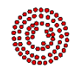
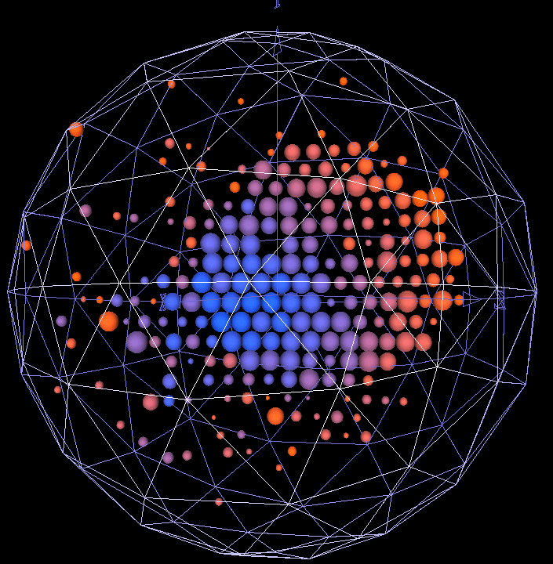
3. Events in the Detector
MiniBooNE collaboration,
NIM.A599(2009)28
Muons
  Sharp, clear rings
    Long, straight tracks
Electrons
  Scattered rings
    Multiple scattering
    Radiative processes
Neutral Pions
  Double rings
    Decays to two photons

Slide 30
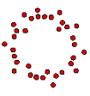
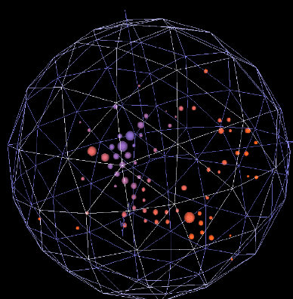
3. Events in the Detector
MiniBooNE collaboration,
NIM.A599(2009)28
Muons
  Sharp, clear rings
    Long, straight tracks
Electrons
  Scattered rings
    Multiple scattering
    Radiative processes
Neutral Pions
  Double rings
    Decays to two photons

Slide 31
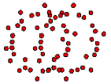
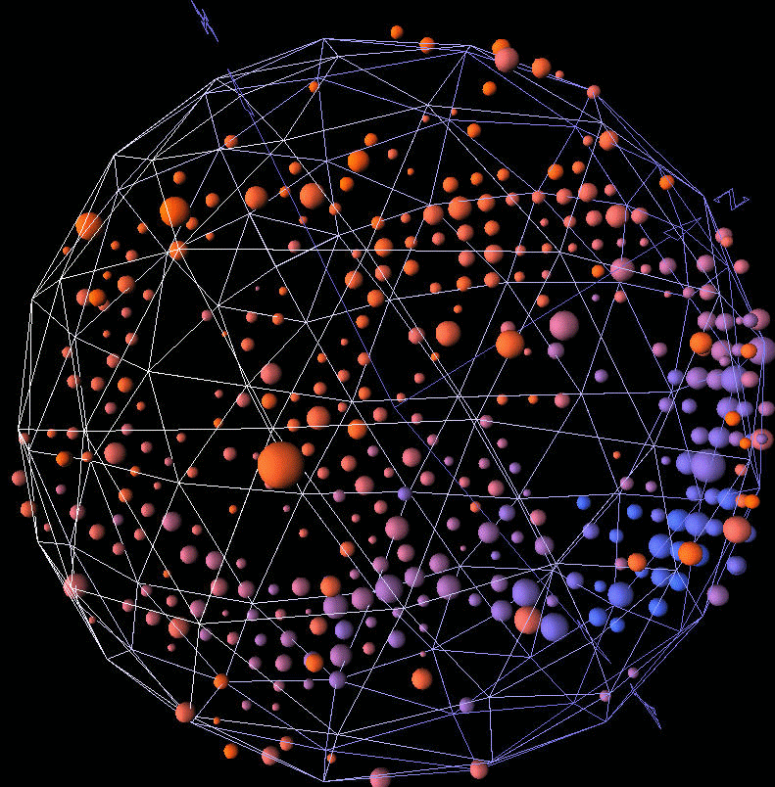
3. Events in the Detector
MiniBooNE collaboration,
NIM.A599(2009)28
Muons
  Sharp, clear rings
    Long, straight tracks
Electrons
  Scattered rings
    Multiple scattering
    Radiative processes
Neutral Pions
  Double rings
    Decays to two photons

Slide 32
1. Introduction
2. Neutrino beam
3. Events in the detector
4. Cross section model
5. Oscillation analysis
6. Neutrino oscillation result
7. New Low energy excess result
8. Anti-neutrino oscillation result
9. Neutrino disappearance result

Slide 33
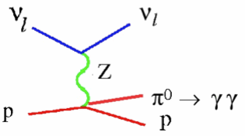
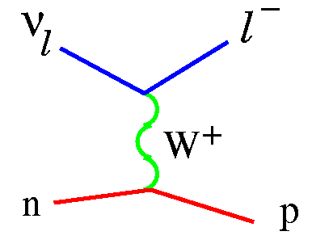
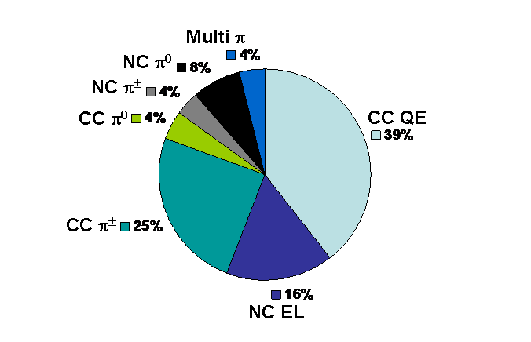
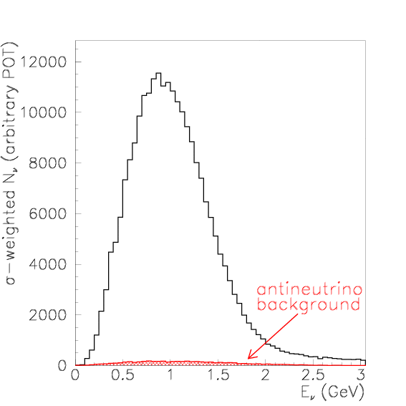
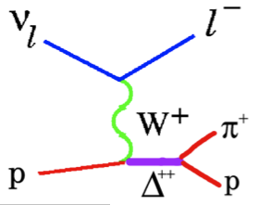
4. Cross section model
Predicted event rates before cuts
(NUANCE Monte Carlo)
Casper, Nucl.Phys.Proc.Suppl.112(2002)161
Event neutrino energy (GeV)

Slide 34
4. Cross section model
Predicted event rates before cuts
(NUANCE Monte Carlo)
Casper, Nucl.Phys.Proc.Suppl.112(2002)161
Event neutrino energy (GeV)

Slide 35
4. CCQE cross section model tuning
CCQE (Charged Current Quasi-Elastic)
ν_{μ} charged current quasi-elastic (ν_{μ} CCQE) interaction is the most abundant (~40%) and the fundamental interaction in MiniBooNE detector
MiniBooNE detector
(spherical Cherenkov detector)
Cherenkov 1
muon like Cherenkov light and subsequent decayed electron (Michel electron) like Cherenkov light are the signal of CCQE event
μ
e
ν-beam
12C
Cherenkov 2
n
p
(Scintillation)

Slide 36
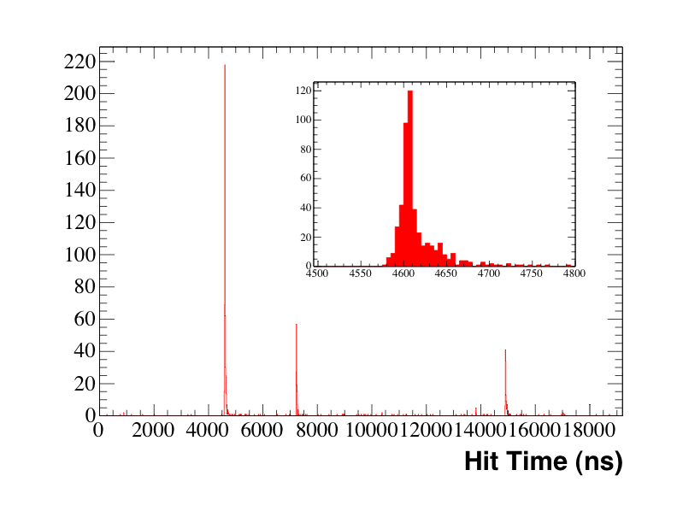
4. CCQE cross section model tuning
19.2 μs beam trigger window with the 1.6 μs spill
Multiple hits within a ~100 ns window form “subevents”
ν_{μ} CCQE interactions (ν+n → μ+p) with characteristic two “subevent” structure from stopped μ→ν_{μ}ν_{e}e
Number of tank hits for CCQE event
μ
e

Slide 37
4. CCQE cross section model tuning
All kinematics are specified from 2 observables, muon energy E_{μ} and muon scattering angle θ_{μ}
Energy of the neutrino E_{ν}QE and 4-momentum transfer Q₂QE can be reconstructed by these 2 observables, under the assumption of CCQE interaction with bound neutron at rest (“QE assumption”). CCQE is the signal channel of ν_{e} candidate.
E_{μ}
12C
μ
ν-beam
cosθ

Slide 38
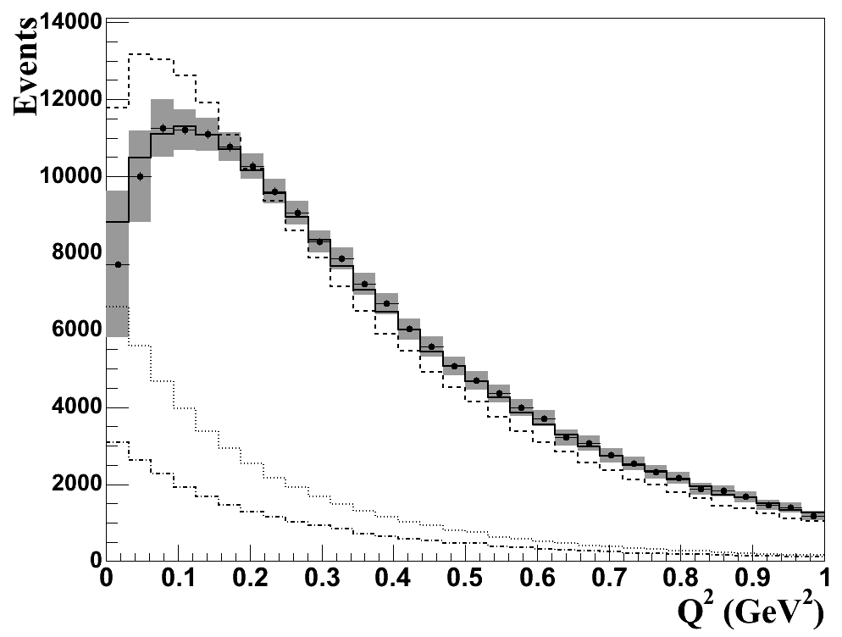
4. CCQE cross section model tuning
MiniBooNE collaboration
PRL100(2008)032301
The data-MC agreement in Q2 (4-momentum transfer) is not good
We tuned nuclear parameters in Relativistic Fermi Gas model
Smith and Moniz,
Nucl.,Phys.,B43(1972)605
Q2 fits to MB ν_{μ} CCQE data using the nuclear parameters:
M_{A}eff - effective axial mass
κ - Pauli Blocking parameter
Relativistic Fermi Gas Model with tuned parameters describes
ν_{μ} CCQE data well
This improved nuclear model is used in ν_{e} CCQE channel, too.
Q2 distribution before and after fitting
data with all errors
simulation (before fit)
simulation (after fit)
backgrounds

Slide 39
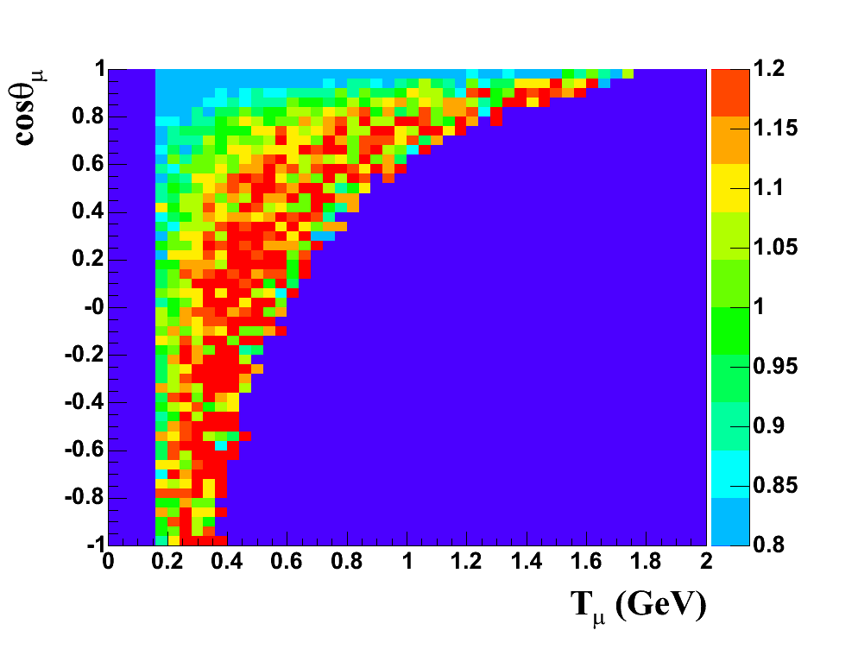
4. CCQE cross section model tuning
Without knowing flux perfectly, we cannot modify cross section model
Data-MC ratio for T_{μ}-cosθ_{μ} plane, before tuning

Slide 40
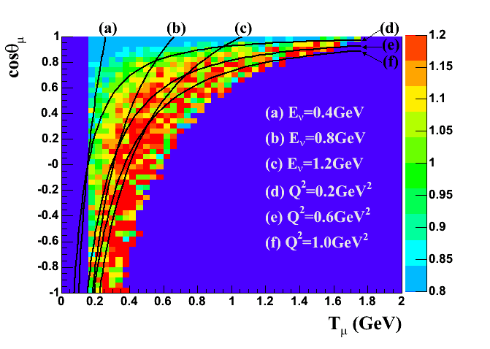
4. CCQE cross section model tuning
Without knowing flux perfectly, we cannot modify cross section model
Data-MC mismatching follows Q2 lines, not E_{ν} lines, therefore we can see the problem is not the flux prediction, but the cross section model
Data-MC ratio for T_{μ}-cosθ_{μ} plane, before tuning

Slide 41
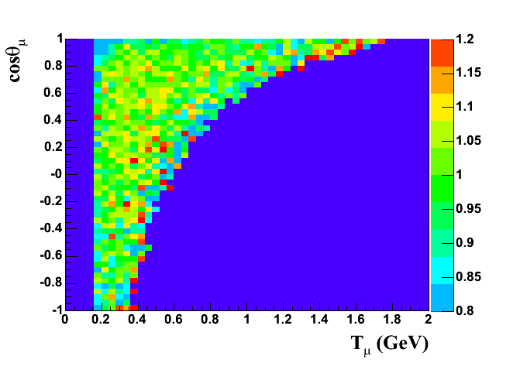
4. CCQE cross section model tuning
Without knowing flux perfectly, we cannot modify cross section model
Data-MC mismatching follows Q2 lines, not E_{ν} lines, therefore we can see the problem is not the flux prediction, but the cross section model
Data-MC ratio for T_{μ}-cosθ_{μ} plane, before tuning
Data-MC ratio for T_{μ}-cosθ_{μ} plane,after tuning

Slide 42
4. NCπo rate tuning
NCπo (neutral current πo production)
The signal of ν_{e} candidate is a single isolated electron
- single electromagnetic shower is the potential background
- the notable background is Neutral current πο production
Because of kinematics, one always has the possibility to miss one gamma ray, and hence this reaction looks like signal
πο
MiniBooNE NCπo candidate

Slide 43
4. NCπo rate tuning
NCπo (neutral current πo production)
The signal of ν_{e} candidate is a single isolated electron
- single electromagnetic shower is the potential background
- the notable background is Neutral current πο production
Because of kinematics, one always has the possibility to miss one gamma ray, and hence this reaction looks like signal
Asymmetric decay
πο
MiniBooNE NCπo candidate

Slide 44
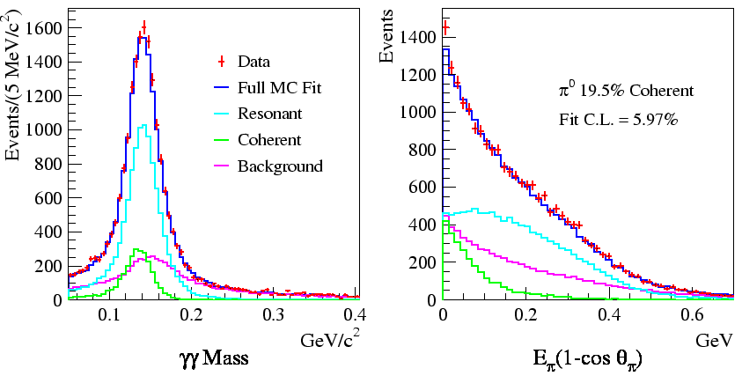
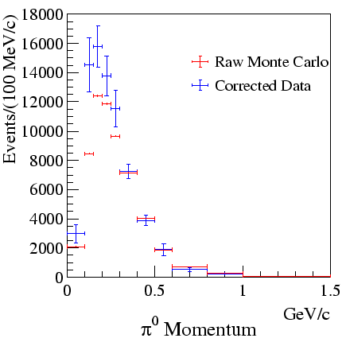
4. NCπo rate tuning
We tuned NCπo rate from our NCπo measurement. Since loss of gamma ray is pure kinematic effect, after tuning we have a precise prediction for intrinsic NCπo background for ν_{e} appearance search.
Data-Mc comparison of πo kinematics (after tuning)
Resonance
Coherent
ν
ν
ν
ν
Z
N
Z
A
MiniBooNE collaboration
PLB664(2008)41
Δ
πo
γ
πo
γ
N
A
γ
γ

Slide 45
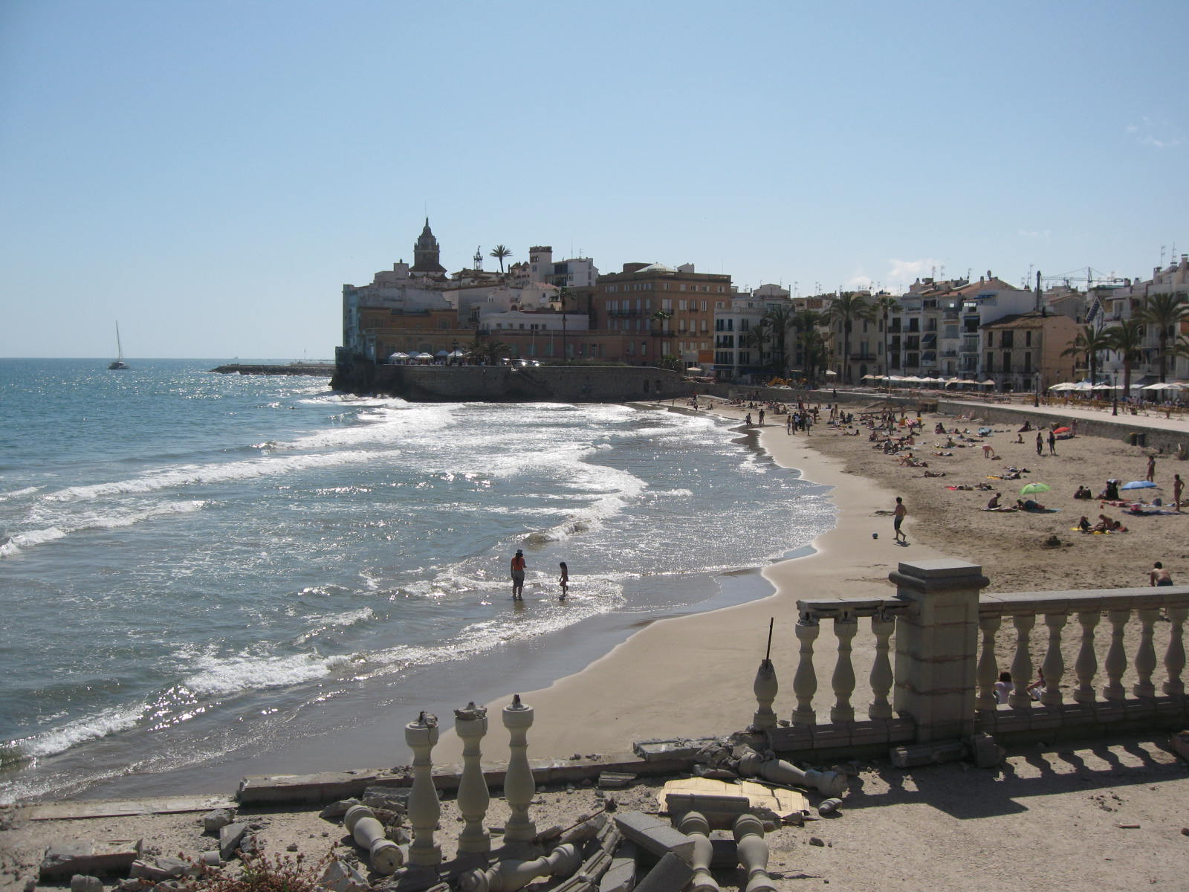
4. MiniBooNE cross section results
NuInt09, May18-22, 2009, Sitges, Spain
All talks proceedings are available on online (open access),
http://proceedings.aip.org/proceedings/confproceed/1189.jsp
NuInt09 MiniBooNE results
In NuInt09, MiniBooNE had 6 talks and 2 posters
1. charged current quasielastic (CCQE) cross section measurement
by Teppei Katori, PRD81(2010)092005
2. neutral current elastic (NCE) cross section measurement
by Denis Perevalov, arXiv:1007.4730
3. neutral current πo production (NCπo) cross section measurement (ν and anti-ν)
by Colin Anderson, PRD81(2010)013005
4. charged current single pion production (CCπ+) cross section measurement
by Mike Wilking, paper in preparation
5. charged current single πo production (CCπo) cross section measurement
by Bob Nelson, paper in preparation
6. improved CC1π+ simulation in NUANCE generator
by Jarek Novak
7. CCπ+/CCQE cross section ratio measurement
by Steve Linden, PRL103(2009)081801
8. anti-νCCQE measurement
by Joe Grange, paper in preparation

Slide 46
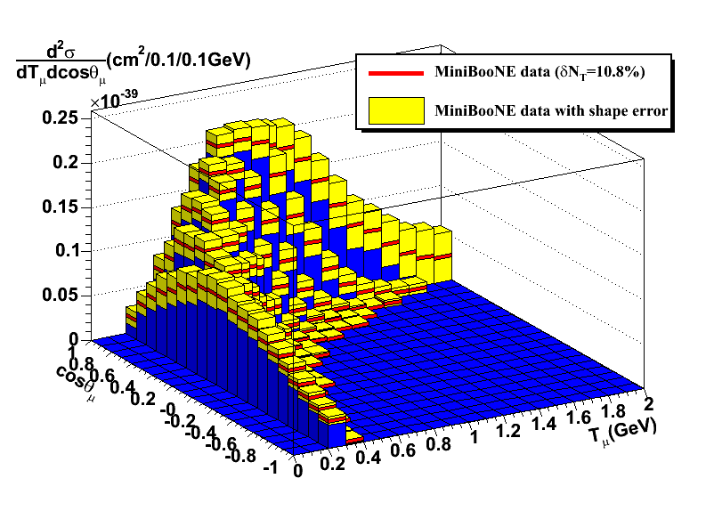
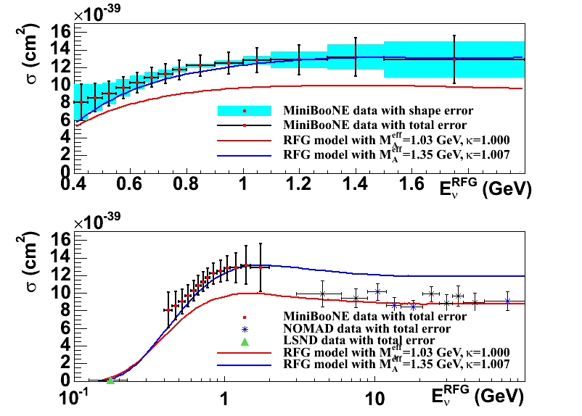
4. MiniBooNE cross section results
NuInt09, May18-22, 2009, Sitges, Spain
All talks proceedings are available on online (open access),
http://proceedings.aip.org/proceedings/confproceed/1189.jsp
NuInt09 MiniBooNE results
In NuInt09, MiniBooNE had 6 talks and 2 posters
1. charged current quasielastic (CCQE) cross section measurement
by Teppei Katori, PRD81(2010)092005
2. neutral current elastic (NCE) cross section measurement
by Denis Perevalov, arXiv:1007.4730
3. neutral current πo production (NCπo) cross section measurement (ν and anti-ν)
by Colin Anderson, PRD81(2010)013005
4. charged current single pion production (CCπ+) cross section measurement
by Mike Wilking, paper in preparation
5. charged current single πo production (CCπo) cross section measurement
by Bob Nelson, paper in preparation
6. improved CC1π+ simulation in NUANCE generator
by Jarek Novak
7. CCπ+/CCQE cross section ratio measurement
by Steve Linden, PRL103(2009)081801
8. anti-νCCQE measurement
by Joe Grange, paper in preparation
1. the first measurement of CCQE double differential cross section
2. measured Q2 shape prefer high axial mass (M_{A}) under RFG model
3. ~30% higher absolute cross section from the recent NOMAD result
Flux-integrated double differential cross section
Flux-unfolded total cross section

Slide 47
1. Introduction
2. Neutrino beam
3. Events in the detector
4. Cross section model
5. Oscillation analysis
6. Neutrino oscillation result
7. New Low energy excess result
8. Anti-neutrino oscillation result
9. Neutrino disappearance result

Slide 48
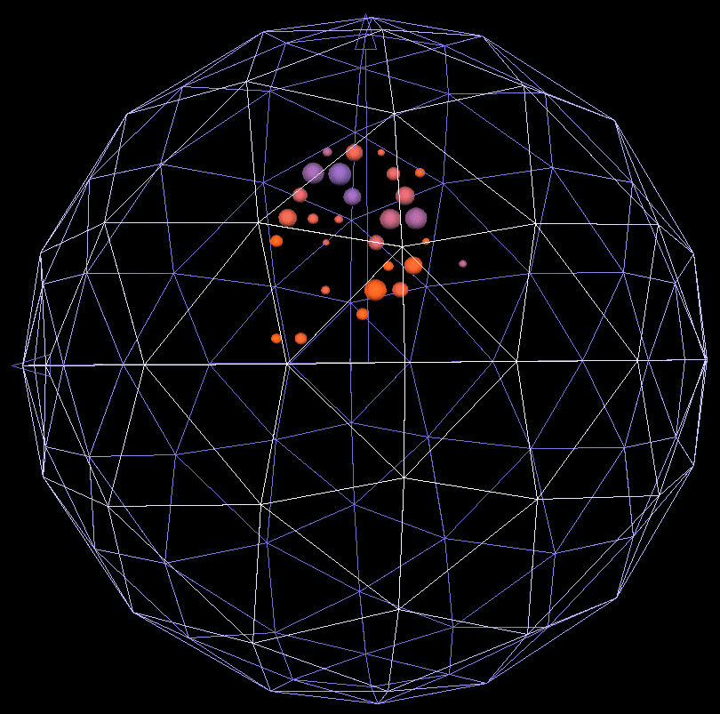
5. Blind analysis
The MiniBooNE signal is small but relatively easy to isolate
The data is described in n-dimensional space;
hit time
veto hits
energy

Slide 49
5. Blind analysis
The MiniBooNE signal is small but relatively easy to isolate
The data is described in n-dimensional space;
hit time
CCQE
NCπo
veto hits
high energy
energy
ν_{e} candidate
(closed box)
The data is classified into "box". For boxes to be "opened" to analysis they must be shown to have a signal < 1σ. In the end, 99% of the data were available
(boxes need not to be exclusive set)

Slide 50
5. Blind analysis
π → μ ν_{μ}
“Intrinsic” ν_{e} + ν_{e} sources:
  μ+ → e+ ν_{μ} ν_{e} (52%)
  K+ → π0 e+ ν_{e} (29%)
  K0 → π e ν_{e} (14%)
  Other ( 5%)
K→ μ ν_{μ}
Since MiniBooNE is blind analysis experiment, we need to constraint intrinsic ν_{e} background without measuring directly
(1) μ decay ν_{e} background
(2) K decay ν_{e} background
μ → e νμ νe
K→ π e νe
ν_{e}/ν_{μ} = 0.5%
Antineutrino content: 6%

Slide 51
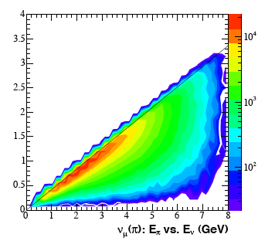
5. Blind analysis
(1) measure ν_{μ} flux from ν_{μ}CCQE event to constraint ν_{e} background from μ decay
ν_{μ}CCQE is one of the open boxes.
Kinematics allows connection to π flux, hence intrinsic ν_{e} background from μ decay is constraint. In the really, simultaneous fit of ν_{e}CCQE and ν_{μ}CCQE take care of this.
hit time
CCQE
NCπo
veto hits
high energy
energy
π → μ ν_{μ}
Eν-Eπ space
E_{ν} (GeV)
E_{ν} = 0.43 E_{π}
μ → e ν_{μ} ν_{e}
E_{π}(GeV)

Slide 52
5. Blind analysis
(2) measure high energy ν_{μ} events to constraint ν_{e} background from K decay
At high energies, above “signal range” ν_{μ} and “ν_{e} -like” events are largely due to kaon decay
hit time
CCQE
NCπo
veto hits
high energy
energy
π → μ ν_{μ}
example of open boxes;
- ν_{μ}CCQE
- high energy event
- CCπ+
- NC elastics
- NC πο
- NC electron scattering
- Michel electron
etc....
K→ μ ν_{μ}
signal range
ν events
Dominated
by Kaon
decay
K→ π e ν_{e}

Slide 53
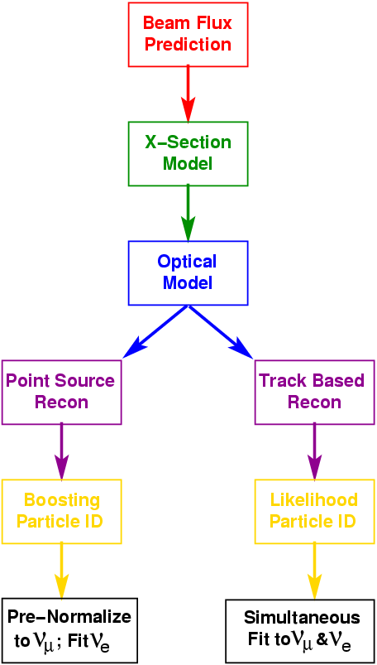
5. MiniBooNE oscillation analysis structure
Start with a GEANT4 flux prediction for the ν spectrum from π and K produced at the target
Predict ν interactions using NUANCE neutrino interaction generator
Pass final state particles to GEANT3 to model particle and light propagation in the tank
Starting with event reconstruction, independent analyses form: (1) Track Based Likelihood (TBL) and (2) Boosted Decision Tree (BDT)
Develop particle ID/cuts to separate signal from background
Fit reconstructed E_{ν}QE spectrum for oscillations
detector model
“BDT”
“TBL”
Boosting Particle ID
Likelihood Particle ID
Simultaneous Fit to ν_{μ} & ν_{e}
Pre-Normalize to ν_{μ} ; Fit ν_{e}

Slide 54
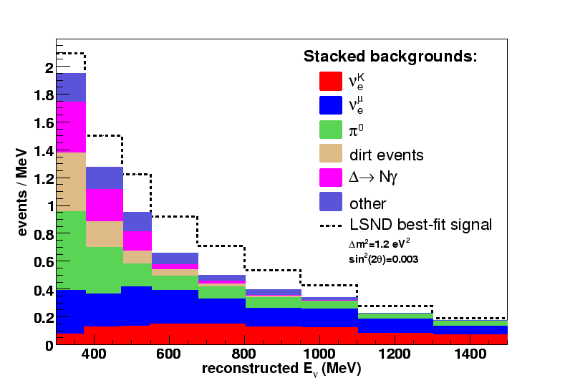
5. Track-Based Likelihood (TBL) analysis
TBL analysis summary
- Oscillation analysis uses 475MeV<E<1250MeV
475 MeV – 1250 MeV
ν_{e}^{K} 94
ν_{e}^{μ} 132
π⁰ 62
dirt 17
Δ→Nγ 20
other 33
total 358
LSND best-fit ν_{μ}→ν_{e} 126
Notes:
cut to reject low energy events near wall is: .not.(R>426 cm .and. E_{visible}<280)

Slide 55
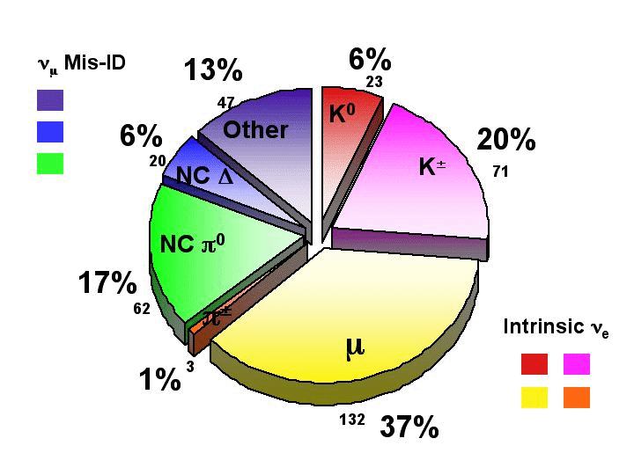
5. Track-Based Likelihood (TBL) analysis
We have two categories of backgrounds:
ν_{μ} mis-id
intrinsic ν_{e}
(TB analysis)

Slide 56
1. Introduction
2. Neutrino beam
3. Events in the detector
4. Cross section model
5. Oscillation analysis
6. Neutrino oscillation result
7. New Low energy excess result
8. Anti-neutrino oscillation result
9. Neutrino disappearance result

Slide 57
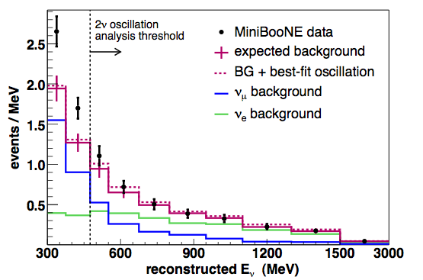
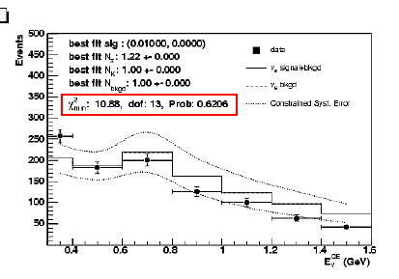
6. The MiniBooNE initial results
MiniBooNE collaboration,
PRL98(2007)231801
TBL analysis
TBL show no sign of an excess in the analysis region (where the LSND signal is expected from 1 sterile neutrino interpretation)
Visible excess at low E
BDT analysis
BDT has a good fit and no sign of an excess, in fact the data is low relative to the prediction
Also sees an excess at low E, but larger normalization error covers it

Slide 58

6. The MiniBooNE initial results
MiniBooNE collaboration,
PRL98(2007)231801
The observed reconstructed energy distribution
is inconsistent with a ν_{μ}→ν_{e} appearance-only model
Energy-fit analysis:
solid: TBL
dashed: BDT
Independent analyses
are in good agreement.
Within the energy range defined by this oscillation analysis, the event rate is consistent with background. 2 neutrino massive oscillation model is rejected as a explanation of LSND signal.
Excluded
region

Slide 59

6. Excess at low energy region?
MiniBooNE collaboration,
PRL98(2007)231801
Our goals for this first analysis were:
- A generic search for a ν_{e} excess in our ν_{μ} beam,
- An analysis of the data within a ν_{μ}→ν_{e} appearance-only context
Within the energy range defined by this oscillation analysis, the event rate is consistent with background.
However, there is statistically significant excess at low energy region.
The low energy excess is not consistent with any 2 neutrino massive oscillation models.

Slide 60
1. Introduction
2. Neutrino beam
3. Events in the detector
4. Cross section model
5. Oscillation analysis
6. Neutrino oscillation result
7. New Low energy excess result
8. Anti-neutrino oscillation result
9. Neutrino disappearance result

Slide 61
7. Excess at low energy region?
Commonplace idea
Muon bremsstrahlung
- We studied from our data, and rejected.
Bodek, arXiv:0709.4004
γ
ν
W
μ
MiniBooNE collaboration, arXiv:0710.3897
X
X’
Harvey, Hill, Hill, PRL99(2007)261601
Standard model, but new
Anomaly mediated gamma emission
- Under study, need to know the coupling constant
- naïve approximation, same cross section for ν-N and ν-N
ν
ν
Z
γ
ω
X
X

Slide 62


7. Excess at low energy region?
Nelson, Walsh, PRD77(2008)033001
Beyond the Standard model (most popular)
New gauge boson production in the beamline
- can accommodate LSND and MiniBooNE
- solid prediction for anti-neutrinos.
Lorentz violating oscillation model
- can accommodate LSND and MiniBooNE
- predict low energy excess before MiniBooNE result.
- Under study
Kostelecky, TK, Tayloe, PRD74(2006)105009

Slide 63

7. Oscillation analysis update
We re-visit all background source, to find any missing components
Photonuclear effect
Low energy gamma can excite nuclei, an additional source to remove one of gamma ray from NCπo
Photonuclear effect
ν
ν
Z
N
Δ
πo
γ
N
γ
Other missing processes, (π-C elastic scattering, radiative π- capture, π induced Δ radiative decay) are negligible contribution to the background

Slide 64
7. Oscillation analysis update
We re-visit all background source, to find any missing components
New radiative gamma error
single gamma emission process
Delta resonance rate is constraint from data, so not hard to predict
new analysis take account the re-excitation of Delta from struck pion, this increases the error from 9% to 12%.

Slide 65

7. Oscillation analysis update
We re-visit all background source, to find any missing components
New flux prediction error
- external measurement error directly propagates to MiniBooNE analysis, without relying on the fitting.
New low energy bin
- analysis is extended down to 200MeV
New data set
- additional 0.83E20 POT data.
New dirt background cut
- remove 85% of dirt originated backgrounds (mostly πo made outside of the detector)

Slide 66


7. New oscillation analysis result
MiniBooNE collaboration,
PRL102(2009)101802
New ν_{e} appearance oscillation result
- low energy excess stays, the original excess in 300-475MeV becomes 3.4σ from 3.7σ after 1 year reanalysis.
- again, the shape is not described by any of two neutrino massive oscillation models
Now, we are ready to test exotic models, through antineutrino oscillation data

Slide 67
1. Introduction
2. Neutrino beam
3. Events in the detector
4. Cross section model
5. Oscillation analysis
6. Neutrino oscillation result
7. New Low energy excess result
8. Anti-neutrino oscillation result
9. Neutrino disappearance result

Slide 68

8. Antineutrino oscillation result
MiniBooNE collaboration,
PRL103(2009)111801
Many exotic models have some kind of predictions in antineutrino mode.
Analysis is quite parallel, because MiniBooNE doesn’t distinguish e- and e+ or μ- and μ+ on event-by-event basis.
Bottom line, we don’t see the low energy excess.

Slide 69
8. Antineutrino oscillation result
MiniBooNE collaboration,
PRL103(2009)111801
Implications
So many to say about models to explain low energy excess…
- The models based on same NC cross section for ν and anti-ν (e.g., anomaly gamma production) are disfavored.
The models proportioned to POT (e.g., physics related to the neutral particles in the beamline) are disfavored.
- The models which predict all excess only in neutrino mode, but not antineutrino are favored, such as neutrino-only induced excess

Slide 70

8. New antineutrino oscillation result
MiniBooNE collaboration,
arXiv:1007.1150
- Antineutrino mode is the direct test of LSND signal
- Analysis is limited with statistics
New antineutrino oscillation result
- 70% more data
- low level checks have been done
(beam stability, energy scale)
- new dirt event rate measurement
(consistent with neutrino mode)
- new NCπo rate measurement
(consistent with neutrino mode)
- ν fraction is measured in anti-ν beam
 | 200-475 MeV | 475-1250 MeV | 200-3000 MeV
Data | 119 | 120 | 277
New antineutrino oscillation result
(presented at Neutrino 2010, Athens)

Slide 71

8. New antineutrino oscillation result
MiniBooNE collaboration,
arXiv:1007.1150
- Antineutrino mode is the direct test of LSND signal
- Analysis is limited with statistics
New antineutrino oscillation result
- 70% more data
- low level checks have been done
(beam stability, energy scale)
- new dirt event rate measurement
(consistent with neutrino mode)
- new NCπo rate measurement
(consistent with neutrino mode)
- ν fraction is measured in anti-ν beam
MiniBooNE now see the excess in
LSND-like Δm2 region!
 | 200-475 MeV | 475-1250 MeV | 200-3000 MeV
Data | 119 | 120 | 277
MC (stat+sys) | 100.5 ± 14.3 | 99.1 ± 13.9 | 233.8 ± 22.5
Excess (stat+sys) | 18.5 ± 14.3 (1.3σ) | 20.9 ± 13.9 (1.5σ) | 43.2 ± 22.5 (1.9σ)

Slide 72

8. New antineutrino oscillation result
MiniBooNE collaboration,
arXiv:1007.1150
- Antineutrino mode is the direct test of LSND signal
- Analysis is limited with statistics
New antineutrino oscillation result
- 70% more data
- low level checks have been done
(beam stability, energy scale)
- new dirt event rate measurement
(consistent with neutrino mode)
- new NCπo rate measurement
(consistent with neutrino mode)
- ν fraction is measured in anti-ν beam
MiniBooNE now see the excess in
LSND-like Δm2 region!
- flatness test (model independent test)
shows statistically significance of signal.
 | before fit
 | χ²/NDF | probability
475 < E_{ν}^{QE} < 1250 MeV | 18.5/6 | 0.5%
Background subtracted data

Slide 73

8. New antineutrino oscillation result
MiniBooNE collaboration,
arXiv:1007.1150
- Antineutrino mode is the direct test of LSND signal
- Analysis is limited with statistics
New antineutrino oscillation result
- 70% more data
- low level checks have been done
(beam stability, energy scale)
- new dirt event rate measurement
(consistent with neutrino mode)
- new NCπo rate measurement
(consistent with neutrino mode)
- ν fraction is measured in anti-ν beam
MiniBooNE now see the excess in
LSND-like Δm2 region!
- flatness test (model independent test)
shows statistically significance of signal.
2 massive neutrino model is favored over
99.4% than null hypothesis
 | before fit |  | after fit
 | χ²/NDF | probability | χ²/NDF | probability
475 < E_{ν}^{QE} < 1250 MeV | 18.5/6 | 0.5% | 8.0/4 | 8.7%
E>475 MeV
Best ft point
Δm2 = 0.064eV2
sin22θ = 0.96

Slide 74
1. Introduction
2. Neutrino beam
3. Events in the detector
4. Cross section model
5. Oscillation analysis
6. Neutrino oscillation result
7. New Low energy excess event
8. Anti-neutrino oscillation result
9. Neutrino disappearance result

Slide 75

9. Neutrino disappearance oscillation result
MiniBooNE collaboration,
PRL103(2009)061802
ν_{μ} and anti-ν_{μ} disappearance oscillation
- test is done by shape-only fit for data and MC with massive neutrino oscillation model.
- MiniBooNE can test unexplored region by past experiments, especially there is no tests for antineutrino disappearance between Δm2=10eV2 and atmospheric Δm2 .

Slide 76



9. Neutrino disappearance oscillation result
MiniBooNE-SciBooNE combined ν_{μ} disappearance oscillation analysis
- combined analysis with SciBooNE can constrain Flux+Xsec error.
Flux-> same beam line
Xsec->same target (carbon)
Scintillator tracker
Muon range detector

Slide 77

9. Neutrino disappearance oscillation result
MiniBooNE-SciBooNE combined ν_{μ} disappearance oscillation analysis
- combined analysis with SciBooNE can constrain Flux+Xsec error.
Flux-> same beam line
Xsec->same target (carbon)
- this significantly improves sensitivities, especially at low Δm2. An analysis for anti-ν_{μ} is ongoing.

Slide 78



Future: MicroBooNE
scintillation from LiqAr
128nm
450nm
TPB (wave length shifter) coated acrylic plate
Liquid Argon TPC experiment at Fermilab
- 70 ton fiducial volume LiqAr TPC
- R&D detector for future large LiqAr TPC for DUSEL
- 3D tracker (modern bubble chamber)
- data taking will start from 2013(?)
- dE/dx can separate single electron from gamma ray (e+e- pair)
Cryogenic PMT system
liquid Argon TPC

Slide 79

Conclusions
MiniBooNE is a ν_{e} appearance oscillation experiment to test LSND signal
MiniBooNE successfully rejected two neutrino massive oscillation model as an explanation of LSND signal. However, MiniBooNE first result includes unexplained low energy event excess.
After 1 year re-visit for all background source, the low energy excess is now confirmed.
The initial data from antineutrino oscillation result doesn’t show any low energy excess.
The new high statistics antineutrino oscillation show small excess at low energy region and the large excess at where LSND-like Δm2 expect signal.
The MiniBooNE-SciBooNE combined ν_{μ}-disappearance analysis is ongoing.

Slide 80

BooNE collaboration
University of Alabama
Bucknell University
University of Cincinnati
University of Colorado
Columbia University
Embry Riddle Aeronautical University
Fermi National Accelerator Laboratory
Indiana University
University of Florida
Los Alamos National Laboratory
Louisiana State University
Massachusetts Institute of Technology
University of Michigan
Princeton University
Saint Mary's University of Minnesota
Virginia Polytechnic Institute
Yale University
Thank you for your attention!

Slide 81
Buck up

Slide 82

2. LSND experiment
In terms of the oscillation probability,
P( ν_{μ}−ν_{e})=0.264 ± 0.067 ± 0.045
Under the 2 flavor massive neutrino oscillation model, one can map into Δm2-sin22θ space (MS-diagram)
This model allows comparison
to other experiments:
Karmen2
Bugey
ν_{μ}→ ν_{e}
ν_{e} disapp.

Slide 83


3. Stability of running
Full ν Run
Observed and
expected events
per minute

Slide 84





4. Calibration source
Laser flask system
Muon tracker and scintillation cube system

Slide 85

4. Calibration source

Slide 86
4. MiniBooNE cross section results
NuInt09, May18-22, 2009, Sitges, Spain
All talks proceedings are available on online (open access),
http://proceedings.aip.org/proceedings/confproceed/1189.jsp
NuInt09 MiniBooNE results
In NuInt09, MiniBooNE had 6 talks and 2 posters
1. charged current quasielastic (CCQE) cross section measurement
by Teppei Katori, PRD81(2010)092005
2. neutral current elastic (NCE) cross section measurement
by Denis Perevalov, arXiv:1007.4730
3. neutral current πo production (NCπo) cross section measurement (ν and anti-ν)
by Colin Anderson, PRD81(2010)013005
4. charged current single pion production (CCπ+) cross section measurement
by Mike Wilking, paper in preparation
5. charged current single πo production (CCπo) cross section measurement
by Bob Nelson, paper in preparation
6. improved CC1π+ simulation in NUANCE generator
by Jarek Novak
7. CCπ+/CCQE cross section ratio measurement
by Steve Linden, PRL103(2009)081801
8. anti-νCCQE measurement
by Joe Grange, paper in preparation
CCQE double differential cross section
- first double differential cross section measurement
- observed large absolute cross section

Slide 87


4. MiniBooNE cross section results
by Denis Perevalov
NuInt09, May18-22, 2009, Sitges, Spain
All talks proceedings are available on online (open access),
http://proceedings.aip.org/proceedings/confproceed/1189.jsp
NuInt09 MiniBooNE results
In NuInt09, MiniBooNE had 6 talks and 2 posters
1. charged current quasielastic (CCQE) cross section measurement
by Teppei Katori, PRD81(2010)092005
2. neutral current elastic (NCE) cross section measurement
by Denis Perevalov, arXiv:1007.4730
3. neutral current πo production (NCπo) cross section measurement (ν and anti-ν)
by Colin Anderson, PRD81(2010)013005
4. charged current single pion production (CCπ+) cross section measurement
by Mike Wilking, paper in preparation
5. charged current single πo production (CCπo) cross section measurement
by Bob Nelson, paper in preparation
6. improved CC1π+ simulation in NUANCE generator
by Jarek Novak
7. CCπ+/CCQE cross section ratio measurement
by Steve Linden, PRL103(2009)081801
8. anti-νCCQE measurement
by Joe Grange, paper in preparation
Flux-averaged NCE p+n differential cross section
- highest statistics cross section measurement
- new Δs (strange quark spin) extraction method

Slide 88


4. MiniBooNE cross section results
by Colin Anderson
NuInt09, May18-22, 2009, Sitges, Spain
All talks proceedings are available on online (open access),
http://proceedings.aip.org/proceedings/confproceed/1189.jsp
NuInt09 MiniBooNE results
In NuInt09, MiniBooNE had 6 talks and 2 posters
1. charged current quasielastic (CCQE) cross section measurement
by Teppei Katori, PRD81(2010)092005
2. neutral current elastic (NCE) cross section measurement
by Denis Perevalov, arXiv:1007.4730
3. neutral current πo production (NCπo) cross section measurement (ν and anti-ν)
by Colin Anderson, PRD81(2010)013005
4. charged current single pion production (CCπ+) cross section measurement
by Mike Wilking, paper in preparation
5. charged current single πo production (CCπo) cross section measurement
by Bob Nelson, paper in preparation
6. improved CC1π+ simulation in NUANCE generator
by Jarek Novak
7. CCπ+/CCQE cross section ratio measurement
by Steve Linden, PRL103(2009)081801
8. anti-νCCQE measurement
by Joe Grange, paper in preparation
- first differential cross section measurement
- observed large absolute cross section
NCπo differential cross section
(both ν and anti-ν)

Slide 89


4. MiniBooNE cross section results
by Mike Wilking
NuInt09, May18-22, 2009, Sitges, Spain
All talks proceedings are available on online (open access),
http://proceedings.aip.org/proceedings/confproceed/1189.jsp
NuInt09 MiniBooNE results
In NuInt09, MiniBooNE had 6 talks and 2 posters
1. charged current quasielastic (CCQE) cross section measurement
by Teppei Katori, PRD81(2010)092005
2. neutral current elastic (NCE) cross section measurement
by Denis Perevalov, arXiv:1007.4730
3. neutral current πo production (NCπo) cross section measurement (ν and anti-ν)
by Colin Anderson, PRD81(2010)013005
4. charged current single pion production (CCπ+) cross section measurement
by Mike Wilking, paper in preparation
5. charged current single πo production (CCπo) cross section measurement
by Bob Nelson, paper in preparation
6. improved CC1π+ simulation in NUANCE generator
by Jarek Novak
7. CCπ+/CCQE cross section ratio measurement
by Steve Linden, PRL103(2009)081801
8. anti-νCCQE measurement
by Joe Grange, paper in preparation
- first double differential cross section measurement
- observed large absolute cross section
double differential cross section
(both pion and muon)

Slide 90


4. MiniBooNE cross section results
by Bob Nelson
NuInt09, May18-22, 2009, Sitges, Spain
All talks proceedings are available on online (open access),
http://proceedings.aip.org/proceedings/confproceed/1189.jsp
NuInt09 MiniBooNE results
In NuInt09, MiniBooNE had 6 talks and 2 posters
1. charged current quasielastic (CCQE) cross section measurement
by Teppei Katori, PRD81(2010)092005
2. neutral current elastic (NCE) cross section measurement
by Denis Perevalov, arXiv:1007.4730
3. neutral current πo production (NCπo) cross section measurement (ν and anti-ν)
by Colin Anderson, PRD81(2010)013005
4. charged current single pion production (CCπ+) cross section measurement
by Mike Wilking, paper in preparation
5. charged current single πo production (CCπo) cross section measurement
by Bob Nelson, paper in preparation
6. improved CC1π+ simulation in NUANCE generator
by Jarek Novak
7. CCπ+/CCQE cross section ratio measurement
by Steve Linden, PRL103(2009)081801
8. anti-νCCQE measurement
by Joe Grange, paper in preparation
- first differential cross section measurement
- observed large absolute cross section
CCπo Q2 differential cross section

Slide 91


4. MiniBooNE cross section results
by Jarek Novak
NuInt09, May18-22, 2009, Sitges, Spain
All talks proceedings are available on online (open access),
http://proceedings.aip.org/proceedings/confproceed/1189.jsp
NuInt09 MiniBooNE results
In NuInt09, MiniBooNE had 6 talks and 2 posters
1. charged current quasielastic (CCQE) cross section measurement
by Teppei Katori, PRD81(2010)092005
2. neutral current elastic (NCE) cross section measurement
by Denis Perevalov, arXiv:1007.4730
3. neutral current πo production (NCπo) cross section measurement (ν and anti-ν)
by Colin Anderson, PRD81(2010)013005
4. charged current single pion production (CCπ+) cross section measurement
by Mike Wilking, paper in preparation
5. charged current single πo production (CCπo) cross section measurement
by Bob Nelson, paper in preparation
6. improved CC1π+ simulation in NUANCE generator
by Jarek Novak
7. CCπ+/CCQE cross section ratio measurement
by Steve Linden, PRL103(2009)081801
8. anti-νCCQE measurement
by Joe Grange, paper in preparation
- state-of-art models are implemented, tested
M_{A}1π fit with Q2 distribution for various nuclear models

Slide 92


4. MiniBooNE cross section results
by Steve Linden
NuInt09, May18-22, 2009, Sitges, Spain
All talks proceedings are available on online (open access),
http://proceedings.aip.org/proceedings/confproceed/1189.jsp
NuInt09 MiniBooNE results
In NuInt09, MiniBooNE had 6 talks and 2 posters
1. charged current quasielastic (CCQE) cross section measurement
by Teppei Katori, PRD81(2010)092005
2. neutral current elastic (NCE) cross section measurement
by Denis Perevalov, arXiv:1007.4730
3. neutral current πo production (NCπo) cross section measurement (ν and anti-ν)
by Colin Anderson, PRD81(2010)013005
4. charged current single pion production (CCπ+) cross section measurement
by Mike Wilking, paper in preparation
5. charged current single πo production (CCπo) cross section measurement
by Bob Nelson, paper in preparation
6. improved CC1π+ simulation in NUANCE generator
by Jarek Novak
7. CCπ+/CCQE cross section ratio measurement
by Steve Linden, PRL103(2009)081801
8. anti-νCCQE measurement
by Joe Grange, paper in preparation
- data is presented in theorist friendly style
CCπ+like/CCQElike cross section ratio

Slide 93


4. MiniBooNE cross section results
by Joe Grange
NuInt09, May18-22, 2009, Sitges, Spain
All talks proceedings are available on online (open access),
http://proceedings.aip.org/proceedings/confproceed/1189.jsp
NuInt09 MiniBooNE results
In NuInt09, MiniBooNE had 6 talks and 2 posters
1. charged current quasielastic (CCQE) cross section measurement
by Teppei Katori, PRD81(2010)092005
2. neutral current elastic (NCE) cross section measurement
by Denis Perevalov, arXiv:1007.4730
3. neutral current πo production (NCπo) cross section measurement (ν and anti-ν)
by Colin Anderson, PRD81(2010)013005
4. charged current single pion production (CCπ+) cross section measurement
by Mike Wilking, paper in preparation
5. charged current single πo production (CCπo) cross section measurement
by Bob Nelson, paper in preparation
6. improved CC1π+ simulation in NUANCE generator
by Jarek Novak
7. CCπ+/CCQE cross section ratio measurement
by Steve Linden, PRL103(2009)081801
8. anti-νCCQE measurement
by Joe Grange, paper in preparation
- highest statistics in this channel
- support neutrino mode result
- new method to measure neutrino contamination
anti-νCCQE Q2 distribution

Slide 94
5. Cross section model
Events producing pions
CCπ+
Easy to tag due to 3 subevents.
Not a substantial background to
the oscillation analysis.
NCπ0
The π0 decays to 2 photons,
which can look “electron-like”
mimicking the signal...
<1% of π0 contribute
to background.
μ
ν
25%
Δ
π⁺
N
N
ν
ν
8%
Δ
π⁰
N
N
(also decays to a single photon
with 0.56% probability)

Slide 95


5. Boosted Decision Tree (BDT) analysis
BDT analysis summary
- Oscillation analysis uses 300MeV<E<1600MeV
- PID cut is defined each E_{ν}QE bin
PID cut

Slide 96
5. Error analysis
Handling uncertainties in the analyses:
What we begin with...
... what we need
For a given source
of uncertainty,
Errors on a wide range
of parameters
in the underlying model
For a given source
of uncertainty,
Errors in bins of
E_{ν}QE
and information on
the correlations
between bins

Slide 97
5. Error analysis
Handling uncertainties in the analyses:
What we begin with...
... what we need
For a given source
of uncertainty,
Errors on a wide range
of parameters
in the underlying model
For a given source
of uncertainty,
Errors in bins of
E_{ν}QE
and information on
the correlations
between bins
"multisim"
nonlinear error propagation
Input error matrix
keep the all correlation
of systematics
Output error matrix
keep the all correlation
of E_{ν}QE bins

Slide 98
5. Multisim
Multi-simulation (Multisim) method
many fake experiments with different parameter set give the variation of correlated systematic errors for each independent error matrix
total error matrix is the sum of all independent error matrix
Input error matrices
dependent
π+ production (8 parameters)
π- production (8 parameters)
K+ production (7 parameters)
K0 production (9 parameters)
beam model (8 parameters)
cross section (27 parameters)
π0 yield (9 parameters)
dirt model (1 parameters)
detector model (39 parameters)
independent
B.P.Roe,
Nucl.,Instrum.,Meth,A570(2007)157

Slide 99
5. Multisim
cross section parameter space
ex) cross section uncertainties
QE σ norm
M_{A}QE 6%
E_{lo}sf 2%
QE σ norm 10%
correlated
uncorrelated
M_{A}
E_{lo}
Input cross section error matrix
cross section error for E_{ν}QE
1st cross section model
2nd cross section model
3rd cross section model
...
repeat this exercise many times to create smooth error matrix for E_{ν}QE
n₁ n₂ n₃ n₄ n₅ n₆ n₇ n₈ E_{ν}QE (GeV)

Slide 100
5. Multisim
cross section parameter space
ex) cross section uncertainties
QE σ norm
M_{A}QE 6%
E_{lo}sf 2%
QE σ norm 10%
correlated
uncorrelated
M_{A}
E_{lo}
Input cross section error matrix
cross section error for E_{ν}QE
1st cross section model
2nd cross section model
3rd cross section model
...
repeat this exercise many times to create smooth error matrix for E_{ν}QE
n₁ n₂ n₃ n₄ n₅ n₆ n₇ n₈ E_{ν}QE (GeV)

Slide 101
5. Multisim
Output cross section error matrix for E_{ν}QE
cross section error for E_{ν}QE
1st cross section model
2nd cross section model
3rd cross section model
...
Oscillation analysis use output error matrix for χ2 fit;
χ2 = (data - MC)T (M_{output})-1 (data - MC)
n₁ n₂ n₃ n₄ n₅ n₆ n₇ n₈ E_{ν}QE (GeV)

Slide 102
5. Multisim
ex) cross section uncertainties
M_{A}QE 6%
E_{lo}sf 2%
QE σ norm 10%
QE σ shape function of E_{ν}
ν_{e}/ν_{μ} QE σ function of E_{ν}
NC π0 rate function of π0 mom
M_{A}coh, coh σ ±25%
Δ → Nγ rate function of γ mom + 7% BF
E_{B}, p_{F} 9 MeV, 30 MeV
Δs 10%
M_{A}1π 25%
M_{A}Nπ 40%
DIS σ 25%
etc...
determined from
MiniBooNE
ν_{μ} QE data
determined from
MiniBooNE
ν_{μ} NC π0 data
determined
from other
experiments

Slide 103
5. Multisim
Total output error matrix
M_{total} = M(p+ production)
+ M(p- production)
+ M(K+ production)
+ M(K0 production)
+ M(beamline model)
+ M(cross section model)
+ M(π0 yield)
+ M(dirt model)
+ M(detector model)
+ M(data stat)
Oscillation analysis χ2 fit
χ2 = (data - MC)T (M_{total})-1 (data - MC)

Slide 104
6. Track-Based Likelihood (TBL) analysis
This algorithm was found to have the better sensitivity to ν_{μ}→ν_{e} appearance.
Therefore, before unblinding, this was the algorithm chosen for the “primary result”
Fit event with detailed, direct reconstruction of particle tracks,
and ratio of fit likelihoods to identify particle
Fit event under the different hypotheses;
- muon like
- electron like
Fit is characterized by 7 parameters
Fit knows
- scintillation, Cherenkov light fraction
- wave length dependent of light propagation
- scattering, reemission, reflection, etc
- PMT efficiencies
θ,φ
E
t,x,y,z
light

Slide 105

6. Boosted Decision Tree (BDT) analysis
Muon decay electron spectrum
Events are reconstructed with point-like model
Construct a set of analysis variables
(vertex, track length, time cluster, particle direction, event topology, energy, etc)
{(xk, yk, zk), tk, Qk}
rk
dtk = tk – rk/c_{n}- t
(ux, uy, uz)
θ
θ_{c}
s
(x, y, z, t)
Point-like model

Slide 106



6. Boosted Decision Tree (BDT) analysis
A Decision Tree
(sequential series of cuts
based on MC study)
Variable 1
(N_{signal}/N_{bkgd})
bkgd-like
signal-like
Variable 2
9755/23695
bkgd-like
sig-like
Variable 3
30,245/16,305
1906/11828
7849/11867
sig-like
bkgd-like
This tree is one of many possibilities...
20455/3417
9790/12888
etc.

Slide 107


6. Boosted Decision Tree (BDT) analysis
Boosted Decision Tree
- a kind of data learning method (e.g., neural network,...)
- training sample (MC simulation) is used to train the code
- combined many weak classifiers ( ~1000 weak trees) to make strong "committee"
Leaf
(k-2)th
(k-1)th
Leaf
(k+1)th
Node
kth decision tree
Boosted Decision Trees

Slide 108









6. Boosted Decision Tree (BDT) analysis
Fake data sample
Example of classification problem
Two ways to use decision trees. 1) Multiple cuts on X and Y in a big tree, 2) Many weak trees (single-cut trees) combined
The goal of the classifier is to
separate blue (signal) and red (background) populations.
1) Development of a single decision tree
2) Many weak trees (single cut trees) only 4 trees shown
1 cut
2 cuts
Tree 1
Tree 2
3 cuts
4 cuts
Tree 3
Tree 4

Slide 109


6. Boosted Decision Tree (BDT) analysis
Single decision tree
500 weak trees committee
Classified
as signal
Classified as background
Boosting Algorithm has all the advantages of single decision trees, and less suceptibility to overtraining.

Slide 110


7. Error analysis
We constrain π0 production using data from our detector
This reduces the error on predicted mis-identified π0s
Because this constrains the Δ resonance rate, it also constrains the rate of Δ→Nγ
Reweighting improves agreement in other variables

Slide 111

7. Multisim
Error Matrix Elements:
MC
MC
Correlations between
E_{ν}QE bins from
the optical model:
N is number of events passing cuts
MC is standard monte carlo
α represents a given multisim
M is the total number of multisims
i,j are E_{ν}QE bins
BDT
Total error matrix
is sum from each source.
TB: ν_{e}-only total error matrix
BDT: ν_{μ}-ν_{e} total error matrix

