Slide 1



Observation of Zγ→ννγ at DØ
Yurii Maravin (KSU)

Slide 2
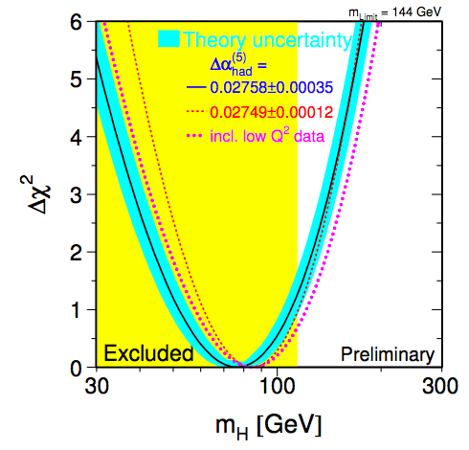
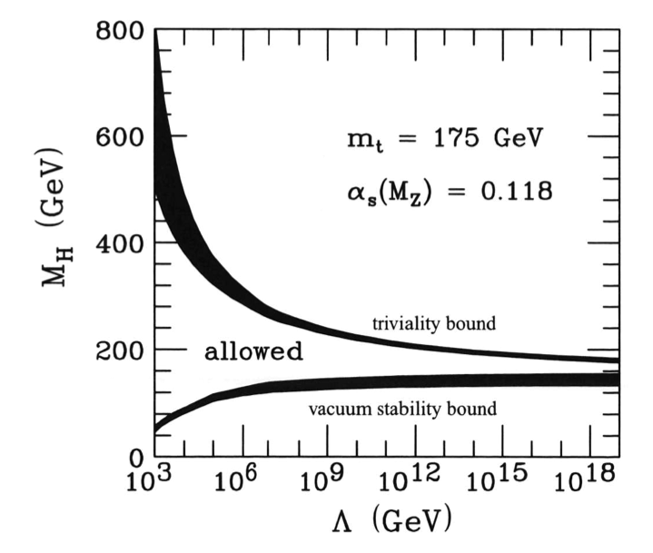
Where is Higgs?
Artificial add-on to the standard model (is it even there?)
There is a mounting tension between direct and indirect limits
SM fits prefer light Higgs that leads to vacuum instabilities at high renormalization scales
160 GeV
115 GeV

Slide 3
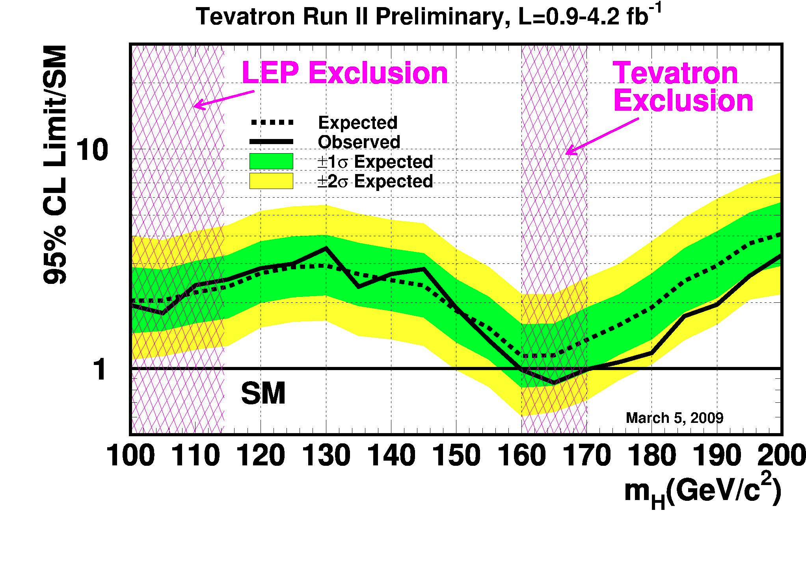
There is no high mass Higgs
Recent results from Tevatron exclude 160-170 GeV region

Slide 4
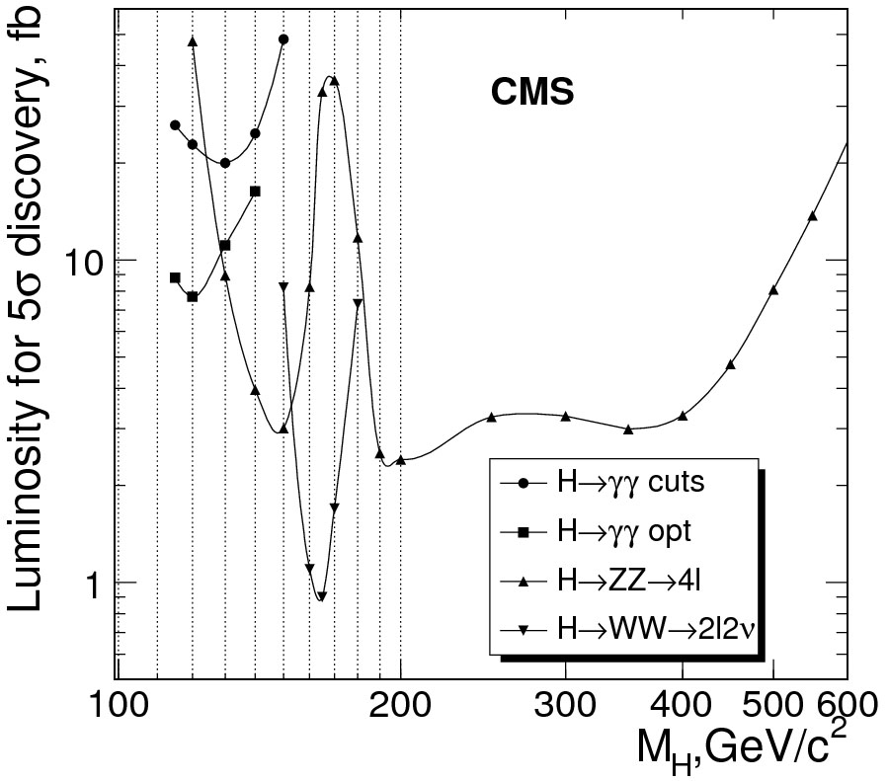
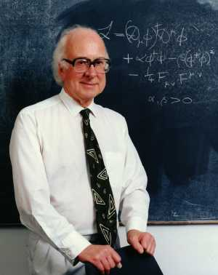
Search for Higgs at LHC
Low mass Higgs discovery channel is H→γγ
LEP

Slide 5

Photons?

Slide 6
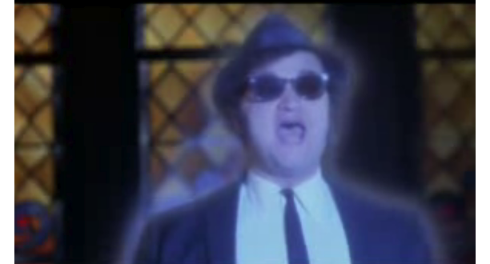
Yes I see the light!

Slide 7
Physics with photons
Higgs!
  Low mass γγ resonances – but wit will take time to get there
Randall-Sundrum gravitons
  High mass γγ resonances
Large extra dimensions
  Excess of high mass γγ pairs (virtual gravitons)
  Mono-photons (photon recoils against a graviton that escapes into extra dimension
GMSB SUSY or UED
  γγ + missing ET
Hidden Valley, GMSB SUSY, 4th generation
  Long lived particles decaying into photons or electrons
Zγ/Wγ production
  Measure gauge boson couplings, search for resonances

Slide 8
In this talk: photons @ DØ
Example of a photon physics program at DØ
  Photon identification criteria
    Synergy with CMS
  Analysis of mono-photon events with 3.6 /fb
  Limits on ZZγ and Zγγ anomalous couplings
  Observation of Zγ→ννγ

Slide 9
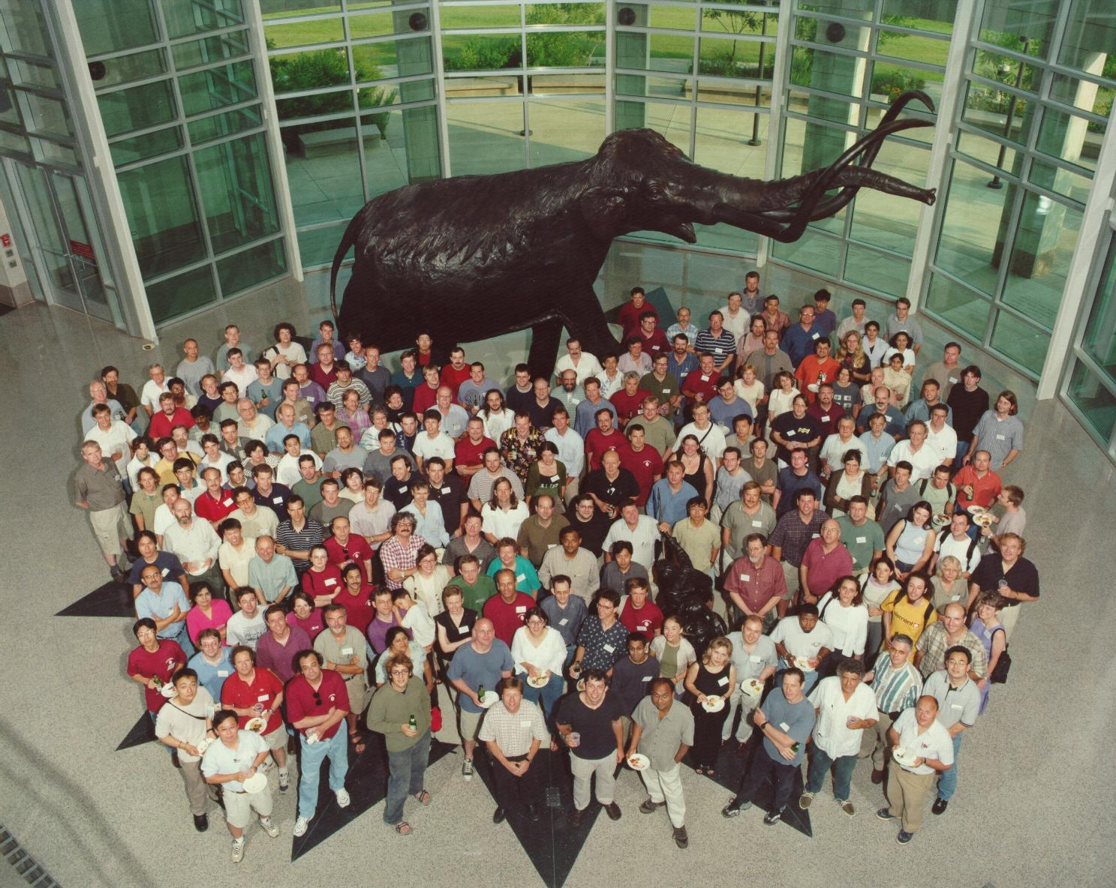

DØ Collaboration
18 countries
82 institutions
500 authors

Slide 10
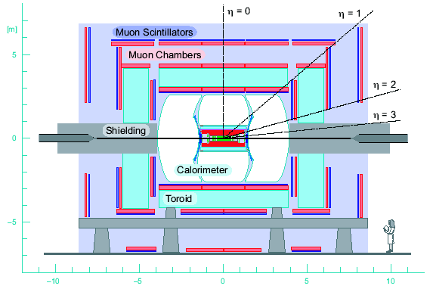
DØ Detector
Tracker
Solenoid Magnet
protons
antiprotons
3 Layer
Muon
System
Electronics
Preshowers

Slide 11
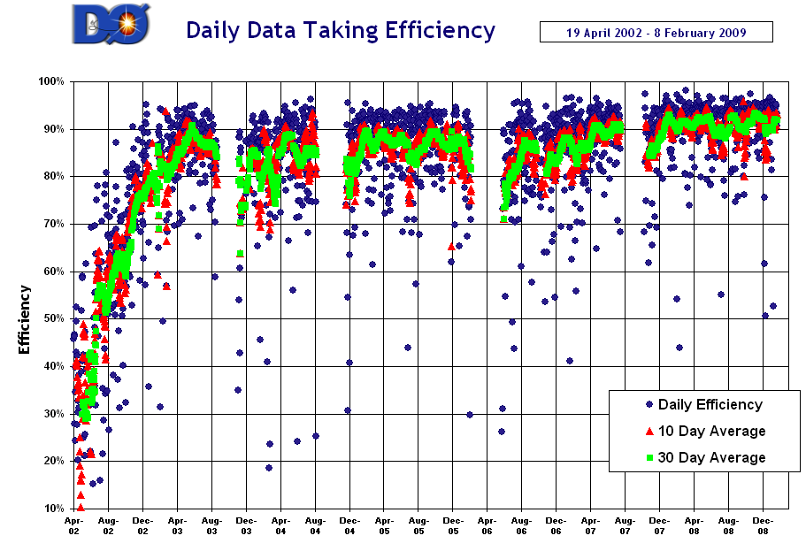
Data taking efficiency

Slide 12
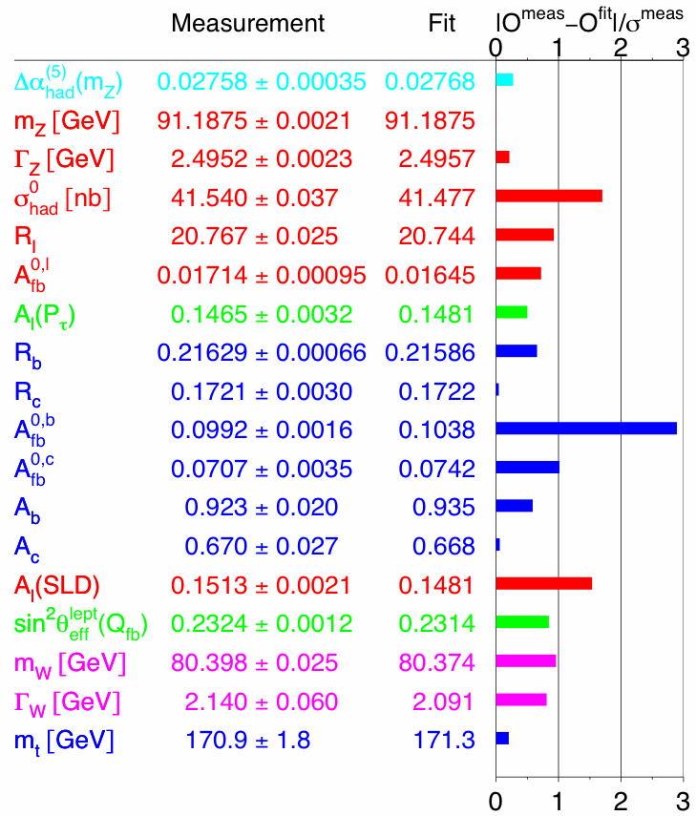
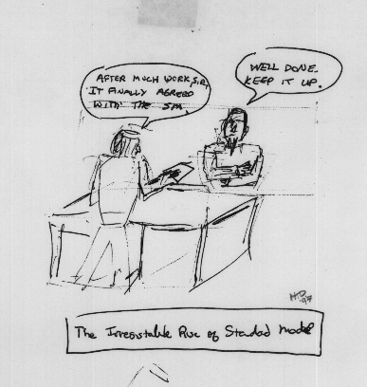
The irresistible rise of the SM
From Tom Diehl’s office wall
Wonderful agreement with experimental results
  What lies ahead?

Slide 13
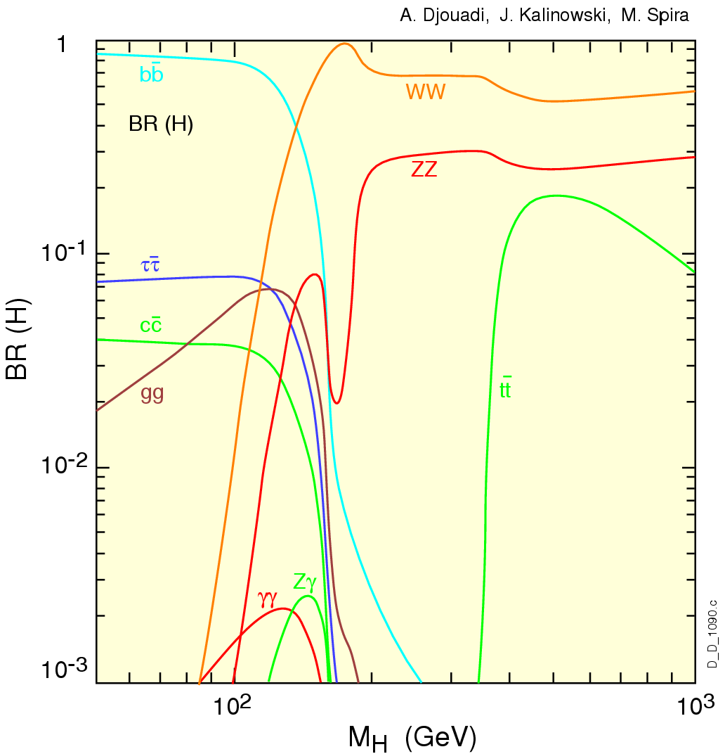
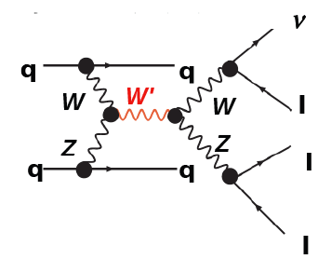
Diboson physics
Physics with multiple bosons in the final state
  Such as WW, WZ, Zγ, γγ, …
A number of important measurements and searches
  Cross section
  Search for resonant production
    Such as Higgs, or fermiophobic higgs, or whatever…
  Self-interaction boson couplings are the least well known parameters of the EW sector of the standard model

Slide 14


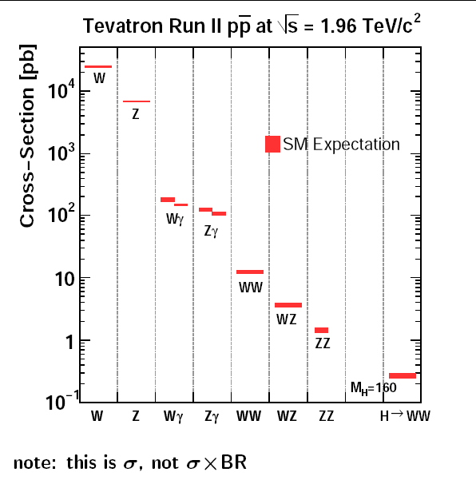
Accelerator
top
Higgs

Slide 15
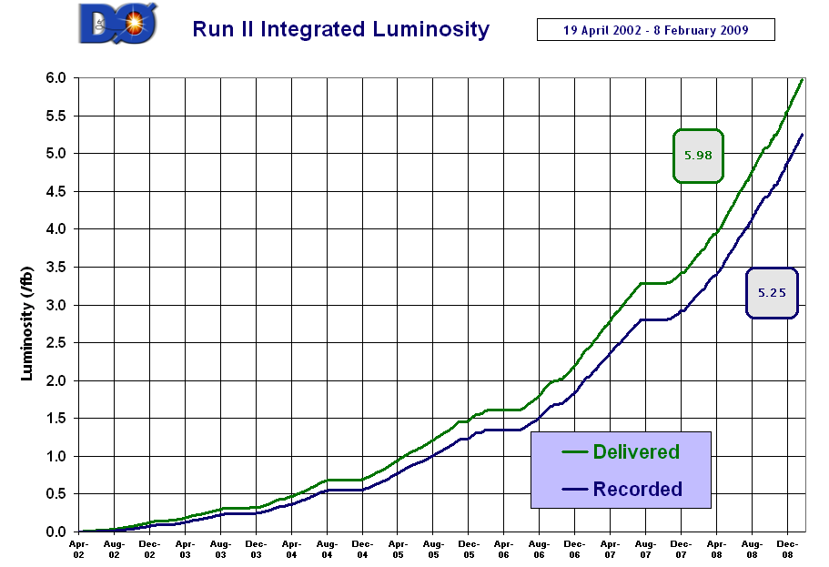
Integrated luminosity
3.6 fb⁻¹ of integrated
luminosity
Thanks to Tevatron!

Slide 16
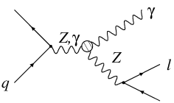
Zγ production
SM predicts only two tree-level diagram of Zγ via initial and final state radiation
  No final state radiation in ννγ final state
  ZZγ and Zγγ couplings are almost zero
    QED corrections are at the 10⁻⁴ level
?

Slide 17
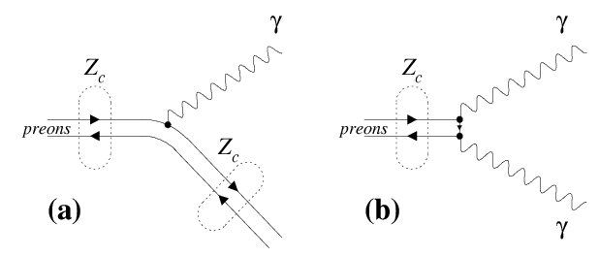
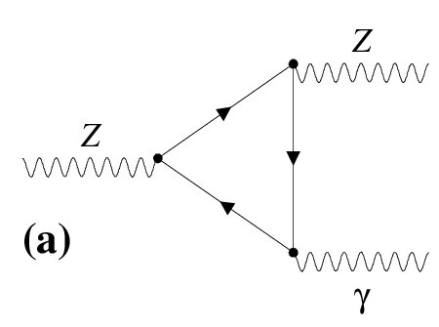
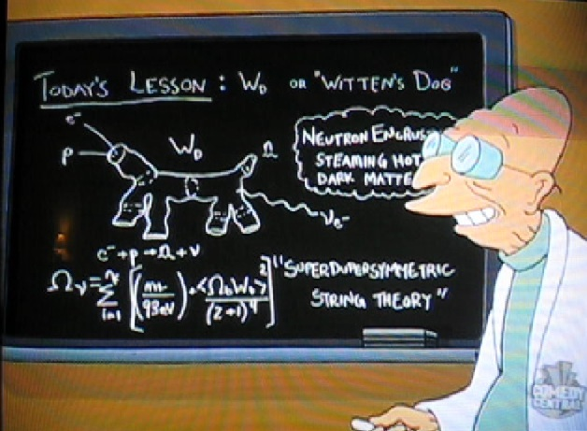
New phenomena in Zγ
Numerous possible extensions of the standard model result in non-zero ZZγ and Zγγ couplings
Compositeness
X
X
X
Something else?
Follow effective Lagrangian approach
  Parameterize the ZZγ/Zγγ vertex in the most general way

Slide 18
Most general parameterization
Baur & Berger, 1993
ZVγ vertex can be parameterized by 8 complex couplings and where is 1-4
  h₁, h₂ are CP-odd,
  h₃, h₄ are CP-even
  Unitarity is violated at high ŝ, use form-factor ansatz to enforce good energy behavior
Here, Λ is a new physics scale that is responsible for conserving unitarity at high ŝ
  Customary, n = 3 for and, and 4 for
Low energy
approximation

Slide 19
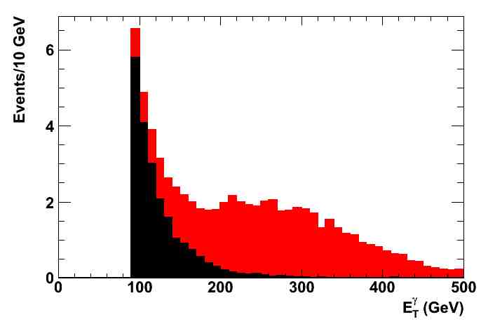
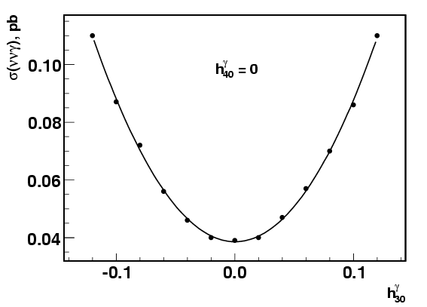
Effect of anomalous coupling
Any non-zero coupling result in increase of the cross section and harder p_{T} spectrum of the photon and Z
  Produced from Baur MC 4-vector output (LO)
Standard model
Standard model
Anomalous TGC
Anomalous coupling
Photon p_{T}

Slide 20
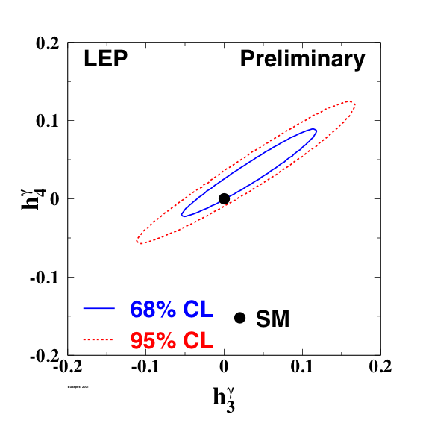
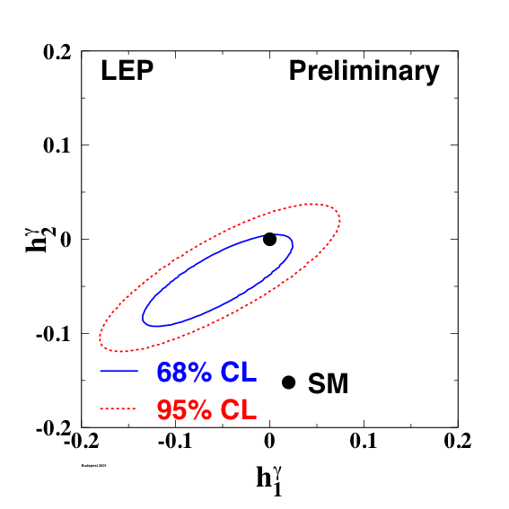
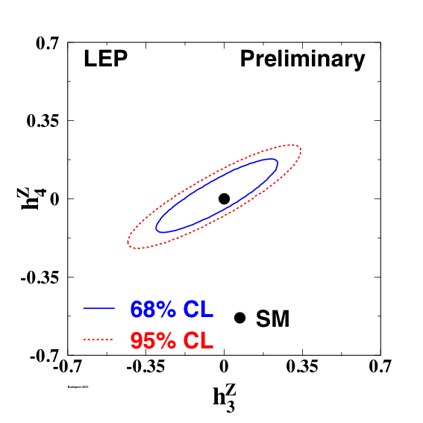
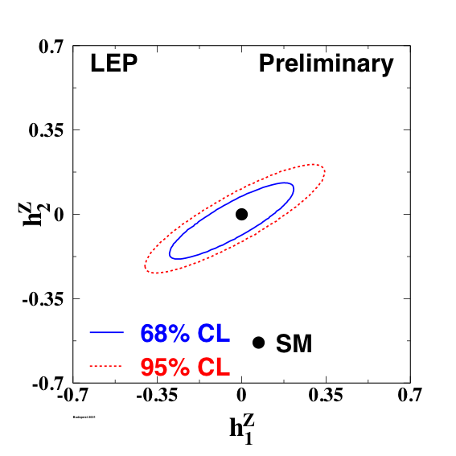
Previous results on Zγ: LEP
LEP EWWK 2003, Preliminary
Measured ZZγ and Zγγ couplings agree with SM at 10⁻¹ – 10⁻² level

Slide 21
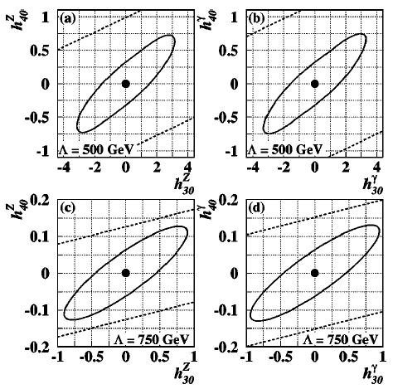
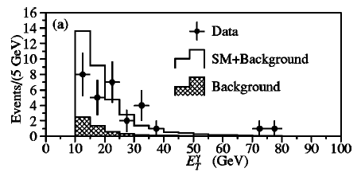
Previous Tevatron results Zγ→llγ
DØ set limits Zγ→llγ in Run I
  Observed 29 events
  The p_{T}^{γ} spectrum agree
  with standard model
  prediction
Agreement with SM at 10⁻¹ – 10⁻² level

Slide 22
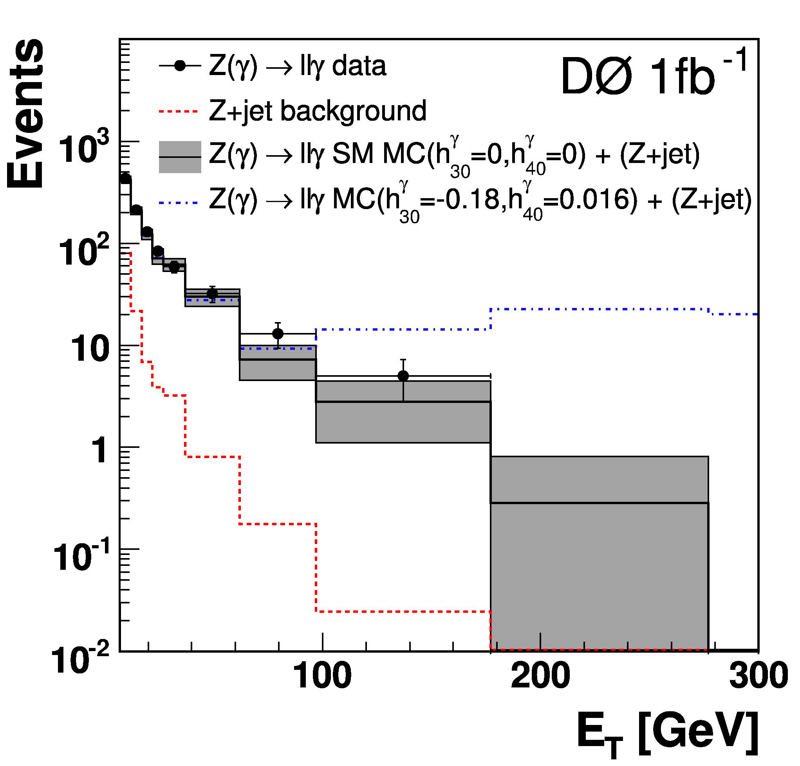
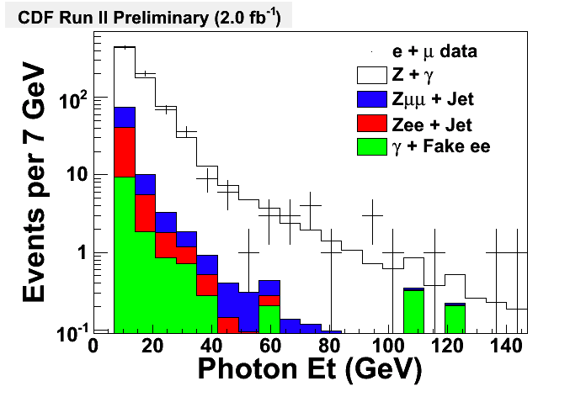
Previous Run II results on Zγ→llγ
Both CDF and DØ performed extensive studies of the Zγ production in Zγ→llγ
  Both cross section and p_{T}^{γ} spectrum agree with standard model prediction
  Limits are
Agreement with SM at 10⁻¹ – 10⁻³ level

Slide 23

Can we do better?
Precision is still dominated by statistics
  Sensitivity is in the tail of the p_{T}^{γ} distribution
Major limiting factors:
  Three particle final state
  Low Z→ll branching fraction
Challenging alternative: Zγ→ννγ
  Much higher acceptance
  No FSR processes!
  Neutrino branching fraction is three times the Z→ll
Precision should double for the ννγ channel alone!

Slide 24
Zγ→ννγ
Z
Very challenging
  Has not been seen at Tevatron!
Final state is a single photon and a missing transverse energy (MET) consistent with Z→νν production
  Backgrounds:
    QCD processes and W production (e → γ)
    Beam-halo, bremsstrahlung cosmic muons
A crucial ingredient to this analysis is identification of photons

Slide 25
Photon identification
Unconverted photons do not have much redundancy: just a shower in the calorimeter
  Handles to suppress backgrounds:
    Isolation in tracker and hadron
    calorimeter
    Shower profile should be
    consistent with that of a photon
    No track pointing to the photon candidate
      No additional hits in the vicinity of a photon candidate is consistent with not reconstructed track
π⁻
π⁰
π⁺
π⁺
π⁰
π⁰
π⁻
π⁰
π⁰
π⁺
normal jet
fluctuated jet: most energy is carried by π⁰

Slide 26
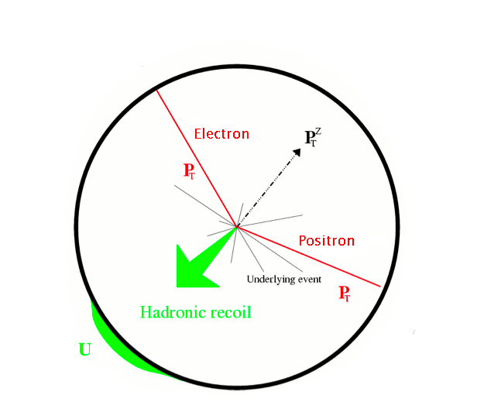
Calibrating photons
We must find Higgs to produce a photon calibration signal!
Use data for calibration: Z→ee
  Use Monte Carlo to
  describe the difference
  between photon and
  electron shower well
  Tune Monte Carlo so that it
  describes electrons well
    Cross checked in data with FSR Zγ events

Slide 27
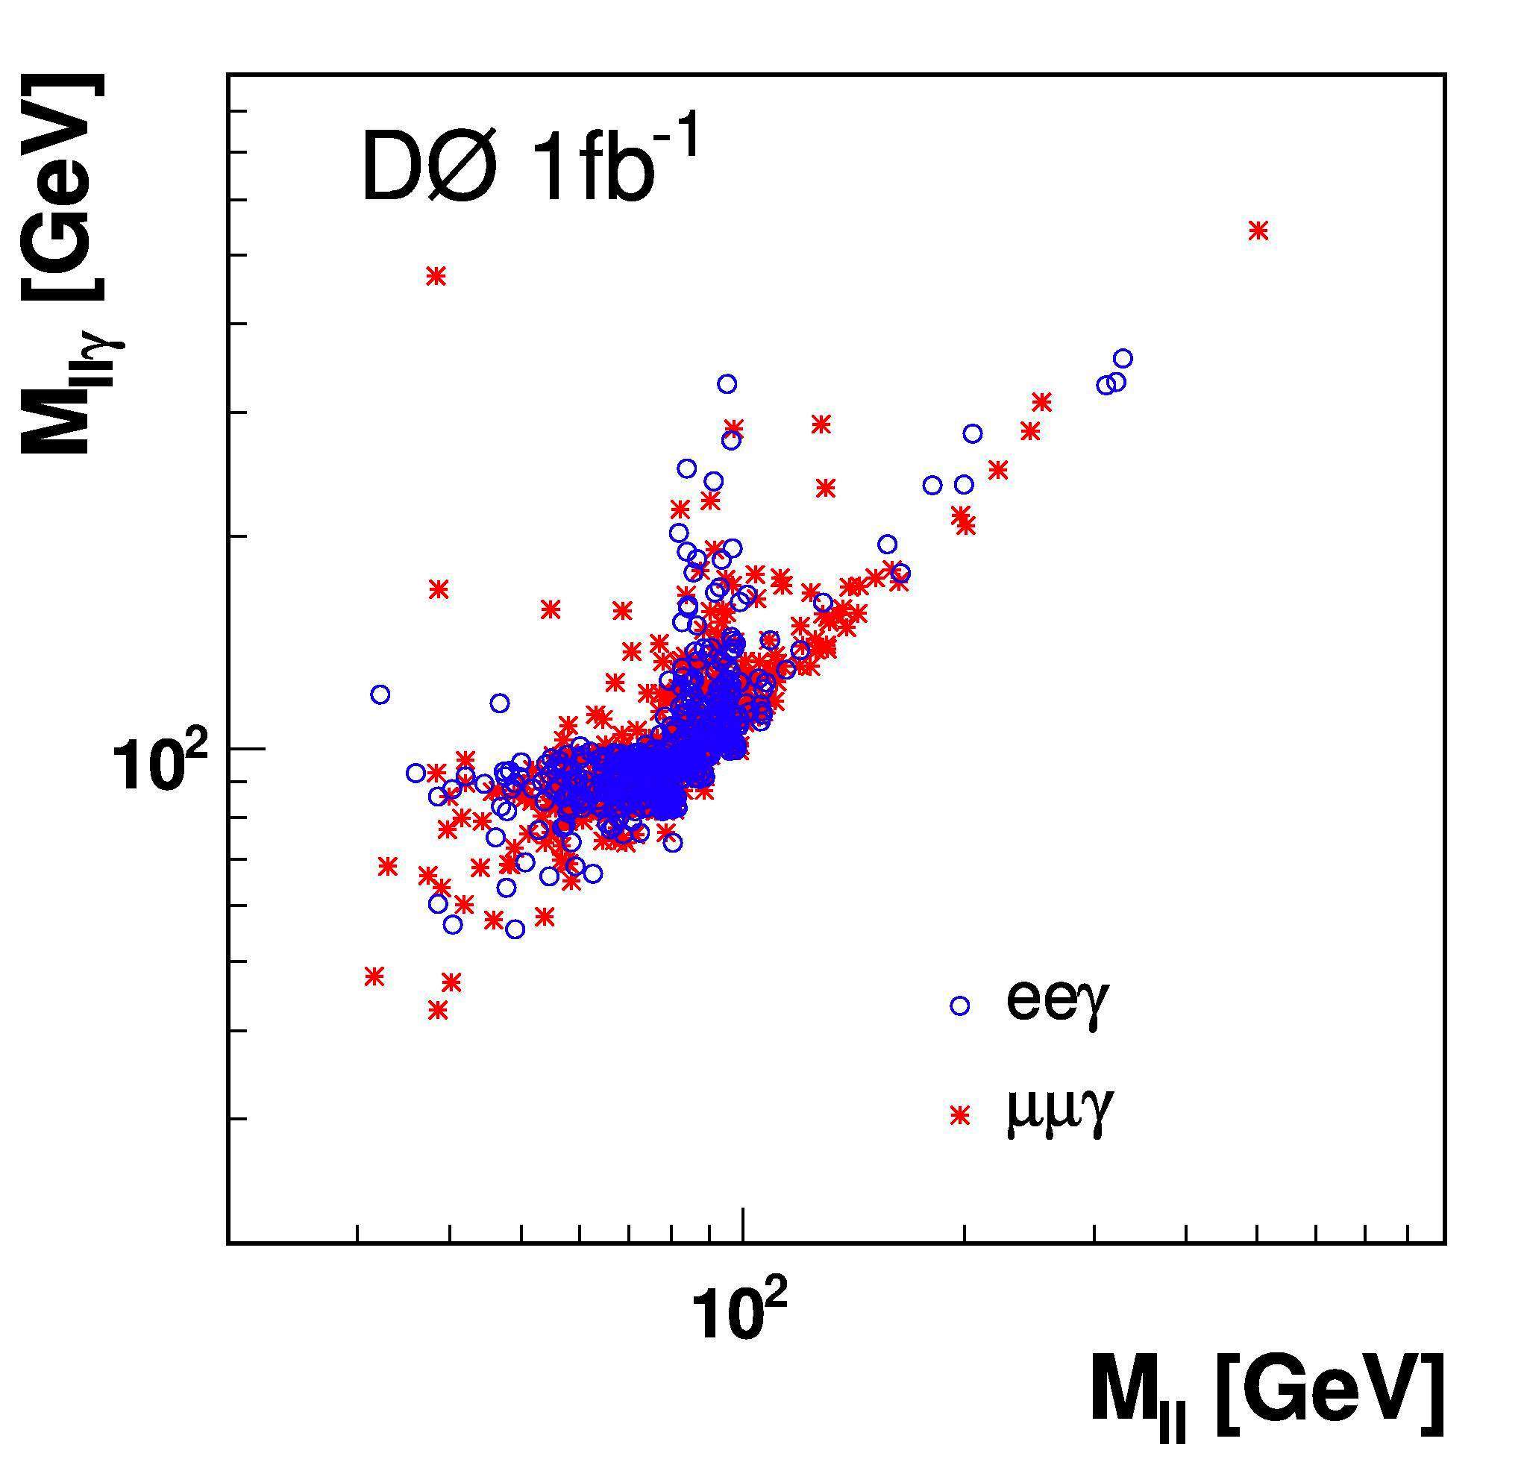
Z→llγ as a standard candle
FSR Zγ is the cleanest source of photons
  One can use FSR production
  to make photon sample very
  clean and to infer photon
  energy scale!

Slide 28
Suppression of electrons
In addition to the standard matching algorithm in φ and η space, require tracker hits density along the EM trajectory to be consistent with noise
  Hit density and resolution is determined in data
Improves electron track matching efficiency and decreases the e→γ misidentification rate by a factor of four!
Calorimeter
IP
Shower
Tracker

Slide 29
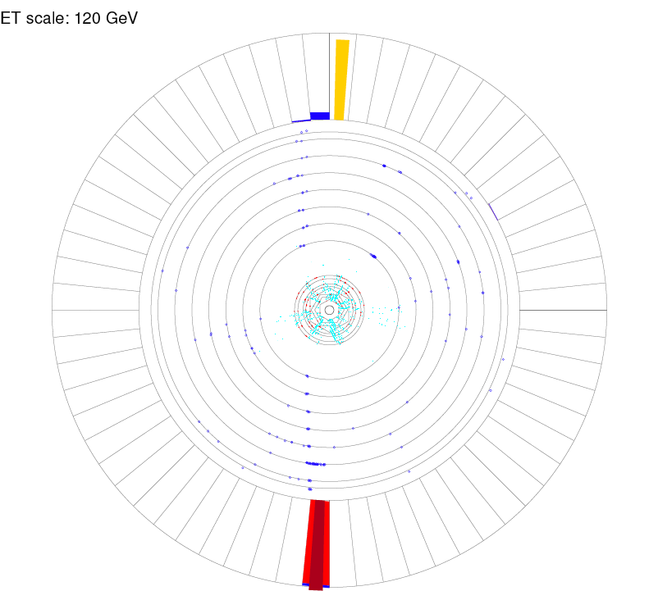
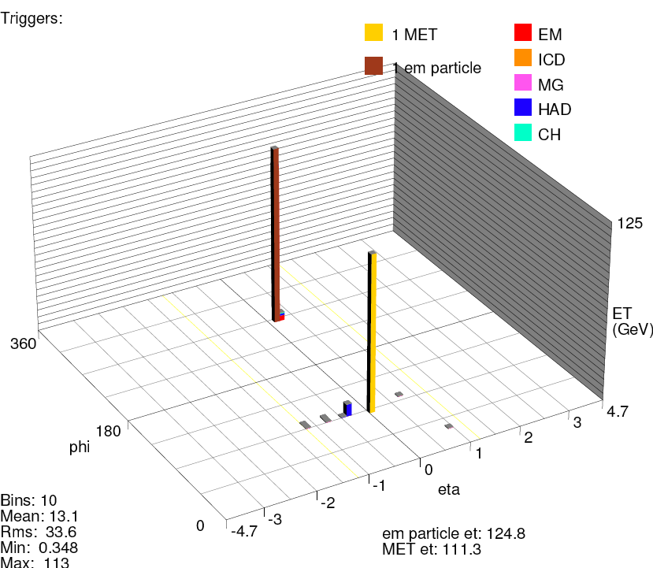
Non-pointing background
One of the major backgrounds to the ννγ final state is cosmic muon that radiated a photon in the calorimeter
DØ
DØ

Slide 30
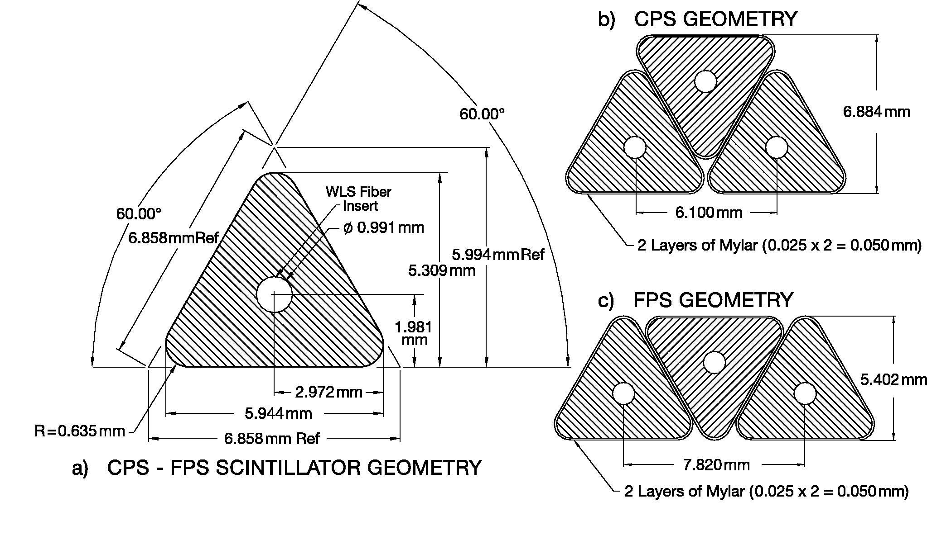
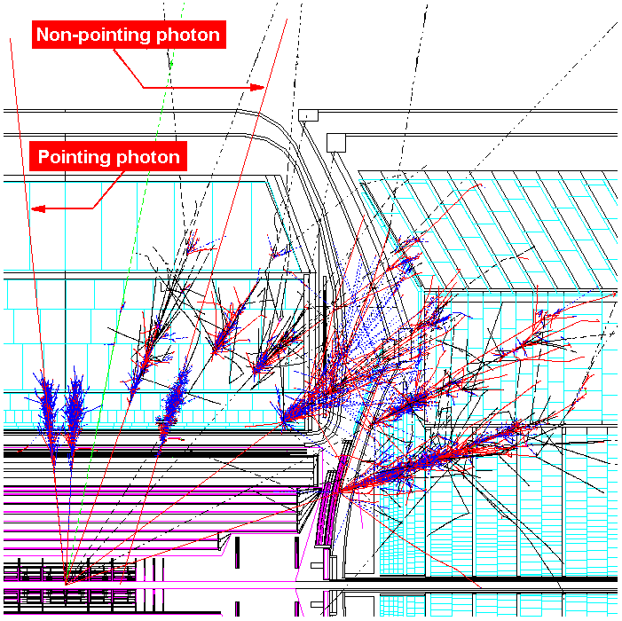
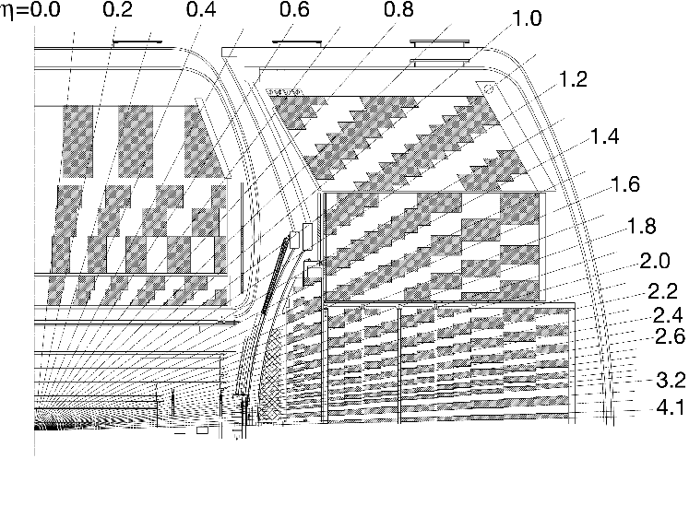
DØ Calorimetry
DØ calorimeter is highly segmented
  Use it to pinpoint the
  shower direction in 3D!
CH
OH
FH
MH
EM
IH

Slide 31
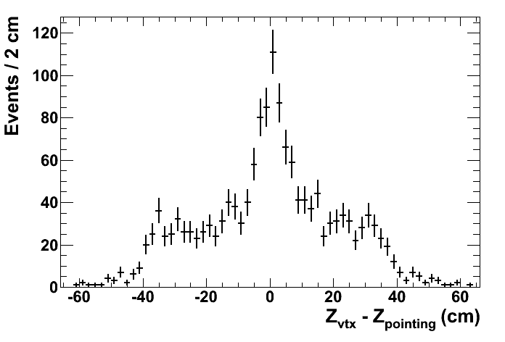
Pointing in z-coordinate
Cosmics and beam-halo photons would not point to the primary vertex of the event
  Exploit this to identify and reject non-collision backgrounds
Single γ sample
Turn-offs due to reconstruction acceptance

Slide 32
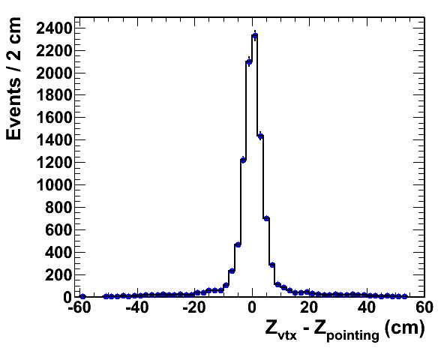
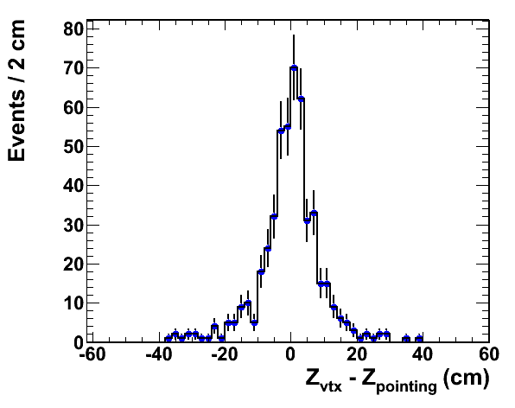
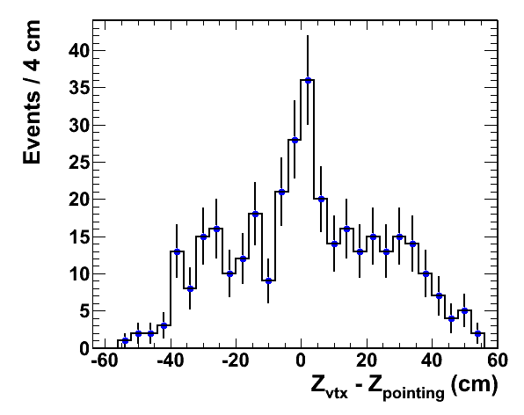
Electrons
Δz distributions from data
  Extremely important for the MET measurement
  Electrons and photons have
  narrow showers and thus small Δz resolution
    Use Z→ee sample
  Misidentified jets have wider
  shower profile and thus larger pointing resolution
    Use “bad” EM sample and γ+jet
  Non-collision is pretty flat
    Use cosmics-enriched data
EM Jets
Cosmics-enriched
sample

Slide 33
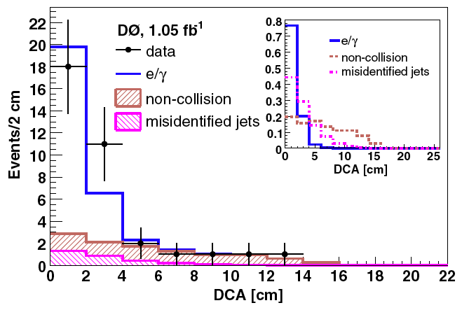
Identification of non-pointing γ
Determine DCA distributions
from data
PRL 101, 011601 (2008)
~ 12 cm

Slide 34
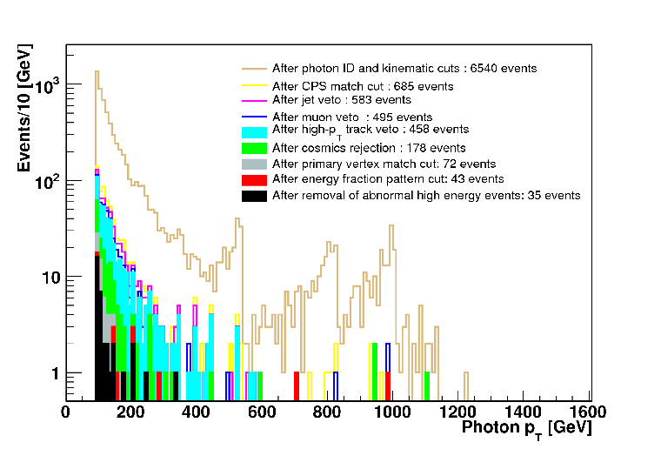
Applying the pointing algorithm
Select data sample with photon p_{T} > 90 GeV
  Sample is dominated by muon Bremsstrahlung
  Applying pointing requirements reduces cosmics and beam-halo considerably!
Bremsstrahlung dominates
Kinematics requirements only
lukewarm cells
Applying CPS information

Slide 35
Selecting Ζγ→ννγ
Select events with single EM triggers
  Fully efficient at 40 GeV
Require event to have missing E_{T} > 70 GeV
Require a clean event
  No jets with p_{T} > 15 GeV, isolated tracks, cosmic rays, muons…
Photon candidate has p_{T} > 90 GeV, |η| < 1.1, isolated, and have shower profile consistent with that of a photon

Slide 36
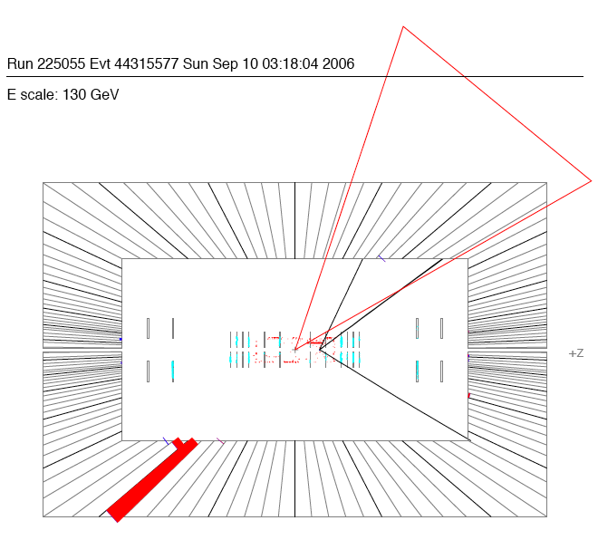
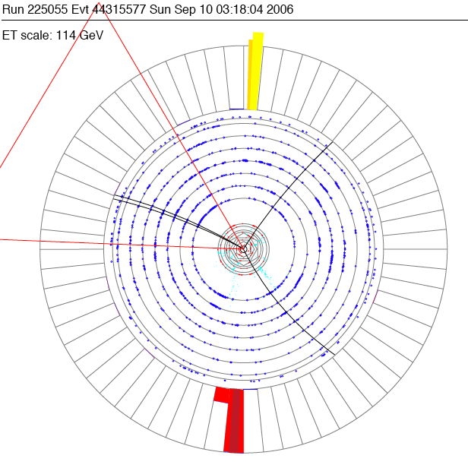
ννγ candidate event

Slide 37
Backgrounds
W→eν: electron is misidentified as a
photon
  Estimated from W data sample
Non-collision: cosmic or halo muon Bremsstrahlung
  Estimated from DCA template method
W or Z + jet: jet is misidentified as a photon
  Estimated from the DCA template method
W+γ → lν + γ: lepton is lost
  Small, estimated from Monte Carlo simulation

Slide 38
Simulation
There is a number of Monte Carlo generators on the market: use Baur generator
  The generator of choice for CDF, DØ, CMS,…
Use both NLO and LO generators to simulate the process kinematics and acceptance and calculate theoretical cross section
  NLO generator is used to calculate NLO k-factor
  Detector simulation is done by using Parameterized Monte Carlo Simulation (PMCS)
    Very fast and reliable!

Slide 39
Cross section measurement
Using 3.64 fb⁻¹ of data we observe 51 Zγ→ννγ candidate events with an estimated
17.3 ± 0.6 (stat.) ± 2.3 (syst.) background events
  Theory predicts 39 ± 4 fb (NLO)
Perform 10⁸ pseudo-experiments with background-only hypothesis to find out that the probability for for background to fluctuate up is 3.1 x 10⁻⁷ which corresponds to 5.1σ
  First observation of Zγ→ννγ at the Tevatron!
σ Br(Z→νν) = 32 ± 9 (stat+syst) ± 2 (lumi) fb
.

Slide 40
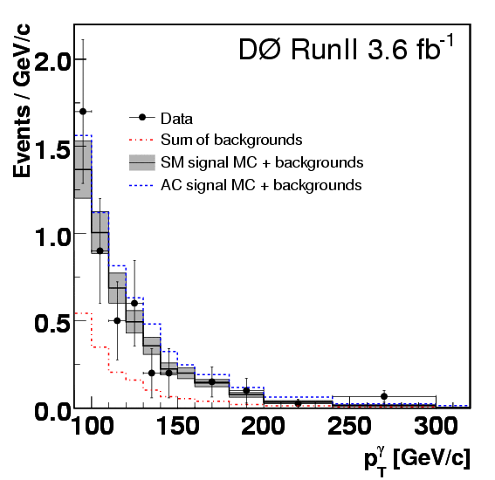
Measuring ZZγ/Zγγ couplings
Data are consistent
with standard model
production
  Proceed with setting
  limits on anomalous
  couplings

Slide 41
Setting limits on ZZγ and Zγγ
The observable (photon p_{T}) is sensitive to the strength of the coupling
  We present results for CP-even couplings: sensitivity to h₁ is similar to h₃, and similarly h₂ is similar to h₄
Generate a 2D grid of simulation with different values of couplings (h₃₀ and h₄₀)
  Set CP-odd couplings to zero

Slide 42
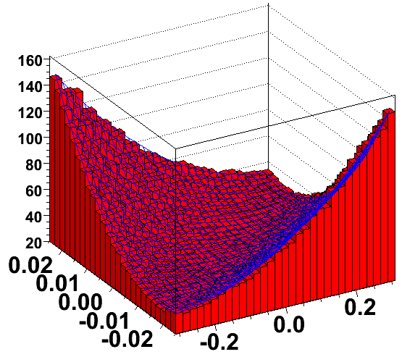
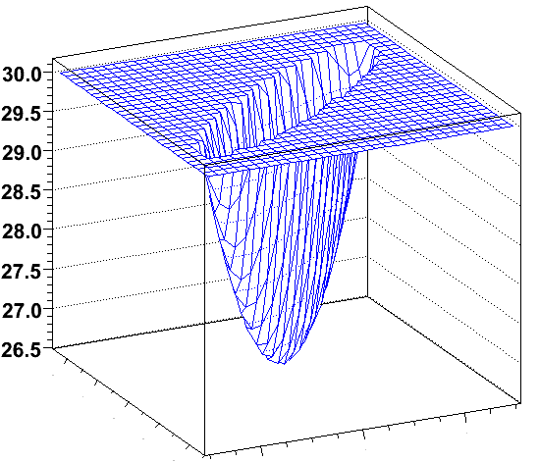
Assume Poisson statistics for signal and Gaussian statistics for systematic uncertainties and background, calculate the likelihood of data to be described by aTGC simulation and background
  Repeat for every point of the generated grid
-log(L)
-log(L)
L ≈ 3
  h₄₀^{Z}
  h₃₀^{Z}

Slide 43
Limits on anomalous couplings
Submitted to PRL
Set 1D limits by setting all the other aTGCs to zero
Old DØ result!
 | Λ = 1.2 TeV | Λ = 1.5 TeV
Zγ→llγ 1 fb⁻¹ | |h₃₀^{γ}|<0.085 |h₄₀^{γ}|<0.0054 | |h₃₀^{γ}|<0.079 |h₄₀^{γ}|<0.0036
Zγ→llγ 1 fb⁻¹ | |h₃₀^{Ζ}|<0.083 |h₄₀^{Ζ}|<0.0054 | |h₃₀^{Ζ}|<0.075 |h₄₀^{Ζ}|<0.0037
Zγ→ννγ 3.6 fb⁻¹ | |h₃₀^{γ}|<0.042 |h₄₀^{γ}|<0.0029 | |h₃₀^{γ}|<0.037 |h₄₀^{γ}|<0.0020
Zγ→ννγ 3.6 fb⁻¹ | |h₃₀^{Ζ}|<0.041 |h₄₀^{Ζ}|<0.0029 | |h₃₀^{Ζ}|<0.036 |h₄₀^{Ζ}|<0.0020
Zγ combination | |h₃₀^{γ}|<0.038 |h₄₀^{γ}|<0.0025 | |h₃₀^{γ}|<0.033 |h₄₀^{γ}|<0.0017
Zγ combination | |h₃₀^{Ζ}|<0.037 |h₄₀^{Ζ}|<0.0025 | |h₃₀^{Ζ}|<0.033 |h₄₀^{Ζ}|<0.0017
This result!
Best limits from Tevatron!

Slide 44
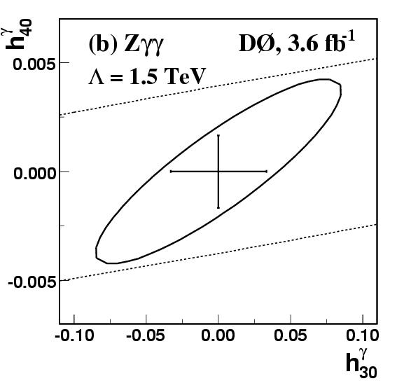

Limits on anomalous couplings
The most probable values of the ZZγ and Zγγ couplings is at the standard model predictions

Slide 45
Comparison with LEP
These results: |h₃₀^{V}| < 0.033, |h₄₀^{V}| < 0.0017
  Similar results for CP-odd couplings
LEP results
  LEP does not scale couplings with the form-factor, which makes direct comparison more complex
    Additional e^{iπ/2} factor from Baur MC

Slide 46
Summary of these results
We observed Zγ→ννγ for the first time at the Tevatron and measured the cross section to be in excellent agreement with the standard model
We set the tightest limits on anomalous ZZγ and Zγγ couplings at the Tevatron
|h₃₀^{γ}|<0.033 |h₄₀^{γ}|<0.0017
|h₃₀^{Ζ}|<0.033 |h₄₀^{Ζ}|<0.0017

Slide 47
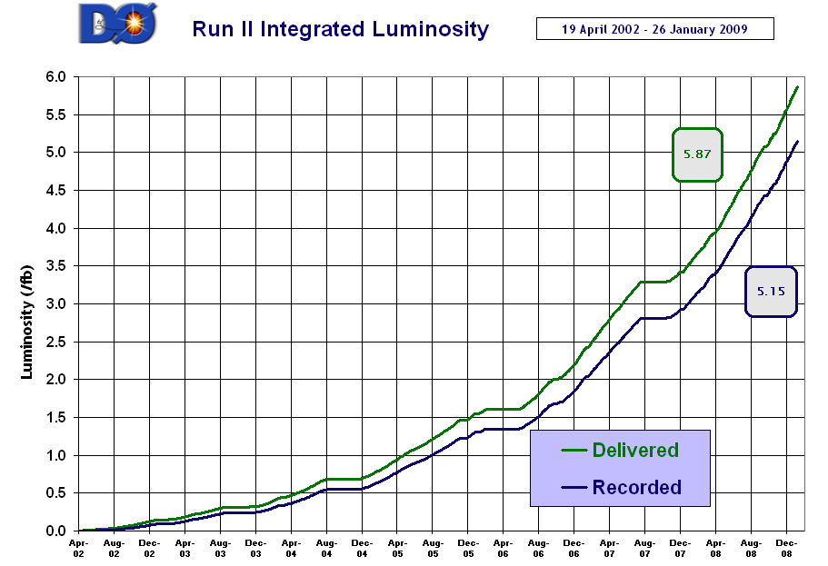


What comes next?
Prediction is very difficult, especially if it is about the future
Mark Twain, Niels Bohr, Yogi Berra
It is exiting time to do HEP at the Tevatron
We have all the necessary ingredients to perform rather sophisticated data analyses
  Ever-increasing integrated luminosity
  Well-understood detectors
  Well-developed analysis tools
We have a good shot at making
more discoveries at the Tevatron!

