Slide 1
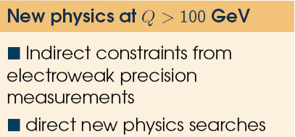
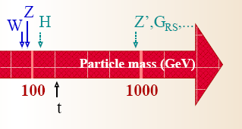

GOAL: Model-independent spin determination of resonant boson (H, Z’, G,…) production via Drell-Yan pp -> γγ X at LHC
S. Dalley & P. Nadolsky, Dept. Physics, SMU
Spin of Resonant Boson Production at LHC
Osland, Pankov, Paver, Tsytrinov, QCD LO Boson dσ/dz “Center-Edge” Asymmetry in pp -> l l X [hep-ph/0805.2734]
Center-Edge Asymmetry
in z = cos θ*

Slide 2
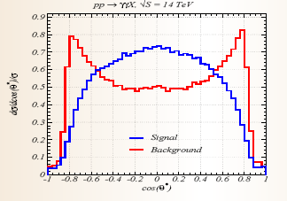
What do we know about γγ ?
SM & Scalar Bosons (Higgs):
Balazs, Berger, Nadolsky, Yuan,
QCD NLO + NLL Resummation for
SM + Higgs dσ/dΦ in pp -> γγ X
[hep-ph/0704.0001]
ResBos: Standard tool for
Higgs searches
Vector Bosons:
No contribution to γγ final state
Tensor Bosons (KK-Gravitons):
Kumar, Matthews, Ravindran, Tripathi, NLO QCD + Graviton dσ/dΦ in pp -> γγ X [hep-ph/0902.4894]
Li, Li, Yang, NLO QCD + Resum + Graviton total σ [hep-ph/0606045]

Slide 3
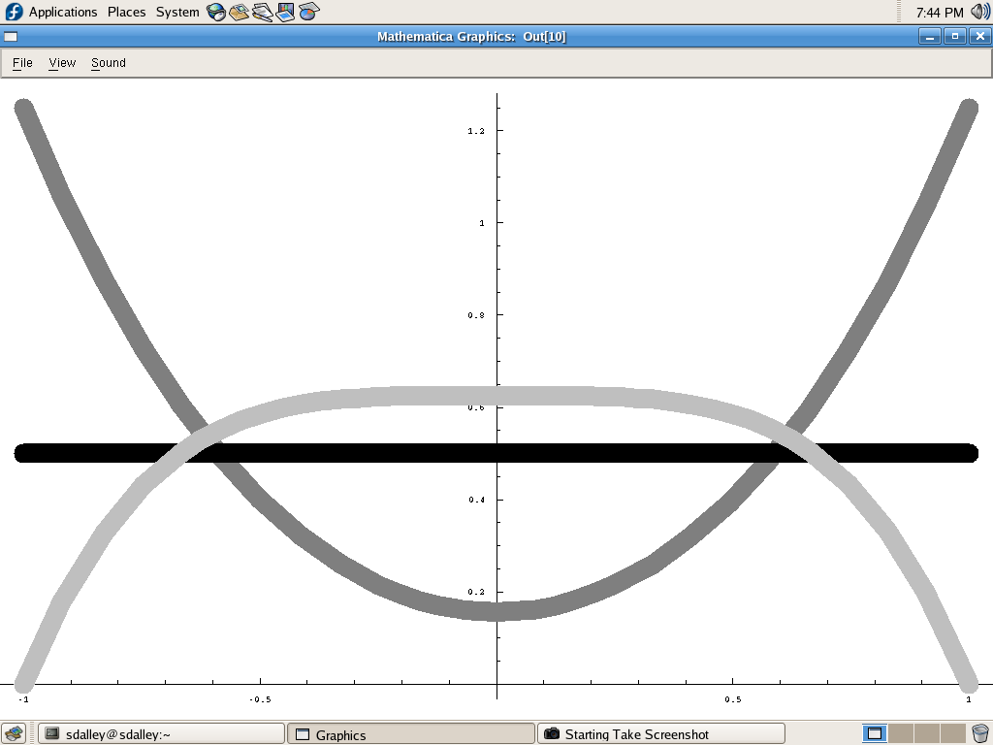
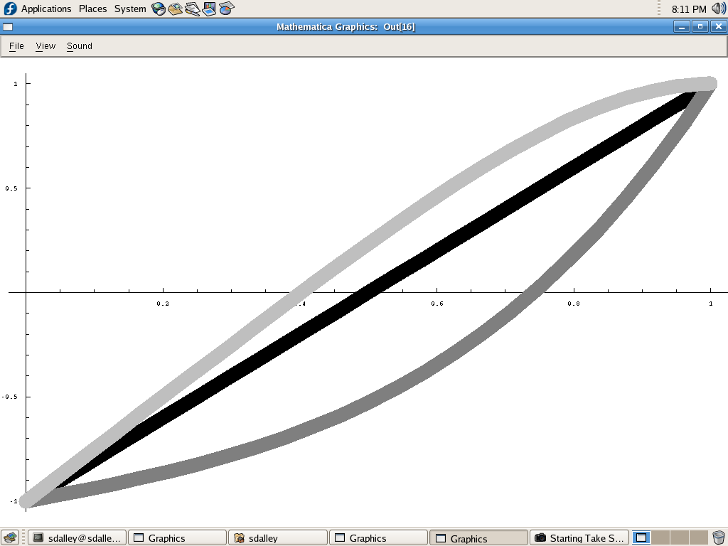
z = cos θ* dependence in LO QCD
No cuts, no SM background.
Assume gg PDF dominates.
dσ/dz
Tensor → γγ
Scalar
A_{CE} = σ_{CE}/σ
Tensor → l l
Tensor → l l
z
z*
Tensor → γγ
To-Do Summary: include QCD NLO + NLL Resummation of initial state radiation for Spin-2 resonance in pp → γγ X in RESBOS (dσ/dΦ), include exp and theory cuts, compare A_{CE} for scalar and tensor resonances @ LHC

